Slide 1
A Data Driven Approach to predict the winner of a Creicket Match specificaly handling the case that players in the team change over time.
Mentor: Madan Jhanwar
Tushar Kadu
Akshay Joshi
Nilesh Patil
Pankaj shipte

Slide 2
Introductiuon
Victory is the ultimate goal in any sport. In thiswork we address the winning factors in the sport of One Day International (ODI) cricket.
Winning an ODI cricket match depends on various factors related to scoring as well as physical strength of the two teams.
In this project we have studied many such factors to check its effect on result of match.

Slide 3
Approach
Data Cleaning
Normalization of Data
Feature Extraction
Comparative study of verius algorthms
  Regression vs classification
Combination of features

Slide 4
Fetures used
Toss:
  Team Winning the toss.
Home Team Advantage:
  Teams Playing on their home grounds will have an advantage.
Matches played Between two teams:
  Total no of matches playe between the two teams.

Slide 5
Fetures Used
Team Batting first :
  Chance of Winning a team batting first on given Venue
Debudant player:
  Calculated the average score of the debudant player in a match. Used this value in the scoring function if it is the debut match of a player.
Latest form of the player in the Team:
  Average run of a player in previous 5 matches
  Average bowling performance of a bowler in previous 5 matches
Scoring function :
  strength = (BattingStrengthA - BattingStrengthB)/2.0 + (BowlingStrengthA - BowlingStrengthB)/2.0

Slide 6
Performance
Features Used : Accuracy
Toss : 56.3
Toss_Decision : 56.33
HTH : 58.99
Venue : 56.69
Team Batting First : 54.31
Strength : 55.59
Latest Form : 52.73

Slide 7
    Features Used : Accuracy
Toss + Toss_Decision +
WinningPerDes + Strength : 52.66
Toss + Toss_Decision +
      Venue + Strength : 56.00
Toss + Toss_Decision + HTH : 47.89
Toss + Venue + Toss_Decision : 55.23
Toss + WinningPerDes + Venue
+ Toss_Decision : 52.84

Slide 8
Features Used : Accuracy
Toss + WinningPerDes +
Venue + Strength + Toss_Decision : 53.94
WinningPerDes + Venue +
Strength + Toss_Decision : 53.44
WinningPerDes + Venue + Strength : 54.13
WinningPerDes + Venue : 55.04
Toss + Toss_Decision + WinningPerDes
Strength + Venue + HTH : 50.82

Slide 9
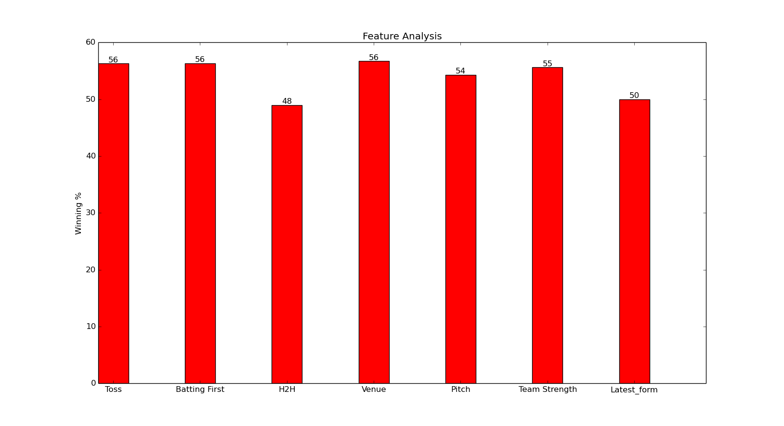

Slide 10
            THANK YOU

