Slide 1
MAR 2026
Document Processing
Solution
AI Architecture
Pankaj Singh
Senior Solutions Architect
3rd March 2026
Computershare
Computershare Distribution Only

Slide 2
Solution Overview
MAR 2026
A .NET AI-powered document processing pipeline — end to end
Ingests shareholder documents from a watched file system folder, extracts structured text via Azure Document Intelligence (OCR), classifies document intent using a locally-hosted Phi-3.5-mini SLM via Foundry Local, and persists results on a locally running SQL Server — all orchestrated by a RouterAgent built on Microsoft Agent Framework (MAF)
1
INPUT
2
EXTRACT
3
CLASSIFY
4
PERSIST
File System Watch
incoming / processed / failed
Shareholder docs, cheques,
forms, letters
Azure Document Intelligence
OCR & text parsing
Structured data extraction
from documents
Phi-3.5-mini-instruct SLM
Foundry Local (CPU inference)
Intent label + confidence
score returned
SQL Server LocalDB
Intent records & scores
LiteDB document blob
storage (docs.db)
→
→
→
RouterAgent (Microsoft Agent Framework)
Orchestrates the full pipeline: GetAsync → ExtractAsync → ClassifyAsync → SaveAsync
Computershare
Computershare Distribution Only
1

Slide 3
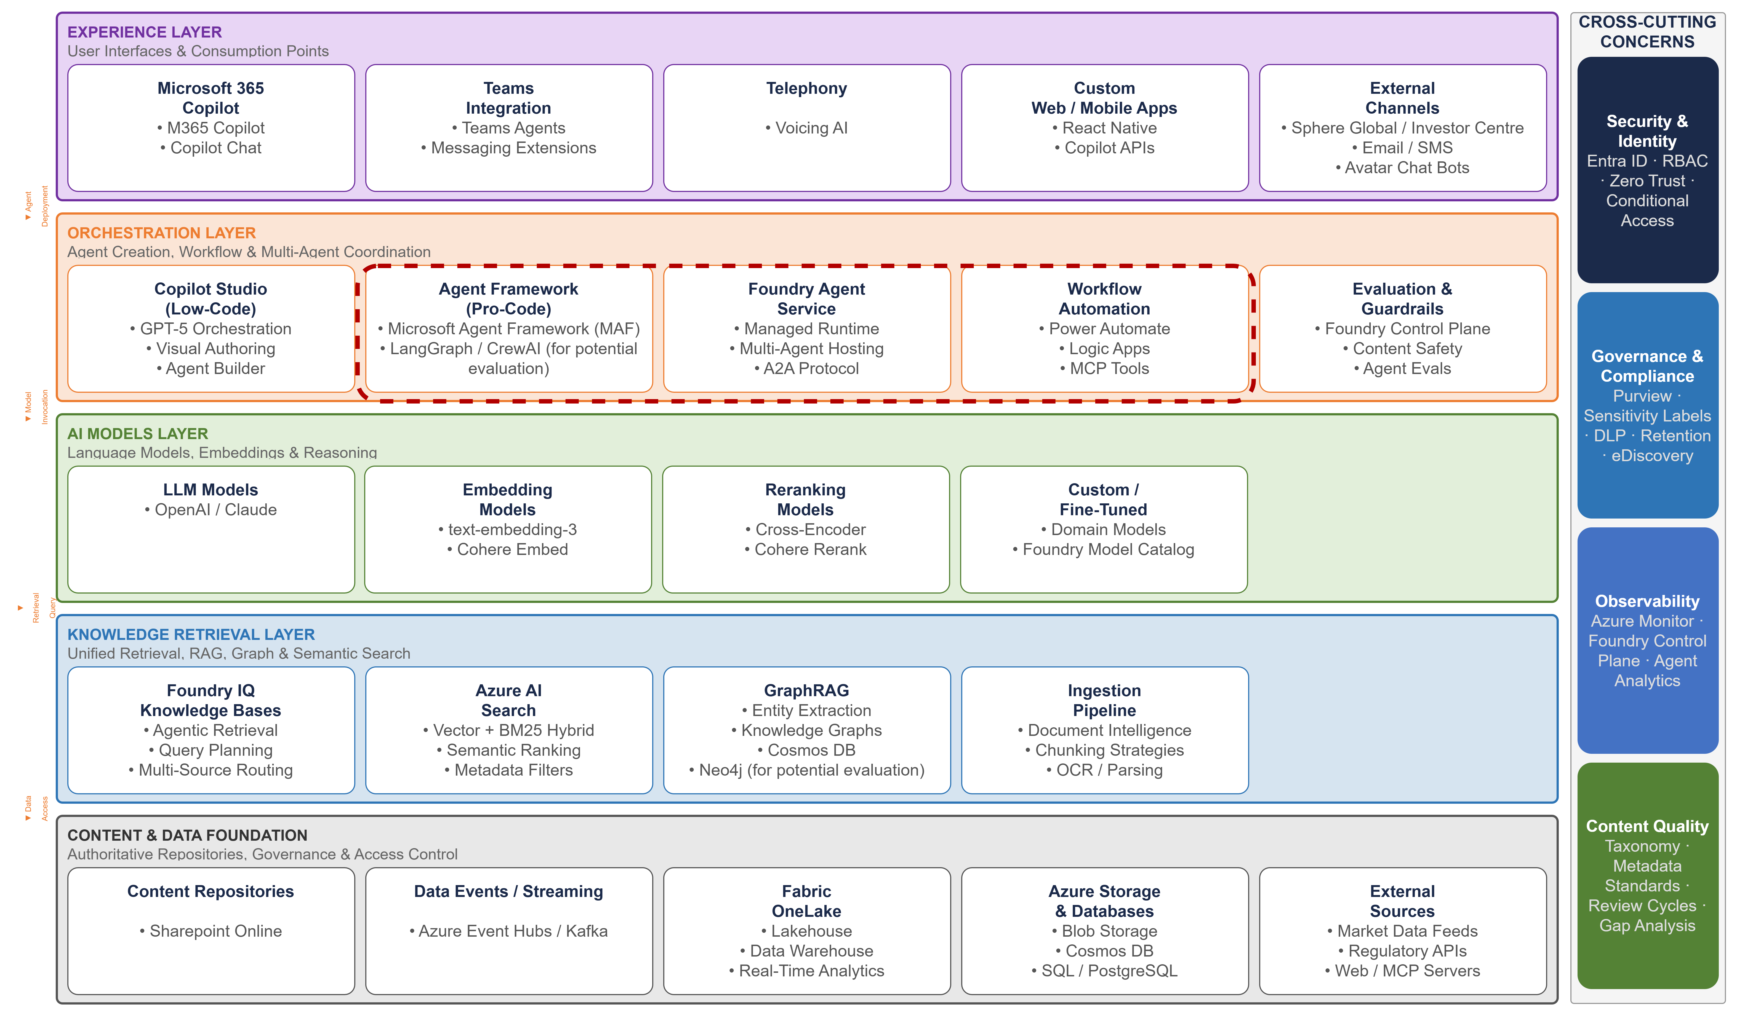
AI Conceptual Architecture – Enterprise Knowledge & Agent Platform
Computershare
Computershare Distribution Only
2

Slide 4
AI Architecture — Computershare 5-Layer Reference
MAR 2026
EXPERIENCE LAYER
.NET Console App
File System Watch
(incoming / processed / failed folders)
User Interfaces & Consumption Points
ORCHESTRATION LAYER
RouterAgent (Microsoft Agent Framework)
OcrProcessingAgent • IntentClassifierAgent
Foundry Local Runtime (OpenAI-compatible API)
Agent Creation, Workflow & Multi-Agent Coordination
AI MODELS LAYER
Phi-3.5-mini-instruct (generic-cpu)
Foundry Model Catalog • Local SLM Inference
Language Models, Embeddings & Reasoning
KNOWLEDGE RETRIEVAL LAYER
Azure Document Intelligence (OCR / form parsing)
Text extraction pipeline into structured format
Unified Retrieval, RAG, Graph & Semantic Search
CONTENT & DATA FOUNDATION
SQL Server LocalDB — intent records & confidence scores
LiteDB — raw document blobs • File System source folders
Authoritative Repositories, Governance & Access Control
Computershare
Computershare Distribution Only
3

Slide 5
Swappable Technology — Cloud Alternatives
MAR 2026
Dependency-inversion based architecture enables drop-in Azure cloud equivalents
Core domain interfaces in DocumentProcessing.Core remain stable. Only infrastructure adapters change — enabling zero-disruption migration from local to cloud.
IIntentClassifier
IDocumentStorage
NOW (Local)
CLOUD
NOW (Local)
CLOUD
Foundry Local
Phi-3.5-mini (CPU)
Azure AI Foundry
GPT-4o / Phi-4 / o1
LiteDB
(Document Blobs)
Azure Blob Storage
(scalable object store)
→
→
IIntentRepository
RouterAgent layer
NOW (Local)
CLOUD
NOW (Local)
CLOUD
SQL Server LocalDB
(Intent Records)
Azure SQL DB
or Cosmos DB
Microsoft Agent
Framework (MAF)
Azure AI Agent Service
(managed orchestration)
→
→
Core domain layer (interfaces) remains stable — only infrastructure adapters change.
Computershare
Computershare Distribution Only
4

Slide 6
Key Takeaways
Dependency-inversion architecture — local → cloud migration with zero core domain changes
Local SLM inference via Foundry Local means zero cloud cost during development & prototyping
Cloud lift-and-shift ready: Azure AI Foundry, Azure SQL, and Blob Storage are drop-in replacements
RouterAgent (MAF) cleanly separates orchestration from OCR and classification agent concerns
Directly aligned to Computershare's 5-layer AI reference model — ready for stakeholder communication
Computershare
Computershare Distribution Only
5

