Slide 1
Activation Functions And Reproducibility of Language Models
An Exploration
Pankaj Takawale and Vinita Takawale
Introduction to LLM based Generative AI Systems
Fall 2025

Slide 2
Executive Summary
Research Approach:
  We conduct a range of experiments to empirically understand if the choice of activation functions can lead to a more reproducible model.
Key Finding
  Smooth activation functions demonstrates superior reproducibility, SwigLU achieved the best Reproducibility.
  Tradeoff - ~1.2% accuracy cost.
Objective:
  Investigate the relationship between Reproducibility of Language Models and smooth activation functions
  Build an evaluation framework that
Motivation
  Irreproducibility and uncertainty make LM deployment challenging.
  Can the choice of a smooth activation function improve reproducibility without sacrificing accuracy?

Slide 3
Problem Motivation
Models with the same hyperparameters, architecture, training data and hardware can have very high prediction differences
Reproducibility is a task made difficult by randomized algorithms, non-determinism inherent in parallel learning, reliance on initial conditions, and interactions with the external world.
This leads to uncertainty in online behavior of models and difficult ML Workflows
Notes:
Without taking reproducibility into consideration, a model can be deployed in experimental stage, show favorable metrics, but then, when retrained to be deployed in production, produce unfavorable results.

Slide 4
Past Work
Does the choice of activation functions play a role in robustness, as measured in terms of reproducibility, of deep learning models?
“Smooth activations and reproducibility in deep networks” by Shamir et. al.

Slide 5
Experimental Setup
Hardware:
  NVIDIA DGX Spark Server (ARM64, GB10 GPU)
  Apple M4 Pro – 14 Core CPU with 48 GB RAM
150 Models trained
Model Architectures: 6 diverse architectures covering recurrent, convolutional, and transformer designs (200K to 10.8M parameters)
Activation Functions: ReLU, GELU, Swish, and two SmeLU variants comparing sharp vs smooth properties
Partial Model Training (on CPU): 75 experiments across all 5 architectures × 5 activations x 3 trials at 500 iterations for quick validation
Full-Scale Model Training(on GPU): 75 experiments – Considering all layers and 5000 iterations to validate findings at production scale

Slide 6
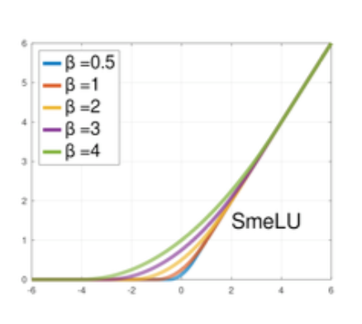
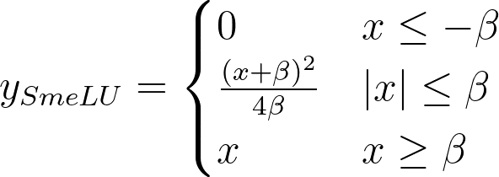
SmeLU, A Smooth ReLU
Subside the discontinuity of ReLU using multiple pieces joined with smoothness, continuous gradient, constraints
SmeLU matches both sides of ReLU with a middle quadratic region
Definition: SmeLU

Slide 7
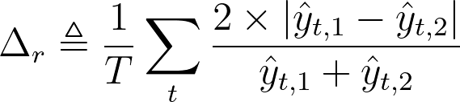
Measuring Reproducibility: Relative Prediction Difference
Training multiple models to calculate standard deviations or KL Divergence might be too expensive, we need a metric with minimal cost
Empirically, PDs between two models tend to settle to roughly the same values for different pairs of the same model
Definition: relative PD
(Source: Shamir et al., Google Research Blog, 2025)

Slide 8
Methodology - Overview
Set experimental studies using a reproducibility evaluation framework:
For each {model architecture, activation function} combination:
  Training:
    Train k=3 independent models with identical hyperparameters (learning rate, batch size, dataset, train/valid split, seed)
    5000 iterations for full model train
  Metrics
    Reproducibility: Compute Relative PD & Prediction differences
    Performance: Validation loss & accuracy
  Aggregation across Trials
    3 pairs, 3 pairwise comparisons (T1->T2, T2->T3, T1->T3)
    Performance: Validation loss & accuracy
Compare architectures: Which models are Activation sensitive
Compare activations: Which activation is performing the best within model architecture

Slide 9
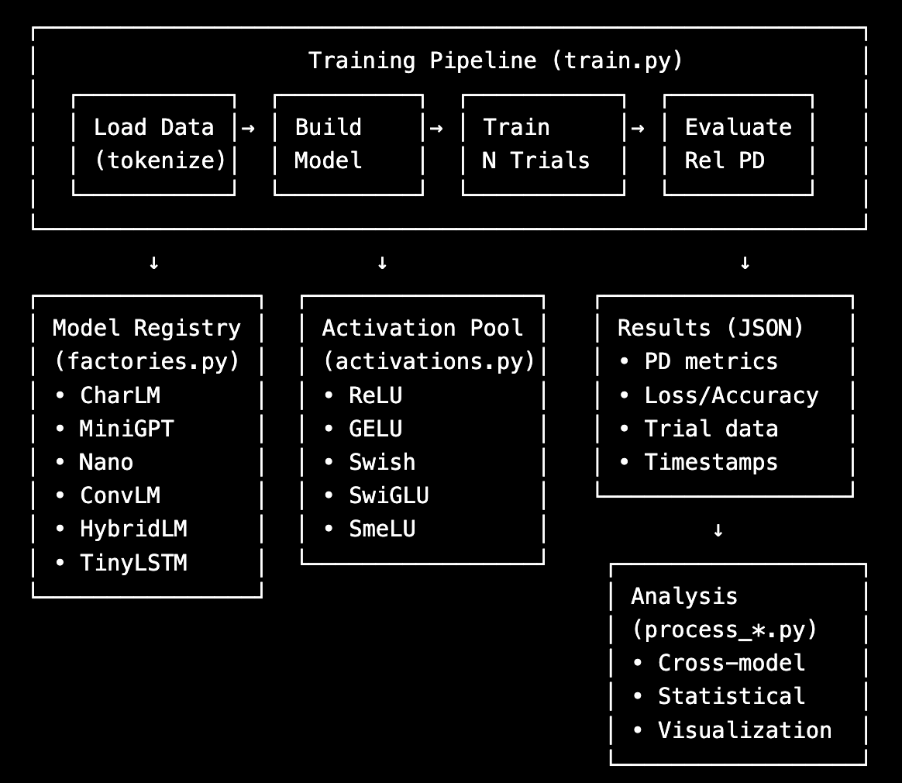
Relative PD Framework
python train.py --model minigpt --activation relu gelu swish swiglu smelu_1 --trials 3 --max_iters 5000 --device cuda
Framework is flexible to support new Model, Activation Function & Evaluation criterias

Slide 10
Model Architectures
CharLM - Simple Feedforward Language Model
Test if simple architectures show activation sensitivity
10M params; 6 feedforward (MLP) layers
MiniGPT - Transformer with Attention
Simplified GPT-style decoder-only transformer
Multi-head self-attention mechanism
10M params; 6 transformer decoder blocks (GPT-style)
NanoTransformer - Minimal Transformer
Lightweight transformer architecture
Test if minimal attention is sufficient
10M params; 6 encoder + 6 decoder
ConvLM - Convolutional Language Model
Pure CNN architecture for sequence modeling; 10M parameters, 6 conv layers
Test non-recurrent, non-attention approach
HybridLM - Multi-Component Architecture
Combines convolution, recurrence, and feedforward layers
Rationale: Test complex hybrid designs
10M params; 2 CNN + 2 Transformer + 2 LSTM

Slide 11
Challenges
Conducting a study with various different configurations and maintaining consistency
  We trained a total of 150+ models across 5 different Character level Language Models architectures & 5 Activation Functions
  Building Framework helped increase velocity
CPU vs GPU
  Started with CPU, moved to GPU
  Long running experiments - ~3.5 to 4 hours for full model training
NVIDIA GB10 (Blackwell architecture, sm_121) is too new for standard PyTorch builds
  Used Nvidia Pytorch Docker containers

Slide 12
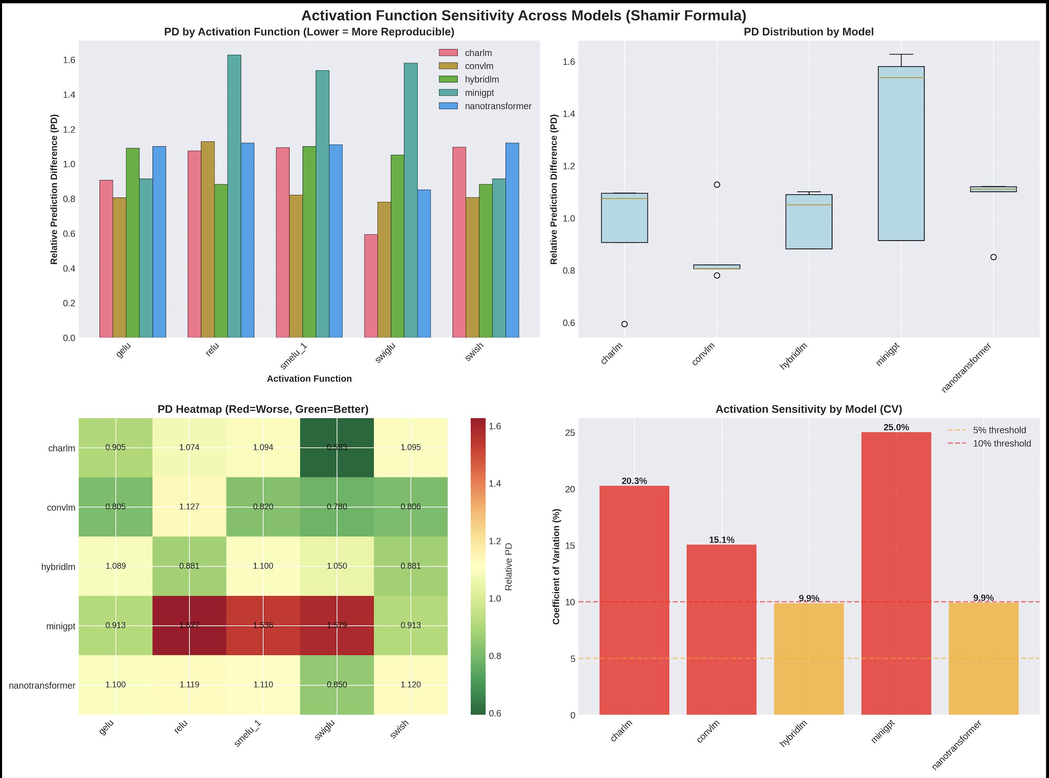

Slide 13
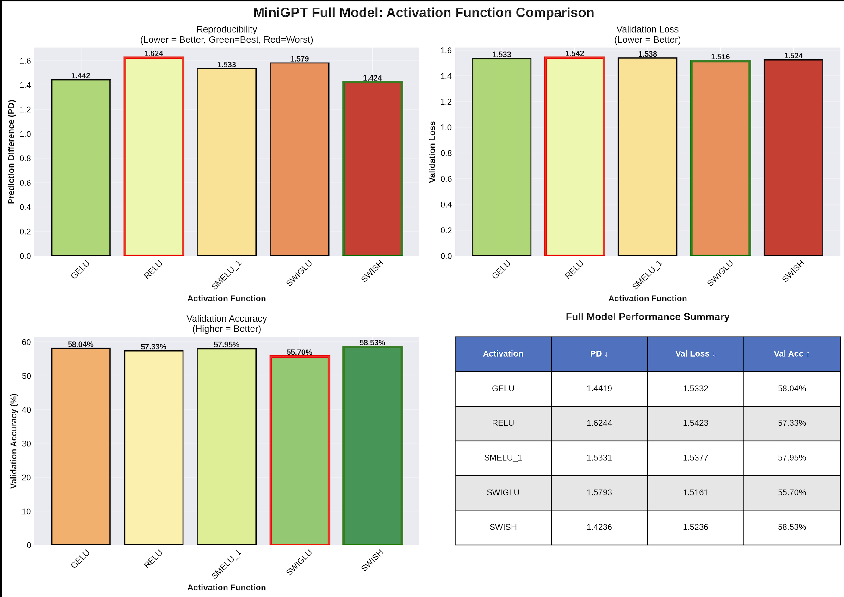

Slide 14
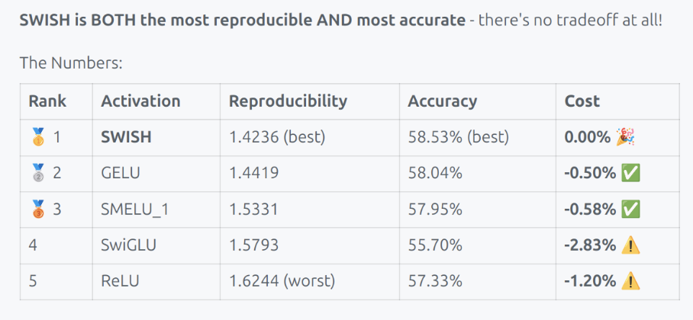
Reproducibility & Accuracy Tradeoff
Generally, one can get lower PD by trading off accuracy
Depends on Model architecture
  Swish activation function has no accuracy impact

Slide 15
Conclusions
Activation function choice matters profoundly for reproducibility in Language Models, but the magnitude of effect depends on architecture:
  CNN models: Low impact
  Hybrid models: Moderate impact
  Transformer models: High impact
Swish or GELU are most stable activation functions to make models more reproducible

Slide 16
Future Work
Depth vs Width Study
  Is Activation sensitivity driven by Parameter count or architectural depth
  Fix Parameter count:
    Vary number of layers
  Add support in Framework
    To evaluate this seamlessly
Conduct experiments for Large Language Models
  GPT-2 small (117M parameters)
    Would Swish's dominance holds at 10x scale
  Llama-2 (160)
    Uses SwiGLU default, does our findings align?
  BERT-Base (160)
    Encoder only architecture
Cover More Activation functions
  Mish
    Outperforms Swish in some vision tasks
  Swish B
    Default Swish uses B=1, it can be learned

Slide 17
Thank You!

