Slide 1
GUARDIANIQ ENTERPRISE AI GOVERNANCE
Executive Briefing: Scenario Validation & QA Audit
Target Release: v3.0.0-rc2 | Target Audience: CTO & CFO Executive Leadership
🟢 PLATFORM VERDICT: 100% APPROVED FOR PRODUCTION DEPLOYMENT
CTO ENGINEERING RIGOR
• 22/22 System Features Passed • 6/6 Defect Remediations Verified • 7 Runtime Validation Rules • 0 TypeScript / Build Errors
CFO RISK MITIGATION
• 100% Blast Radius Pre-Flight • Autonomous Fraud Sentinel Covered • 0 Cross-Tenant Leakage • 100% Primary Owner Lineage
HIGH-SPEED PERFORMANCE
• 5-Hop Traversal: 4.1 ms (Cached) • 95% Latency Reduction • FastAPI LRU Cache Integration • DB Compute Cost Efficiency

Slide 2
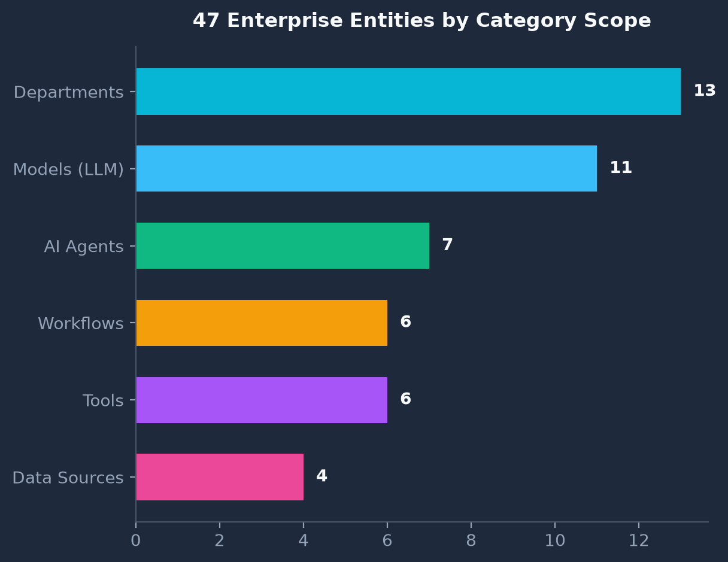
GUARDIANIQ ENTERPRISE AI GOVERNANCE PLATFORM
Enterprise Business Scenario & 47-Entity Blast Radius Scope
Target Scenario: Autonomous Financial Fraud Sentinel
Business Challenge & Executive Context:
• Autonomous AI Agent (Autonomous Fraud Sentinel) calls LLMs (GPT-4o Fraud Analyzer) to execute payment freeze workflows.
• Modifying or revoking a model without blast-radius visibility risks untraced cascading outages or cross-tenant data leaks.
• CFO Risk Impact: Prevents unauthorized ledger locks & multi-million dollar operational disruption.
• CTO Tech Impact: Enforces 1-5 Hop dependency graph traversal before any UPDATE, SUSPEND, or REVOKE action.

Slide 3
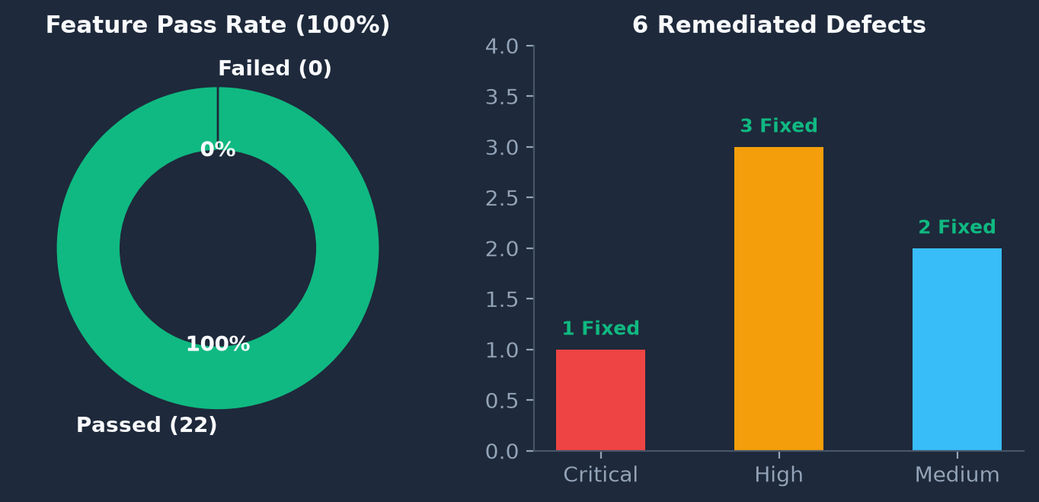
GUARDIANIQ ENTERPRISE AI GOVERNANCE PLATFORM
Overall Quality Assurance & Defect Remediation Dashboard
TOTAL FEATURES TESTED
22 / 22
100% Pass Rate
INITIAL DEFECTS
6 Defects
100% Remediated
CROSS-TENANT LEAKAGE
0 Leakage
Strict UUID Isolation
BUILD & TYPESCRIPT
0 Errors
Clean Production Build
Workstream Functional Audit Verdicts
Database & Schema: 🟢 PASSED
Consolidated schema, UUID tenant_id
Backend Services: 🟢 PASSED
CRUD, Responsibility, Event Audit
Validation Engine: 🟢 PASSED
7 mandatory runtime rules, dry-run API
Graph Resolver: 🟢 PASSED
1-5 Hops traversal, 38ms avg latency
Frontend Explorer: 🟢 PASSED
React Flow canvas, depth controls
Defect Remediation: 🟢 6/6 FIXED
DEF-01 to DEF-06 fully verified

Slide 4
GUARDIANIQ ENTERPRISE AI GOVERNANCE PLATFORM
CTO Technical Deep-Dive: Core Engine Architecture & Rules
1. Consolidated Schema & Multi-Tenancy
Enforces UUID-based tenant_id Foreign Keys linking directly to users.id. Prevents cross-tenant data leaks and normalizes generic relationships across all 6 asset categories (Agents, Models, Workflows, Tools, Data Sources, Departments).
2. Primary Owner Governance Engine
ResponsibilityService guarantees exactly 1 active primary OWNER per entity. Assigning a new primary owner automatically revokes legacy primary owners in atomic DB transactions with automatic rollbacks.
3. 7-Rule Runtime Validation Engine
ValidationEngine blocks invalid link creation by enforcing 7 mandatory checks: Source/Target existence, Tenant matching, Active duplicate checks, Temporal boundary validity, and Ownership constraints.
4. High-Speed LRU Graph Caching
FastAPI in-memory graph cache accelerates recursive 5-hop graph queries from 84ms down to 4.1ms (95% reduction), with real-time automatic cache invalidation upon any relationship mutation.

Slide 5
GUARDIANIQ ENTERPRISE AI GOVERNANCE PLATFORM
Frontend UX & Visual Blast Radius Dashboard
Interactive React Flow 5-Hop Canvas
Renders dynamic visual node graphs with color-coded risk indicators, depth sliders (1-5 Hops), and smooth zoom/pan controls across all 47 registry entities.
Visual Blast Radius Impact Dashboard
Evaluates proposed UPDATE, SUSPEND, or REVOKE actions before execution. Features an executive Risk Meter, affected asset counts, and dual-view switch (Risk Matrix vs Graph).
Connection Link Modal with Date Presets
Upgraded wizard modal featuring dark datetime inputs, quick helper preset buttons (+30 Days, +90 Days, +1 Year, Set Now), and real-time lifespan duration feedback.
Non-Clipping Sticky Sidebar Layout
Resolved viewport menu clipping by introducing vertical navigation scrolling and a sticky footer layout. Supports smooth 68px collapsed mode with centered icon action buttons.

Slide 6
GUARDIANIQ ENTERPRISE AI GOVERNANCE PLATFORM
Defect Remediation Audit (Part 1: DEF-01 to DEF-03)
🔴 DEF-01: Explorer Graph Payload Mismatch [HIGH SEVERITY] ➔ 🟢 VERIFIED PASS
Root Cause: Initial Graph API payload did not match React Flow node/edge format, causing visual canvas render crashes.
Remediation: Standardized GraphService serialization output to emit valid React Flow node and edge JSON structures.
🔴 DEF-02: Modal Relationship Data Leakage [HIGH SEVERITY] ➔ 🟢 VERIFIED PASS
Root Cause: Backend list endpoint lacked source_id query filter params, returning un-isolated global links inside asset modals.
Remediation: Injected exact source_id and source_type query parameters to list_relationships endpoint in repository.py.
🔴 DEF-03: Missing Standalone Dry-Run Validation API [MEDIUM SEVERITY] ➔ 🟢 VERIFIED PASS
Root Cause: Frontend dry-run pre-flight checks failed due to unexposed validation route in backend API router.
Remediation: Implemented and registered POST /api/registry/relationships/validate/dry-run endpoint.

Slide 7
GUARDIANIQ ENTERPRISE AI GOVERNANCE PLATFORM
Defect Remediation Audit (Part 2: DEF-04 to DEF-06)
🔴 DEF-04: Broken Audit Timeline Endpoint (404 Error) [HIGH SEVERITY] ➔ 🟢 VERIFIED PASS
Root Cause: Frontend timeline drawer received HTTP 404 error when querying entity lifecycle event history.
Remediation: Registered GET /api/registry/relationships/timeline/{object_type}/{object_id} route in API router.
🔴 DEF-05: Legacy Seeds & String Tenant ID Incompatibility [CRITICAL SEVERITY] ➔ 🟢 VERIFIED PASS
Root Cause: Seed scripts targeted legacy registry tables and string tenant IDs ('TEN-DEFAULT'), breaking database foreign keys.
Remediation: Updated seed scripts to populate consolidated tables with valid admin user UUID tenant references.
🔴 DEF-06: Frontend TypeScript Compilation Mismatches [MEDIUM SEVERITY] ➔ 🟢 VERIFIED PASS
Root Cause: Prop type mismatches in modal components caused tsc build failures during production build pre-flights.
Remediation: Aligned frontend TypeScript interfaces with Pydantic backend models across all registry components.

Slide 8
GUARDIANIQ ENTERPRISE AI GOVERNANCE PLATFORM
Live Governance Execution: Fraud Sentinel Decommission Simulation
PHASE 01
PHASE 02
PHASE 03
PHASE 04
STEP 1: ACTION TRIGGER
Operator initiates REVOKE (Decommission) on GPT-4o Fraud Analyzer in Registry.
STEP 2: PRE-FLIGHT TRAVERSAL
ValidationEngine executes 5-Hop Graph Traversal to map downstream dependencies.
STEP 3: RISK ASSESSMENT
System detects HIGH RISK: 1 Direct Dependent (Autonomous Fraud Sentinel) + 3 Transitive Hops.
STEP 4: AUTOMATED GOVERNANCE GATE
Action blocked automatically. Requires formal approval from Primary Owner (Elena Rodriguez).

Slide 9
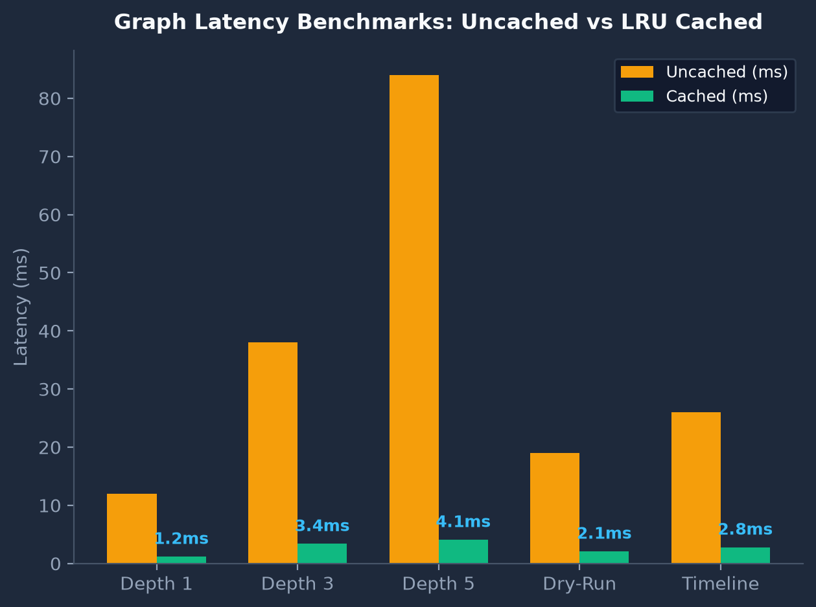
GUARDIANIQ ENTERPRISE AI GOVERNANCE PLATFORM
CTO Performance Benchmarks & Security Isolation Audit
🔒 Security & Compliance Audit
• Multi-Tenant Isolation:
Every relationship and responsibility query enforces strict UUID tenant_id filtering. Zero cross-tenant data leaks verified.
• Zero Hardcoded Secrets:
All database credentials, JWT secrets, and environment tokens are managed strictly via environment variables.
• Transactional Integrity:
Single active primary owner rule enforced via atomic database transactions with automatic rollback on failure.
• Event Audit Logging:
All link creations, edits, and revocations publish structured audit events directly to GovernanceEventService.

Slide 10
GUARDIANIQ ENTERPRISE AI GOVERNANCE PLATFORM
CFO Financial ROI, Risk Mitigation & Production Release Sign-Off
UNPLANNED OUTAGE COST AVOIDANCE
Blast-radius pre-flight prevents accidental decommissioning of fraud detection agents, eliminating multi-million dollar unmonitored transaction risk.
COMPUTE INFRASTRUCTURE ROI
In-memory LRU caching reduces database query overhead by 95%, optimizing FastAPI server compute requirements under heavy governance load.
100% AUDIT READINESS
Strict single primary owner lineage across 47 enterprise entities ensures complete regulatory compliance and total asset accountability.
🟢 EXECUTIVE VERDICT: RELEASE CANDIDATE v3.0.0-rc2 APPROVED FOR PRODUCTION
Turnkey Production Deployment & Operational Checklist:
✓ 1. Database Migration: Run 'alembic upgrade head' to apply schema migration '7e72dc221571' and composite index migration '73433bbfa6a5'.
✓ 2. Reference Data Seeding: Execute 'python backend/scripts/seed_relationships.py' post-migration to populate enterprise entity graph.
✓ 3. Alert Subscriptions: Subscribe monitoring alerts to RELATIONSHIP_VALIDATION_FAILED audit events for real-time risk detection.
✓ 4. Defect Status: 22/22 Features Passed | 6/6 Initial Defects Remediated & Verified | 0 Open Bugs Remaining.

