Slide 1
Predicting EPL Goals
Poisson and Negative Binomial Regression | Predictive Analytics

Slide 2
Problem and objective
Predict goals scored by each team in a football match.
Goals are non-negative integer counts; count GLMs respect this structure.
Compare Poisson and Negative Binomial regression.
Evaluate on the next season rather than a random split.

Slide 3
Dataset and preprocessing
Five seasons: 2022-23 through 2026-27.
Four completed seasons: 1,520 training matches.
Ongoing 2026-27: 80 held-out test matches.
Long format, team/opponent effects, venue and past-only five-match form.

Slide 4
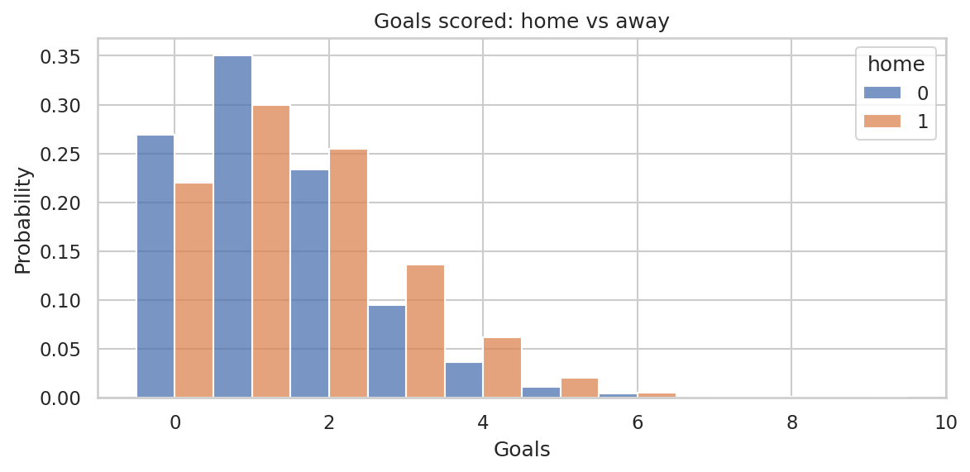
Exploratory data analysis
Average total goals per match: 2.945.
Home mean: 1.613; away mean: 1.332.
Goal counts are discrete and concentrated at lower values.
Shots and shots on target correlate with goals.

Slide 5
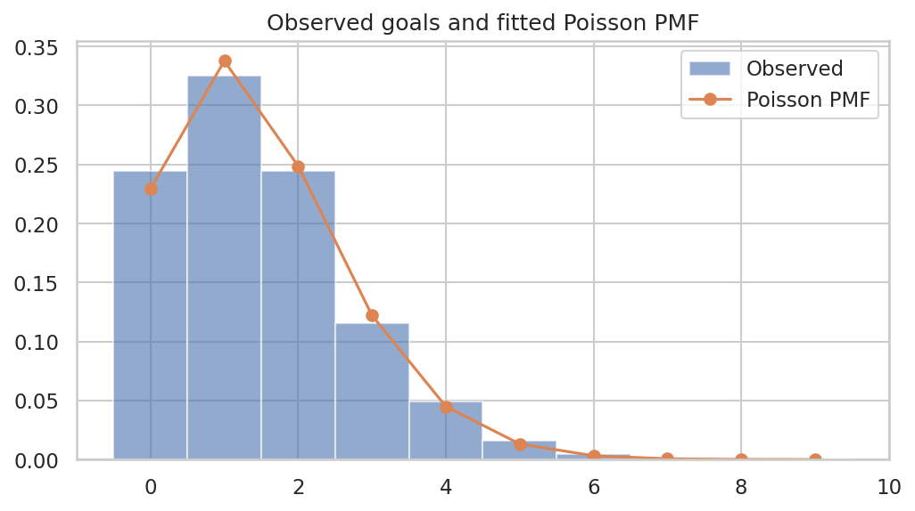
Poisson GLM
Log link: log(λ) = Xβ; expected goals λ = exp(Xβ).
Maximum likelihood estimates team, opponent, venue and form effects.
Home IRR = 1.212 (21.2% higher expected rate).
Pearson dispersion = 0.935.

Slide 6
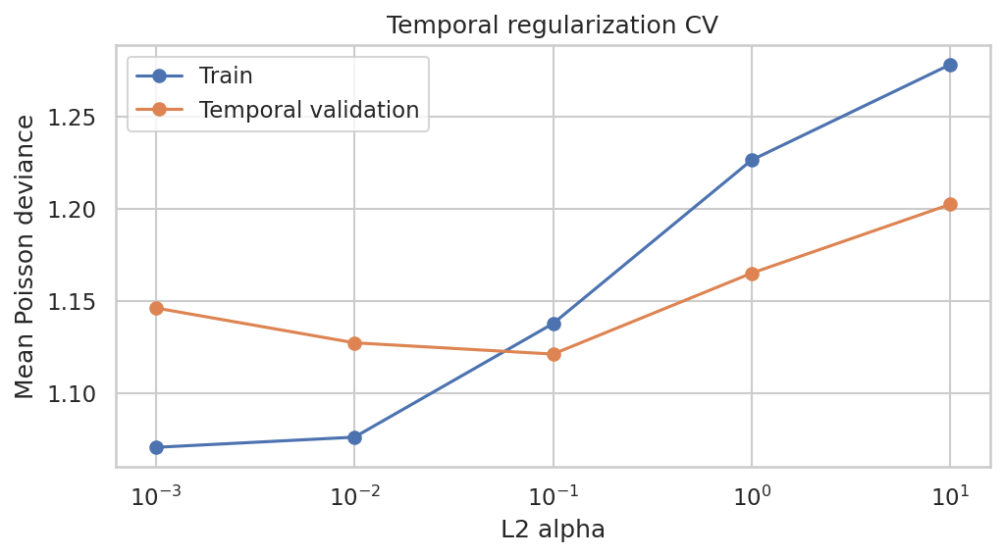
Negative Binomial comparison
NB2 alpha (method of moments) = 0.0534.
Poisson AIC = 9057.13; NB AIC = 9085.80.
Poisson has the lower AIC in this comparison.
The additional NB complexity is not justified by this fit.

Slide 7
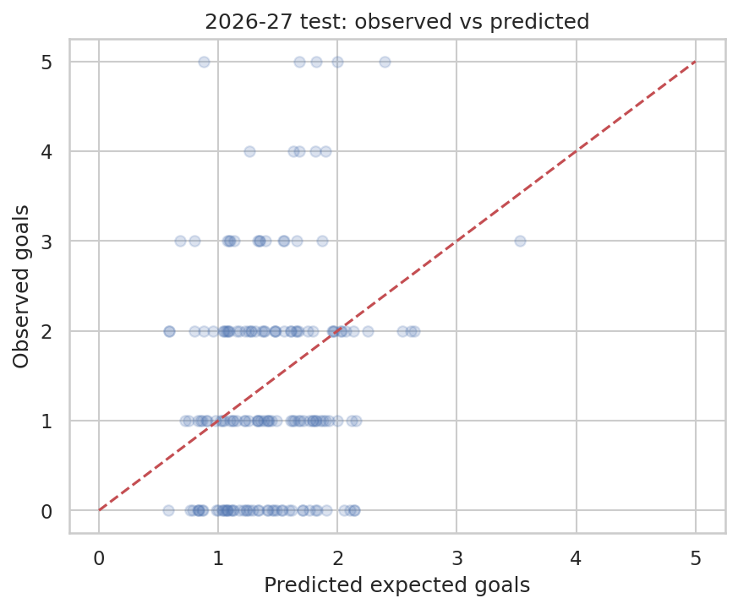
Test results
Poisson RMSE = 1.245; MAE = 1.002.
W/D/L accuracy = 46.2%; always-home baseline = 38.8%.
Test set: 80 matches from the ongoing season.
Exact scores and outcomes remain uncertain.

Slide 8
Conclusion and responsible use
Full workflow: preprocessing, EDA, feature engineering, GLMs and chronological evaluation.
No target leakage: rolling form uses previous matches only.
Limitations: injuries, line-ups, tactics, player quality and new-team history.
Communicate uncertainty; predictions are not guarantees or betting advice.

