Slide 1

What are Generics?
Java supports generic types, such as classes, records and interfaces.
It also supports generic methods. Sound confusing?
COMPLETE JAVA MASTERCLASS
Generics Part 1

Slide 2
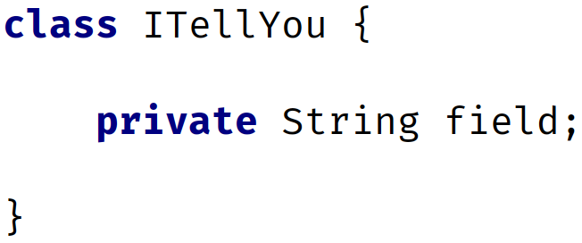
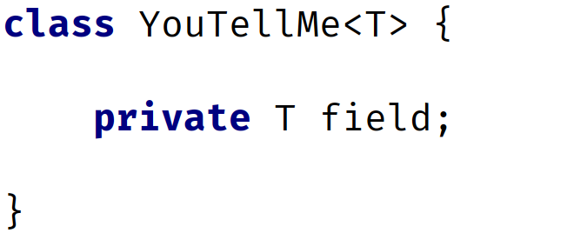
Declaring a Class vs. Declaring a generic Class
On this slide, I'm showing you a regular class declaration, next to a generic class.
The thing to notice with the generic class, is that the class declaration has angle brackets with a T in them, directly after the class name.
T is the placeholder for a type that will be specified later.
This is called a type identifier, and it can be any letter or word, but T which is short for Type is commonly used.
Regular Class | Generic Class
COMPLETE JAVA MASTERCLASS
Generics Part 1

Slide 3
Declaring a Class vs. Declaring a generic Class
For the generic class, the field's type is that placeholder, just T, and this means it can be any type at all.
The T in the angle brackets means it's the same type as the T, specified as the type of the field.
Regular Class | Generic Class
COMPLETE JAVA MASTERCLASS
Generics Part 1

Slide 4
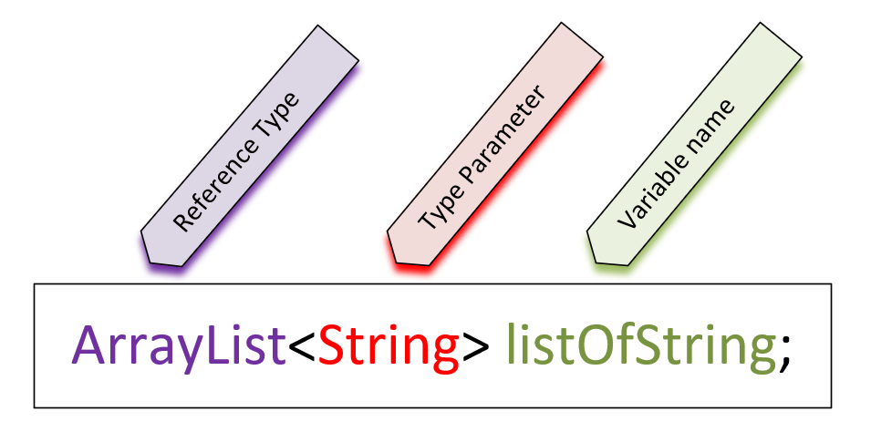
Using a generic class as a reference type
On this slide, I have a variable declaration of the generic ArrayList.
In the declaration of a reference type that uses generics, the type parameter is declared in angle brackets.
The reference type is ArrayList, the type parameter (or parameterized type) is String, which is declared in angle brackets, and listOfString is the variable name.
COMPLETE JAVA MASTERCLASS
Generics Part 1

Slide 5
Using a generic class as a reference type
Many of Java's libraries are written using generic classes and interfaces, so we'll be using them a lot moving forward.
But it's still a good idea to learn to write your own generic class, to help you understand the concept.
COMPLETE JAVA MASTERCLASS
Generics Part 1

