Slide 1

Interfaces used for sorting
Now that I've covered interfaces and generic classes, I want to review in more detail, interfaces I mentioned in previous lectures.
The first is Comparable.
For an array, we can simply call Arrays.sort, and pass it an array, but as I have previously mentioned, the elements in the array, need to implement Comparable.
Types like String, or primitive wrapper classes like Integer or Character are sortable, and this is because they do implement this interface.
COMPLETE JAVA MASTERCLASS
Revisiting Comparable

Slide 2
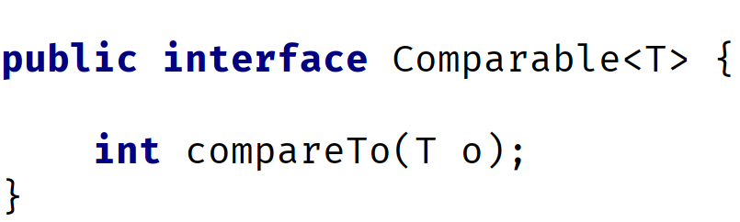
Comparable Interface
The interface declaration in Java.
It's a generic type, meaning it's parameterized.
Any class that implements this interface, needs to implement the compareTo method.
COMPLETE JAVA MASTERCLASS
Revisiting Comparable

Slide 3
Comparable Interface
This method takes one object as an argument, shown on this slide as the letter o, and compares it to the current instance, shown as this.
The table on this slide shows what the results of the compareTo method should mean, when implemented.
resulting Value | Meaning
zero | O == this
negative value | this < o
positive value | this > o
COMPLETE JAVA MASTERCLASS
Revisiting Comparable

