Slide 1

Project NLP:
Comment Classification
Praticipants:
HIMANSHU SACHAN
CHOUHAN VILAS PANDU
NATTA VEERA BALA KISHORE
PENUMATSA SEETARAMARAJU
PANKAJ NAGANATH SALUNKHE
SRI KRISHNA CHAITANYA OGIRALA
MHASKE SHRIKANT CHANDRAKANT

Slide 2
Contents in the Presentation
Objective of Project
Understanding the Dataset
Preprocessing Of Data
EDA
Cleaning the comments
Vectorization
Building Models to predict results
Deployment of the Model

Slide 3
Objective Of Project
The objective of Comment Classification Project is to build a model which is able to classify the user input text comment into different labels .
This is a Multi-Label Project, so we have to train the model to give out a multi label prediction for the user input text comment.

Slide 4
Understanding the Dataset
Number of Rows in Dataset = 1,66,571
Number of Columns in Dataset = 8
Independent Variable or Column:
Comment Text
Target Variables or Columns:
Toxic
Severe Toxic
Obscene
Threat
Insult
Identity Hate

Slide 5
Preprocessing of Data
Preprocessing of Data includes:
Removing the rows which have null values in them.
Removing of the rows which have text data in the Target variable columns.
Converting the 1’s and 0’s in the Target Variables columns from Object data type to Integer data type.

Slide 6
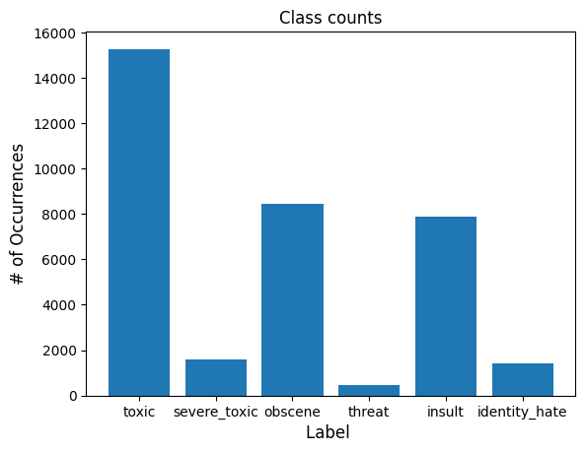
EDA (Exploratory Data Analysis)
Number of Comments(Rows) after preprocessing = 1,58,866
Number of comments with the Labels:-
Toxic : 15,279
Severe Toxic : 1,595
Obscene : 8,442
Threat : 478
Insult : 7,872
Identity Hate : 1,404
Number of comments with No Labels = 1,42,662

Slide 7
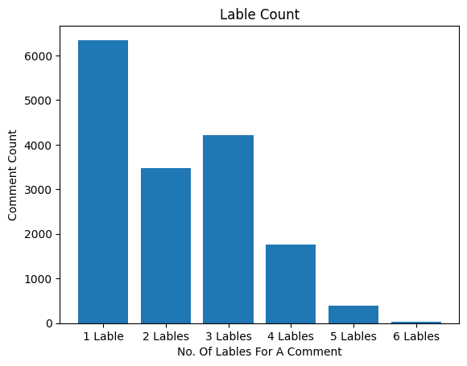
EDA Cont.
Number of comments with Multiple Labels:
1 Label : 6,346
2 Labels : 3,474
3 Labels : 4,208
4 Labels : 1,760
5 Labels : 385
6 Labels : 31

Slide 8
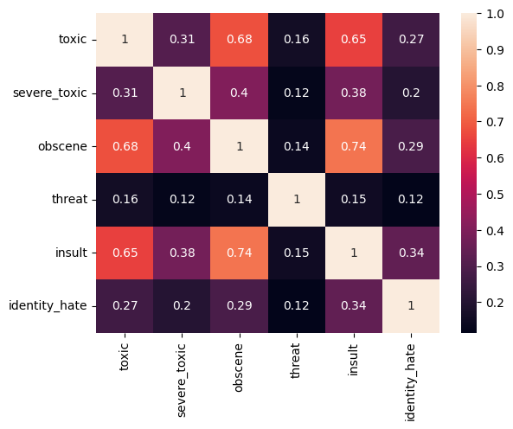
EDA Cont.
Correlation between Labels :
Obscene and Insult :- 74 %
Toxic and Obscene :- 68 %
Toxic and Insult :- 65 %

Slide 9
Cleaning Of Comments
Finding the broken comments and join all the comments together.
Punctuations from the Joint Text, all of the URLs from text are removed.
Removing the words which contain numbers in it andTokenizing the Text using Word Tokenize.
Checking if the Tokens are influenced by stop words by drawing Word Cloud for each Label comment
Removing the stop words from the Tokens.
Joining the stop words removed tokens to form the comments and naming the column Cleaned Comments.
Lemmatizing the Cleaned Comments column.

Slide 10
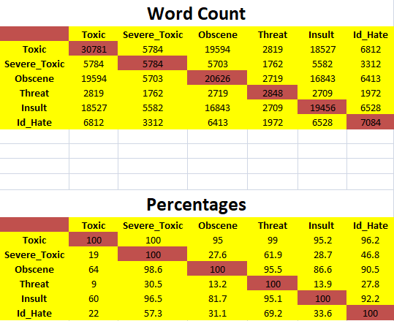
Cleaning Cont.
Here is the relation of the most occurring words in between the labels.
The number of most occurring words in each label are represented in brown boxes.

Slide 11
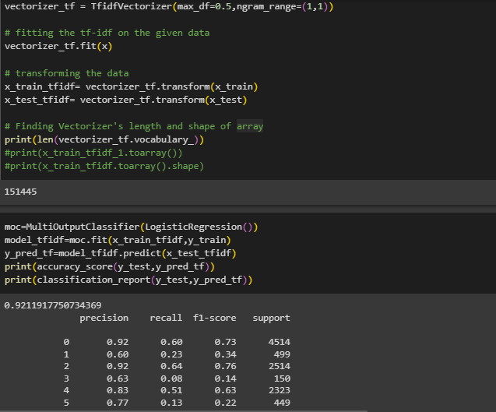
Vectorization
TF-IDF Vectorizer:
Using :
Multi Output Classifier
Logistic Regression
Unigram
Max_df = 0.5
Result :
Vectorizer matrix= 1,11,206 x 1,51,445
Accuracy = 92.1 %
Recall Values are Very Poor.
F1-Scores values are less.

Slide 12
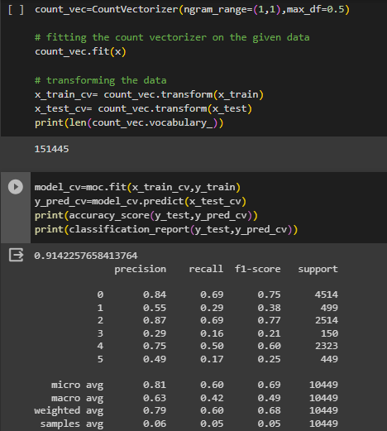
Vectorization Cont.
Countvectorizer :-
Using :
Multi Output Classifier
Logistic Regression
Unigram
Max_df = 0.5
Result :
Vectorizer matrix= 1,11,206 x 1,51,445
Accuracy :- 91.4 %
Recall values are better than TF-IDF.
F1-Scores are better than TF-IDF.

Slide 13
Building Models to Predict Result
We have used 5 methods to build models
Logistic Regression using class_weight=‘balanced’
Logistic Regression using Manual Balancing
Random Forest using class_weight=‘balanced’
Random Forest using Manual Balancing
X G Boost using scale_pos_weight=8.8
The value of scale_pos_weight ratio is
(No. of comments with no label attached to it Divided by No. of comments with at least 1 label attached to it)

Slide 14
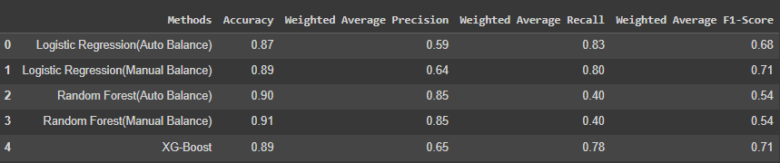
Model Building Cont.
Recall :
It is the ability of the classifier to correctly find the positive instances.
It is the ratio of True Positive divided by sum of True Positive and False Negative
The recall for Logistic Regression using Auto Balancing is the best among all the models.
We are using Logistic Regression Auto Balancing for Deployment.

Slide 15
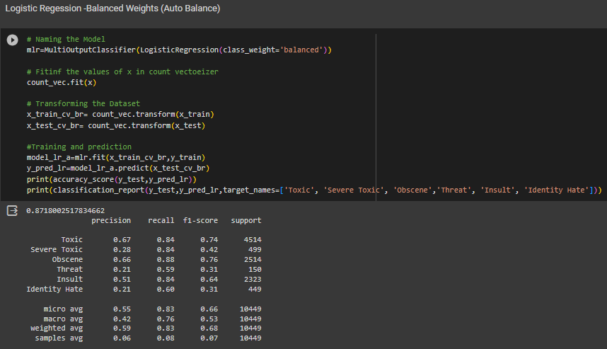
Model Building Cont.
Logistic Regression Code and Result

Slide 16
Deployment of Model
Machine learning model deployment is the process of placing a finished machine learning model into a live environment where it can be used for its intended purpose.
Data science models can be deployed in a wide range of environments, and they are often integrated with apps through an API so they can be accessed by end users.
Models are usually developed in an environment with carefully prepared data sets, where they are trained and tested.
Most models created during the development stage do not meet desired objectives. Few models pass their test and those that do represent a sizable investment of resources.
So moving a model into a dynamic environment can require a great deal of planning and preparation for the project to be successful.

Slide 17
Deployment of Model Steps
The process of actually deploying the model requires several different steps or actions, some of which will be done concurrently.
First, the model needs to be moved into its deployed environment, where it has access to the hardware resources it needs as well as the data source that it can draw its data from.
Second, the model needs to be integrated into a process. This can include, for example, making it accessible from an end user’s laptop using an API or integrating it into software currently being used by the end user.
Third, the people who will be using the model need to be trained in how to activate it, access its data and interpret its output.

Slide 18
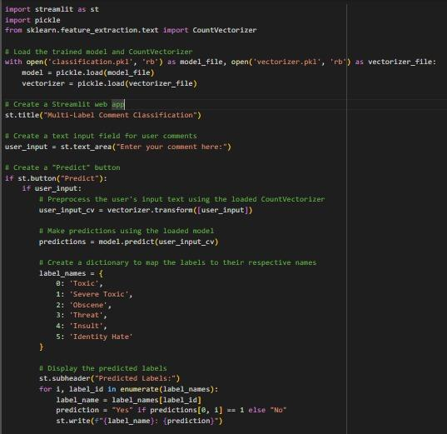
Deployment of Model Code

Slide 19
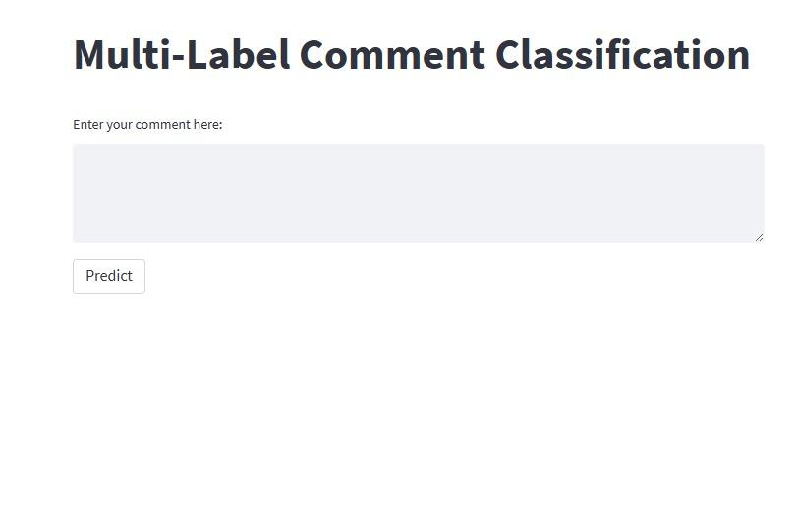
Deployment App View
Our App view has Input Field for ‘Enter your Comment Here’ and a ‘Predict’ button.
We enter the data field with comments and predict weather the comment is :
'Toxic',
'Severe Toxic',
'Obscene',
'Threat',
'Insult',
'Identity Hate'
The result is Yes/No for above parameters.

Slide 20
Conclusion
The objective has been successful to predict comment classification.
We have analyzed, cleaned the data and applied TF-IDF Vectorizer, Counter Vectronizer.
We have used 5 methods to build model and displayed in below picture.

Slide 21
Conclusion contd..
The recall for Logistic Regression using Auto Balancing is the best among all the models.
We are using Logistic Regression Auto Balancing for Deployment.
We have given 3 different comments input and predicted 3 results.
Results are Good Comment, Hate Comment and Toxic Comment.
The results are displayed and explained in screenshots posted in next slides.

Slide 22
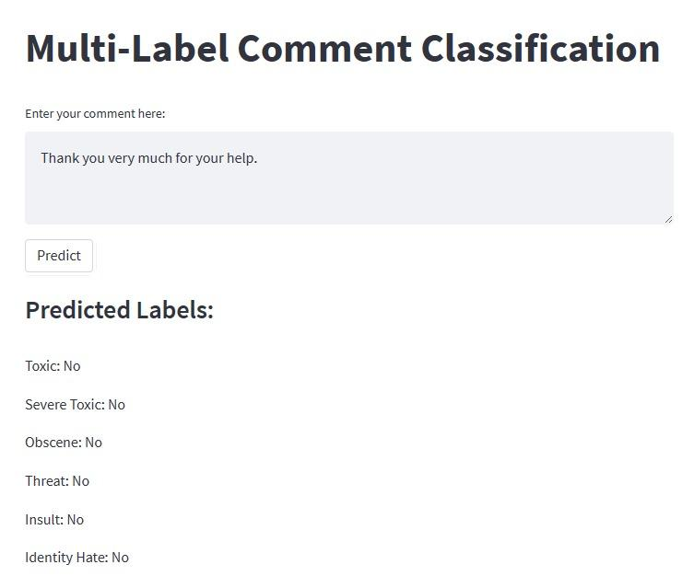
App Result for Good Comment
Here we have a result for Good comment.
Predicted labels result is No for all the labels.
We don’t have any ‘Toxic, Severe Toxic, Obscene, Threat, Insult or Identity Hate.
This is a good comment result.

Slide 23
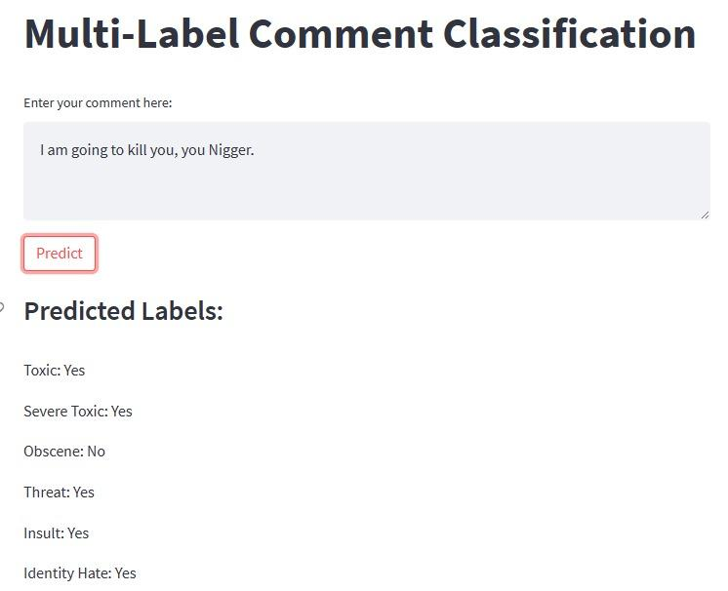
App Result for Hate Comment
Here we have a result for Hate comment.
Predicted labels result is No for Obscene comment.
We have Yes for ‘Toxic, Severe Toxic, Threat, Insult and Identity Hate.
This is a Hate comment result but the comment doesn’t have Obscene comment.

Slide 24
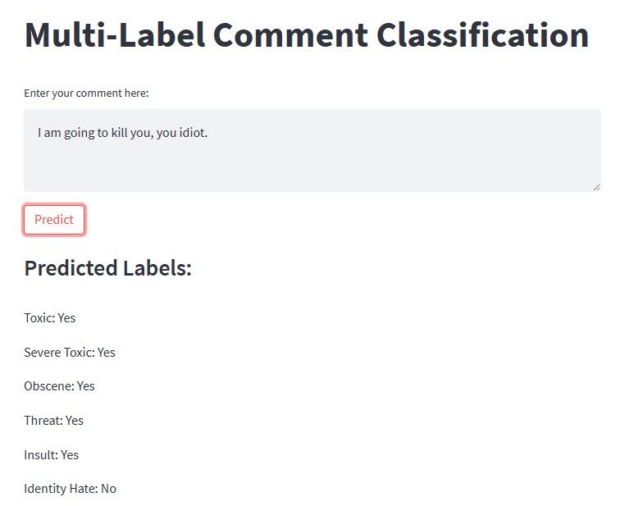
App Result for Toxic Comment
Here we have a result for Toxic comment.
Predicted labels result is No for Identity Hate comment.
We have Yes for ‘Toxic, Severe Toxic, Obscene, Threat and Insult.
This is a Toxic comment result but has no Identity Hate .

