Slide 1
A BENCHMARK STUDY ON MACHINE LEARNING METHODS FOR
FAKE NEWS DETECTION
Neel Kanabar : | 202018024
Arnav Desai : | 202018031
Aneri Joshi : | 202018032
Pankti Fadia : | 202018045

Slide 2
Introduction :
Fake news is been there before the born of the Internet.
With world is being connected through internet, the presence of Fake News has increased widely.
It is difficult to detect if a news is fake or real when such information is available on the internet.
Ex. - 2016 US Elections.
Our project is based on detecting this fake news with the help of different models which gives us the best accuracy with a Front-end Application.

Slide 3
Dataset
Front-End Application
Data Preprocessing
Process-Flow
Testing and Result
Data Visualization
Models

Slide 4
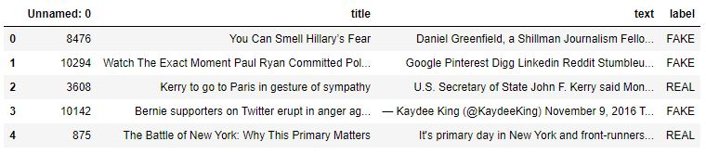
Data Set
Da
Our model is based on Supervised Machine Learning.
This data set consists of 3 column :
Title
Text
Label

Slide 5
Data - Preprocessing
Data-preprocessing is divided in 2 parts :
Data Splitting
Vectorizing
Data Splitting :
Train Data : 80%
Test Data : 20%
Vectorizing :
TFIDF
Max_df = 0.8

Slide 6
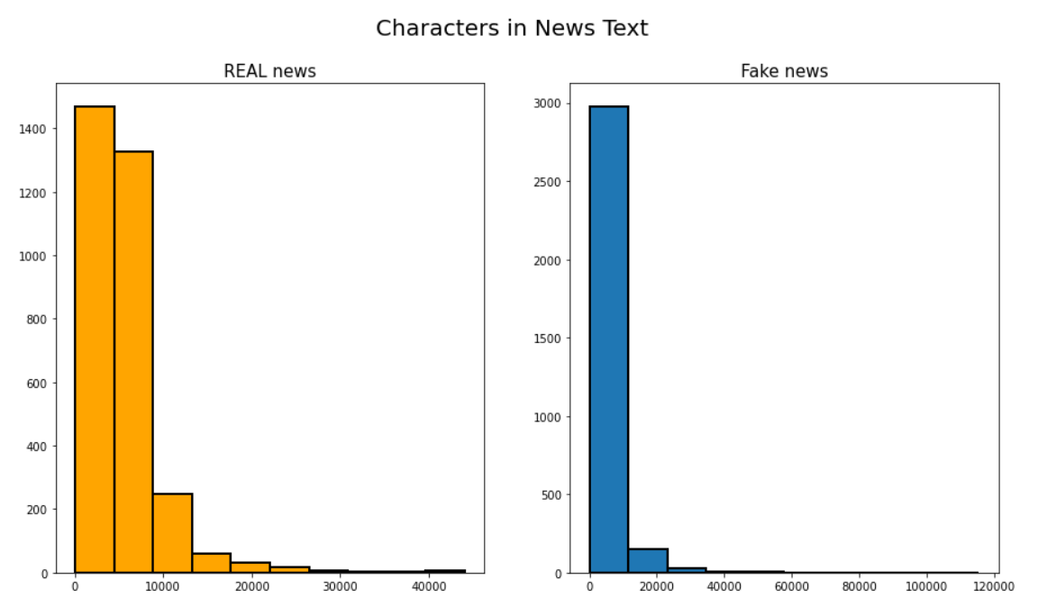
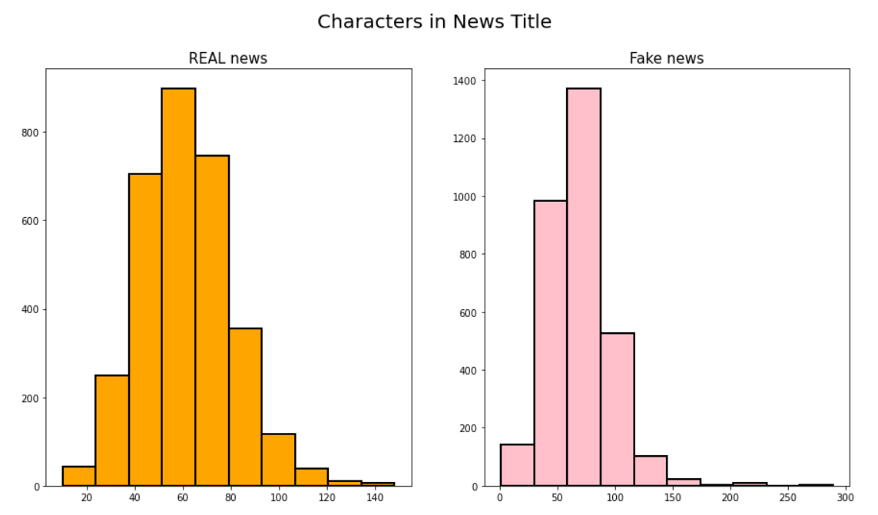
Data - Visualization

Slide 7
Model
01.
02.
03.
Passive-aggressive Classifier
Logistic Regression
Random Forest Classifier

Slide 8
Passive-Aggressive Classifier :
Model
Algorithms for Large-Scale Learning.
Passive : If correct, then no necessity to change the model.
Aggressive : If correct, changes are required in the model.
Default Parameters :
Regularization Step ( C = 1.0 )
Maximum Iteration ( max_iter = 1000 )

Slide 9
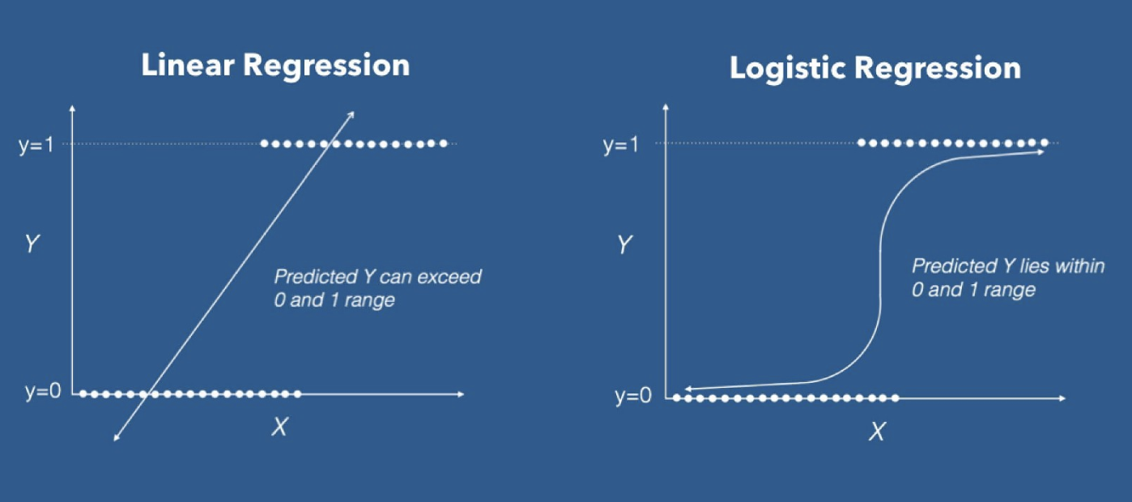
Logistic Regression :
Model
Similar to Linear Regression.
Used for examining the association of independent variables with one variable which splits the data.
Based on maximum likelihood estimation.

Slide 10
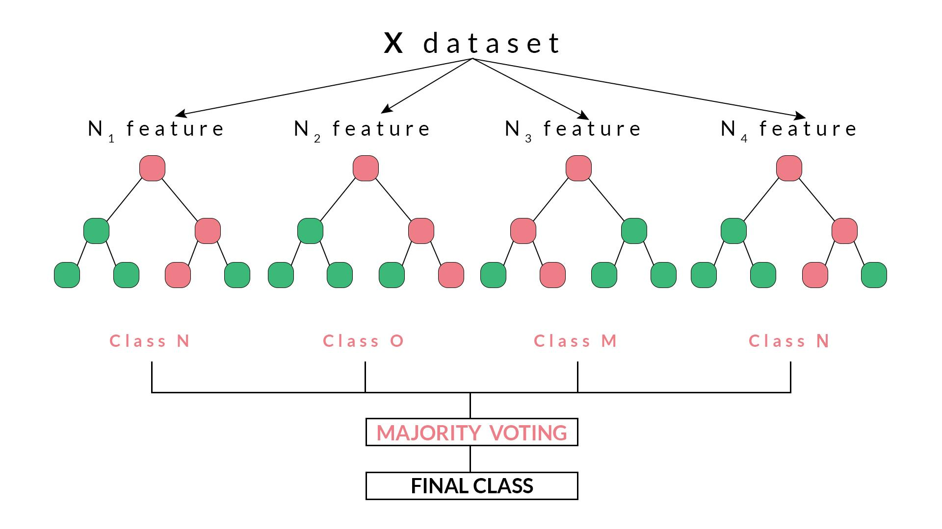
Random Forest Classifier :
Model
It is a Begging Technique.
It is a collection of Decision Trees.
It uses averaging to improve the Predictive Accuracy and Control Overfitting.

Slide 11
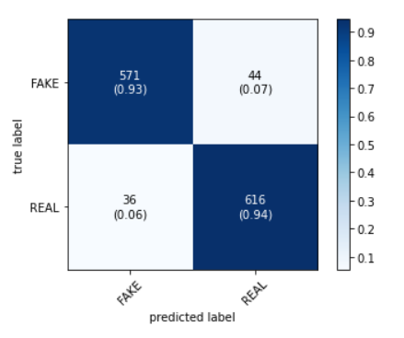
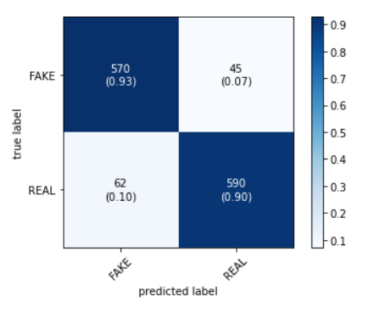
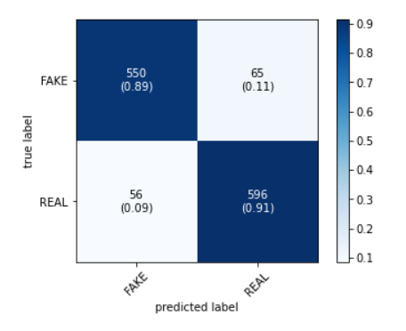
Confusion Matrix :
Testing and Results
Passive-Aggressive Classifier
Random Forest Classifier
Logistic Regression

Slide 12
Accuracy Score & F1 Score :
Passive-Aggressive Classifier
Random Forest Classifier
Logistic Regression
Accuracy Score :
93.69 %
Accuracy Score :
91.55 %
Accuracy Score :
90.45 %
F1 Score :
(0.9369, 0.9368, 0.9368, None)
F1 Score :
(0.9159, 0.9155, 0.9155, None)
F1 Score :
(0.9045, 0.9044, 0.9044, None)

Slide 13
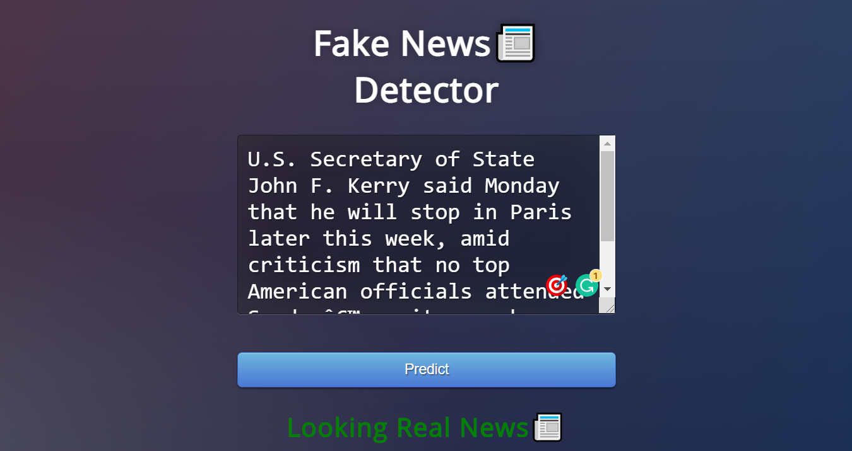

Front - End Application
The Web Application is made with the help of Flask.

Slide 14
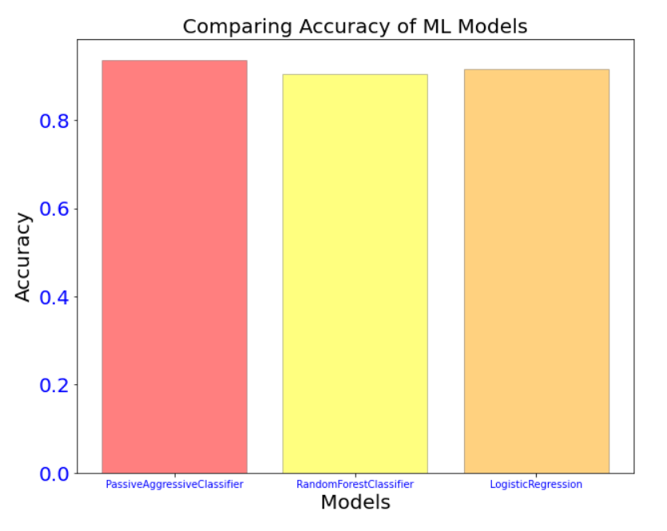
Conclusion :
With all the experiments and model training, we got the best score with Passive - Aggressive Classifier.
Compare to other models, each Accuracy score and F1 score of Passive - Aggressive were more accurate than other models.

Slide 15
Thank You!

