Slide 1
SUDOKU

Slide 2
OBJECTIVE
The objective is to fill a 9X9 grid so that each column, each row and each of the nine 3X3 boxes contains the digits from 1 to 9.
A cell is the smallest block in the game.A row, column and region consists of 9 cells and and the whole game consists of 81 cells .A region has thicker lines surrounding it.

Slide 3
FUTURE WORK
A Sudoku puzzle (9x9) can be thought of a graph with 81 vertices, one for each cell, and two vertices are connected by an edge if they cannot be assigned the same value. For example, all cells in the same row, column or block will have edges between their corresponding vertices.
Given a Sudoku puzzle we can build the associated graph. The given number in the puzzle cane be used to add additional edges to the graph we can then use graph colouring to find a 9-colouring of this graph (colours 1-9)

Slide 4
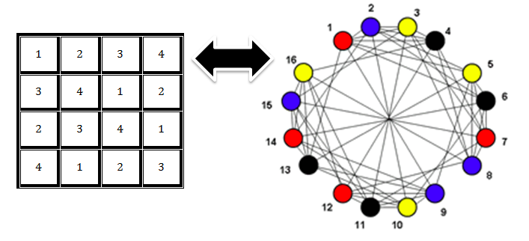
4x4 SUDOKU PUZZLE
Each puzzle consists of a 4x4 or 6x6 grid containing given clues in various places. The object is to fill all empty squares so that the numbers 1 to 4 (for 4x4 puzzles) or 1 to 6 (for 6x6 puzzles) appear exactly once in each row, column and box.
The graph of a 4X4 sudoku puzzle can be drawn as:

Slide 5
9X9 SUDOKU PUZZLE
Enumerate the 81 cells of the Sudoku board with numbers from 81. Then the graph associated with a Sudoku puzzle consists of 81 vertices (one for each cell of the board), together with edges as follows: two vertices are connected by an edge if the cells that they correspond to are in the same column, row or 3x3 box. We have thus represented the Sudoku grid as a graph. With 81 vertices and several hundred edges it would be a big graph if one wanted to draw it, so let us just think about it without attempting to produce a graphical representation. What about the numbers in the cells of the Sudoku puzzle, how do we represent those? Assign each number from 1 to 9 a colour. Now colour the vertices corresponding to cell that contains a given number in the colour of the number.
It is now easy to see that completing a Sudoku puzzle without violating the Sudoku condition is equivalent to colouring the vertices of the corresponding graph while ensuring that no two adjacent vertices have the same colour.

