Slide 1

Desired security outcomes
Public Cloud Speed Boat Boot Camp
Calvin Mangubat

Slide 2
Learning objectives
At the end of this module, attendees will:
Understand what Palo Alto Networks believes is the customer’s desired security outcome
Understand what it takes to achieve this security outcome
Be able to explain why are endpoints still being compromised
Explain how we convert unknown threats to known threats
Understand what the conversion of unknown-to-known means to the customer

Slide 3
Desired Security Outcomes
Real-time security
Pro-active security
Prisma Cloud Compute (Static)
Prisma Cloud
Cortex
Prisma SaaS
NGFW
Prisma Cloud Compute (Runtime)
GP
Prisma Access

Slide 4

Desired Security Outcomes
Cyber Attack Lifecycle
Command & Control
Act on Objective
Reconnaissance
Weaponization
Delivery
Exploitation
Installation
Stop the attack at any point!

Slide 5
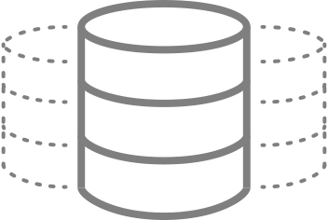
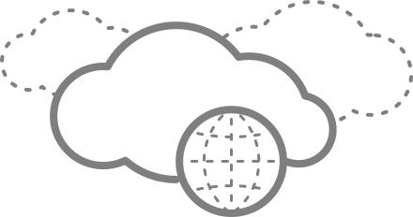

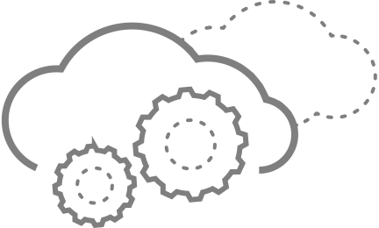
















A NEW ARCHITECTURE FOR CLOUD SECURITY
Data Center
Public Cloud
Internet
SaaS
Security Service Layer
Prisma
User-ID
App-ID
Threat
Wildfire
URL Filtering
Cortex XDR
Prisma SaaS
Connectivity Layer
IPsec VPN
SSL VPN/IPsec
SD-WAN
Clean Pipe
Clientless VPN
BRANCH
RETAIL
HQ
MOBILE
Notes:
We believe that a better approach is to deliver protection from the cloud. Enforce security policies for all your users and applications in the cloud, rather than at the edge.
Your users, no matter where they are, connect to the cloud service and access all of their applications, including the ones in the data center, the internet, the public cloud or SaaS. They also get consistent protection, because the security is the same in every location. And the organization can quickly and easily deploy protection to different locations by deploying new protections from the cloud rather than having to ship security appliances or build out one-off point solutions.
With Prisma, you get exactly these things. The connectivity layer links together your locations and users. The connectivity layer can be established with IPsec, SSL VPN, or many of the other services.
The security service layer delivers protection, so that organizations stay on top of what’s happening. It uses policy to drive control over access to applications, and enforce the protections to reduce risk and stop threats. It also provides the integration points with other solutions such as Cortex and the integration with the entire Prisma Suite.

Slide 6








THE MOST COMPLETE PUBLIC CLOUD SECURITY OFFERING
PUBLIC CLOUD
HOST
Infrastructure-as-a-Service (IaaS)
Secure OS and app within workloads
INLINE
Web Server
App Server
Protect and segment cloud workloads
WEB
APP
Platform-as-a-Service (PaaS)
RedLock
API
SERVERLESS
CONTAINERS
STORAGE
Continuous security & compliance
Users/Admins

Slide 7



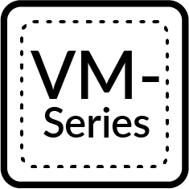

The Problems We Can Help You Solve
Data Security
DLP / Storage scanning
Hosts & Containers
Runtime security
Configuration monitoring (for cloud native)
Vulnerable image detection
Network Security
Network visibility and incident investigations
Suspicious/malicious traffic detection
Virtual firewall for in-line protection
Visibility, Detection & Response
Users & Credentials
Account & access key compromise detection
Anomalous insider activity detection
Privileged activity monitoring
Configurations / Control Plane
Compliance scanning (CIS, PCI, GDPR, etc.)
Storage, snapshots, & image configuration monitoring
VPC, security groups & firewall configuration monitoring
IAM configuration monitoring

Slide 8
Key Customer Pain Points in Public Cloud
Decentralized Administration & Lack of Visibility
Complexity of Compliance Management in the Cloud
Inability to Rapidly Detect & Respond to Threats
No CMDB, centralized asset inventory or network topology diagrams exist for public cloud
Large number of privileged users with little governance
Hundreds of unique cloud services, with more added daily
Proving compliance to auditors challenging in dynamic environments
Traditional SIEMs do not have cloud context, and are unable to adapt to large data volumes and speed of change in public cloud
Impact
Impact
Impact
Increased likelihood of undetected misconfigurations
Inability to quantify risk to management and board
Stalled or delayed digital transformation initiatives
Increased costs in achieving compliance
Alert fatigue due to constant changes
Extensive delays in investigating alerts with no context

Slide 9
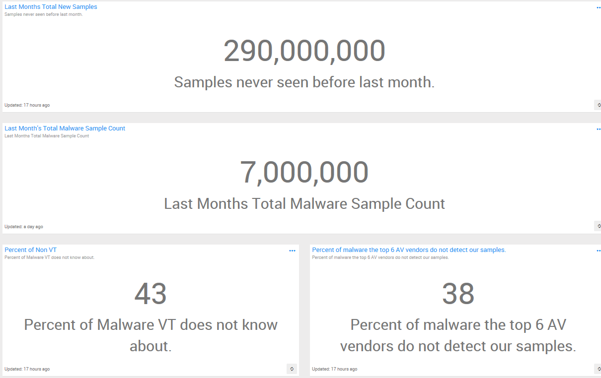
Threat landscape

Slide 10
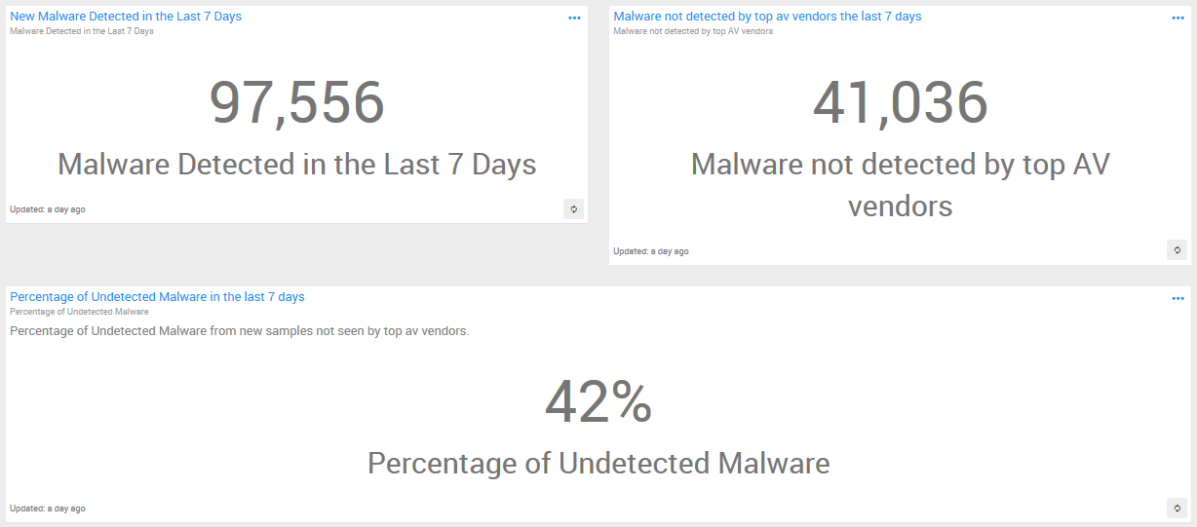
Threat landscape

Slide 11
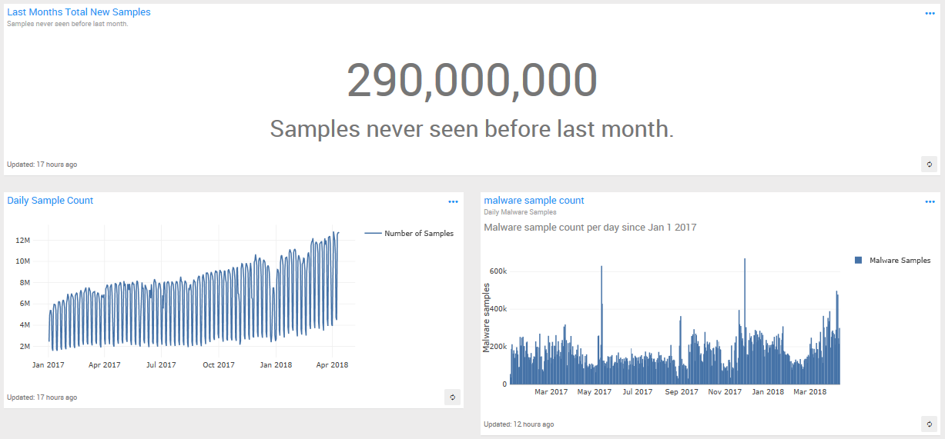
Threat landscape

Slide 12
THANK YOU

