Slide 1
Domain : Big Data Analytics in Finance
Group : 1 (PGP-DSE Online , Feb’22)
Team Members
1) Arpit Mathur
2) Ashish Ranjan
3) Komati Sai Rakesh
4) Pankul Agarwal
5) Vighnesh Jha
6) Vighnesh Nayak
Team Mentor
Mr Muppidi Srikar

Slide 2
Dataset Name : Credit Score Classification
Problem Statement:
Predicting Credit Score to classify segment of customers on basis of rating.
Brief Introduction :
To Minimize the manual efforts of Financial institutions for providing loans to their customers on the basis of their credit score and help them minimizing credit risk and hence number of defaulters.

Slide 3
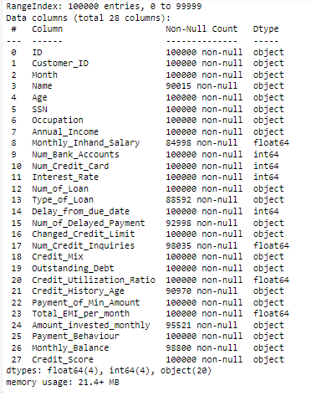
Initial Dtypes of Features in Dataset

Slide 4
Data Set Information
Dataset has 100000 instances (rows) and 28 attributes (columns).
Missing Values:
Feature_Name | Values | %Missing Values
Changed_Credit_limit | 2061 | 2.06%
Payment_of_min_amount | 11885 | 11.8%
Amount_invesnted_monthly | 8683 | 8.68%
Payment_Behaviour | 7511 | 7.5%
Monthy_ Balance | 1193 | 1.1%

Slide 5

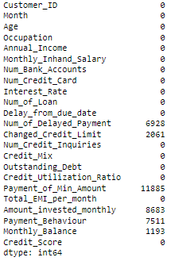
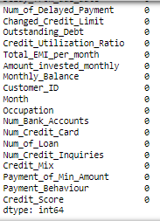
Data Pre-processing
Null Values Treatment and Imputation: Imputation via SimpleImputer
Before
After

Slide 6
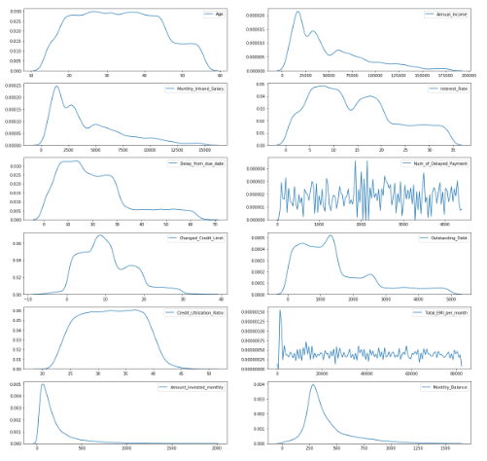
Uni-variate Analysis of Numerical Features: KDE Plot
Highly Right Skewed Features:
Annual Income, Monthly Inhand Salary, Annual Invested monthly, Monthly balance, Delay from due date and Outstanding debt Total EMI per month

Slide 7
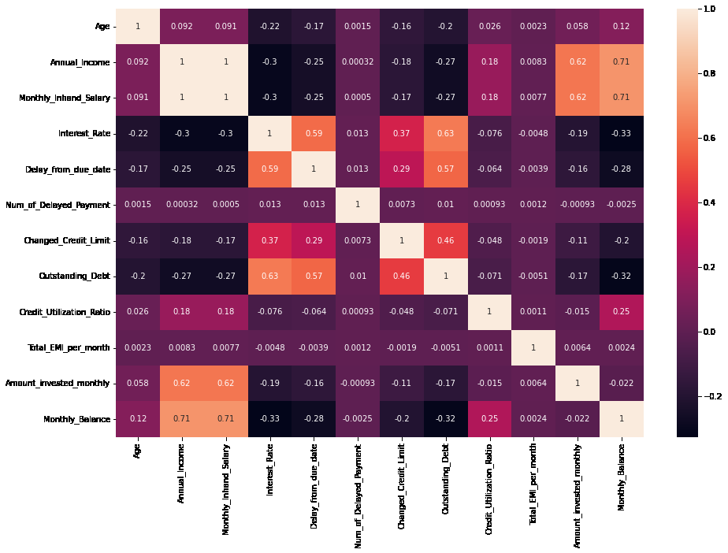
Bi- Variate Analysis
A correlation matrix is a table showing correlation coefficients between variables. Each cell in the table show correlation between two variables. Correlation Coefficient value of more than 0.5 and less than -0.5 are visualized in the Heat-Map. Annual Income and Monthly inhand salary variables are highly positively correlated.
After applying VIF we concluded to drop Monthly Inhand Salary and Monthly Balance.

Slide 8
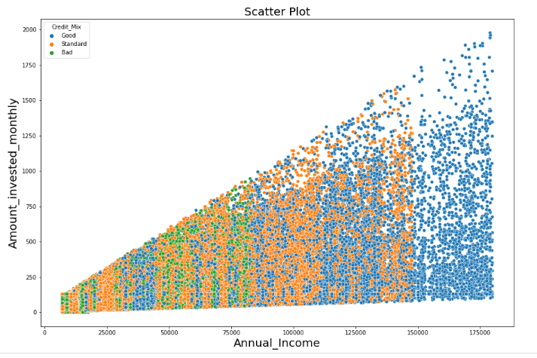
Multi- Variate Analysis
Inference :
Annual Income and Amount invested monthly shows a positive correlation. Here we can see that all the customer having annual income more than 150000 lie in Good category of credit mix.
The proportion of observations falling under “BAD” Credit_Mix category tends to have an annual income of <~ 80K units

Slide 9
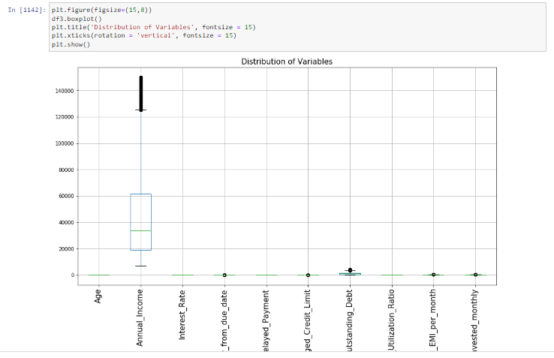
Outlier Detection

Slide 10
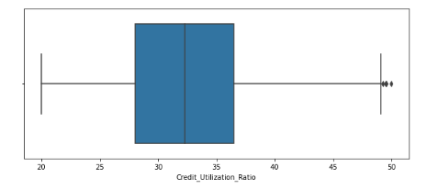
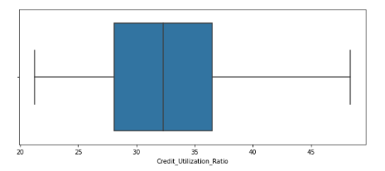
Outliers Treatment
Credit Utilization Ratio is observed with outliers hence dealt with IQR method
After treating the outliers

Slide 11
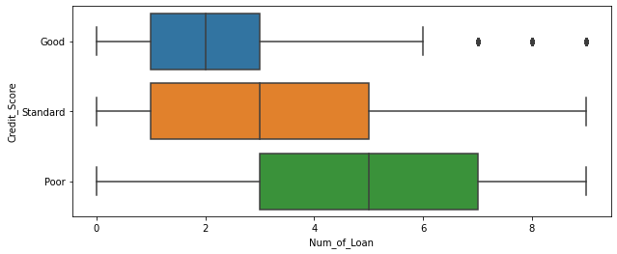
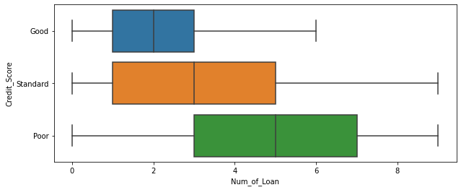
Outliers Treatment
In the above figure, we can see customers having number of loans >= 7 and having Credit score as good are shown as outliers
After treating the outliers

Slide 12
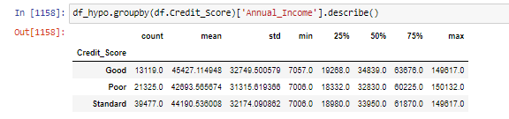
Hypothesis Testing
Does the annual income affects the credit_score of customer –(ANNOVA)
H0 : Credit Score is independent of annual income
H1 : Credit Score is dependent on annual income
Conclusion: From the Statistical Values we can see that
since p value (close to 0) <alpha(0.05) ---> reject H0
We can conclude that credit_score is dependent on Annual Income.

Slide 13
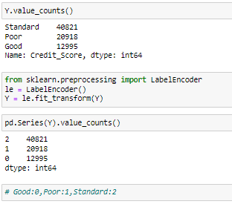
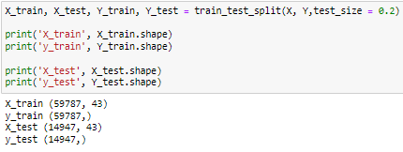
TTT & Target Label Encoding
Label Encoding Target
TTT with 80:20 split

Slide 14
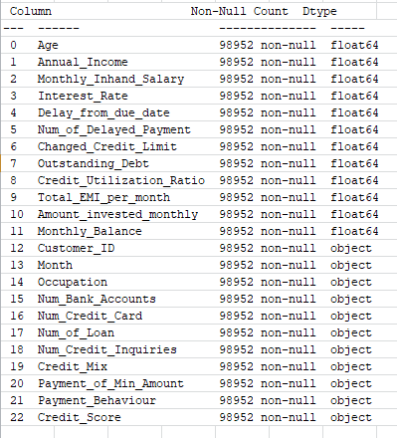
Final Dataset Variables and Dtypes after Preprocessing

Slide 15
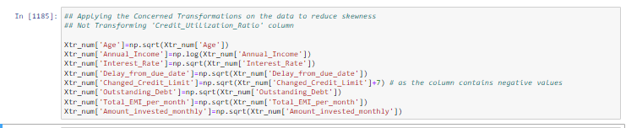
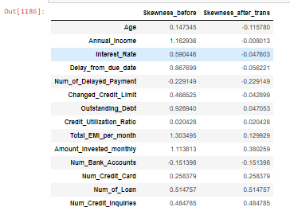
Transformation & Skewness

Slide 16
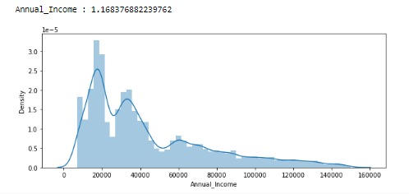
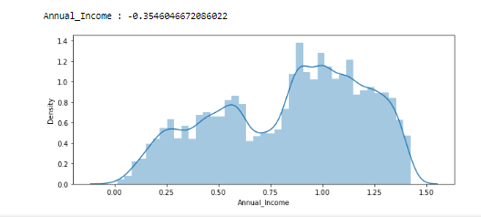
Transformation Techniques
Skewness before transformation of Annual Income is 1.168 hence applying log transformation
Skewness reduced to -0.35

Slide 17
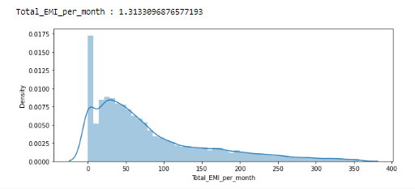
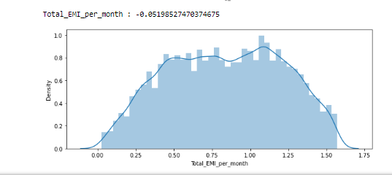
Transformation Techniques
Skewness before transformation of Total EMI per Month is 1.31 hence applying log transformation
Skewness reduced to -0.05

Slide 18
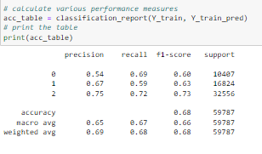
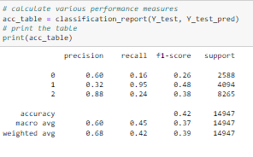
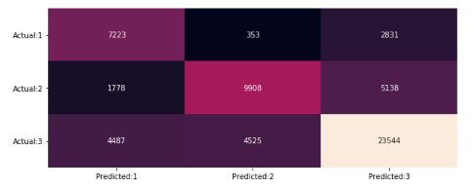
Multinomial Logistic Regression
As we are dealing with Multi Class Classification problem , hence used ‘multi-nomial logistic regression as baseline model.
Confusion Matrix

Slide 19
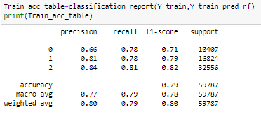
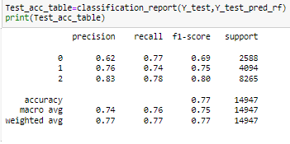
Random Forest Algorithm
Classification report is depicted as above and we are obtaining an accuracy of 0.79 on train data and 0.77 on test data.
Predictions needs to be more accurate and there is left a lot of scope for improvement.
As some parameters of Multinomial Logistic Regression gives ambiguity , trying to adapt to Random Forest Algorithm as it would fit and provide more substantial results.

Slide 20
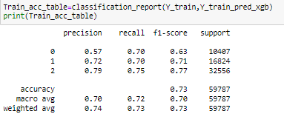
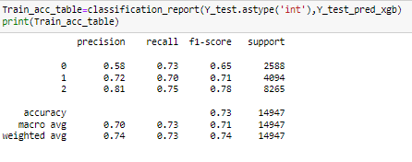
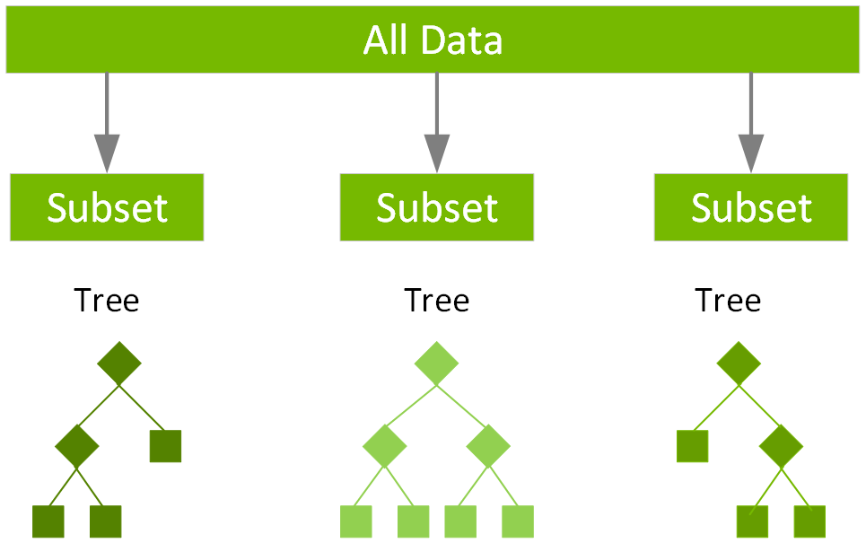
Xgboost Classifier
XGBoost, which stands for Extreme Gradient Boosting, is a scalable, distributed gradient-boosted decision tree (GBDT) machine learning library. It provides parallel tree boosting and is the leading machine learning library for regression, classification, and ranking problems.

Slide 21
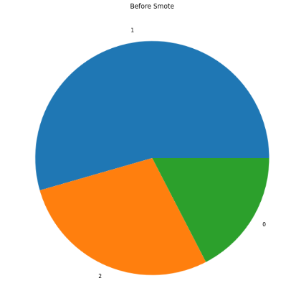
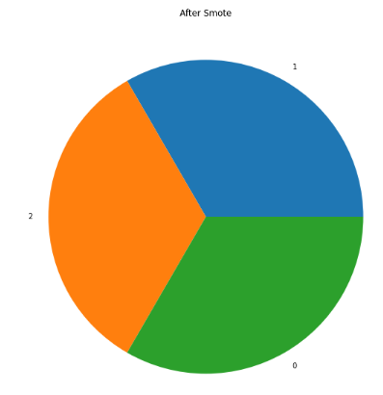
Class Imbalance
Detection of Imbalance
SMOTE treatment
0:Good
1:Poor
2:Standard

Slide 22
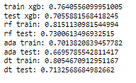
Scores of SMOTE considering models
After treating class imbalance,
The scores of different models are shown here

Slide 23
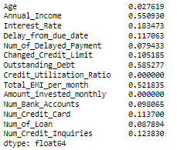

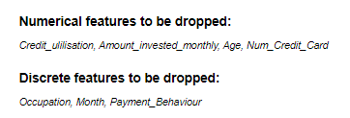
Feature Selection using Mutual_Info_Classifier
Mutual information between two random variables is a non-negative value, which measures the dependency between the variables. It is equal to zero if and only if two random variables are independent, and higher values mean higher dependency.
Observation
Conclusion:

Slide 24
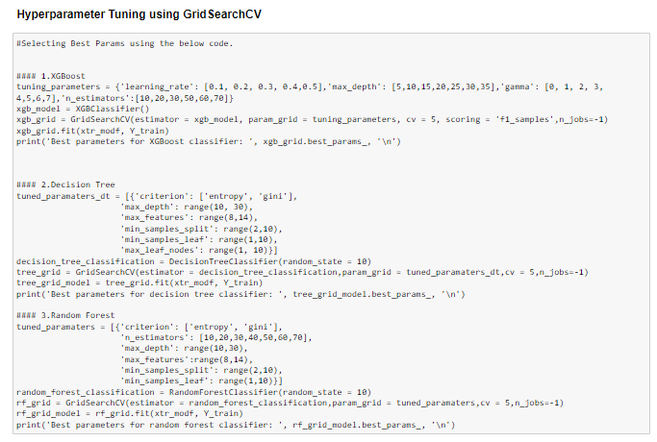
Hyper Parameter Tuning using GridSearchCV

Slide 25
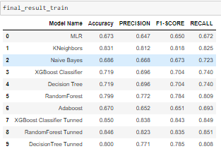
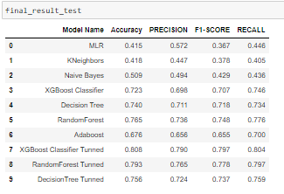
Results
Train Result
Test Result

Slide 26
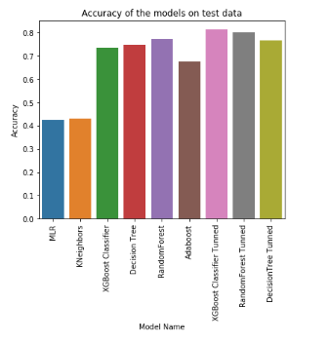
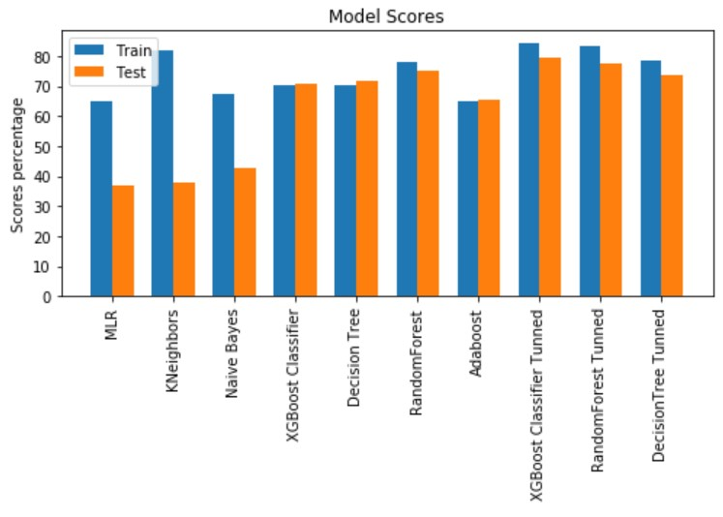
Evaluation Metrics of Models
Plot : Model Accuracies
F1 scores of Train & Test Models:

Slide 27

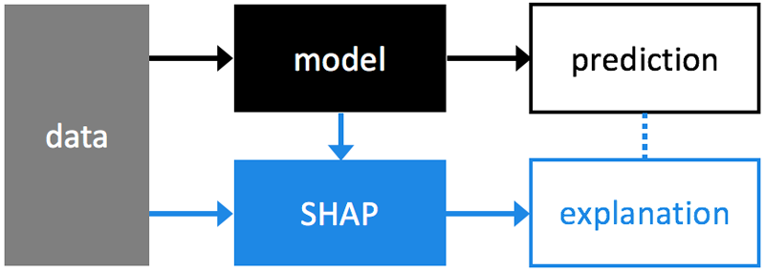
Model Explain ability Using SHAP
The key idea of SHAP is to calculate the Shapley values for each feature of the sample to be interpreted, where each Shapley value represents the impact that the feature to which it is associated, generates in the prediction

Slide 28
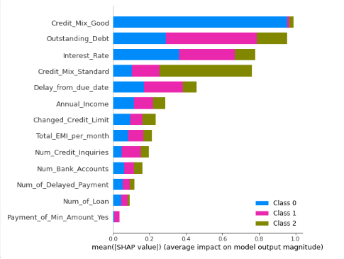
Conclusion Through SHAP
Plot depicts , how does an individual class label of target variable is utilizing a particular feature used in analysis

Slide 29
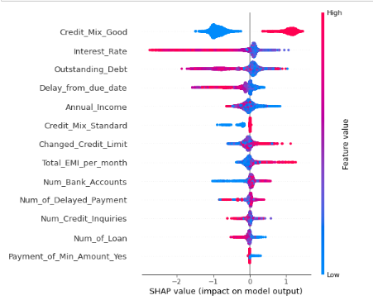
Summary Plot through SHAP
In the summary plot, we see first indications of the relationship between the value of a feature and the impact on the prediction. But to see the exact form of the relationship, we have to look at SHAP dependence plots.

Slide 30
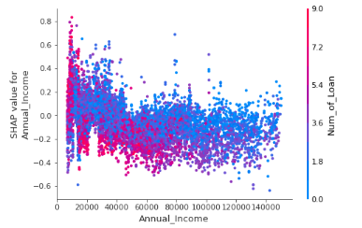
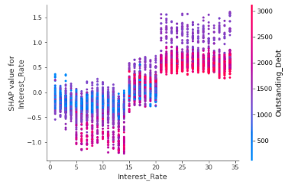
Dependence Plots for Poor and Good Class Labels
Good Class Label
Poor Class Label

Slide 31
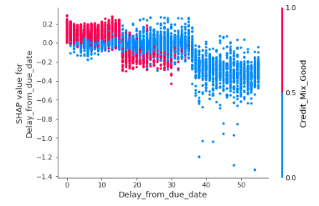
Dependence Plot for Standard Class Label
As we can observe from the plot , the plot shows progressive interaction effect b/w delay_from_due_date & Credit_Mix_Good.

Slide 32


Conclusions
KEY FEATURE : Despite being multi-class problem able to achieve good scores.
We have selected XGBOOST model as our final model because it shows best performance metrics among others.
Considering models after SMOTE gave us somewhat less appropriate results as compared to one with having class imbalance, hence our predictions are slightly biased towards STANDARD rating.
Also as per business case studies we came to conclusion that mostly firms to attract customer , didn’t let them to show in POOR category hence our model works best fit for industry.
Future Scope and development for this model’s upgradation can be closely examining the interaction effects being provided by explainibility libraries and implementing those interactions as new features , to turn prediction at next level Accuracy.
Train Metrics:
Test Metrics:

Slide 33


