Slide 1
Tutorial 01: Experimental Environments of Linux 0.11
ESTR 3102
Yang GUO
yangguo@cse.cuhk.edu.hk

Slide 2
Goal
Introduce the experimental method of using the PC simulation software to run the Linux 0.11 system on the real computer
Overview and installation of Bochs
Compilation environment of Linux 0.11 system
A demonstration

Slide 3
Experimental Platform & Package
Experimental Platform
XUbuntu
Please download the package from the blackboard and unzip it
bochs/ includes the executable files, the library and the configuration files
linux-0.11/ includes the source code of linux-0.11
gcc-3.4-ubuntu.tar.gz is the source code of gcc-3.4
Image is an image file generated by the compiled (toy) kernel
hdc-0.11.img is a filesystem image (not used today)
$ tar -zxvf oslab-package.tar.gz
$ cd oslab-package
$ ls

Slide 4
Bochs Overview
The best way to run a Linux 0.11 system is to use PC emulation software (virtualize or emulate an Intel x86 hardware environment)
VMware's VMware Workstation software
Oracle's VirtualBox open source software
Open source software Bochs (the pronunciation is the same as "box")
Bochs
Know the specific state and precise timing of the executed program in the simulated hardware environment

Slide 5
Setting up the Bochs System
To run an operating system in Bochs, we need at least:
Bochs executable files
BIOS (Basic Input/Output System) image files (commonly referred to as 'BIOS-bochs-latest’)
VGABIOS (Video Graphics Array) image files (eg 'VGABIOS-lgpl-latest')
At least one boot image file
Note: image - a serialized copy of the entire state of a computer system stored in some non-volatile form such as a file. A system is said to be capable of using system images if it can be shut down and later restored to exactly the same state

Slide 6
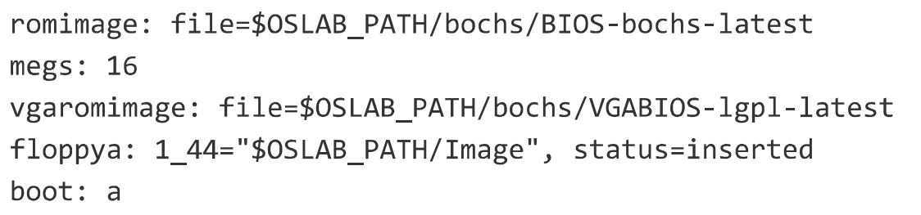
Run an OS in Bochs
Demo
*.bxrc configuration file of Bochs
$ bochs -f xx.bxrc
Boot image
An image file generated by the compiled kernel (it contains the code and data for the entire kernel, including the code for the boot sector)
1
2
3
4
5
Boot image
Notes:
The floppy disk that stores the bootable kernel image file is called the kernel boot disk. (bootimage); The floppy disk that holds the root file system is called the root file system image file (rootimage). Of course, we can also load the kernel image file from the floppy disk, and at the same time use the root file system in the hard disk, or let the system boot the system directly from the hard disk, that is, load the kernel image file from the root file system of the hard disk and use the root file system in the hard disk

Slide 7
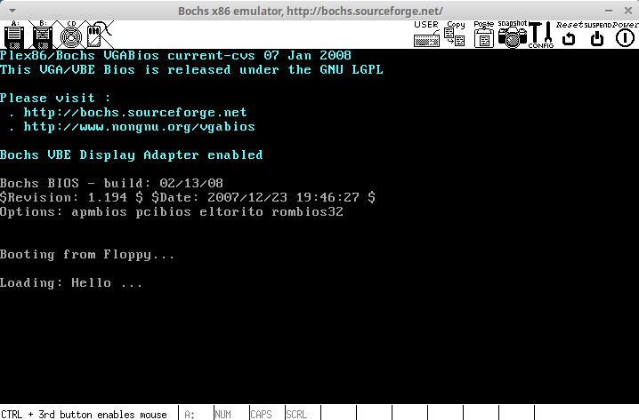
Run an OS in Bochs
Demo: a simple kernel that prints a sentence
Notes:
The floppy disk that stores the bootable kernel image file is called the kernel boot disk. (bootimage); The floppy disk that holds the root file system is called the root file system image file (rootimage). Of course, we can also load the kernel image file from the floppy disk, and at the same time use the root file system in the hard disk, or let the system boot the system directly from the hard disk, that is, load the kernel image file from the root file system of the hard disk and use the root file system in the hard disk

Slide 8
Generate a Boot Image by Ourselves
Generate a boot image by ourselves: a toy image that prints a sentence
Compilation environment
Use Linux 0.11 source code to generate a toy image

Slide 9

Compilation Environment
Compile Linux 0.11 code in XUbuntu
Install GCC-3.4
Other tools
$ tar -zxvf gcc-3.4-ubuntu.tar.gz
$ cd gcc-3.4
$ sudo ./inst.sh i386
$ sudo apt-get install build-essential bin86 manpages-dev

Slide 10
Use Linux 0.11 Source Code to Generate a Boot Image
The original source code of Linux 0.11 cannot be directly compiled in XUbuntu
A modified version of the Linux 0.11 kernel source code is used
Compile
Set the configuration of bochs (bochs/bochsrc.bxrc)
Run
$ cd linux-0.11/boot/
$ make
Demo
$ export OSLAB_PATH={the root path of the package}
$./bochs/bochs-gdb -f ./bochs/bochsrc.bxrc

Slide 11
References
A heavily commented linux kernel source code
Linux内核完全注释(修正版v3.0)
https://hoverwinter.gitbooks.io/hit-oslab-manual/content/environment.html

