Slide 1
CSCI 3150 Introduction to Operating Systems
LAB Three: Superblock – Define File system metadata
TA: CHEN Zizhan
chenzz@cse.cuhk.edu.hk

Slide 2
Goal
In the Project, you will be asked to implement some basic functions of a Simple File System.
These two labs (lab-3 & 4) are the pre-knowledges to help you understand the project.

Slide 3
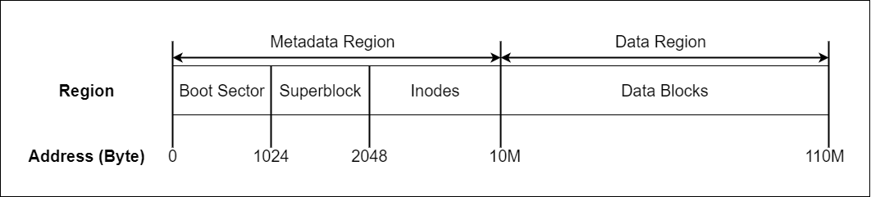
Background
File system can be divided into metadata region and data region.
Superblock is the first block in the metadata region, which describes the basic information of the file system.
Where the inodes and data block begins
Block size

Slide 4
Superblock structure
A typical superblock structure can be found below:
typedef struct _super_block_
{
int i_offset; /* the starting position of inode */
int d_offset; /* the starting position of data blocks */
int max_inode; /* the maximum number of inodes */
int max_data_blk; /* the maximum number of data blocks */
int next_available_inode; /* the index of next free inode */
int next_available_blk; /* the index of next free data block */
int blk_size; /* the size of data block */
};

Slide 5
Superblock parameters
Specifically, in SFS (the simplified file system in project):
the inode region starts at 2048 bytes (i_offset);
the data region starts at 10 MB (d_offset);
the block size is 4 KB (blk_size).

Slide 6
Superblock parameters
Some related parameters can be found below:
#define SB_OFFSET 1024 /* The offset of superblock region*/
#define I_OFFSET 2048 /* The offset of inode region */
#define D_OFFSET 10485760 /* The offset of data region */
#define MAX_INODE 100 /* The maximum number of inode */
#define MAX_DATA_BLK 25600 /* The maximum number of block */
#define BLK_SIZE 4096 /* The size per block */

Slide 7
Get the metadata of a file system
When we access a file system, the first step is reading the superblock region on the hard disk, load the superblock data into memory.
From superblock we get the basic information of the file system, and access the files base on these basic information.
Read a file
Open a file

Slide 8
Superblock.c -- A simple program to display the Superblock
A simple program (superblock.c) has been provided to display the superblock. There are several files in the zip file:
HD: It is used to simulate the hard disk. This “HD” file has been properly initialized based on the data structure defined by _super_block_ with the parameters above.
Superblock.h: It contains the structure of superblock and the parameters of the SFS.
Superblock.c: The C program with functions to read the superblock.
Superblock-test.c: It contains two cases which show the superblock region on the hard disk and its information, respectively.

Slide 9
Compile and Run
Copy the HD, superblock.c, superblock-test.c, and superblock.h to your current directory.
Compile the superblock-test.c as below:
gcc -o superblock-test superblock-test.c superblock.c
Then you can run the test program by:
./superblock-test ./HD

Slide 10
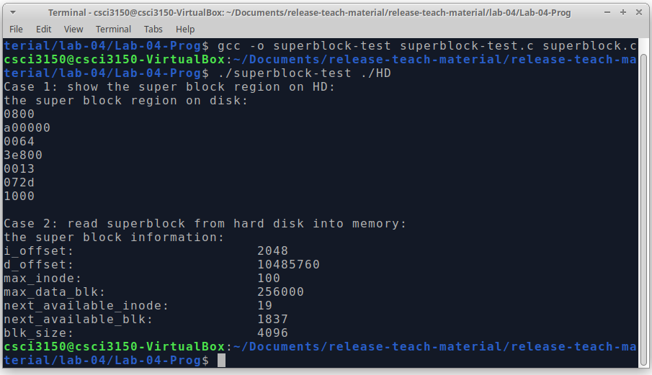
Result
You can find two test cases shown like the figure below:

Slide 11
Implementation
In superblock.c program, there is one main function:
read_sb(): read the superblock region into memory and form an entity of super block structure, then return the link of this entity.
For more detailed implementation, please read the superblock.c program.

