Slide 1
CSCI 3150 Introduction to Operating Systems
Lab Four: Inode – Define the metadata of files
TA: CHEN Zizhan
chenzz@cse.cuhk.edu.hk

Slide 2
Goal
In the Project, you will be asked to implement some basic functions of a Simplified File System.
These two labs (lab-3 & 4) are the pre-knowledges to help you understand the project.

Slide 3
Background
Each file has one inode and inode describes the metadata of the file:
File type (regular file or directory);
File size;
How many data blocks the file occupies;
The indexes of those data blocks.
Once we obtain an inode, we can get all the data blocks of a specific file. Read the bytes in these data blocks then we get the content of the file.

Slide 4
Inode structure
A typical inode structure can be found below:
typedef struct _inode_ /* The structure of inode, each file has only one inode */
{
int i_number; /* The inode number */
time_t c_time; /* Creation time of the file*/
int f_type; /* 0 for regular file, 1 for directory file*/
int f_size; /* The size of the file (bytes)*/
int blk_num; /* The number of data blocks occupied by this file*/
int direct_blk[2]; /*Two direct data block pointers */
int indirect_blk; /*One indirect data block pointer */
int f_num; /* Number of files under a directory (0 for regular file)*/
} inode;

Slide 5
Directory mapping
In file system, ordinary file and directory are both described by inodes.
It is easy to imagine how a regular file is stored in the file system:
First it has inode, which contains metadata;
Then it has data blocks, the pointers are stored in the inode.
How about directory?
Directory is a special type of file;
Directory also has inode and data blocks.
The only difference is that the data blocks do not store user data, instead they store a list of special data structure called dir_mapping, which is the mapping of file name and inode number.

Slide 6
Dir_mapping structure
A typical structure can be found below:
typedef struct dir_mapping /* Record file information in directory file */
{
char dir_name[20]; /* The file name in current directory */
int i_number; /* The corresponding inode number */
} DIR_NODE;

Slide 7
Look for a file under directory
When we look for a specific file under a directory, actually we are traversing these dir_mappings one by one, comparing the dir_name with the file name.
Once the dir equals the file name, the corresponding i_number will be returned.

Slide 8
A simple inode.c Program
We provide a simple program to show the structure of inode and how to use it.
There are five files under the “code” directory:
HD: It is the hard disk simulation file.
superblock.h: It contains the structure of superblock and the parameters of SFS.
inode.h: It contains the structure of inode and the structure of dir_mapping.
inode.c: It contains the basic read function about inode. There are also print functions to show inode information and inode region on hard disk. print_dir_mappings will show the dir_mappings under a specific directory.
inode-test.c: It contains two test cases. The first case is about how to show the inode information and the inode region on the hard disk file. The second case is about how to show all the dir_mappings under the root directory.

Slide 9
Compile and Run
Compile the inode-test.c with inode.c:
gcc -o inode-test inode-test.c inode.c
and run the command below:
./inode-test ./HD

Slide 10
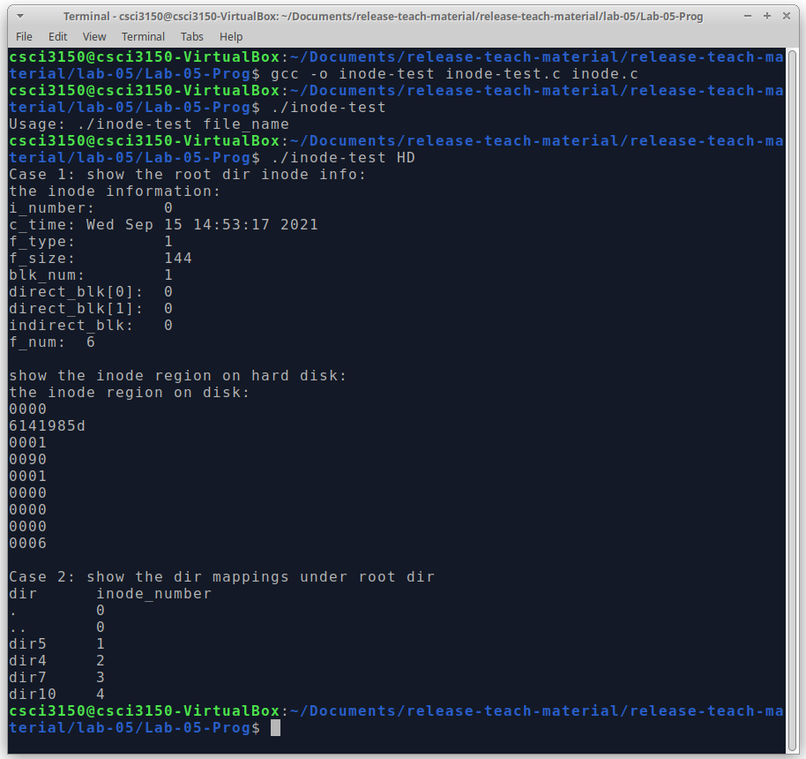
Result
You will see several examples on your screen:

Slide 11
Implementation
The core functions of inode.c are listed below (they should be useful for the project and can be used):
read_inode(): initiate an inode structure pointer and read an inode from HD.
print_dir_mappings(): first read the inode corresponding to current i_number. Then initiate a DIR_NODE type pointer p_block, which will point to the entry list. Read the block into memory according to the direct_blk[0] of inode (SFS only support 100 inodes, 100 * sizeof(DIR_NODE) < 4096, thus only direct_blk[0] will be used ), whose pointer is p_block. Then iterate through the entry list and print out all the entries.
More detailed implementation can be found in inode.c and inode-test.c.

