Slide 1
Tutorial 02: Simulate FIFO Scheduling
CSCI3150 - Introduction to operating system
Tutor: Zhang Kai
kzhang@cse.cuhk.edu.hk

Slide 2
Goal
1. Understand basic data structure: queue, and know well about the properties.
2. Practice to simulate FIFO Scheduling with queue.

Slide 3
Outlines
1. Queue
Concept & Property
Implementation
2. Simulate FIFO Scheduling
Data Structure
Input files
Program Structure

Slide 4
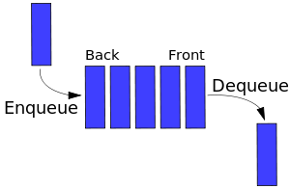
Queue - Concept & Property
Concept:
A Queue is a linear collection in which the entities in the collection are kept in order and there are only two operations on the collection:
Enqueue: addition of elements to the rear terminal position;
Dequeue: removal of elements from the front terminal positon.
Property:
Queue is a kind of FIFO (First-In-First-Out) data structure, which means the first element added to the queue will be the first one to be removed.
(Representation of a FIFO queue)

Slide 5
Queue - Implementation (queue.h & queue.c)
We will use the Linked List we provide to implement Queue. At first, we need to include Linked List head file linkedlist.h.
Also, we will rename the node structure to LinkedQueue.
With the Linked List structure, the representation is like this:
#include "linkedlist.h”
typedef LinkedList LinkedQueue;
head
a₁
a₂
a₃
NULL
Tail
Head

Slide 6
Queue - Implementation
For Queue, we will also have several functions to be implemented:
LinkedQueue* InitQueue();
int IsEmptyQueue(LinkedQueue* LQueue);
LinkedQueue* EnQueue(LinkedQueue* LQueue, Eletype value);
Eletype DeQueue(LinkedQueue* LQueue);
Eletype FrontQueue(LinkedQueue* LQueue);

Slide 7
Queue - Implementation
At first, we need to initialize a queue:
In this function, Create() is implemented in linkedlist.h, and we just return an empty LinkedList as an empty Queue.
Then, it is also important to know whether a Queue is empty:
We also directly call function IsEmpty(LQueue) from linkedlist.h.
LinkedQueue* InitQueue(){
return Create();
}
int IsEmptyQueue(LinkedQueue* LQueue){
return IsEmpty(LQueue);
}

Slide 8
Queue - Implementation
LinkedList* AddHead(LinkedList* Llist, Eletype value){
LinkedList* node = (LinkedList*)malloc(sizeof(LinkedList));
node -> num = value;
node -> next = Llist -> next;
Llist -> next = node;
return Llist;
}
Next, we need to implement the most important functions, EnQueue, DeQueue and FrontQueue.
(Enqueue new element b.)
Because Queue is a FIFO data structure, when new element in, we put data at the Tail.
head
a₃
a₂
a₁
NULL
Tail
Head
b
LinkedQueue* EnQueue(LinkedQueue* LQueue, Eletype value){
return AddHead(LQueue, value);
}

Slide 9
Queue - Implementation
Eletype DeQueue(LinkedQueue* LQueue){
if (IsEmpty(LQueue)){
printf("Delete Error! Empty!");
return -1;
}else{
LinkedQueue* pt = LQueue;
Node tmp;
while (pt->next){
if (pt->next->next == NULL){
tmp = pt->next;
pt->next = NULL;
break;
}
pt = pt->next;
}
return tmp->num;
}
}
Next, we need to implement the most important functions, EnQueue, DeQueue and FrontQueue.
(Dequeue operation will remove the element at the head of Queue.)
DeQueue will return the value of removed element.
head
a₃
a₂
a₁
NULL
Tail
Head

Slide 10
Queue - Implementation
Then, we need a function to get the value of the element at the head of Queue:
Eletype FrontQueue(LinkedQueue* LQueue){
if (IsEmpty(LQueue)){
printf("Error! Empty!");
return -1;
}else{
LinkedQueue* pt = LQueue;
Node tmp;
while (pt->next){
if (pt->next->next == NULL){
tmp = pt->next;
break;
}
pt = pt->next;
}
return tmp->num;
}
}

Slide 11
Simulate FIFO Scheduling
Download and copy tutorial-02.zip in your current directory and then unzip files as follows:
unzip ./tutorial-02.zip
In this zip, there will be 2 .h header files, 3 .c code file, process.file, queue.cfg and a Makefile. These files respectively are implemented linked list (linkedlist.h & linkedlist.c), implemented queue (queue.h & queue.c), Simulation C file (csci3150_tut2.c), process input file (process.file) and queue configuration file (queue.cfg).

Slide 12
Data Structure
1. One process has several metrics, including pid, arrival time, service time, execution time, waiting time turnaround time and completion time. The structure of process is shown as follows:
typedef struct process {
int process_id;
int arrival_time;
int service_time;
int execution_time;
int waiting_time;
int turnaround_time;
int completion_time;
} Process;

Slide 13
Data Structure
2. For the Queue we will use, the element we stored should be Process. Just as the following code shows:
typedef struct node {
Process proc;
struct node *next;
int allotment_time;
int time_slice;
} LinkedList, *Node;
typedef LinkedList LinkedQueue;

Slide 14
Input files
1. process.file contains the process information and its format is as follows:
ProcessNum N
pid:X1, arrival_time:X11, execution_time:X12
pid:X2, arrival_time:X21, execution_time:X22
…
pid:XN, arrival_time:XN1, execution_time:XN2

Slide 15
Input files
1. process.file example:
ProcessNum 10
pidnum:2, arrival_time:10, execution_time:10
pidnum:1, arrival_time:10, execution_time:10
pidnum:3, arrival_time:10, execution_time:10
pidnum:4, arrival_time:1, execution_time:11
pidnum:0, arrival_time:100, execution_time:10
pidnum:5, arrival_time:70, execution_time:30
pidnum:6, arrival_time:30, execution_time:46
pidnum:7, arrival_time:120, execution_time:15
pidnum:8, arrival_time:130, execution_time:19
pidnum:9, arrival_time:163, execution_time:20

Slide 16
Input files
2. queue.cfg contains the queue information and in this lab, we use only one queue, the example is given below:
Here, the first line denotes the number of queues we will use in this scheduler, the next line denotes the time slice for Queue 1.
QueueNum 1
Time_Slice_Q1 10

Slide 17
Program Structure (csci3150_tut2.c)
int main(){ int proc_num = ReadProcessFile();
Process proc[proc_num]; for (int i = 0;i < proc_num; i++){
proc[i].process_id = proc_tmp[i].process_id;
proc[i].arrival_time = proc_tmp[i].arrival_time;
proc[i].execution_time = proc_tmp[i].execution_time;
}
SortProcess(proc, proc_num); int queue_num = GetQueueNum(); LinkedQueue** ProcessQueue = (LinkedQueue**)malloc (sizeof(LinkedQueue*) * queue_num);
ReadQueueCfg(ProcessQueue, queue_num);
Calculate(proc, proc_num);
InitOutputFile();
Schedule(proc, ProcessQueue, proc_num);
return 0;
}
Notes:
At first, call function ReadProcessFile() to parse process.file and store process information into Global Variable Process* proc_tmp. Then, we store process information
into Local Variable process array proc[] by using a for loop. Next, use SortProcess(proc, proc_num) to sort processes according to their arrival time and pid.
Then, queue_num and GetQueueNum() are used to get queue number in queue.cfg. ProcessQueue will initialize first and store queue information by calling ReadQueueCfg(ProcessQueue, queue_num).
At last, we call Calculate(proc, proc_num) and Schedule(proc, ProcessQueue, proc_num) to finish the whole simulation procedure.

Slide 18
Program Structure - Part 1
The first part is to deal with the input files.
To deal with process.file and queue.cfg, we have these Global variable and functions.
Process* proc_tmp;
int ReadProcessFile();
int min(int x, int y);
Process MinProc(Process x, Process y);
void SortedProcess(Process* p, int num);
int GetQueueNum();
void ReadQueueCfg(LinkedQueue** LQueue, int num);

Slide 19
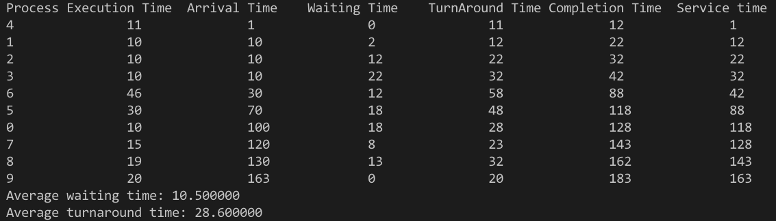
Program Structure - Part 2
The second part is to calculate the waiting time, service time, turnaround time and completion time for every process we get in the first part.
In this function, we will calculate waiting time, turnaround time and completion time for every process we get in first part. For our given process.file example, this function will output like this:
void Calculate(Process* proc, int n);

Slide 20
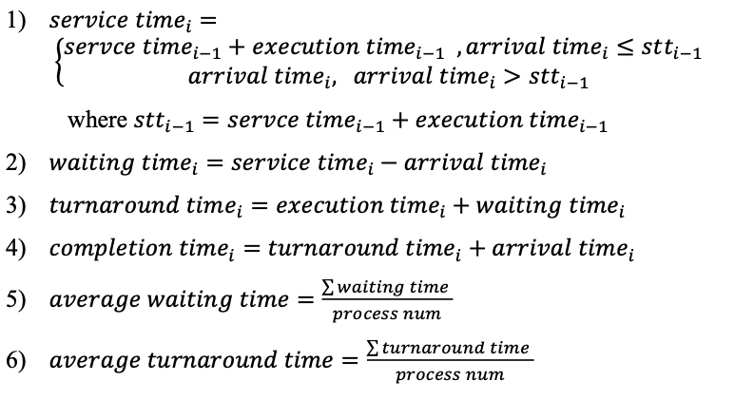
Program Structure - Part 2
For an process, the service time means the time when the process begins to run. We have:

Slide 21
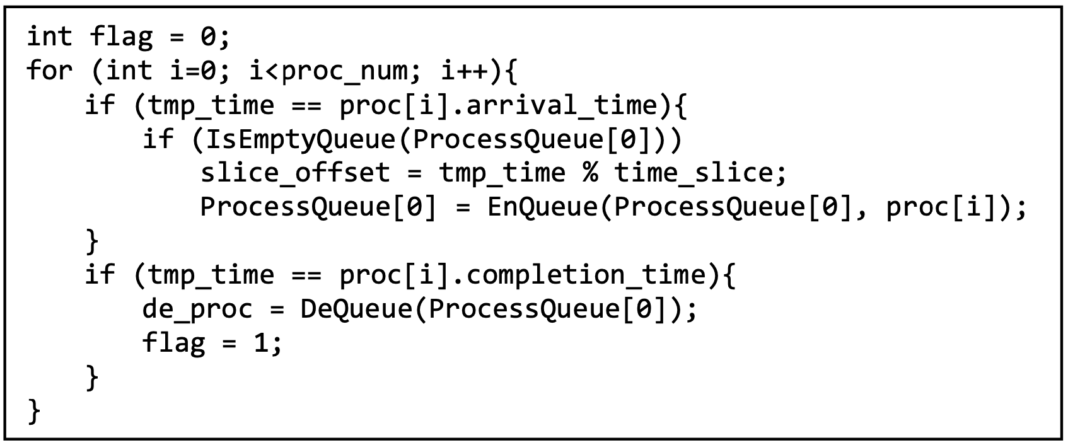
Program Structure - Part 3
The third part is to use the queue and processes we get before to simulate FIFO scheduling.
In this function, we can use a while loop to represent time. In every loop the process array proc[] will be travelled and if it is the time for some processes to arrive or to complete, we will do EnQueue and DeQueue operation respectively.
void schedule(Process* proc, LinkedQueue* ProcessQueue, int proc_num);

Slide 22
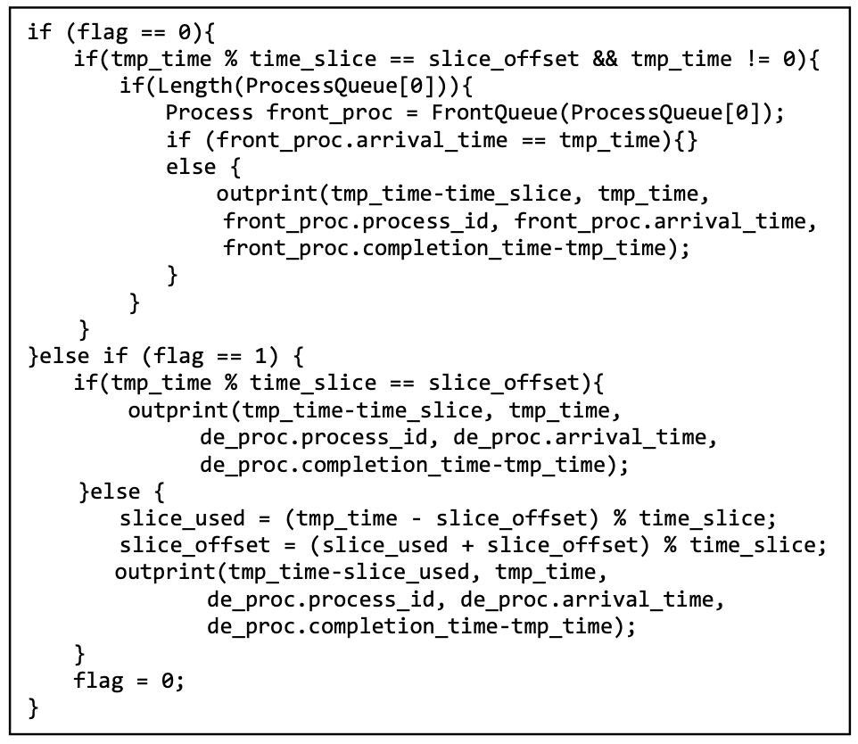
Program Structure - Part 3
For every past time slice, we will output a line. If some process finishes without using up one time slice, we will just output the information of this time slot.
There are 3 situations we need to output:
1) Just use up the time of one time slice and no process finishes, output current process’s information;
2) Finish one process and use up the time of one time slice at the same time, output finished process’s information.
3) Finish one process without using up the time of one time slice, we need to calculate how much time are used during this time slice (slice_used) and the offset in one time slice (slice_offset). Then just output finished process’s information, the time slot should be tmp_time-slice_used to tmp_time, where tmp_time is the time.

Slide 23
Output format and function call
The program will output the schedule result to the file output.log. The format in output.log is as follows:
Time_slot:x-y, pid:x1, arrival-time:x2, remaining_time:x3
Time_slot: x-y denotes the time interval starting at time x and end at time y with the smallest time slice among all queues;
pid:x1 denotes the corresponding process with pid x1 is scheduled in this time interval;
arrival-time:x2 and remaining_time:x3 denote the arrival time and remaining time of the process are x2 and x3, respectively.
There is at least one space character between them.

Slide 24
Output format and function call
We have two functions to do this work:
In this function, we initialize the file output.log. If this file already exists, we will clear it;
if it does not exist, make a new file named output.log.
The parameters of this function are respectively x, y, x1, x2 and x3 we mentioned before. It will output a formatted line into output.log.
void InitOutputFile();
void outprint(int time_x, int time_y, int pid, int arrival_time, int remaining_time);

Slide 25
Compile and run
You can compile and run your code in this way after unzip tutorial-02.zip:
Then you can find output like this in terminal:
make
./FIFOScheduler

Slide 26
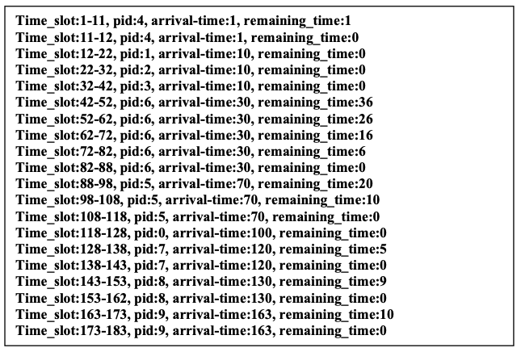
Compile and run
In output.log, you should find:

Slide 27
Q & A
You do not need to submit anything for this tutorial. This is just a tutorial for you to know how to simulate FIFO Scheduling, and it will be helpful if you want to finish the Bonus Assignment 3.
Any questions?

