Slide 1
Beijing University of Posts and Telecommunications
北京邮电大学
CONTROL BOARD FOR CNC SYSTEMS BASED IN LINUX
Author: Rodolfo Boris Oporto Quisbert
Final Project

Slide 2
Contents
1 Introduction
2 Background and technologies
3 Design and implementation
4 Results
5 Conclusions and future work

Slide 3
1 Introduction
Project motivation
  Try to make a fully functional control board for CNC systems.
    In the last years, this systems have attracted the attention of many groups, interested especially in 3D printers.
  Research about Open Source solutions a its characteristics.
    Raspberry-Pi, LinuxCNC, Xenomai, RepRap, Raspbian.

Slide 4
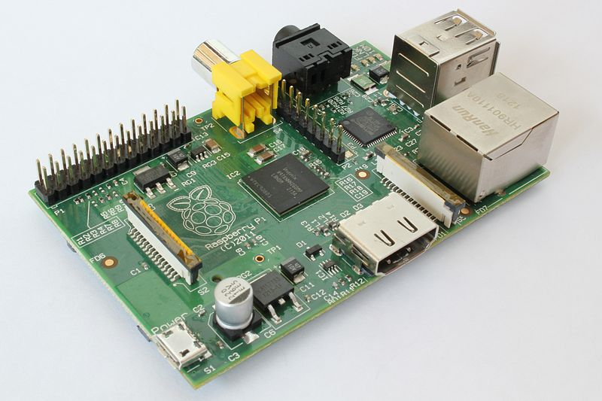
2 Background
Raspberry Pi
  Raspberry-Pi is a low cost fully-functional computer, based in BCM2835 SoC from Broadcom.
  This board was developed to be used as part of an educational program in UK.

Slide 5
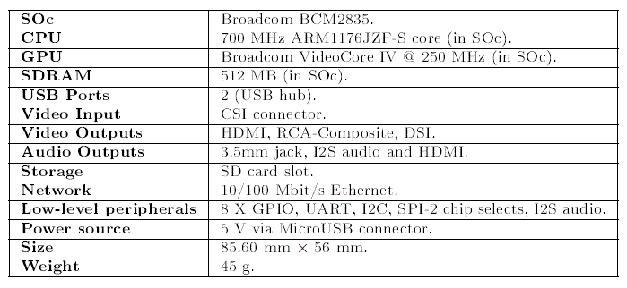
2 Background
Raspberry Pi
  Low cost (~300RMB)
  Huge community.
    Support.
    Docummentation.
      Blogs, papers, internet forums, books.

Slide 6
2 Background
Real time under Linux
  PREEMPT_RT patch
    Preemption: Preemption is the interruption of a computer process without its cooperation
    How does it work?
      Making in-kernel locking-primitives.
      Critical sections protected.
      Implementing priority.

Slide 7
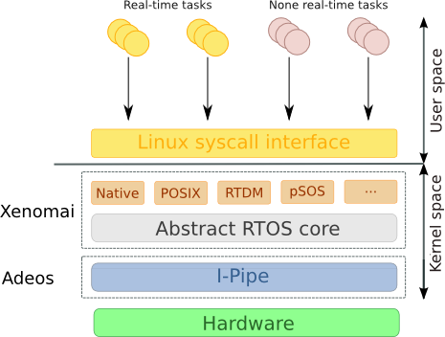
2 Background
Real time under Linux
  Xenomai
    Xenomai is a real-time development framework cooperating with the Linux kernel.
    API skins: native, POXIS, RTDM, pSOS
    Two spaces
      Kernel space: Hard real-time applications
      User space: Real-time applications

Slide 8
2 Background
Real time under Linux
  Why Xenomai?
    Xenomai has a well documented API with different skins.
      Examples, internet forums, API html documentation.
    There is experiences with Xenomai running in Raspberry-Pi and LinuxCNC.
    Official Xenomai patch for Raspberry-Pi.

Slide 9
2 Background
LinuxCNC
  Software collection for CNC machines. Former know as EMC.
  Hardware Abstraction Layer
    LinuxCNC use software components know as Hardware Abstraction Layer (HAL)
    The developer can abstract from the details inside these blocks and use it like Symulink block.

Slide 10
2 Background
LinuxCNC
  Hardware Abstraction Layer
    Some very important HAL components
      RT Threads: hard real time thread which can be used to perform HAL functions at specific time
      Stepgen: This component allow to control stepper-motors, generating all the signals required.
      PID: This component implements a PID control block.
      PWMgen: This component generate a PWM signal.

Slide 11
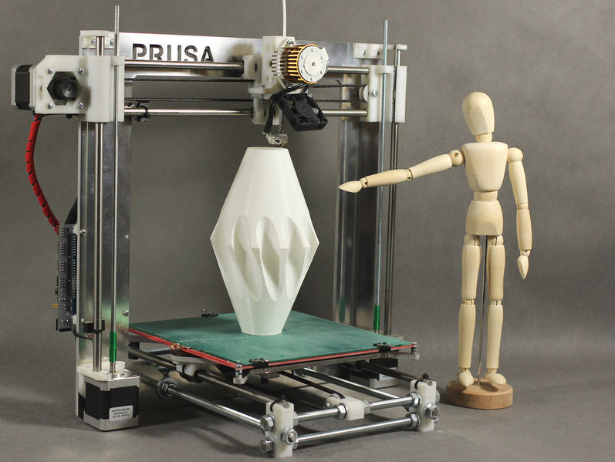
2 Background
RepRap - 3D printer
  RepRap is an Open Source project which starts in 2005, in the University of Bath, in UK by Adrian Bowyer. The aim of RepRap project was to create a 3D printer cheaper than the commercial ones, and the most important, a self-replicant 3D printer.

Slide 12
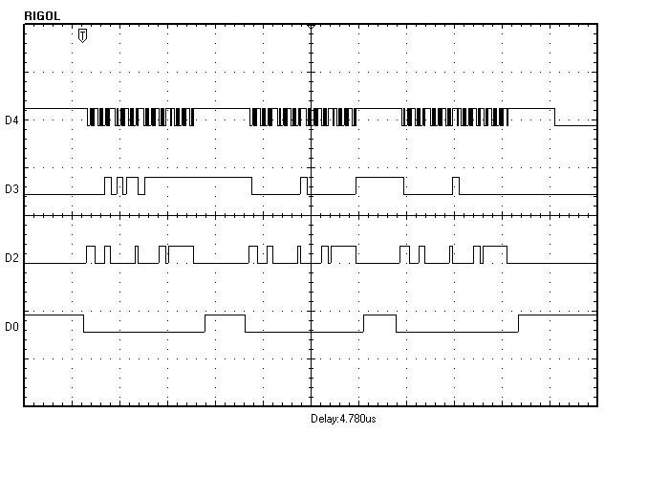
3 Design and implementation
Board description
  ADC: The core of the ADC system is the ADS8556 from Texas Instruments. This device has six channels, 16 bit's resolution, fully bipolar inputs, with serial or parallel communication. This device use SAR as conversion method. And the communication is through SPI.

Slide 13
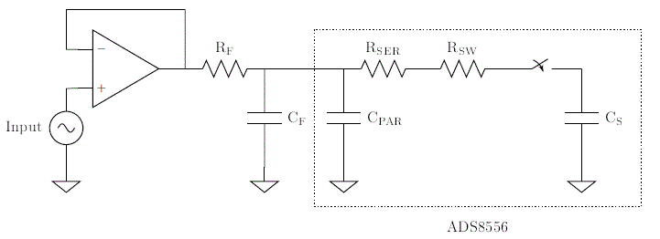
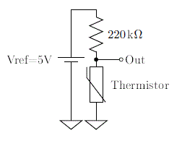
3 Design and implementation
Board description
  ADC
    Sample and hold subcircuit.
    Voltage reference for resistive transductors

Slide 14
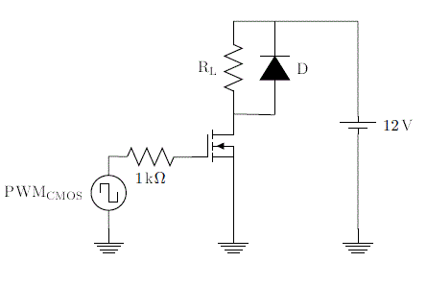
3 Design and implementation
Board description
  PWM: In this work was required N-MOSFET IRF630B to supply enough energy to components such as heaters and servomotors.

Slide 15
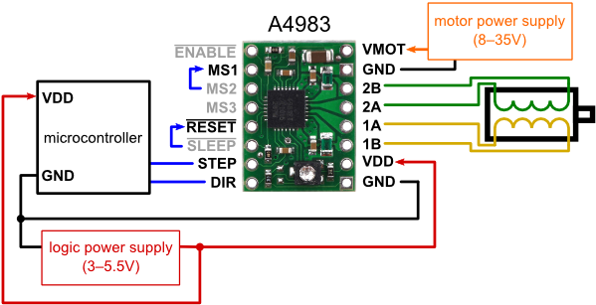
3 Design and implementation
Board description
  Steppers drivers: To control the stepper-motors, we use the A4983. A4983 is an integrated driver that just require the STEP and DIR signals.

Slide 16
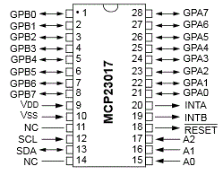
3 Design and implementation
Board description
  MCP23S17 from Microchip.
    16 bidirectional I/O.
    Control by interruption.
    SPI communication.

Slide 17
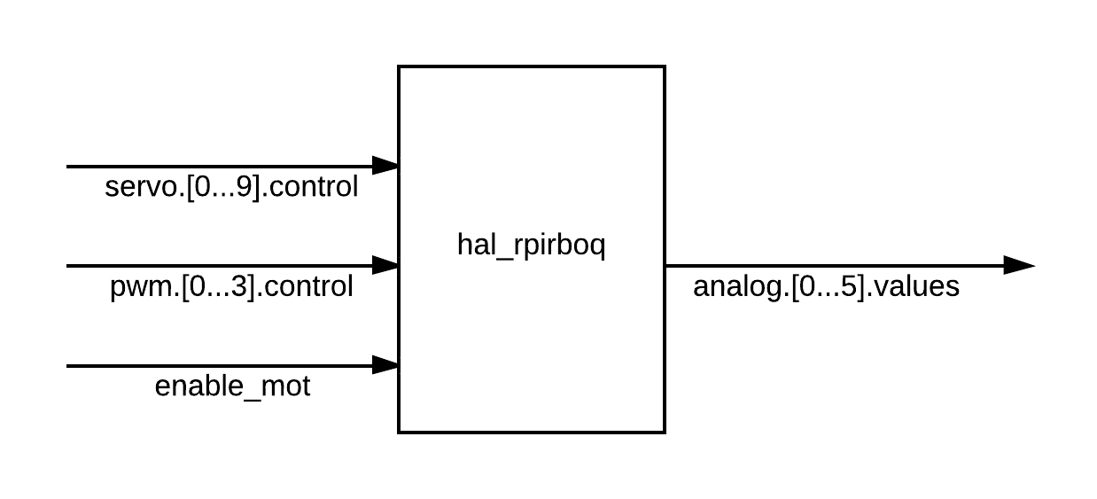
3 Design and implementation
HAL Driver
  HAL is the highest level of a component in LinuxCNC. It means that any complex system is composed by several HAL blocks.
  In this work was implemented a HAL component that controls the board.

Slide 18

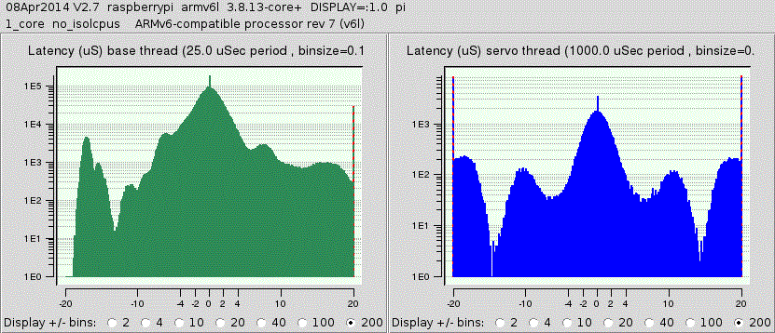
4 Results
Latency test
  This test start two real-time threads and perform testing real-time functions.
  The user interface present the average of latency in both, and the most important the maximum jitter value that can be interpreted as the minimum period that can be used to execute real-time functions.

Slide 19
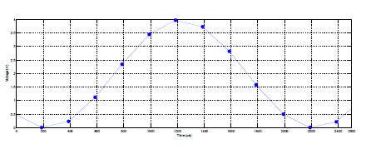
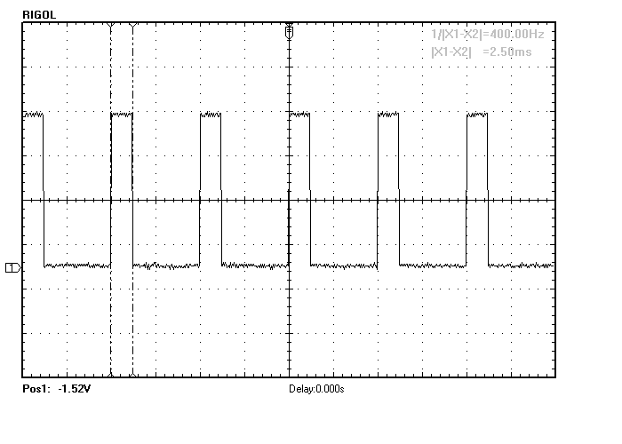
4 Results
Board tests
  ADC test
    samples_cvs.c
  PWM test
    pwm_test in LinuxCNC

Slide 20
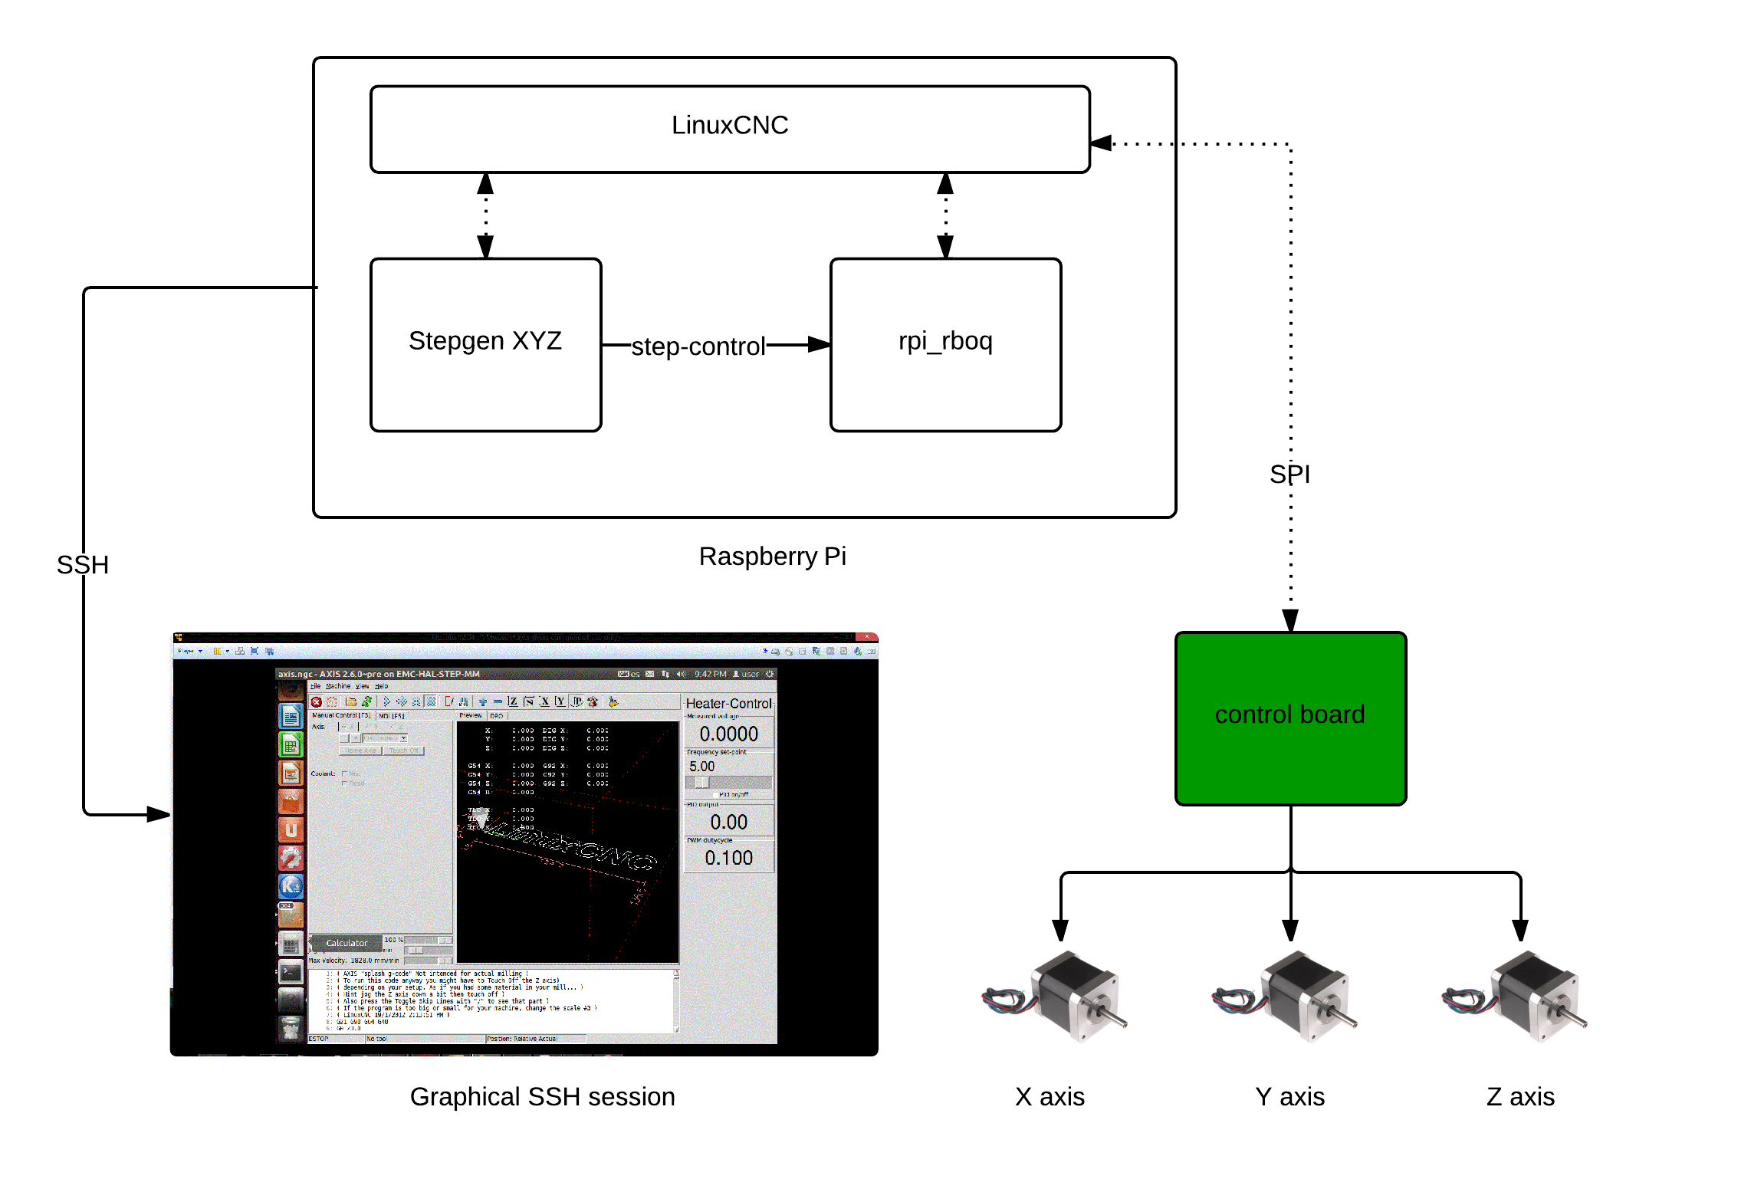
4 Results

Slide 21
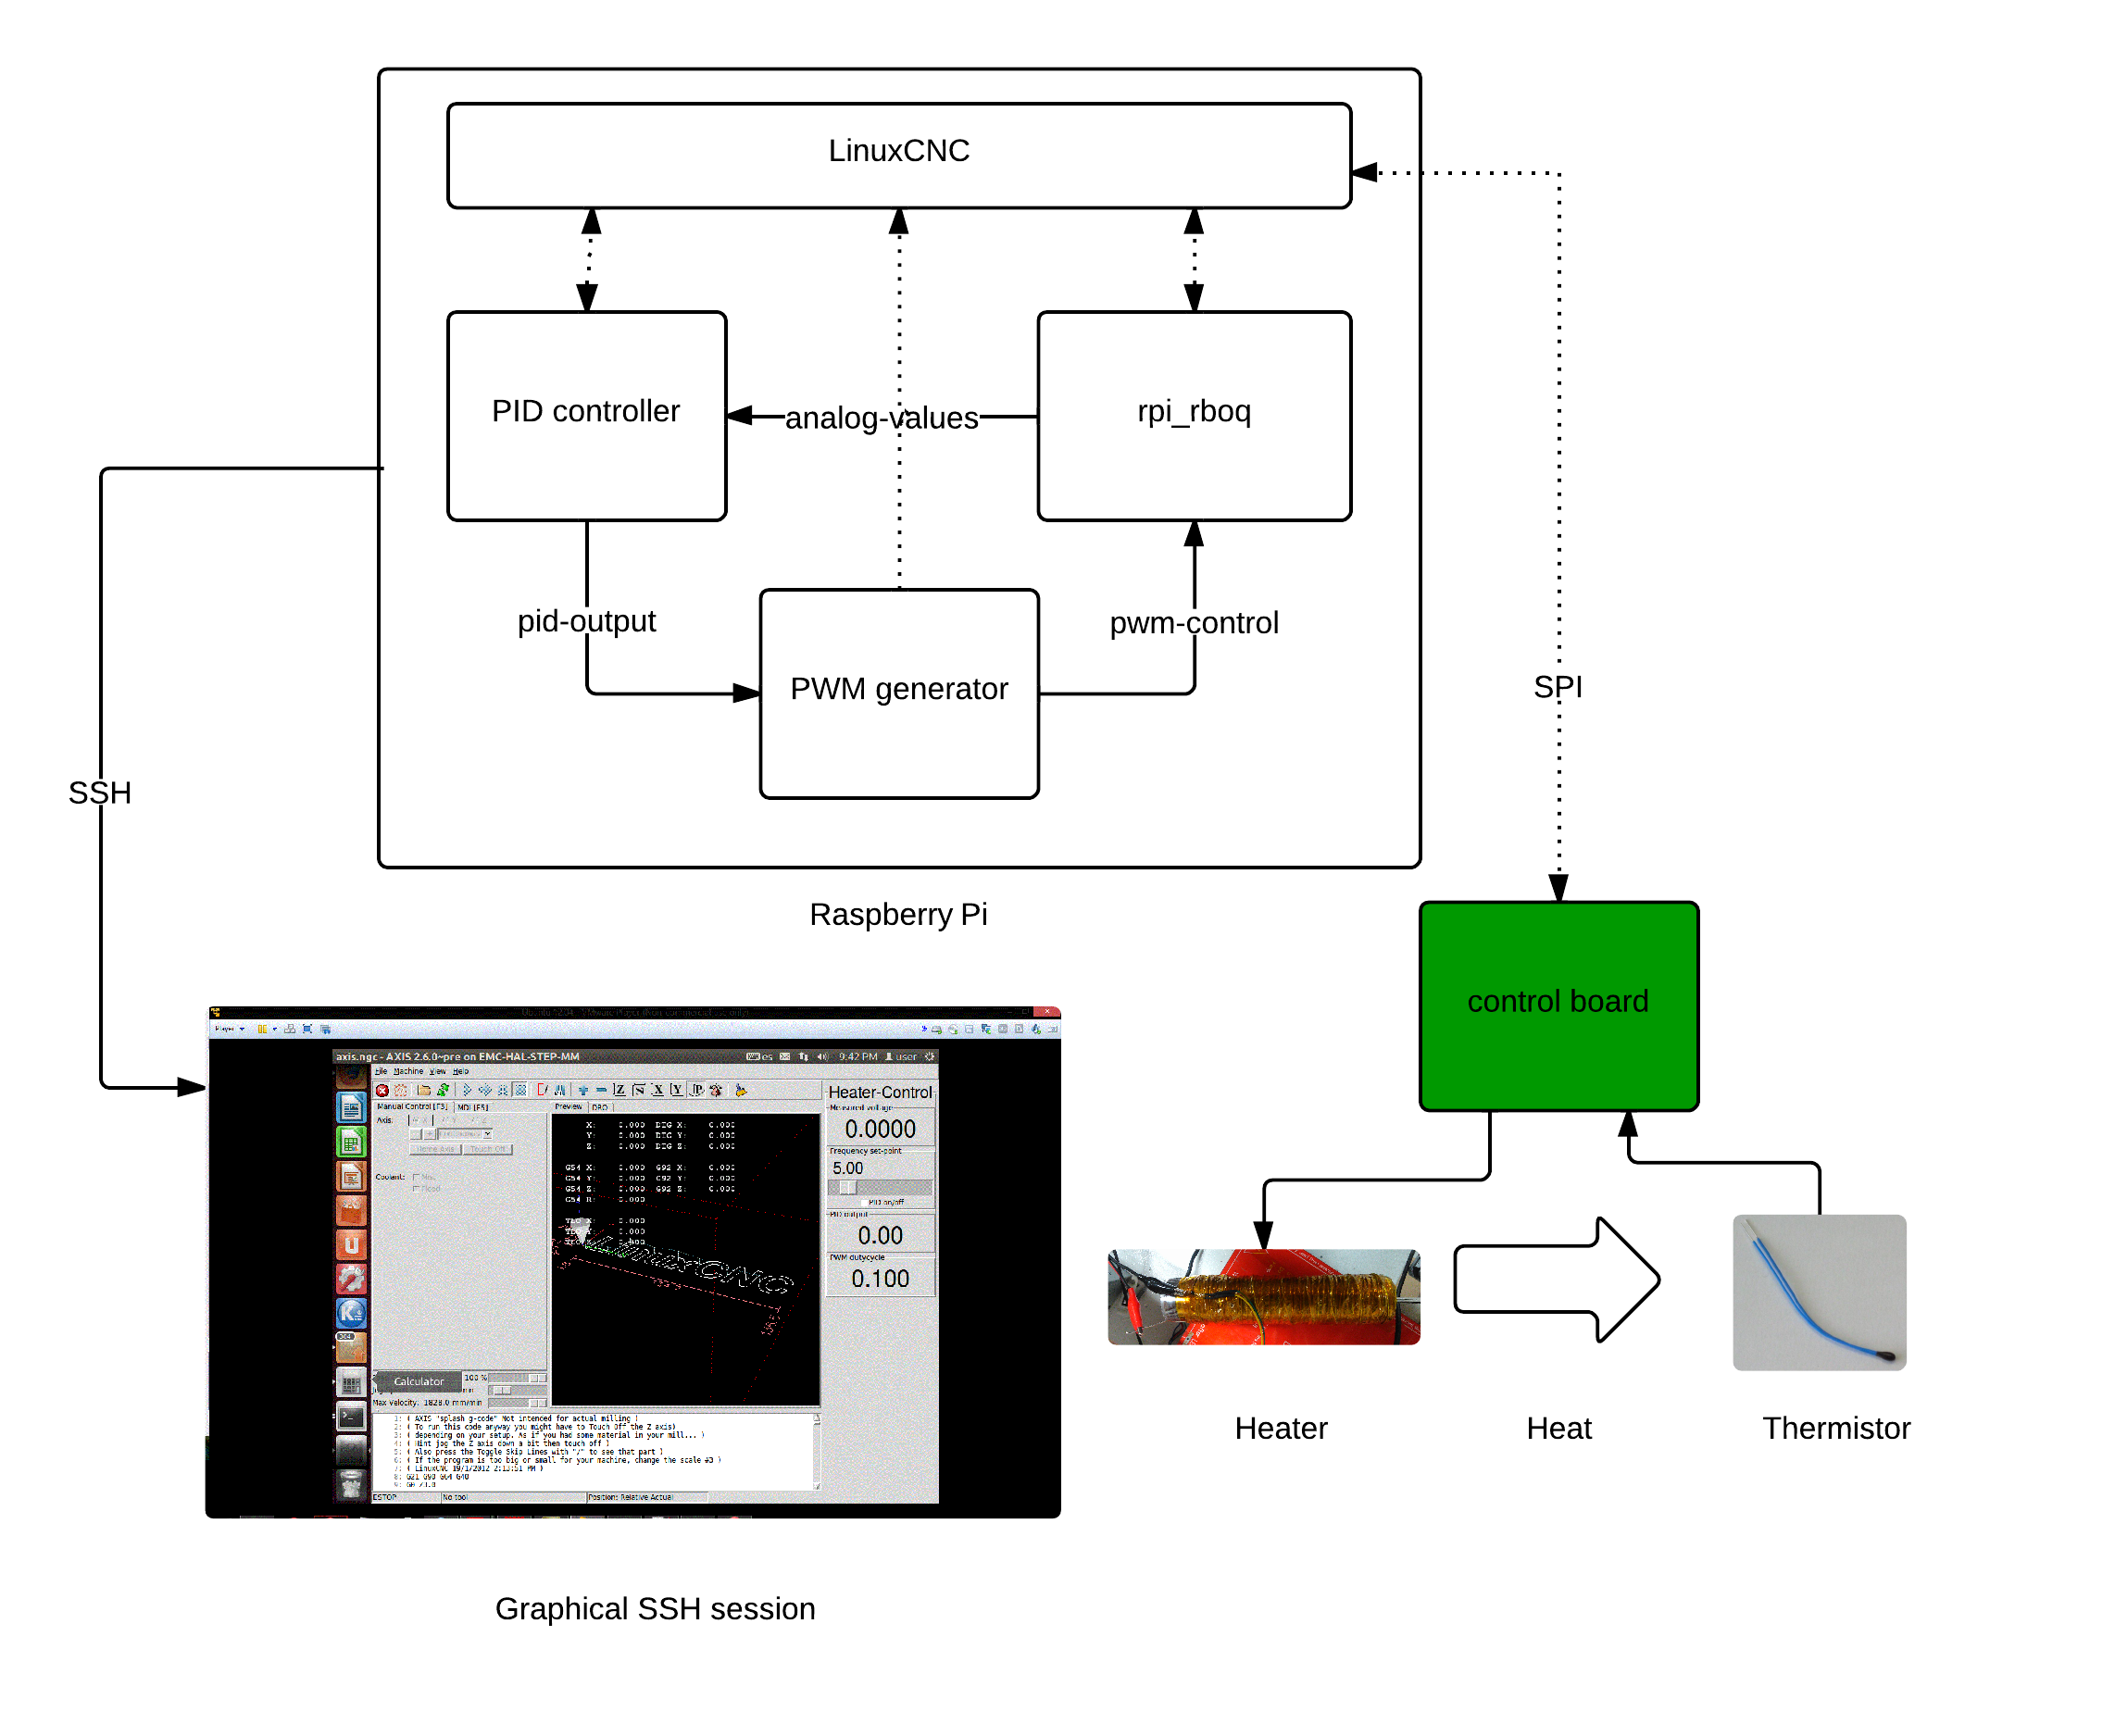
4 Results

Slide 22
5 Conclusions and future work
Conclusions and results discussion
  In general, the board designed, achieved a good integration with others blocks.
  We found some speed lilmitations due to the maximum jitter provided by Raspberry-Pi
    PWM maximum frequency 200Hz.
    Maximum stepps 200 steps/second.
    ADC maximum input signal frequency 10kHz
Future work

