Slide 1

Presentation by:
Shanmukh Behara (ug8788 )
Snigdha Enumulapally (xc2373)
Damoder Reddy Pannala (lz7285 )
Sri Samhitha Pallelamudi (ti6266)
Wine Dataset
BAN 620 – Data Mining

Slide 2
Agenda
Objective
Data Analysis
Data Modeling
Conclusion

Slide 3
Objective
To determine the behavior of the model with and without scaling the data
To find the best model to classify wine types and predict the quality

Slide 4
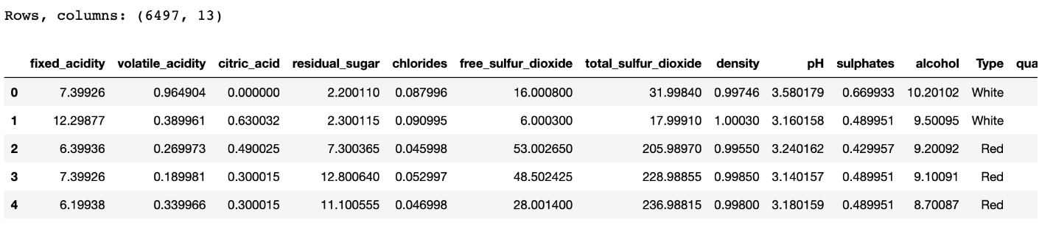
Data Analysis
In the given data set we have 6497 rows and 13 attributes
Dataset consists of two types of wines Red & White.

Slide 5
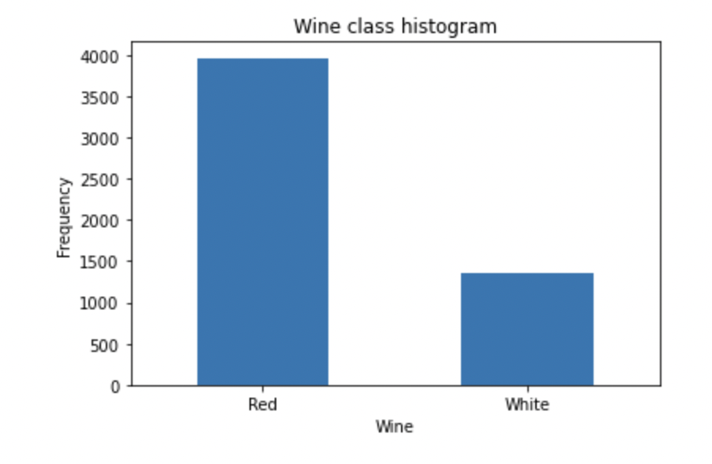
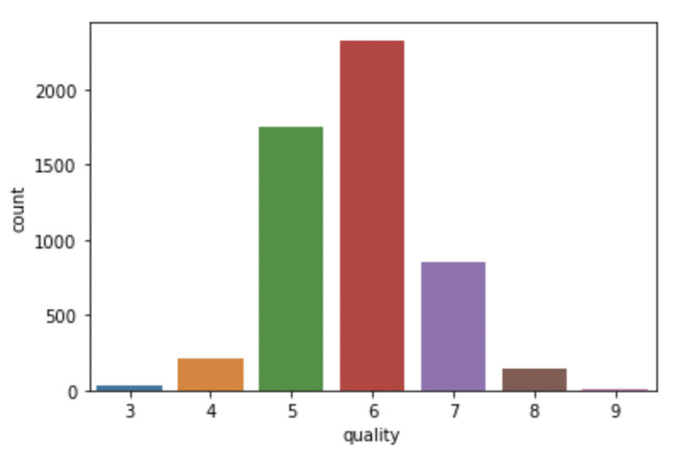
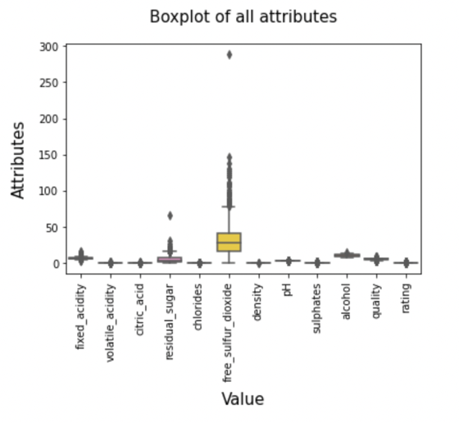
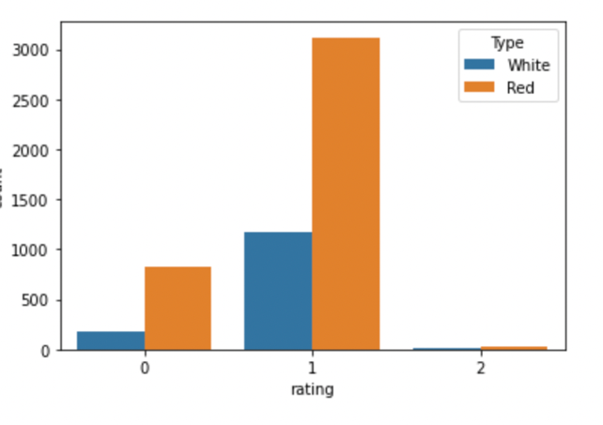
Data Analysis

Slide 6
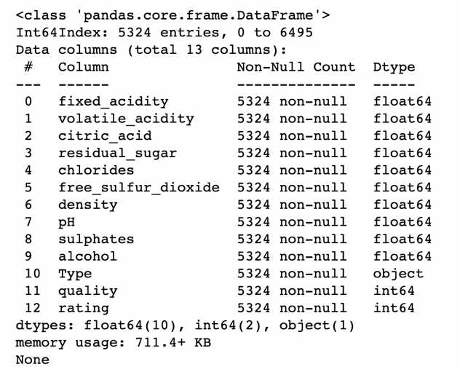
Data Analysis
Highly correlated attribute ‘Total_Sulfur_Dioxide’ has been dropped.
Duplicates have been removed from the dataset.
New column Rating have been added based on quality of Wine
Missing values and Outliers are imputed with mean values.
Below is the data info() after above changes to the dataset:

Slide 7
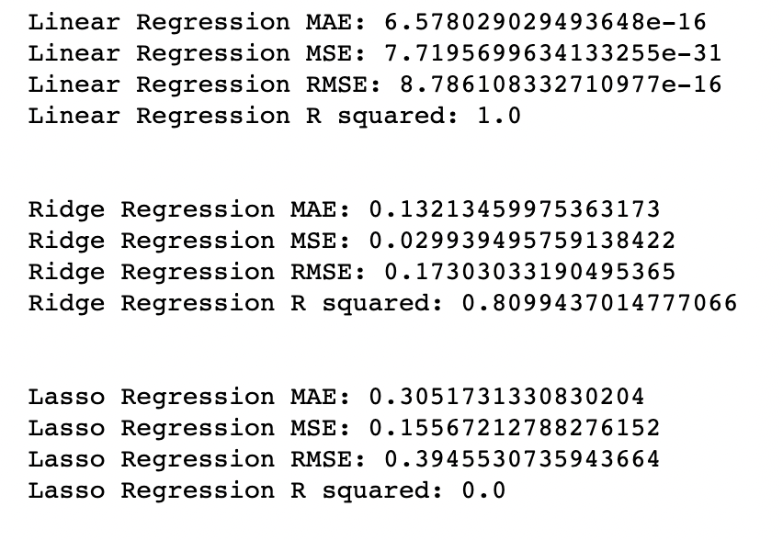
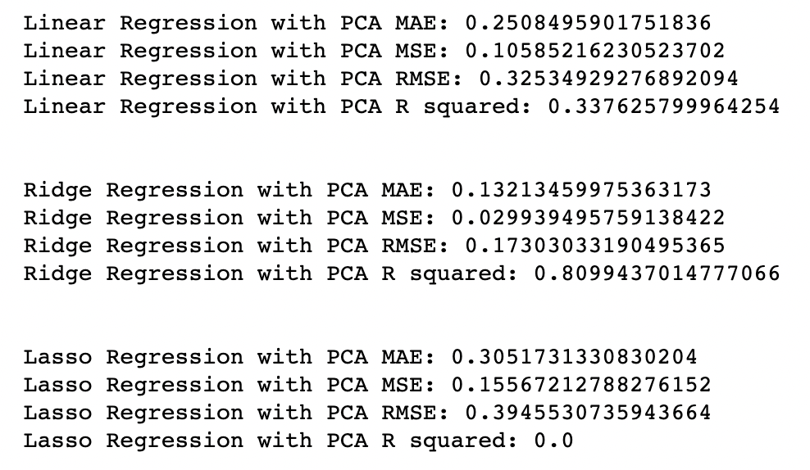
Data Modeling
By minimizing the lines of code required, we followed a process of scaling, PCA, and modeling for different algorithms one after the other using pipelines in our project.
Predicting Quality of wine with and without PCA:

Slide 8
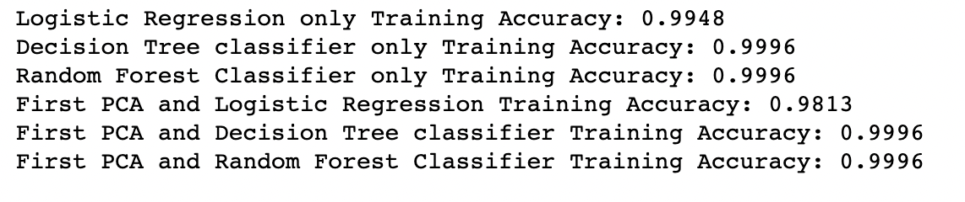
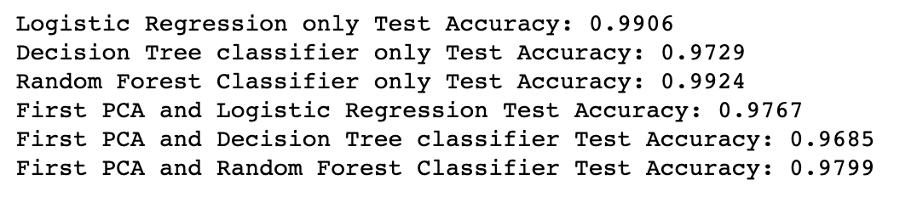
Data Modeling
Classification of wine type:

Slide 9
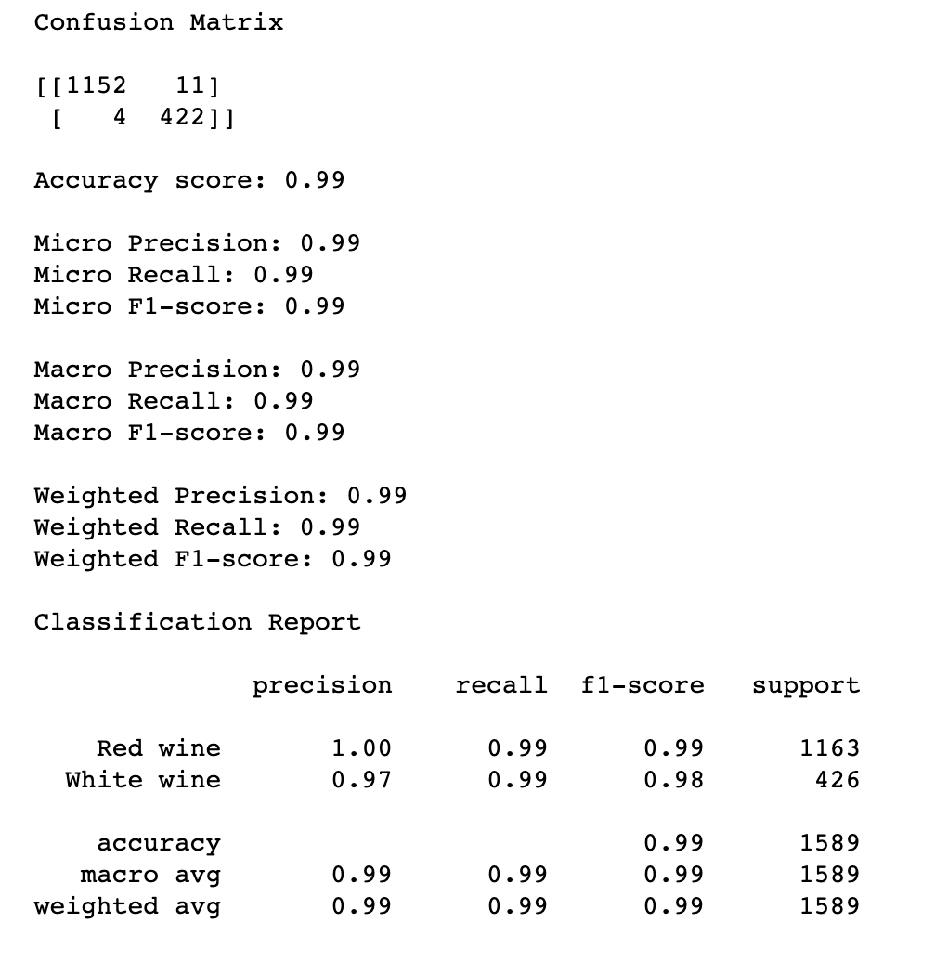

Data Modeling
Logistic Regression:
Random Forest :

Slide 10
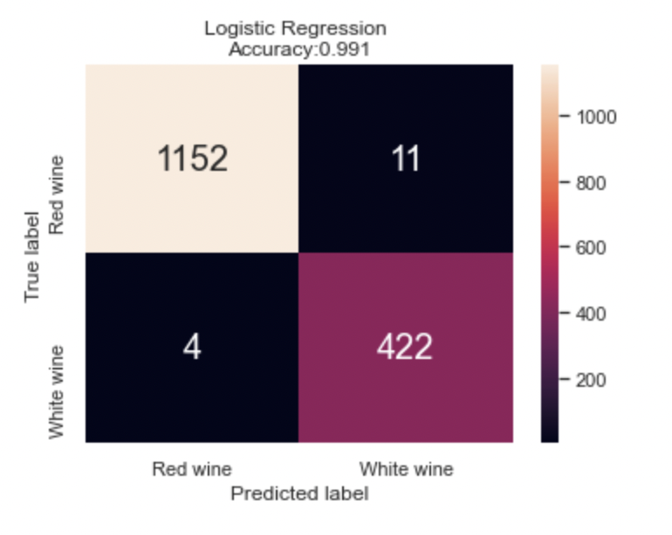
Data Modeling
Confusion Matrix of Logistic Regression:
Since the data looks very ideal hence, the Logistic Regression as well as Random Forest gave best result.

Slide 11
Conclusion
Wine Quality prediction:
After applying different regression models, based on the accuracy and other outputs, we can say that we achieved best accuracy of 80.77% for Linear Regression model.
Wine Type classification:
After applying different classification models, based on the accuracy and other outputs, we can say that we achieved best accuracy of 99% for both Logistic Regression model and Random Forest.

