Slide 1
Let’s Go Out – Android App
Jia Wong Gui Say

Slide 2
Project Description
Vote system
User accounts
Create groups
Create votes! (When user votes for a specific location, it is optional for them to put comments down)
Either users can put votes up and the location with most votes will be presented to each users
Users can also use a random button to let the program decide for them

Slide 3
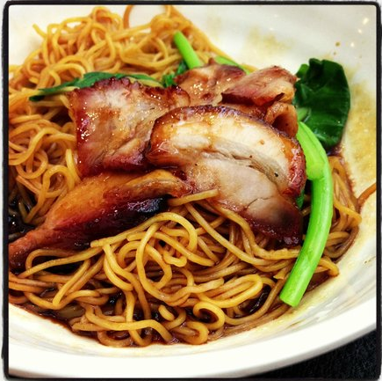
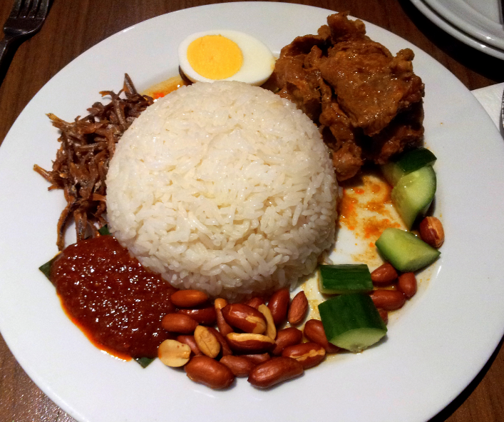
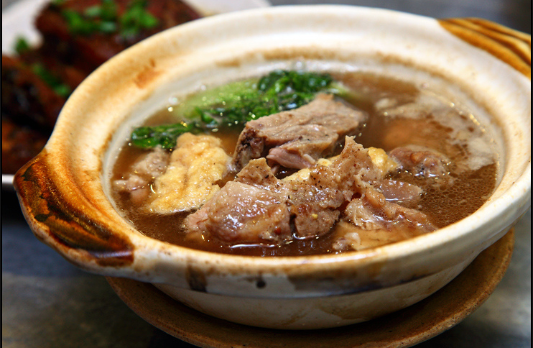
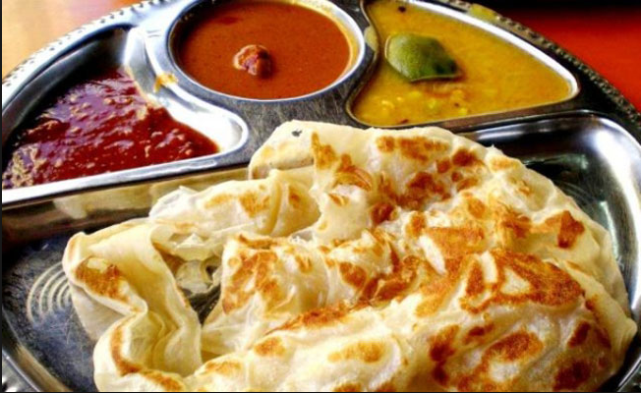
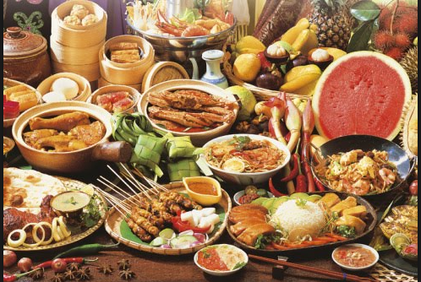
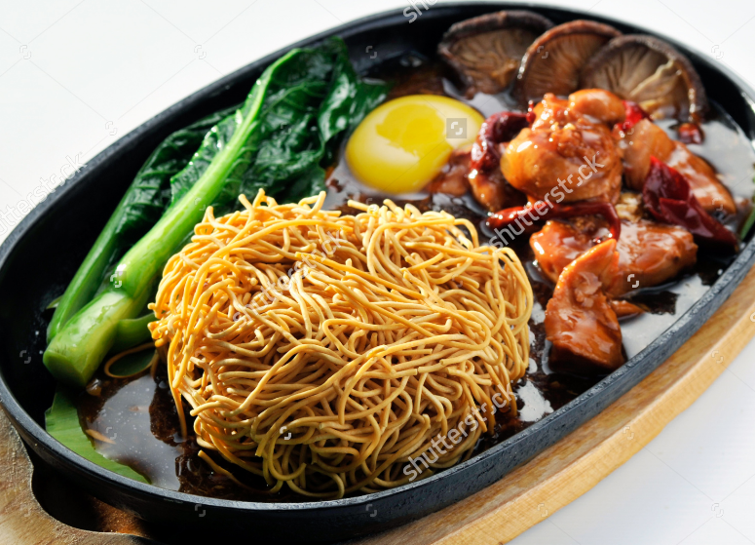
Inspiration
Learn to create an app before graduating
Trouble deciding where to go for food
Personal use in the future
This will be fun to create and learn!

Slide 4



Tools:
Android Studio
Programming languages: Java, XML

Slide 5
Possible enhancements
Add chatting function to groups
Link location of restaurants to Google Map
Keep track what users voted previously

Slide 6

Anticipated Problems
First time creating an Android app
Creating an app that requires the internet (Real time)

Slide 7

Thank you! Questions?? :D

