Slide 1
Build a Simple Artificial Neural Network in Pytorch
Peter A Noble PhD
http://peteranoble.com
October 10, 2018

Slide 2

Download and install Jupyter
Google jupyter

Slide 3
Download and install Pytorch
PyTorch is an open-source deep learning platform
There are official PyTorch tutorials hosted on Azure Notebooks
Versions of PyTorch as sometimes critical to successful programming (get version 0.4.1)

Slide 4
Five steps to creating your own Artificial Neural Network
Import Libraries
Read-in the Normalized Data
Design the architecture
Construct the Model
Run the Model
Test your understanding

Slide 5
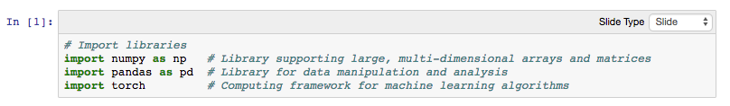
Import Libraries

Slide 6
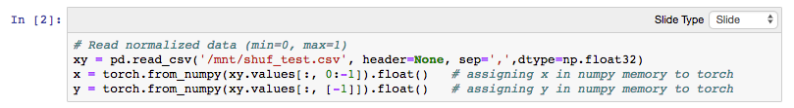
Read-in the Normalized Data
The input comes from directory /mnt
There is no header; the numbers are separated by comma; and 32 bytes in size
The input consists of x-values up until the last column; i.e., (:, 0:[-1])
The output consists of y-values in the last column; i.e., (:, [-1])

Slide 7
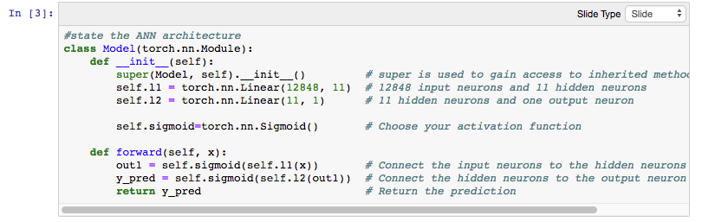
Design the Architecture

Slide 8
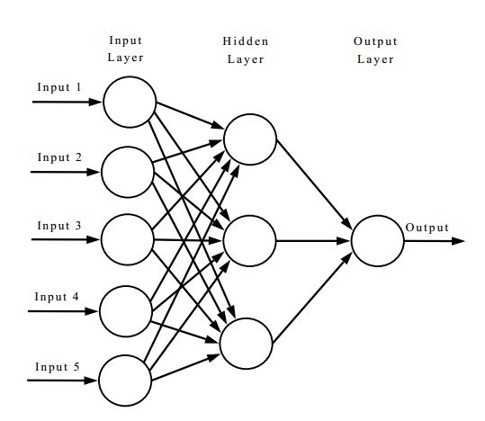
Architecture (not all neurons are shown)
S: Sigmoid activation
+ bias
S
Y: the actual target value
S
S
Y
S
Neurons:
12848 inputs
11 hidden
1 output

Slide 9
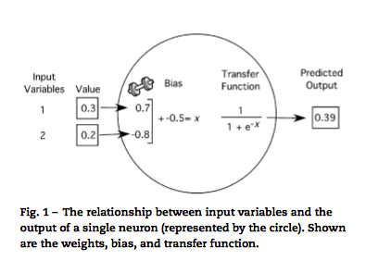
Single neuron
Noble, P.A. and E. Tribou (2007) Ecological Modelling 203:87-98

Slide 10
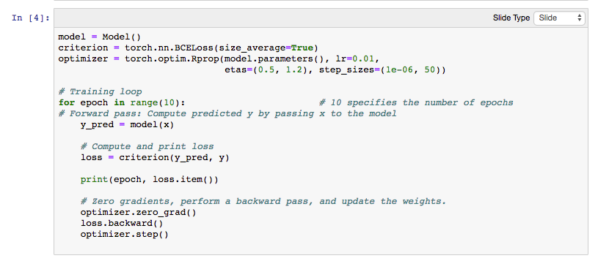
Construct the Model

Slide 11
Criterion: Definition
Criterion = torch.nn.BCELoss(size_average=True)
BCELoss: is a criterion that measures the Binary Cross Entropy between the target and the output
(size_average=True): means the losses are averaged over each loss element in the batch
Other types: Just Google “Loss functions Pytorch”

Slide 12
Optimizer: Definition
optimizer = torch.optim.Rprop(model.parameters(), lr=0.01, etas=(0.5, 1.2), step_sizes=(1e-06, 50))
Rprop: Implements the standard backpropagation algorithm
lr: learning rate
Etas: pair of (etaminus, etaplis), that are multiplicative increase and decrease factors (default: (0.5, 1.2))
step_sizes: a pair of minimal and maximal allowed step sizes (default: (1e-6, 50))
Note: this optimizer specifies standard backprogation for adjusting the weights and biases

Slide 13
Training the Model: Details
for epoch in range(10): Ten training passes will be made through the data
y_pred = model(x): Takes input data to predict y
loss = criterion(y_pred, y): Determines the difference between predicted/actual y’s
print(epoch, loss.item()): Prints the number of passes and corresponding loss
optimizer.zero_grad(): Ensures every time a variable is back-propagated through, the gradient will be accumulated instead of being replaced
loss.backward(): Computes dloss/dx for every parameter x
optimizer.step(): Updates weights and biases based on the current gradient

Slide 14
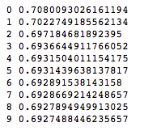
Run the Model
The first column is the epoch and the second column is the loss; note that the loss decreases with epoch number

Slide 15
Test your understanding
How much does the “loss” change when you increase the epochs from 10 to 100, 1000, 10000? Make a scatter plot.
What happens to the ‘loss’ when you decrease/increase the number of neurons in the hidden layer?
What is the effect of using different optimizers and criteria? Test three different ones (download from Pytorch.org)

