Slide 1
Part 2: Artificial Neural Network in Pytorch
Peter A Noble PhD
http://peteranoble.com
October 10, 2018

Slide 2
Content
Assessing the performance of the ANN Model
Testing with Training and Validation Data Sets
Code for Testing the Model With The Training and Validation Data Sets
What does the slope (m), R², and MAE tell us?
Two ways to calculate Slope (m), R², MAE
Push data through the model in Pytorch followed by C++ program
Export weights and biases of the model to files and followed by C++ program and MS Excel spreadsheet

Slide 3
Assessing The Performance of The ANN Model
Determine Mean Absolute Error (MAE), Slope (m), and R-square between actual and predicted outputs
Goal: MAE=0, m=1 and R-square =1
Use train and test files
Train: file used in training (shuf_test.csv)
Test: file not used in training (shuf_valid.csv)
Implement new code in existing model

Slide 4
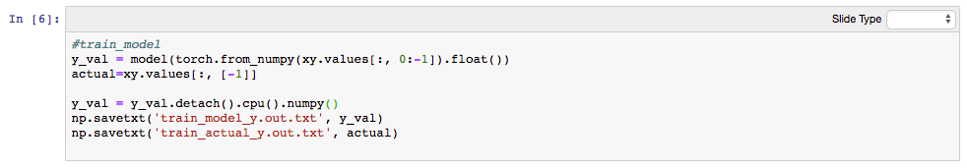
Code for Testing the Model With The Training Set
Put x values through the model into y_val
Put y value into actual
Transfer the memory value of y_val to new y-val
Save y_val and actual to two separate files
Note: this approach should be fast because xy.values is already in memory (when the data was loaded in step 2 of the program)

Slide 5
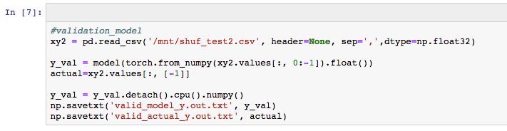
Code for Testing the Model With The Validation Set
Read x- and y- values of validation file into xy2
Extract x values and put through the model into y_val
Put y value into actual
Transfer the memory value of y_val to new y-val
Save y_val and actual to two separate files
Note: this approach will be slow because xy.values from the new file have to be read into memory

Slide 6
What does the slope (m), R², and MAE tell us?
Slope (m): y=mx, m should be close to 1 if the model fits the data
R²: reflects how much of the model is explained; e.g., R² = 0.60 means that about 60% of the variability of the model is explained
Mean absolute error (MAE) of the model is:
Mean of the |predict y - actual y|

Slide 7
Slope (m), R², MAE by C++ program
C++ program: ‘determine_regress_pytorch.cpp’
Compile by: g++ determine_regress_pytorch.cpp -o determine_regress
Implement program: ./determine_regress train_model_y.out.txt train_actual_y.out.txt regress_out.txt results4.txt
Output to the screen or file ‘out.txt’ yields the slope (m), R², and Mean Absolute Error (MAE) as well as the number of records

Slide 8
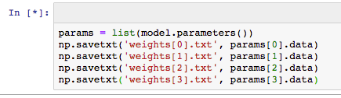
Alternative: export weights and biases as output files
The list statement (by itself) will output weights and biases to the screen.
Here we will save into a file called ‘params’.
Using Numpy (np), we save the weights and biases to different files.
Of note: params[1].data and params[3].data are really the biases – not weights!

Slide 9
Using weights and biases to predicted Y’s and compare to actual Y’s
Compile: g++ predict_y_v3.cpp -o predict_y
Implement: ./predict_y 12848 113 weights[0].txt weights[1].txt weights[2].txt weights[3].txt shuf_test.txt out.txt
The 12848 is the number of input neurons.
The 113 is the number of hidden neurons.
The ‘shuf_test.txt’ refers to the file that will be run through the model.
The out.txt yields a file with three columns: count, predicted value, actual value.
The out.txt file can be loaded into a spreadsheet to calculate the slope (m), R², and MAE.

Slide 10
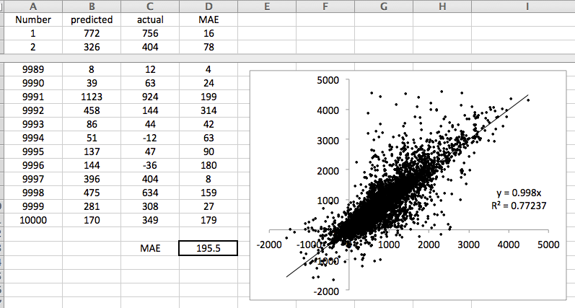
Example Spreadsheet of the Model
The model accounts for 77% of the variability in the data

Slide 11
Assignment to test your understanding
A spreadsheet of m’s, R²’s and MAE’s by epoch for training and validation data sets. Does the model need additional epochs for accurate predictions? Provide scatter plots to argument your position.

