Slide 1
Part 3: Pytorch’s Bells and Whistles
Peter A Noble PhD
http://peteranoble.com
October 11, 2018

Slide 2
Content
What is a data loader? How does it help us train the model?
Batch size
Shuffling
Number of workers
Saving and loading models
Running Your Program in Batch
Test your understanding

Slide 3
Batch: size
batch_size denotes the number of samples contained in each generated batch
A train dataset of 1000 samples, e.g., with a batch_size of 10 will have a size of 100.
As a consequence, training of all data needs 100/10=10 iterations
Best practice: experiment to make batch size as big as possible before running out of memory

Slide 4
Batch: shuffle=True or shuffle=False
shuffle=True: A new order of exploration occurs at each pass. The alternative (shuffle=False) will select the same order of records for each epoch – which is not a good option.
True means that the batches fed into the model will not be similar; making the model more robust.

Slide 5
Batch: Number of workers
num_workers: denotes the number of processes that generate batches in parallel.
Best practice: set the number of workers to the maximum so that CPU computations are efficiently managed.
The “maximum” has to be determined by experimentation (i.e., watch how the memory changes or explodes using “free –m”)

Slide 6
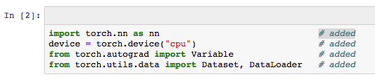
Statements to be added to the previous Pytorch_2 program
Import the torch library
Set the device to the CPU
Torch.device tracks history of the derivatives
Variable backpropagates a loss function to train variable x and stores the value computed by a loss function
Dataset and DataLoaders are Pytorch utilities

Slide 7
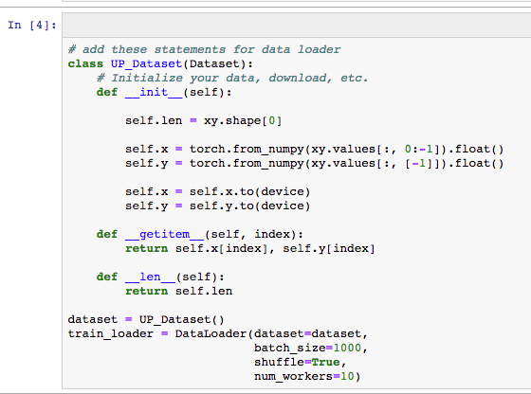
Add-in the data loader

Slide 8
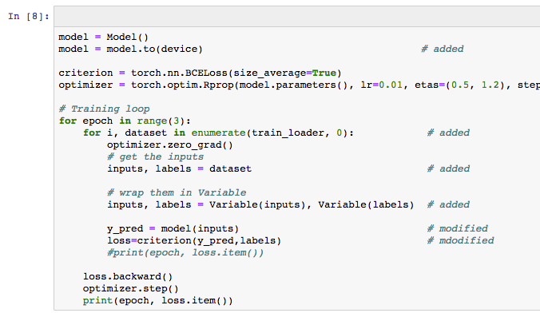
Modify the Model to accommodate the Data loader

Slide 9
Why save a model?
Two reasons:
So that you can reload a saved model without starting training from scratch
So that you can extract the weights and biases later

Slide 10

Save model
The model is saved in a file called ‘saved_model.pt’
The file contains the weights and biases in binary format.

Slide 11
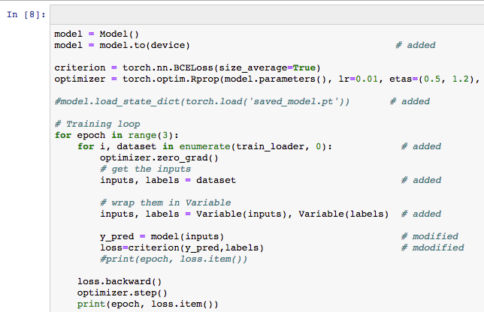
Load model
In this example, the model is tabbed out because I have not saved a model yet. Once there is a saved model, untab it.

Slide 12
Running your Pytorch program in batch
In the same directory as the program, use the following statement:
nohup runipy big_ann5.ipynb &
Nohup: keeps the program running when you shutdown the terminal
Runipy: implements running the compiled program
big_ann5.ipynb: name of the Pytorch program
&: make the program independent of terminal

Slide 13
Test your understanding
How does increasing/decreasing batch size and number of workers affect training?
Optimize the model
How does batch-size affect epochs?
What happens when shuffle=False?
Why run your program in batch?

