Slide 1
Part 4: CPU to GPU
Peter A Noble PhD
http://peteranoble.com
October 11, 2018

Slide 2
Content
Why GPU?
Changes to the code

Slide 3
Why GPU?
CPU (central processing unit): composed of just few cores with lots of cache memory that can handle a few software threads at a time.
GPU (graphics processing unit): composed of hundreds of cores that can handle thousands of threads simultaneously; more efficiently.

Slide 4
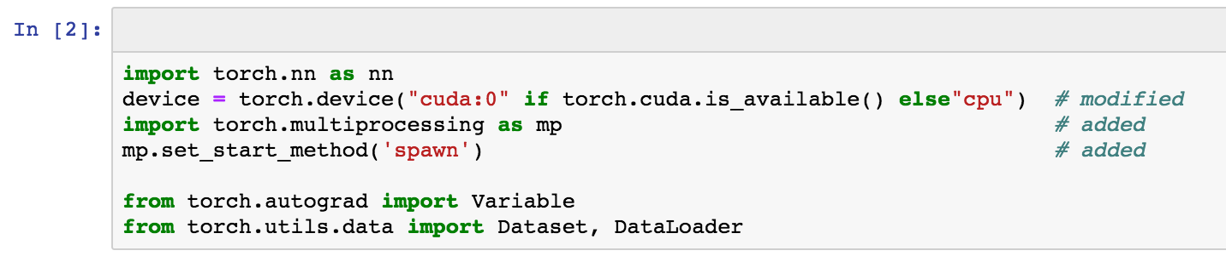
Changes to the code
uses shared memory to provide shared views on the same data in different processes
allows the fully leverage multiple processors on a given machine

Slide 5
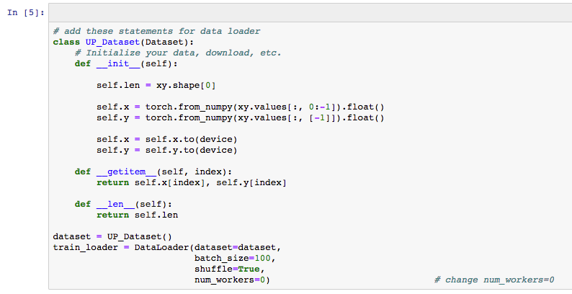
Change num_workers

Slide 6
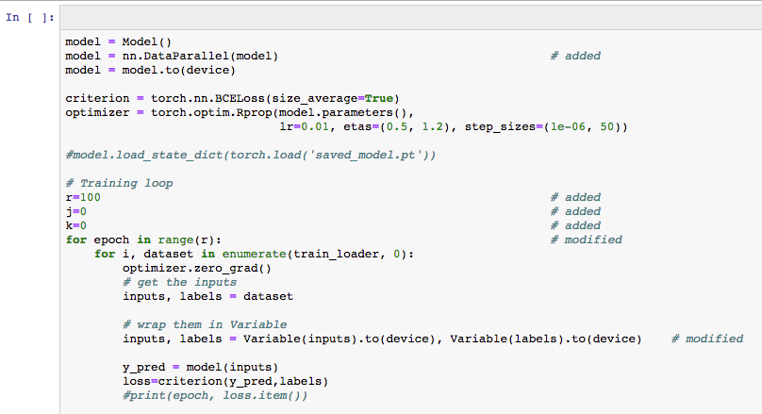
Add ins
DataParallel splits your data automatically and sends job orders to multiple models on several GPUs. After each model finishes their job, DataParallel collects and merges the results before returning it to you.

Slide 7
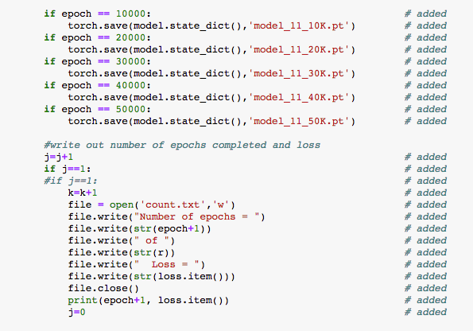
Sequential saving models and tracking of epochs/loss

Slide 8
Test your understanding
What happens when the num_workers is set to 1 when you are using GPUs?
Why is it important to sequentially save models during training and testing?
What is the purpose of the file.write statements?

