Slide 1
Presentation title
Presentation subtitle
Notes:
The is the title slide. Show this one first.
It’s great.

Slide 2
Slide 1 title
Slide 1 bullet 1
Slide 1 bullet 2
Slide 1 bullet 3
Notes:
The is where you wow them. Show this one second.
It’s great.

Slide 3
Slide 2 title
Notes:
The is where you introduce graphs.
It’s graphic.

Slide 4
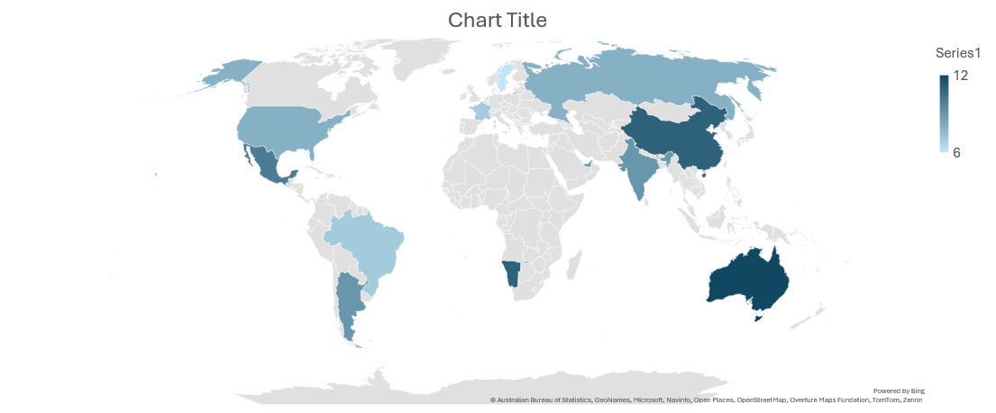
Slide 3 title
Notes:
The is where you finish presenting. Show this one last.
It suffers from simplicity.

