Slide 1




STRATEGIC DYNAMIC MEMORY MANAGEMENT USING HEAP LAYERS
Panagiotis Katsalifis
Alexandra Chelidoni

Slide 2
ALLOCATOR DESIGN:
FROM SPECIALIZED TO GENERAL
  Leveraging Patterns: Using application-specific allocation patterns allows for specialized memory managers that significantly boost performance.
  Library Strategy: Effective specialized allocators should be generalized and organized into a reusable library for broader use.
  The "Full Circle" Design: A robust general-purpose allocator is best defined as a smart combination of these highly optimized, special-purpose components.

Slide 3
HEAP LAYERS LIBRARY
  Modular Architecture: It provides a flexible C++ framework that allows you to build high-performance allocators by stacking different functional "layers".
  Simplified Development: It streamlines the process of writing complex memory managers, making it easier to create both specialized (custom) and standard (general-purpose) allocators.

Slide 4
USING HEAP LAYERS
  It uses C++ templates to build and parameterize several building blocks.
  Combines building blocks to construct different allocation policies.

Slide 5
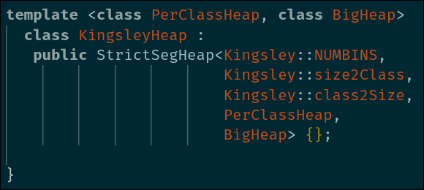
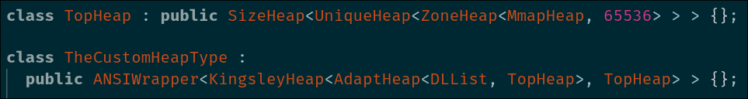
EXAMPLE:
KINGSLEY ALLOCATOR

Slide 6

LAYER CATEGORIES
memory flow
  Top Heap
  Building Block Layer
  Composition Layer
Adapter Layer-Miscellaneous

Slide 7

TOP HEAP
"Source" heap that has no superheap. It simply fetches large chunks of raw memory.
  Mmap (classic syscall as a heap class)
  StaticBufferHeap

Slide 8

BUILDING BLOCK LAYER
It defines how memory is stored and tracked. It takes memory from a top heap and organizes it.
  ZoneHeap (Arena allocator)
  FreelistHeap

Slide 9
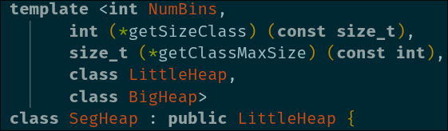
COMPOSITION LAYER
It doesn’t store memory itself; it decides which child heap should handle a request. Its role is to combine multiple heaps into a smarter system.
  Hybrid Heap
  Segregated Heap

Slide 10
ADAPTER LAYER- MISCELLANEOUS
They can actually fit anywhere between the basic layer categories. Each one serves a different purpose.
  SizeHeap (metadata to keep track of the heap size)
  LockedHeap & ThreadSpecificHeap (adds thread-safety)
  ANSI Wrapper (generates the standard C interface for the custom heap)

Slide 11
EXPERIMENTATION
  Design Space Exploration based on the Kingsley Allocator
  Creation of some simplified custom allocators
  Run benchmarks and compare with sysmalloc and mimalloc
  Evaluate results based on memory footprint and execution time

Slide 12

DESIGN SPACE EXPLORATION
  We tried tweaking some parameters of the Kingsley allocator
Negligible changes between different versions
  Made the Kingsley allocator thread safe
we used a global lock, which slowed down execution time by a lot

Slide 13
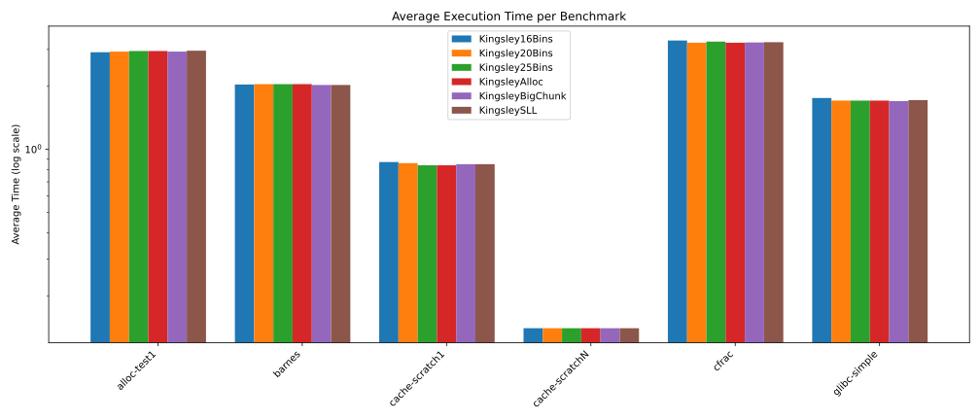

Slide 14
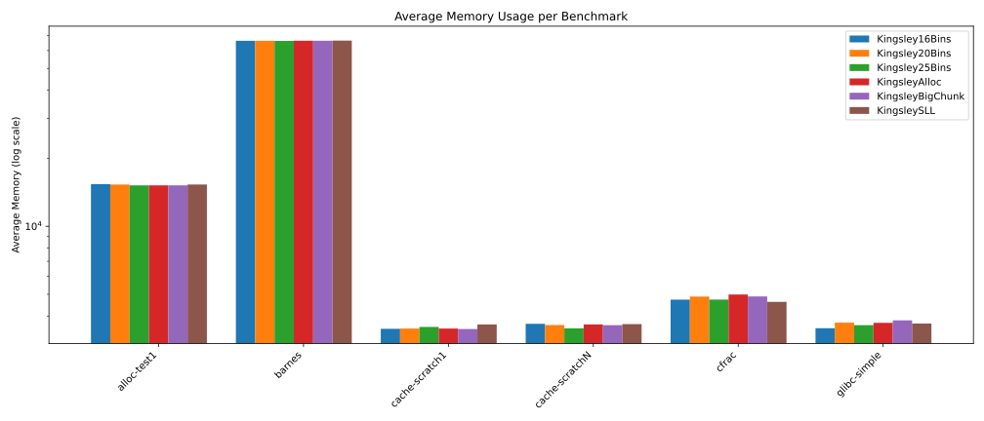

Slide 15
CUSTOM ALLOCATORS
  Created a simple MmapArena
  Based on Segregated Policy created
1) SegPT-16bins
2) StrictSegPT-16bins
3) StrictSegLocked-16bins
4) StrictSegPTCustom (using a custom policy for segregation)
5) StrictSegLockedCustom

Slide 16
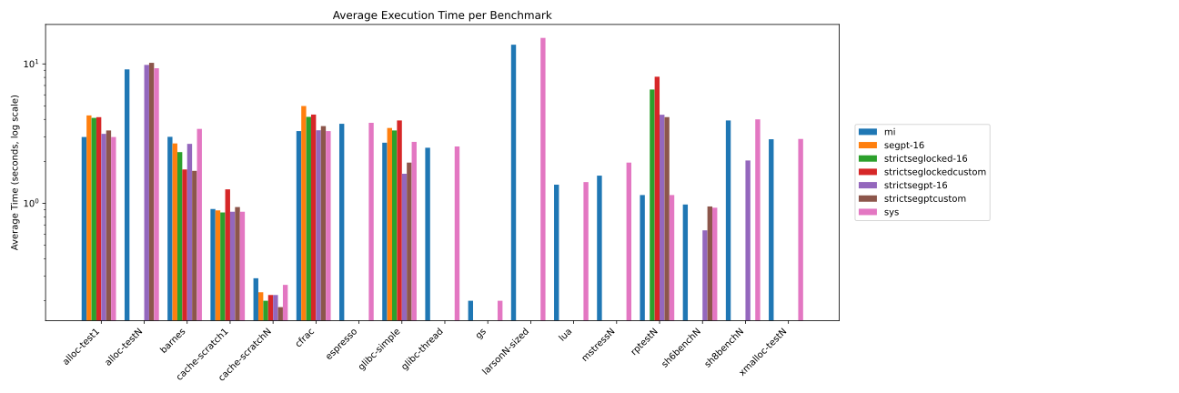

Slide 17
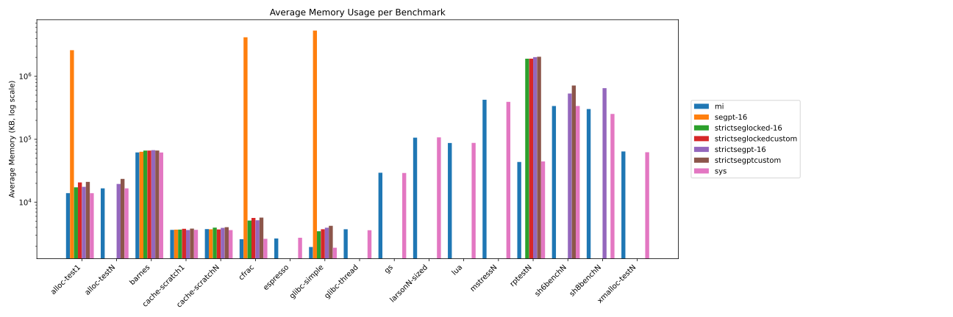

Slide 18
REFERENCES
  Heap Layers Repository: https://github.com/emeryberger/Heap-Layers
  Mimalloc-Bench Repository: https://github.com/daanx/mimalloc-bench
  [1] A. Alexandrescu and E. D. Berger, "Policy-Based Memory Allocation," C++ Report, vol. 12, no. 9, Oct. 2000.
  [2] E. D. Berger, B. G. Zorn, and K. S. McKinley, "Composing High-Performance Memory Allocators," in Proc. ACM SIGPLAN 2001 Conf. Program. Lang. Des. Impl. (PLDI), Snowbird, UT, USA, 2001, pp. 114–124.

Slide 19
THANK YOU !

