Slide 1
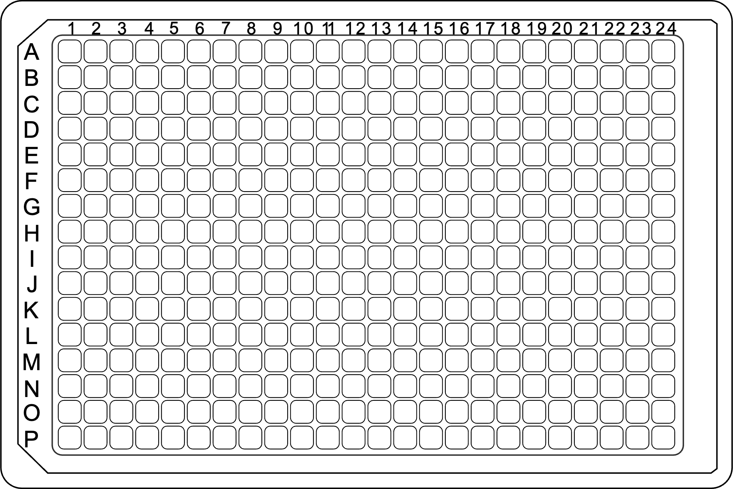
2024_07_26_plate_1
P31156_101
0 μg/ml Dox
0.1 μg/ml Dox
1 μg/ml Dox
Non-transfected
0.01 μg/ml Dox
Non-transfected
0 μg/ml Dox
0.01 μg/ml Dox
0.1 μg/ml Dox
1 μg/ml Dox

Slide 2
2024_07_26_plate_2
P31156_103
0 μg/ml Dox
0.1 μg/ml Dox
1 μg/ml Dox
Non-transfected
0.01 μg/ml Dox
Non-transfected
0 μg/ml Dox
0.01 μg/ml Dox
0.1 μg/ml Dox
1 μg/ml Dox

Slide 3
2024_07_26_plate_3
P31156_105
0 μg/ml Dox
0.1 μg/ml Dox
1 μg/ml Dox
Non-transfected
0.01 μg/ml Dox
Non-transfected
0 μg/ml Dox
0.01 μg/ml Dox
0.1 μg/ml Dox
1 μg/ml Dox

Slide 4
2024_07_26_validation_plate
P31156_102
1 cell
20 cells

Slide 5
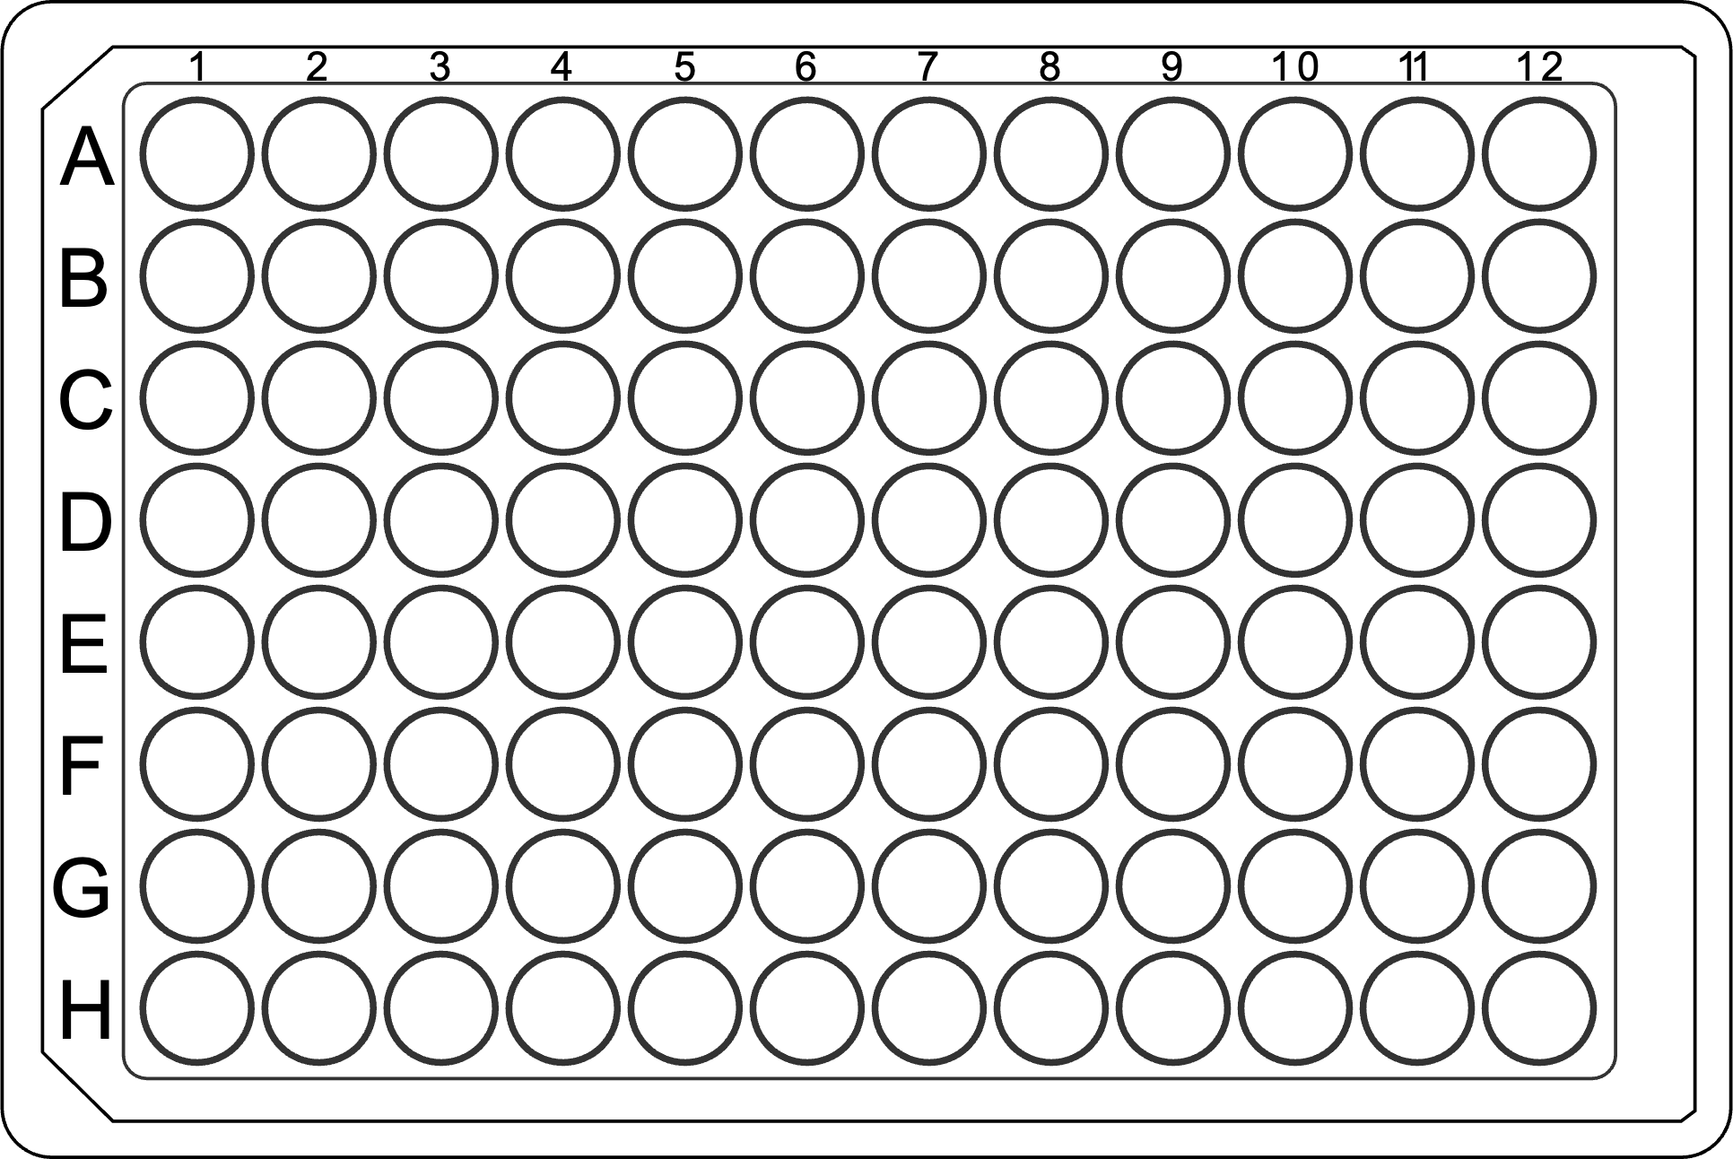
0 μg/ml Dox
0.1 μg/ml Dox
Non-transfected
0.01 μg/ml Dox
1 μg/ml Dox
Non-transfected
0 μg/ml Dox
0.01 μg/ml Dox
0.1 μg/ml Dox
1 μg/ml Dox

Slide 6
0 μg/ml Dox
0.1 μg/ml Dox
Non-transfected
0.01 μg/ml Dox
1 μg/ml Dox
Non-transfected
0 μg/ml Dox
0.01 μg/ml Dox
0.1 μg/ml Dox
1 μg/ml Dox

