Slide 1
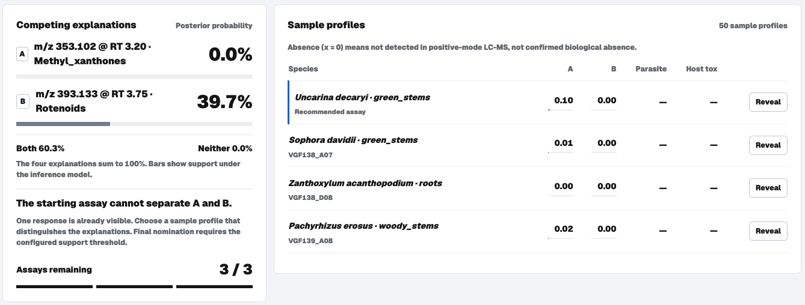
DECOUPLE
Which molecule
did it?
Choose the next assay
before choosing a lead.
Panos Georgakopoulos
Apostolos Dedeloudis
EthnoHack 2026
Track 2: Natural Products & Drug Discovery
01
Notes:
Sources: FINDINGS.md; results/benchmark.json, well_specified/single_driver cells; decouple/setvalued.py; archived app screenshots in video_assets/screenshots. ENPKG: https://zenodo.org/records/7824642. Experimental readouts are measured; compound attributions remain model hypotheses. All benchmark responses are simulated.

Slide 2
PROBLEM
Potency can send you after the wrong lead
Measured ENPKG screen: extracts with more than 80% parasite inhibition
fail the host-toxicity filter
7 / 15
An active mixture is not enough.
Which compound explains activity,
and is it selective?
Measured extract outcomes motivate the problem. They do not establish compound-level causation.
02
Notes:
Sources: FINDINGS.md; results/benchmark.json, well_specified/single_driver cells; decouple/setvalued.py; archived app screenshots in video_assets/screenshots. ENPKG: https://zenodo.org/records/7824642. Experimental readouts are measured; compound attributions remain model hypotheses. All benchmark responses are simulated.

Slide 3
DATA
Measured chemistry. Simulated benchmark.
Two evidence layers with different meanings
1,600
952
measured extracts
semi-synthetic episodes
Abundance profiles
Parasite inhibition and L6 toxicity
Species and plant-organ provenance
238 compound pairs
Real co-occurrence structure
Simulated activity and cytotoxicity
Gaudry et al. provide ENPKG and the published rotenoid result. Our contribution is the decision-support workflow.
03
Notes:
Sources: FINDINGS.md; results/benchmark.json, well_specified/single_driver cells; decouple/setvalued.py; archived app screenshots in video_assets/screenshots. ENPKG: https://zenodo.org/records/7824642. Experimental readouts are measured; compound attributions remain model hypotheses. All benchmark responses are simulated.

Slide 4
METHOD
The useful extract pulls explanations apart
Recommended example: Uncarina decaryi green stems, with xanthone but no detected rotenoid
01 Model the competing explanations
Continuous log-abundance attribution
with a detection floor.
02 Choose contrast, then update
Recompute after each reveal.
Penalise redundant extracts.
Predicted response, not a measured effect. Four hypotheses compete: A, B, both and neither.
04
Notes:
Sources: FINDINGS.md; results/benchmark.json, well_specified/single_driver cells; decouple/setvalued.py; archived app screenshots in video_assets/screenshots. ENPKG: https://zenodo.org/records/7824642. Experimental readouts are measured; compound attributions remain model hypotheses. All benchmark responses are simulated.

Slide 5
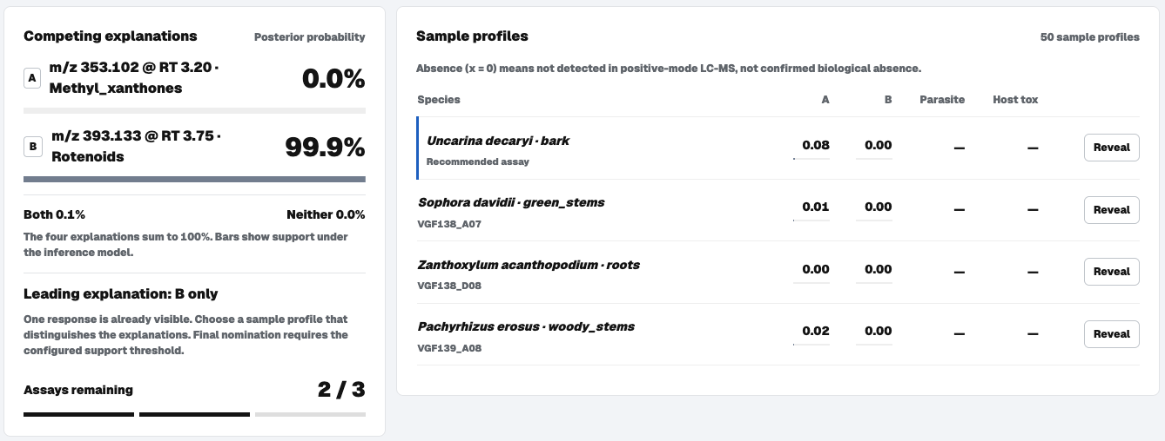
GUIDED DEMO
Three reveals. A trace you can inspect.
Captured workbench state after the first reveal
01 Choose the pair
02 Inspect the contrast
03 Reveal each assay
04 Review and export
The video reconstructs engine states. Assay readouts are archived measurements; verdicts are model outputs.
05
Notes:
Sources: FINDINGS.md; results/benchmark.json, well_specified/single_driver cells; decouple/setvalued.py; archived app screenshots in video_assets/screenshots. ENPKG: https://zenodo.org/records/7824642. Experimental readouts are measured; compound attributions remain model hypotheses. All benchmark responses are simulated.

Slide 6
SELECTION RESULTS
Adaptive contrast ties strongest-first
Correct nomination / all hard episodes, on semi-synthetic benchmarks
16
distinct hard pairs
58 episodes
3-assay budget
95% pair-clustered CIs: 0–24.1% for no assays/random; 6.9–34.4% for strongest-first/adaptive.
06
Notes:
Sources: FINDINGS.md; results/benchmark.json, well_specified/single_driver cells; decouple/setvalued.py; archived app screenshots in video_assets/screenshots. ENPKG: https://zenodo.org/records/7824642. Experimental readouts are measured; compound attributions remain model hypotheses. All benchmark responses are simulated.

Slide 7
SELECTIVITY RESULTS
Fewer simulated wasted isolations
Wasted nominations per 100 episodes, with adaptive contrast selection
32.7%
developable accuracy
under both rules
Overall: 952 episodes
Assumed cytotoxic
prevalence: 50%
Hard stratum: accuracy 12.1% for both; waste 6.9 to 0.0 per 100. Simulated savings, not validated lab savings.
07
Notes:
Sources: FINDINGS.md; results/benchmark.json, well_specified/single_driver cells; decouple/setvalued.py; archived app screenshots in video_assets/screenshots. ENPKG: https://zenodo.org/records/7824642. Experimental readouts are measured; compound attributions remain model hypotheses. All benchmark responses are simulated.

Slide 8
TRADITIONAL KNOWLEDGE
One plant. Different organs.
Pachyrhizus erosus: food and poison uses motivate an organ-level comparison
Rotenoid share
Measured inhibition
Leaves 112.2%
Stems 53.7%
Roots 0.0%
ISDB abundance shares. Raw recorded inhibition shown without clipping. Traditional-use sources: ETHNOBOTANY.md.
08
Notes:
Sources: FINDINGS.md; results/benchmark.json, well_specified/single_driver cells; decouple/setvalued.py; archived app screenshots in video_assets/screenshots. ENPKG: https://zenodo.org/records/7824642. Experimental readouts are measured; compound attributions remain model hypotheses. All benchmark responses are simulated. Traditional knowledge belongs to its knowledge holders. Attribution does not confer access or commercial rights. CANOPUS shows the same ordering with different shares.

Slide 9
UNCERTAINTY
A model verdict is a hypothesis
The workbench can nominate, shortlist, abstain, suggest joint activity, or flag cytotoxicity.
A / B / both / neither
16 pairs
underpin the hard stratum
A joint explanation does not prove synergy.
A nomination does not confirm structure
or therapeutic effect.
Shared simulator / inference assumptions
Uncertain MS annotations
Nothing here is clinically validated. Keep predicted attribution separate from established biology.
09
Notes:
Sources: FINDINGS.md; results/benchmark.json, well_specified/single_driver cells; decouple/setvalued.py; archived app screenshots in video_assets/screenshots. ENPKG: https://zenodo.org/records/7824642. Experimental readouts are measured; compound attributions remain model hypotheses. All benchmark responses are simulated.

Slide 10
IMPACT AND NEXT STEPS
The next test belongs in the lab
Intended benefit: fewer premature isolation decisions and more informative follow-up assays
01
Blinded comparison
Test recommendations against strongest-first prospectively.
02
Broader evidence
Expand hard cases and stress-test response assumptions.
03
Compound and mixture confirmation
Confirm identities, selectivity and joint effects experimentally.
Python / NumPy / RDKit / browser workbench · AI-assisted development
10
Notes:
Sources: FINDINGS.md; results/benchmark.json, well_specified/single_driver cells; decouple/setvalued.py; archived app screenshots in video_assets/screenshots. ENPKG: https://zenodo.org/records/7824642. Experimental readouts are measured; compound attributions remain model hypotheses. All benchmark responses are simulated. Implementation: Python, NumPy, RDKit, pytest, HTML/CSS/JavaScript. AI coding assistance. Video: Manim, FFmpeg, ElevenLabs. Team: Panos Georgakopoulos and Apostolos Dedeloudis. Source: https://github.com/panosgeorgakopoulos/Ethnohack. Code MIT. Data and ontology have separate licences.

