Slide 1
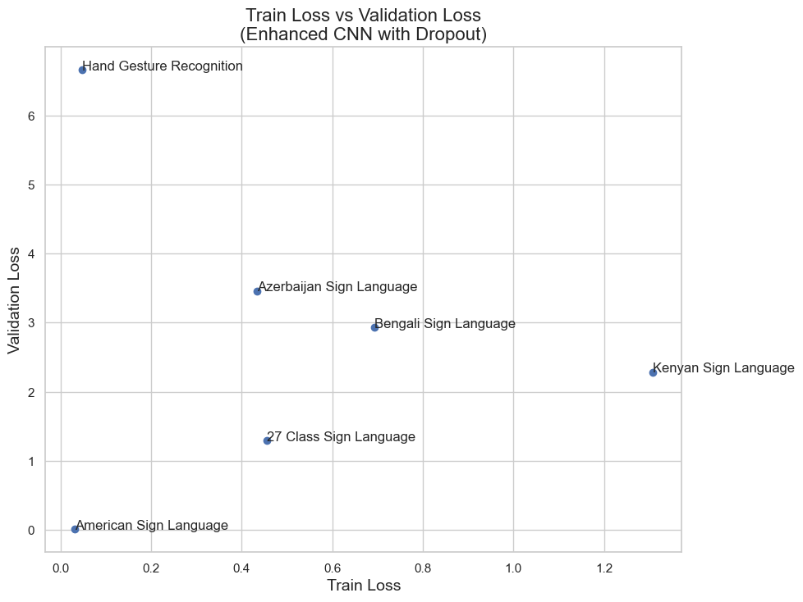
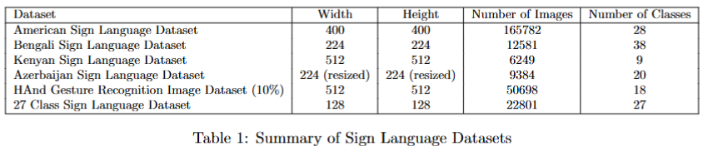
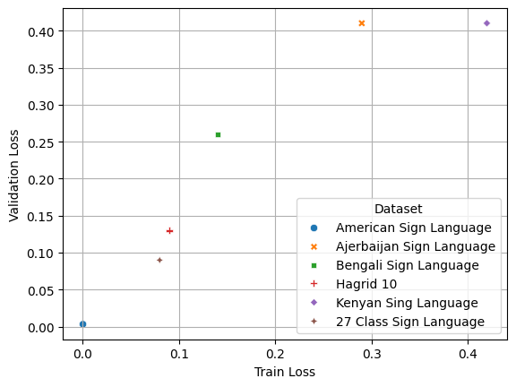
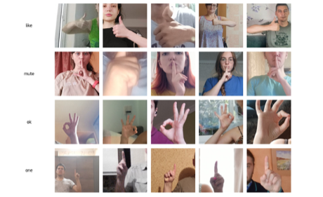
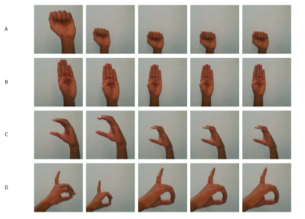
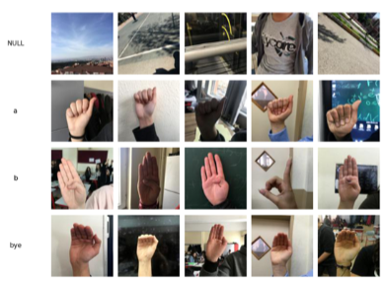
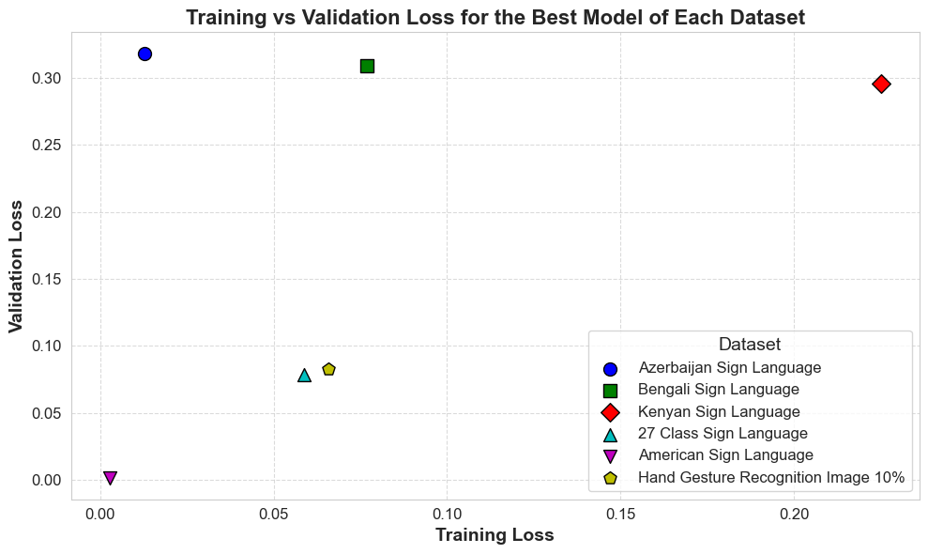
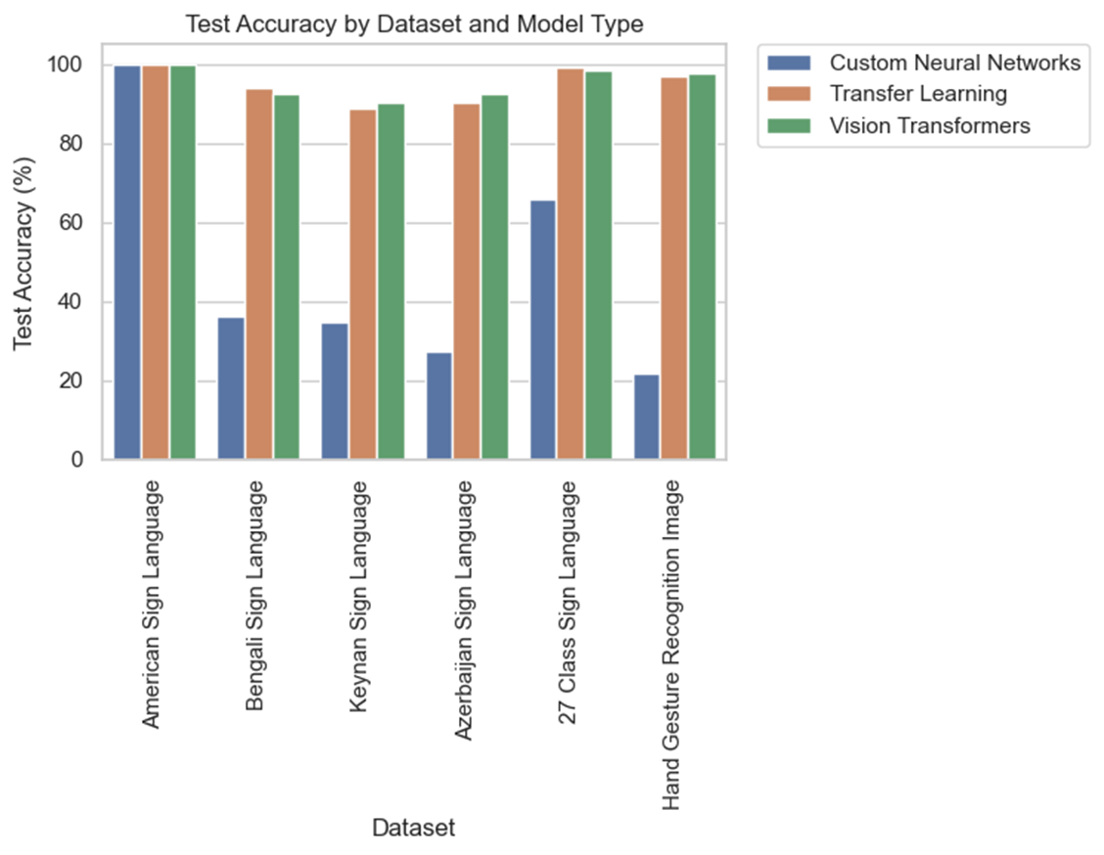
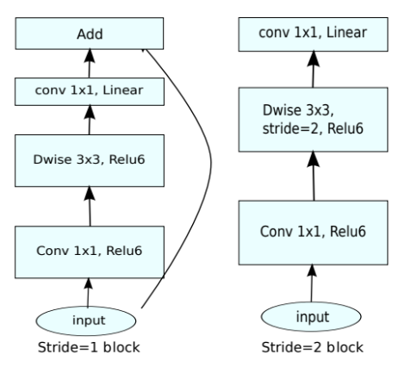
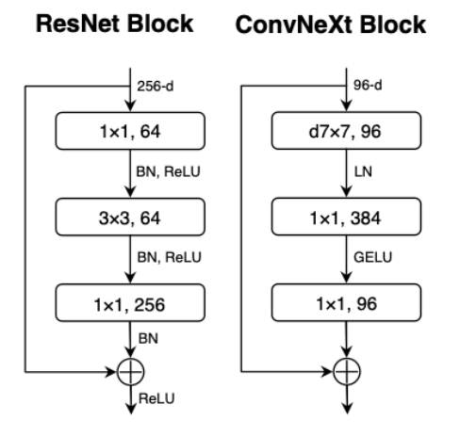
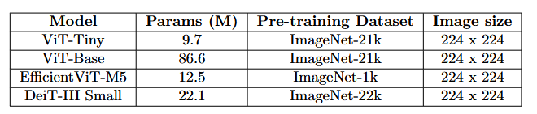
Sign Language Recognition
Myrto Potamiti, Panagiotis Korovesis, Giannis Fourfouris
1. Overview
4. Results
Goal
Develop an effective sign language recognition system.
Methodolody
Comparison of baseline models to more complex architectures
Fine-tuning and transfer learning for better accuracy
Key Observations: Comparison of model architectures and effectiveness
Custom Neural and Convolutional Networks (CNNs)
Enhanced CNN + Dropout: Improved generalization, reduced overfitting.
Tradeoff between model complexity, dataset size, and optimization efficiency.
Optimized performance with early stopping
NN overfitting on complex datasets.
2. Datasets
Six datasets containing different alphabets and gestures
Transfer Learning
MobileNetV2 outperformed ConvNeXt across all datasets despite being smaller.
Similar train-validation accuracies: Proper learning with reduced overfitting.
Minimal train-validation loss differences across all datasets
Fine-tuning the entire model: Significant accuracy improvement over training only the classification head.
Vision Transformers (ViTs)
Fine-tuning classification head: Overfitting on more complex datasets
Visual Transformer Variants: High performance across all datasets
EfficientViT-M5: Optimal time-accuracy tradeoff
Vision transformers data hungry nature: Weaker performance on small datasets
Figure 1: Sample images from: a) Hand Gesture Recognition Image Dataset, b) American Sign Language, c) 27 Class Sign Language Dataset
3. Methodology
Custom Neural and Convolutional Networks (CNNs)
Simple Feedforward Neural Network (FFNN):
Fully connected architecture with a flatten layer
Linear layer with 500 hidden units, ReLU activation.
Simple Convolutional Neural Network (CNN):
Layer 1: 32 filters (5×5) with ReLU.
Layer 2: 16 filters (3×3) with ReLU.
Flatten layer for classification.
Enhanced CNN:
Conv Layer 1: 32 filters (5×5), ReLU, Batch Norm.
Max-Pool 1: 2×2 kernel.
Conv Layer 2: 16 filters (3×3), ReLU, Batch Norm.
Max-Pool 2: 2×2 kernel.
Dropout Layer: 0.5
Fully connected Layer
Transfer Learning
Models:
MobileNetV2
ConvNetXtBase
Training Approach:
Fine-tune only the classification head: hidden size as a hyperparameter
Fine-tune the entire model
Optimizer: Adam optimizer with learning rates:
0.001 for training only the classification head.
0.0001 for full model fine-tuning.
Vision Transformers (ViTs)
Overview: Transformer architecture for image processing
Model Variants:
Classic Vision Transformer architectures
DeiT-III (Data-efficient Image Transformer): Distillation token for knowledge transfer
from a teacher model (usually CNN).
EfficientViT-M5: Cascaded Group Attention for memory efficiency.
Best Models Comparison on all methods:
Traditional CNNs: Poor generalization
Transfer Learning & ViTs outperformed custom CNN models.
Pretrained features boost accuracy.
5. Conclusions
Evaluation of three approaches: Custom Neural Networks, Transfer Learning and Vision Transformers on multiple sign language datasets
Transfer Learning and fine-tuning: Better accuracy on limited data
Context specific model selection: Dataset characteristics and application
6. Future Work
Advanced Data Augmentation
Exploitation of Video Datasets with real-time processing
References
[1] Kapil Londhe, American Sign Language, 2021.
[2] A. Muntakim Rafi et al., "Image-based Bengali sign language alphabet recognition," IEEE GHTC, 2019.
[3] Gaurav Dutta, KSL Challenge Dataset, 2023.
[4] Aykhan Nazimzada, AzSL Dataset, 2022.
[5] A. Kapitanov et al., "HAGrid dataset," IEEE/CVF Winter Conf. on Applications of CV, 2024.
[6] A. Mavi, Z. Dikle, "New 27-class sign language dataset," arXiv, 2022.
[7] M. Sandler et al., "MobileNetV2: Inverted residuals," 2019.
[8] Z. Liu et al., "A ConvNet for the 2020s," CoRR, 2022.
[9] K. He et al., "Deep residual learning," CoRR, 2015.
[10] A. Dosovitskiy et al., "An image is worth 16x16 words: Vision transformers," ICLR, 2021.
[11] H. Touvron et al., "DeiT III: Revenge of the ViT," arXiv, 2022.
[12] X. Liu et al., "EfficientViT: Memory-efficient vision transformer," CVPR, 2022
Deep Neural Network
MSc in Data Science & Information Technologies, Department of Informatics

