Slide 1
WEB SEARCH SYSTEM

Slide 2
Course | ITC6008A1 - SEARCH ENGINES AND WEB MINING
Semester | FALL TERM 2021
Team Members | Panagiotis Trafalis, Thodoris Diamantopoulos, Giannis Fitsopoulos, Ioanna Veizi

Slide 3
TABLE OF CONTENTS
TOPIC & GOAL
ARCHITECTURE
CRAWLER
PREPROCESSING
ARCHITECTURE OF IR SYSTEM
QUERY
RANDOM FOREST REGRESSOR
SEARCH ENGINE INTERFACE
EVALUATION
FUTURE WORK AND RECOMMENDATIONS
CONCLUSION

Slide 4
TOPIC & GOAL
“Build a search engine system which will allow users to search and retrieve information related to tech products.”

Slide 5
Architecture
IR System
Relevant Documents
Corpus
Query
Pretrained Models
Crawler

Slide 6
CRAWLER
ACTIONS
Tool: SCRAPY framework. Process: Make simultaneous requests. Follow the links of the webpage. Store links into a list so that duplicate links will be avoided. Read webpage and parse tags which were defined as “title”, “url”, “p” using bs4. Store context in xml files. 102.000 unique articles were stored on 3 XML files Rotate user agent to avoid ban Set random time sleep between requests Scrapped only static websites - no javascript We did not parse the date and the location

Slide 7
PREPROCESSING
ACTIONS
XML docs to dataframe (URL TITLE CONTENT) Text Preprocessing (contractions etc) Sentence tokenization – duplicate removal Remove duplicated sentences TFIDF Bert on sentences Umap on bert embedings Pretrained queries Classifier on queries based on relevance Save all data and models for future usage

Slide 8

Search Engine Processes
Preprocess User input
Stored locally
Intention to be stored in file server
Retrieve preprocessed documents
Retrieve Article TF-IDF vectors
Query TF-IDF vectorization
Article – Query vectors similarity computation
Top 10 Documents’ Results
If query in pretrained queries
Output: Most Relevant Results
Classification of relevant and non-relevant results
Article - Query embeddings similarity computation
Query encoding using Bert
Use top 10 results Retrieve corresponding sentences BERT embeddings

Slide 9
IR SYSTEM
TFIDF Vectors is trained including a lemmatizer and without stopwords The model has been saved to vectorize the query with the same parameters that produced the weights on TFIDF Use of Bert sentences with “bert-base-nli-max-tokens” on each sentence without pre-processing the articles as it is contextual Maintained the relations between sentences, articles and embeddings in order to combine tables in the future The ranking method on both bert and tfidf methods is cosine similarity Classifier is responsible to discard irrelevant documents

Slide 10
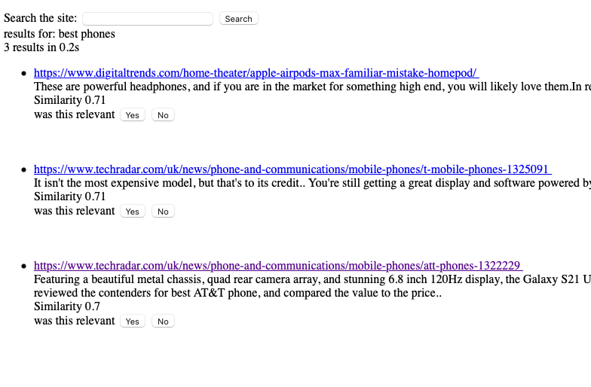
QUERY
ACTIONS | PREPROCESSING
Spellchecker(core : minimum edit distance) Query expansion with customized corpus Query matching with preloaded queries | Query vectorization with TF-IDF model Query vectorization with BERT model
When the query matches preloaded queries.

Slide 11
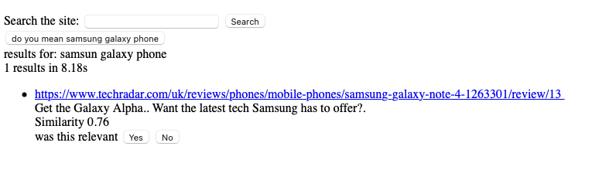
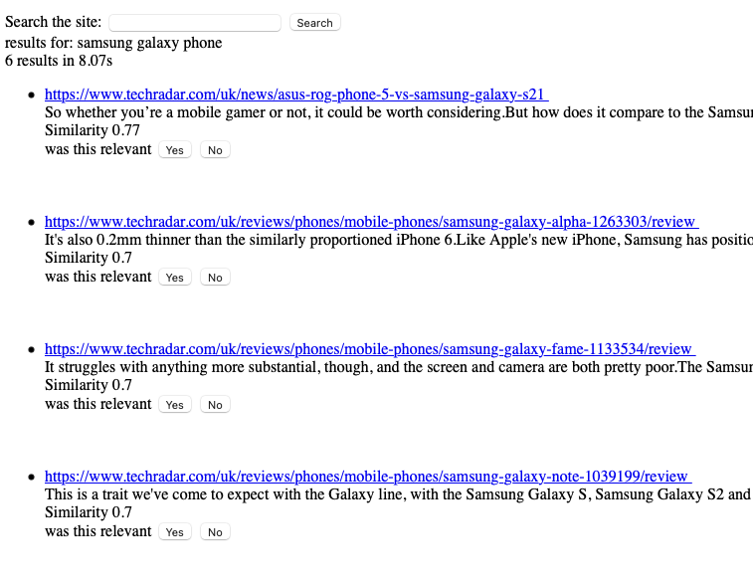
QUERY Spell checking example

Slide 12
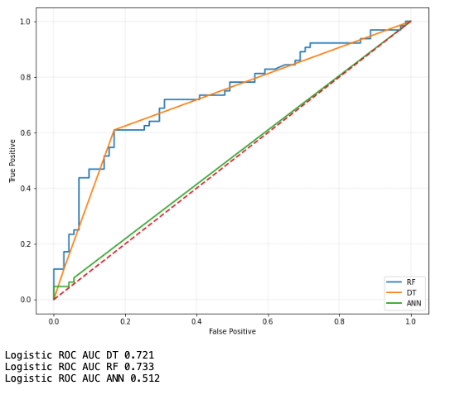
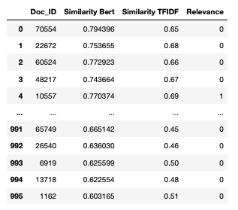
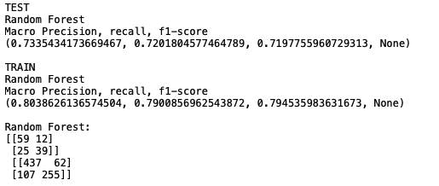
Random Forest Regressor
Build a dataset with 200 Queries and 5 corresponding articles. Final dataset includes 1000 records Different classification methods were evaluated Random Forest provides the highest performance.

Slide 13
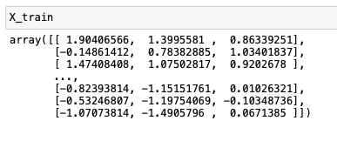
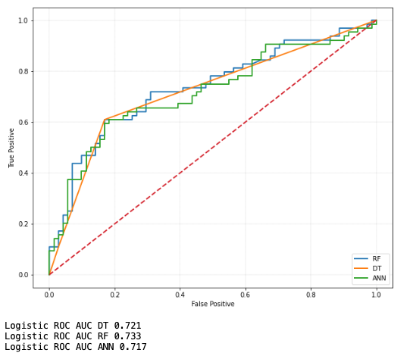
Random Forest Regressor
Using Scaled Data (sklearn stadard Scaler)
Random forest and decission tree produced the same results
ANN got much better than unscaled data
It seems that the model needs more data to increase the score
Underfited
We could not achieve better results on test dataset

Slide 14
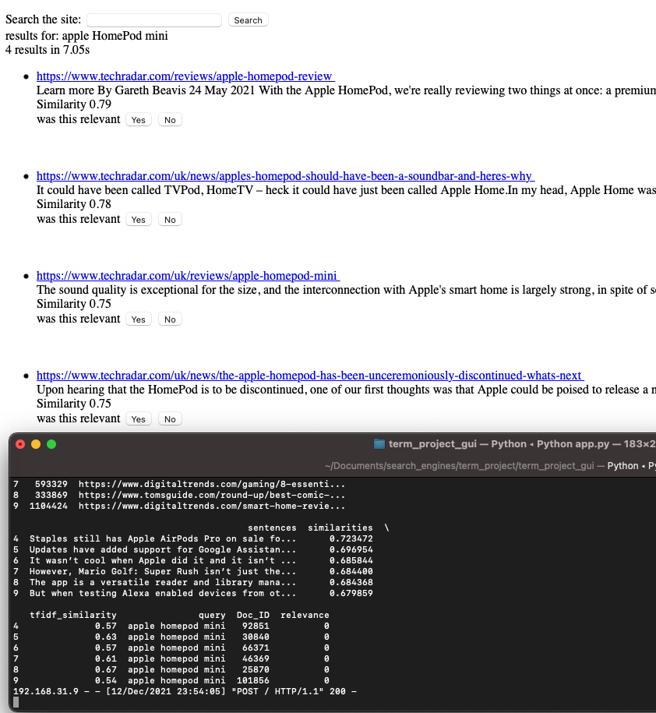
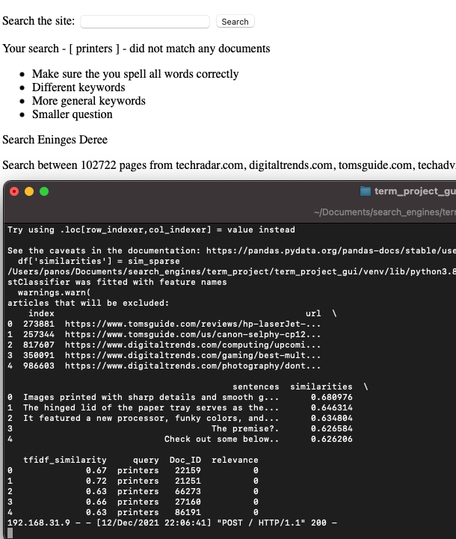
Random Forest Regressor
Examples of Limitations vs Good Practices
Predict wrong relevance

Slide 15
SEARCH ENGINE INTERFACE
Built a user interface with flask.
With the initialization of the interface all models are loaded
The only computations taking place are the preprocessing of queries similarity calculations and classifier prediction

Slide 16
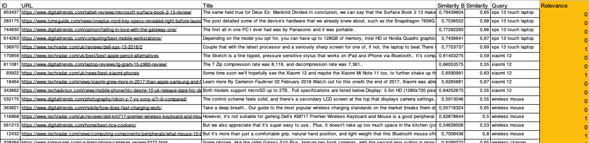
EVALUATION
Overall, 7 model variations were applied and evaluated.
We collected 30 most common queries and evaluated the relevant documents the IR system returned.
The returned documents were limit approximately 5-10 results.
They covered a variety of topics in the domain.
Methods: Precision, Recall, F1- score

Slide 17
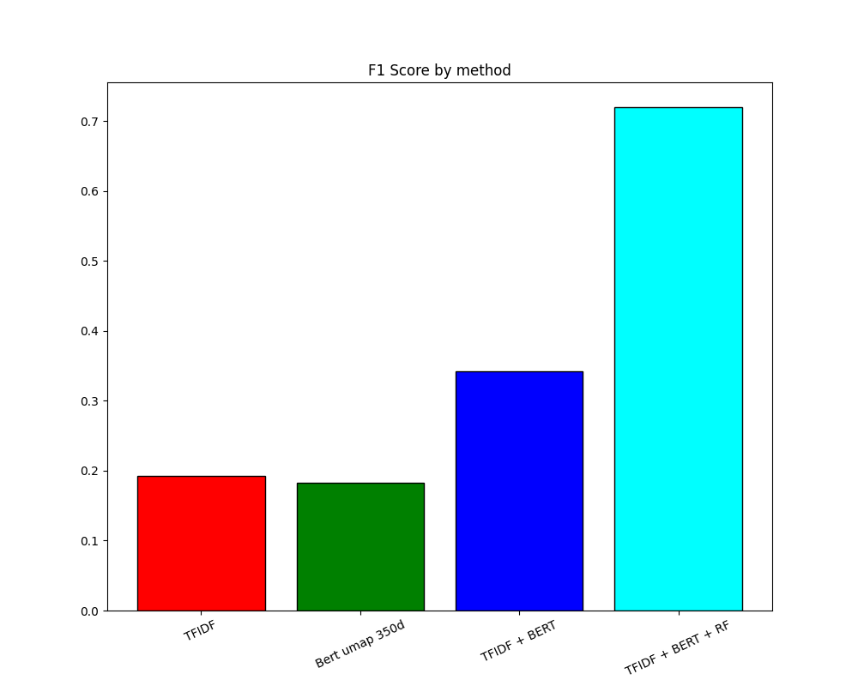
EVALUATION
METHODS | OBSERVATIONS
TF-IDF without stopwords and lemmatization | High performance Mid results
Bert Embeddings | Poor performance Good results
TF-IDF + Bert embeddings | Fair performance Good results
TF-IDF + Bert embeddings ( Umap 10d) | High performance Poor results
TF-IDF + Bert embeddings ( Umap 100d) | Fair performance Poor results
TF-IDF + Bert embeddings ( Umap 350d) | Fair performance Fair results
TF-IDF + Bert embeddings + Classification | Fair performance "The best of all the methods"

Slide 18
FUTURE WORK AND RECOMMENDATIONS
Team Opinion
Even though satisfying results were returning from the queries posed there will always be room for improvement.
Topic modeling integration
Addition of date and the location contribution
Retrain the Bert model based on our corpus
Increase dataset for the classification

Slide 19
CONCLUSION
Overall, we managed to create a search engine where a user can look for tech-oriented articles.
The final information retrieval system returns satisfactory results.
The task proved to be quite challenging.
Further future initiatives may conclude to more accurate and faster results.

Slide 20
THANK YOU

