Slide 1
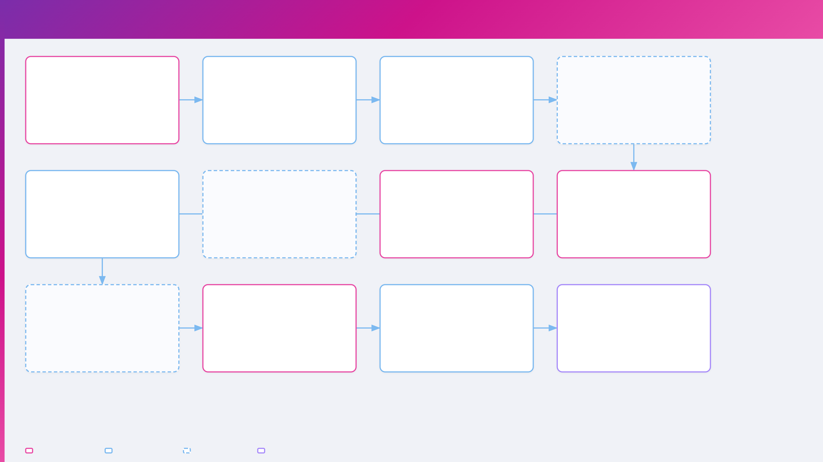
Team Process — End-to-End Flow
Recruiter submits request
Nova generates campaign
Marketing review & guidance
Marketing approves for design
Fills intake wizard with job description, requirements, and budget
6-stage AI pipeline runs automatically — personas, images, copy, creatives, video, landing pages
Marketing Manager reviews output
First approval gate — sends to designer for creative polish
Edit media strategy
Request enters the system
Adjust budgets & targeting
📩 Teams + Outlook to Designer
⏱ ~15–30 minutes
Review ad copy
If changes needed → regenerate pipeline.
Marketing final approval
Designer submits finals
Designer edits & polishes
Designer reviews creatives
Reviews designer's polished creatives and signs off
Creatives marked as ready for final review
Miguel creates
Opens gallery per persona
Quick retouch (Flux 2)
Review all versions & formats
✓ Campaign approved
📩 Teams + Outlook to Marketing
Graphic overlay edits
Check VQA quality scores
Figma export & push
Lightbox fullscreen preview
If revision needed → back to designer.
Notifications sent
Recruiter accesses library
Marketing sends to agency
Agency launches campaigns
Teams + Outlook email to Recruiter and Agency contact
Creative library is live
Generates magic link for paid media team
Opens magic link portal
View composed creatives
🔗 Magic link generated
Downloads all creatives
📩 Campaign live & delivered
Build UTM tracked links
Gets targeting & ad copy
Share with candidates
Gets landing page URLs
Recruiter / Designer
Marketing Manager
Notification / Gate
Agency
Nova Creative Operations · OneForma

Slide 2
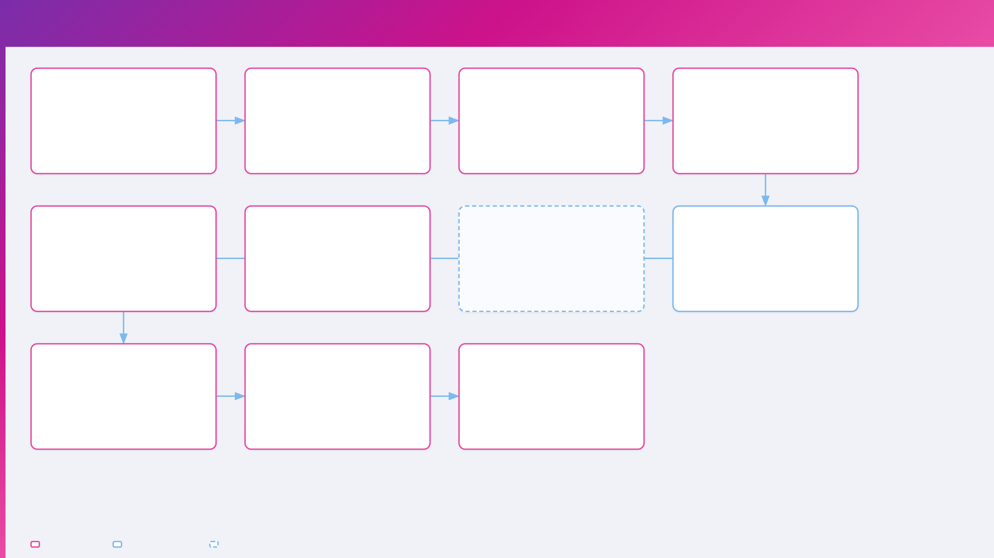
Recruiter Workflow
Receive job description
Upload or paste RFP
Fill project details
Review & submit
Recruiter gets JD or RFP from hiring team — ready to submit
Step 1 of intake wizard — AI extracts task type, regions, qualifications automatically
Steps 2-4 of wizard
Step 5 — verify all fields, click Submit Request
Task type & work mode
Or skip → manual entry
Title, volume, regions
Request created → status: draft
Qualifications & AIDA form
Build UTM tracked links
Open Creative Library
Notification received
Pipeline auto-generates
Sticky Link Builder panel
View all composed creatives filtered by channel tabs — Meta, LinkedIn, TikTok, Google
Teams + Outlook email: "Your campaign creatives are ready for review"
6-stage AI pipeline runs — personas, images, copy, creatives, video, landing pages
Select base URL
Auto-generates UTM params
📩 Teams + Outlook
Copy short link
⏱ ~15–30 minutes
View landing pages
Share with candidates
Download creatives
Per-persona /lp/ URLs available — copy for ad campaign destinations
Distribute tracked links via email, social media, job boards, and direct outreach
Download individual creatives or batch download for offline use
🔗 Landing page URLs
Recruiter never sees: raw images,strategy editing, designer tools,pipeline stages, or admin panel.
Recruiter action
System / automated
Notification
Nova Creative Operations · OneForma

Slide 3
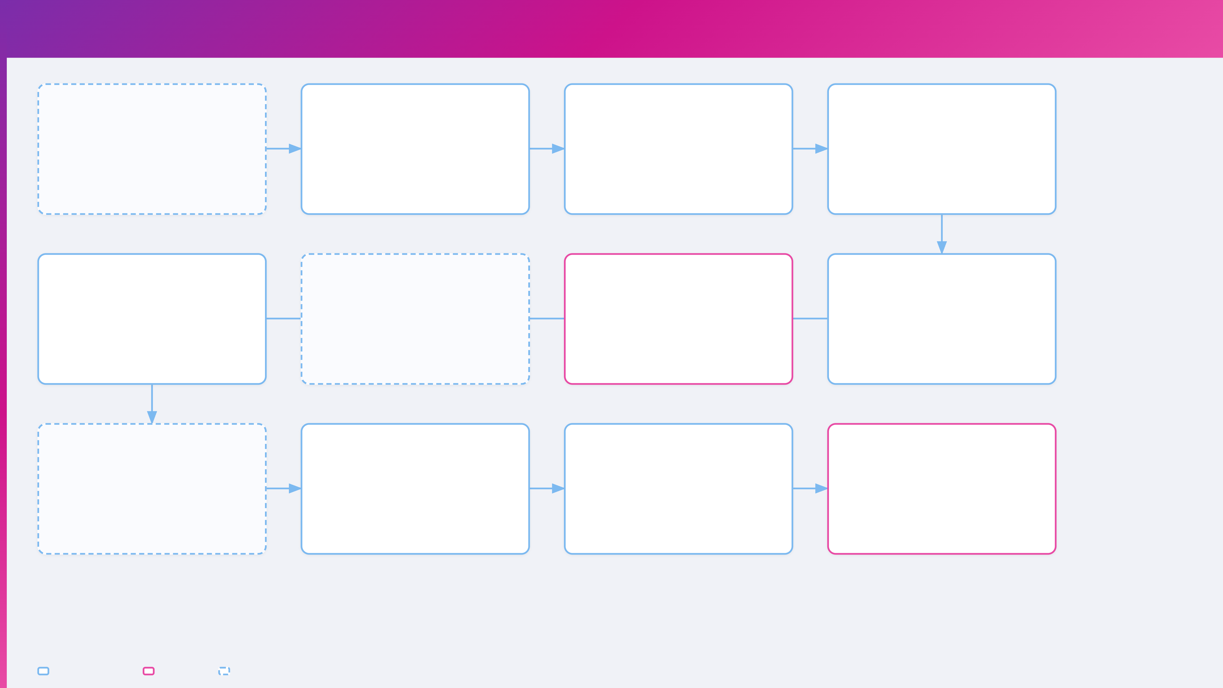
Marketing Manager Workflow
Campaign arrives for review
Review campaign brief
Edit media strategy
Edit ad copy & URLs
Request on dashboard with status: review
Campaign Workspace — 3 tabs
Inline editing with autosave
Per-persona inline editing
📩 Teams + Outlook notification
Messaging strategy
Channel mix % — auto-rebalance
Headlines, body, CTAs
Channel recommendations
Ad set daily budgets
Landing page URLs
Persona summaries
Targeting interests per tier
Job posting URL
All edits autosave — 800ms debounce PATCH.
Final approval
Designer finals submitted
Designer polishes creatives
Approve for design
Reviews designer's polished creatives — last quality gate
Notification received — polished creatives ready for final review
Marketing Manager waits while designer retouches and exports to Figma
First approval gate — satisfied with AI output and edits
✓ Campaign approved
📩 Teams + Outlook
⏱ Designer working
📩 Teams + Outlook to Designer
If revision needed → back to designer.
Notifications sent
Generate agency magic link
Agency receives package
Recruiter accesses library
Teams + Outlook to Recruiter ("campaign live") and Agency contact
Auto-creates authenticated portal URL for paid media agency
Strategy, targeting, creatives, ad copy, UTM links, landing page URLs — all via magic link
Creative library live — recruiter builds tracked links and shares with candidates
📩 Campaign approved & live
🔗 /agency/id?token=...
Marketing action
Other role
Notification / Gate
Nova Creative Operations · OneForma

Slide 4
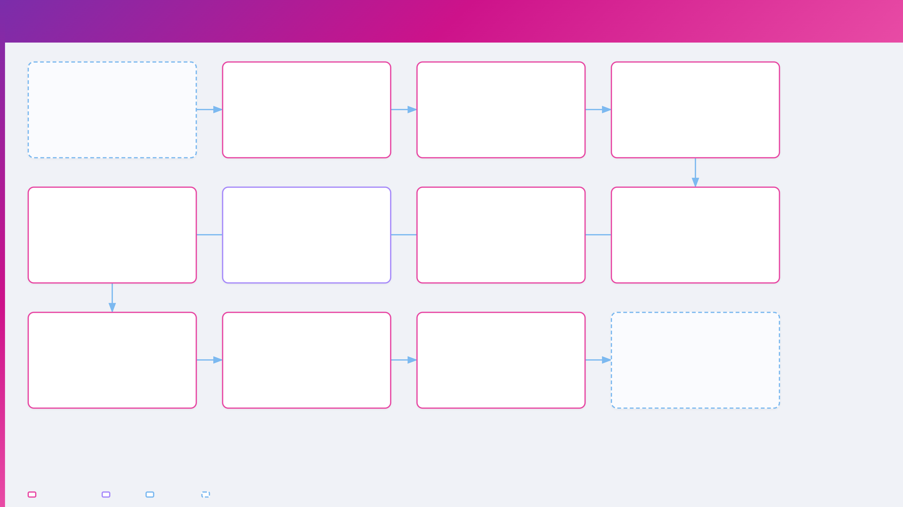
Designer Workflow
Assignment notification
Open Designer Dashboard
Review creative gallery
Review design notes
Teams + Outlook email: "Campaign ready for design review"
Workboard with status groups
Per-persona tabs with context cards
Curated metadata per creative — persona psychology, demographics, targeting context
Needs Attention
Version accordions V1–V5
📩 From Marketing Manager
In Progress
Format cards with VQA scores
Completed
Lightbox fullscreen preview
Regenerate — Seedream 4.5
Figma integration
Graphic Editor — Overlay
Quick Edit — Flux 2
Full image regeneration
Bidirectional workflow
Green layer — live text controls
Amber layer — photo retouching
Change: scene, lighting, pose
Export ZIP SVGs → auto-open
Edit headline, CTA, body copy
Brush mask to select area
Expression, outfit checkboxes
Push: campaign / persona / version
Font, size, color, position
Fix face, remove object, change bg
Triggers Stage 2/4 regen
Sync status polling
Real-time canvas preview
Before/after comparison
Multiple edit rounds until satisfied.
Edit LP in Dreamweaver
Deploy LP to WordPress
Submit finals
Campaign goes live
Download generated HTML → edit in Dreamweaver → sync back to Nova (drift re-validated)
FTP push to WP root → LP URL auto-captured → inserted into campaign_landing_pages
Creatives + landing pages all ready for Marketing Manager's final approval
Marketing approves → recruiter library + agency magic link + live WP landing pages
📩 Teams + Outlook to Marketing
📩 Notifications to all
🔗 URL auto-populates everywhere
Designer action
Figma
Marketing
Notification
Nova Creative Operations · OneForma

Slide 5
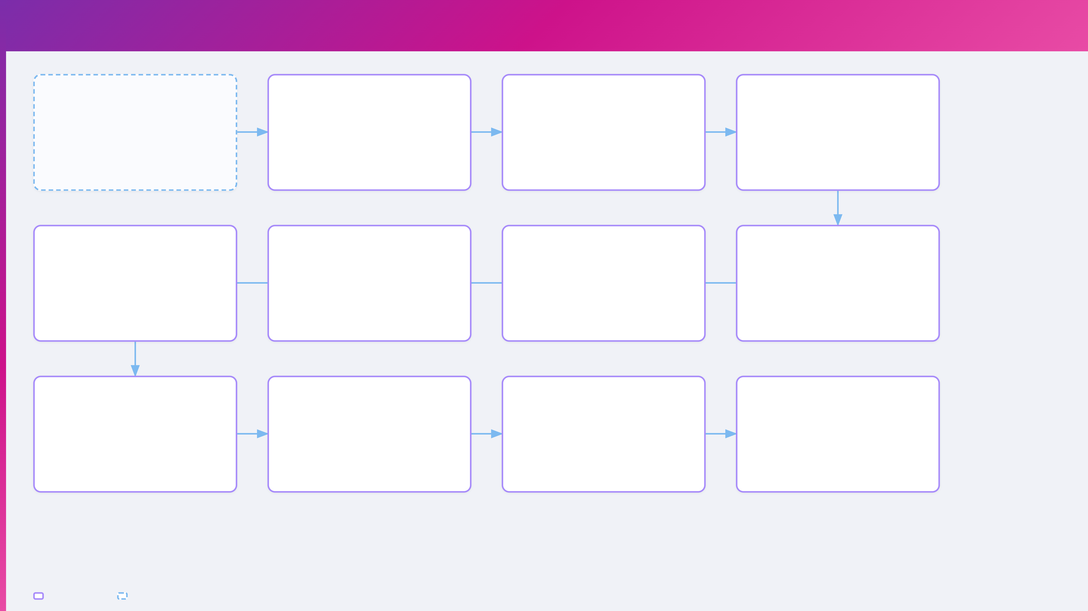
Paid Media Agency Workflow
Receive magic link
Open agency portal
Tab 1: Overview & Strategy
Tab 2: Channels & Ad Sets
Teams + Outlook email with authenticated portal URL — no login required
/agency/id?token=... — campaign title, slug, status badge, expiry timer
High-level campaign view
Per-channel accordion sections with full targeting detail
Persona targeting profiles
📩 From Marketing Manager
⏰ Expires in 7 days
Channel mix visualization
Meta · LinkedIn · TikTok · Google
Budget allocation per channel
Landing page URLs
UTM tracked links
Creative thumbnails & copy
Ad set targeting detail
Per-persona /lp/ routes for ad click destinations — message-matched
Pre-built tracking URLs per creative — ready to paste into ad manager
Per ad set — sorted by VQA score
Per ad set card
Headline, body, CTA
Interests: hyper / hot / broad
🔗 /lp/campaign--persona
🔗 Campaign + source + medium
Description text
Demographics & geo
Hook type badge
Placements & rules
Download all creatives
Launch campaigns
Set ad destinations
Campaigns live
ZIP file with all composed creatives organized by channel and persona
Upload creatives to Meta Ads Manager, LinkedIn Campaign Manager, etc.
Use landing page URLs as click-through destinations in each ad set
(already provided UTMs per ad/creative)
Ads running with tracked links, matched creatives, and per-persona landing pages
📦 Bulk download
✓ End-to-end delivery
Agency is fully read-only — no editing, no approval controls, no raw assets.
Agency action
Notification
Nova Creative Operations · OneForma

Slide 6
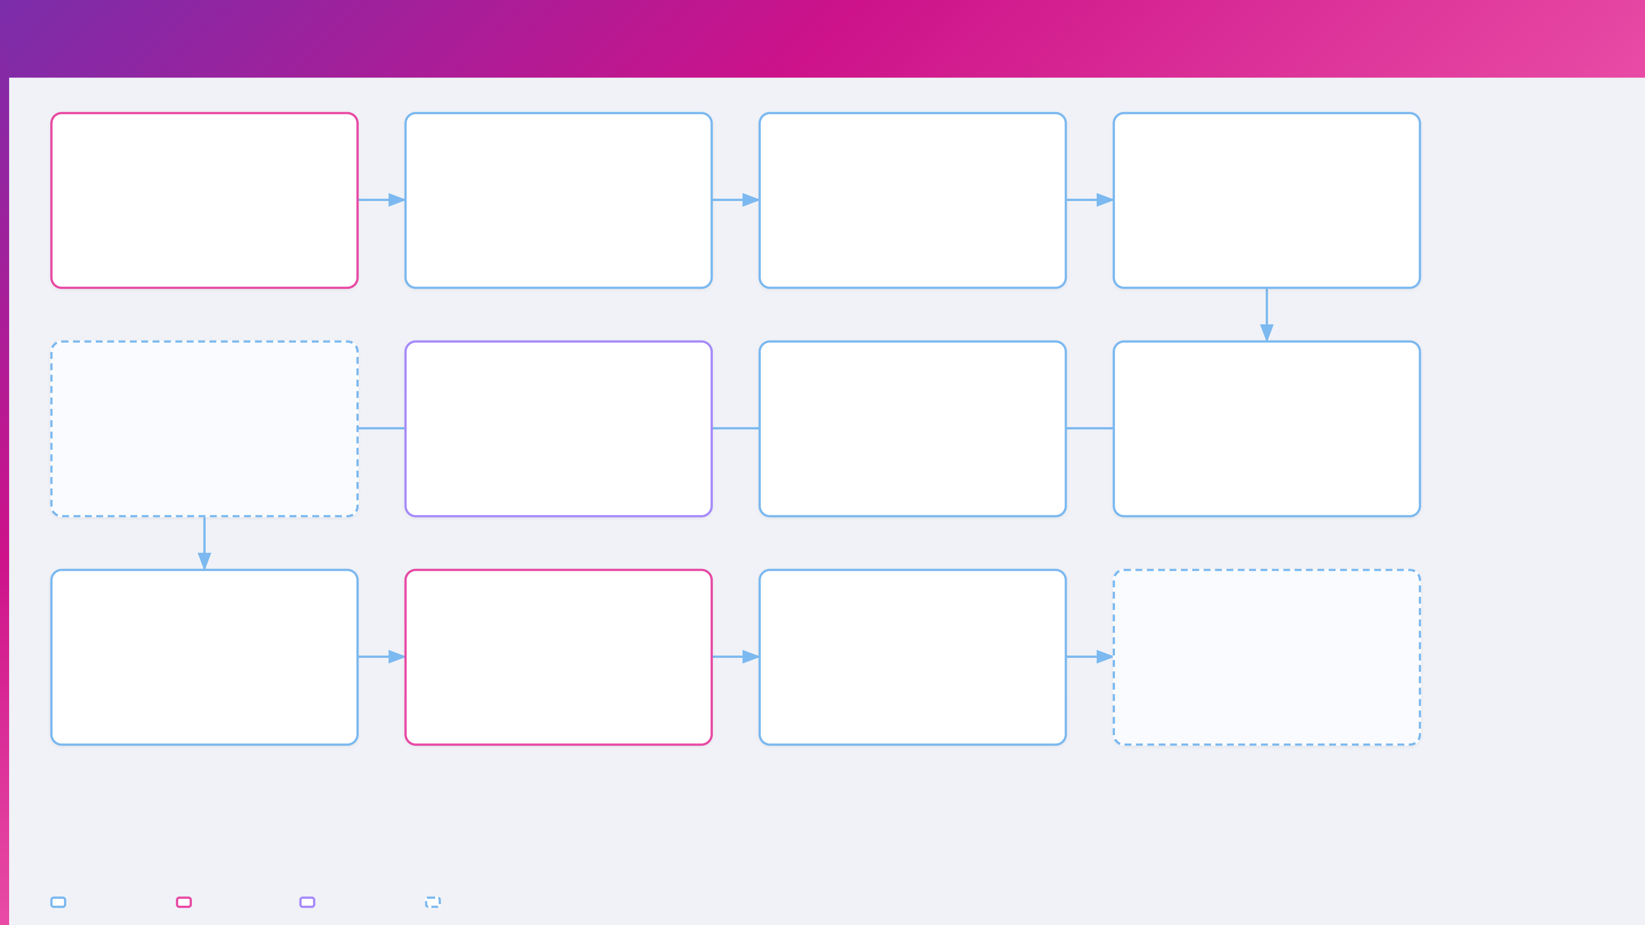
System Pipeline — All 6 Stages
Intake → compute_job
Stage 1: Intelligence
Stage 2: Images
Stage 3: Copy
Recruiter submits → intake_request created → compute_job queued → worker claims
Kimi K2.5 + Qwen 3.5 397B
Qwen 3.5 + Seedream 4.5
Gemma 3 27B (creative specialist)
Research (Kimi) + reasoning (Qwen)
Actor desc (Qwen) → images (Seedream)
Per persona × channel × language
Status: draft → generating
Personas, brief, design direction
Cleanup: Flux 2 Pro (optional)
3 pillar variations each
🛡️ 8-dim eval gate (Qwen 3.5)
🛡️ VQA gate (Qwen3-VL local)
🛡️ Copy quality gate
Pipeline complete
Stage 6: Landing Pages
Stage 5: Video
Stage 4: Composition
All 6 stages done — status → review
Gemma 4 (copy) + GLM-5 (HTML)
Gemma 4 + Seedream + Kling V3
GLM-5 (design) + Gemma 4 (VQA)
📩 Teams + Outlook: Creatives ready
Per-persona, 5 templates
Storyboard (Gemma 4 31B)
HTML/CSS → Playwright → PNG
Hard facts injected (Jinja2)
Scenes (Seedream 4.5)
Flux 2 edit loop (up to 3x)
🛡️ Drift validation (deterministic)
Video (Kling V3 Omni / Sedeo)
🛡️ VQA ≥ 0.85 (Gemma 4 31B)
Marketing reviews all
Designer polishes + deploys
Final approval
Delivery
Strategy, creatives, copy, AND landing pages — edits inline
Creatives + Figma + LP edits in Dreamweaver → FTP to WordPress
Marketing Manager signs off — status → sent
Agency magic link + recruiter library + live WP landing pages
Gate 1 — includes LP review
Gate 2 — LP URL auto-captured
Gate 3 — ✓ Approved
📩 Teams + Outlook to all
Kimi K2.5 (research) · Qwen 3.5 397B (reasoning) · Gemma 3 27B (copy) · Gemma 4 31B (VQA/storyboard) · GLM-5 (design/HTML) · Seedream 4.5 (images) · Flux 2 Pro (edit) · Kling V3 (video)
Pipeline stage
Human action
Stage 6 (new)
Notification / Gate
Nova Creative Operations · OneForma

