Slide 1

Privacy-Preserving Twitter Browsing through Obfuscation
Panagiotis Papadopoulos
Master Thesis Presentation
University of Crete
School of Sciences and Engineering
Computer Science Department
Anonymous Microblogging Browsing through
k-Subscription
Panagiotis Papadopoulos
Master Thesis Presentation
University of Crete
School of Sciences and Engineering
Computer Science Department

Slide 2



Microblogging Services
A popular way for information sharing and communication.
Users are able to have timely access to all information available from various providers.

Slide 3
Publish-Subscribe Model
Information providers (channels)
politicians
news agencies or news reporters
hospitals or doctors
activists
artists
religious organizations
other communities
Users subscribe to (or follow) channels
In this way they receive interesting information in a timely manner

Slide 4
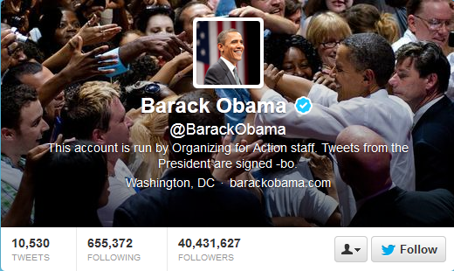

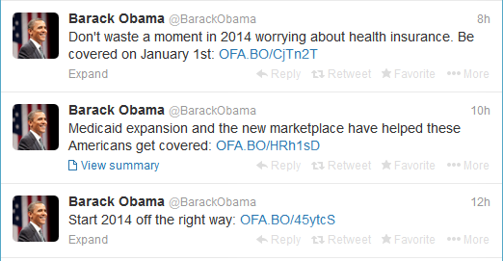

Publish-Subscribe Model (example)
channel subscription process
Channel 1
Channel 2

Slide 5
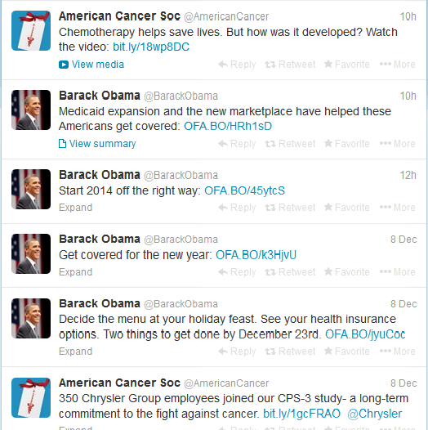
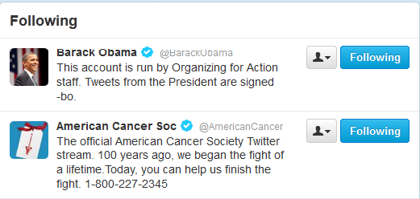
Publish-Subscribe Model (example)
User’s timeline
information delivery process
User’s following

Slide 6
What about users’ privacy?
The microblogging service knows a user’s interests based on the user’s channel subscriptions
Political preferences (e.g., Barack Obama)
Health issues (e.g., cancer)
Detailed user profiling
Privacy-sensitive channels
Can be used for many purposes
Beyond the control of the users

Slide 7
Threat Model
An “honest but curious” microblogging service
capable of passively gain knowledge about users’ interests by monitoring the channels they follow.
knowledge that can be given/sold to third parties e.g. advertisers
Users that need access to timely information and they are able to follow individual channels.
A channel can be the account of a physical person, a corporation, a politician’s office, and so on.

Slide 8
How can we protect users’ privacy?

Slide 9
Existing approaches:
No login
limited information available to non-logged in users.
Correlation of served content + IP address.
Pseudonym or fake account
IP address, third-party tracking cookies, browser fingerprints can reveal user’s identity
Anonymization service (e.g., Tor)
Logging into the service, possibility of Tor nodes blocking
Tor + Fake account
Cookies and fingerprints gathered through anonymous and eponymous browsing sessions
Fake account + Tor + VM per browsing session
Too complex for ordinary users and mobile devices

Slide 10
But…
How can we hide users’ interests in a world where it will be practically impossible to hide one’s real identity?
Our thesis is:
users’ interests can be protected using obfuscation

Slide 11
k-subscription
For each privacy-sensitive channel C₁ a user really wants to follow with k-subscription, the user will also randomly follow k - 1 additional sensitive channels acting as noise: C₁, C₂, C₃, …, C_{k} (where C₂, C₃, …, C_{k} are noise channels)
This way:
The service cannot identify a user’s actual choices
Hide the choices of other users as well
The service cannot identify the users that are actually interested in C₁
Note: All channels C₁, C₂, C₃, …, C_{k} belong to the same set S of privacy-sensitive channels

Slide 12
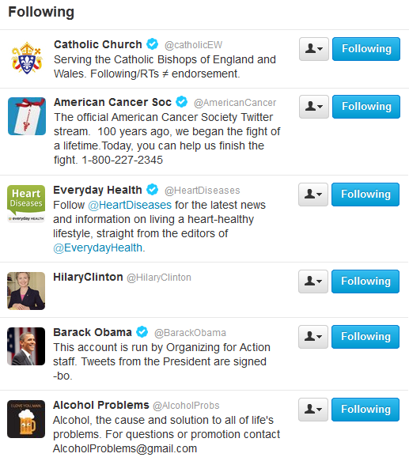

k-subscription in action
Random noise
Real choices

Slide 13
Obfuscation algorithms
Uniform sampling
Randomly select every channel in S as noise with same probability
Proportional sampling
Randomly select every channel in S as noise with probability proportional to its popularity
Multiple channels
Following a set of semantically-related channels. Can be easily identified by the service
Just choose proper k so that there are other users that select the same set as noise

Slide 14

Implementation
Browser extension for Google Chrome browser
Using Twitter as case study
Responsible for obfuscation, noise filtering, timeline construction
twitter.com
Actual + Noise
Channels
k-subscription
Actual Channels
Sensitive Channels Set S

Slide 15
Remove the effect of noise (1/2)
What the microblogging service sees:
What the user sees:
Real + noise channels
Only real channels

Slide 16
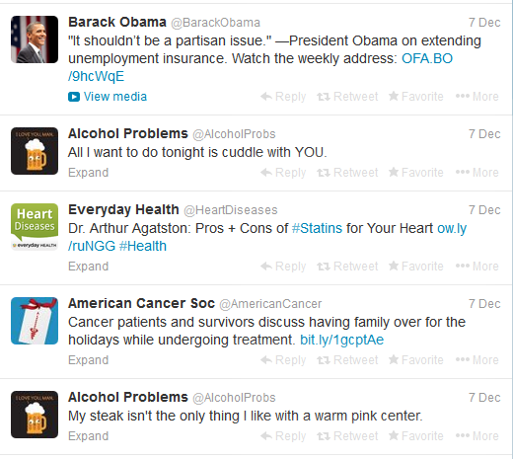
Remove the effect of noise (2/2)
What the microblogging service sees:
What the user sees:
Tweets from real + noise channels
Tweets only from real channels

Slide 17
Disclosure Probability P_{C}
The probability that a user following channel C is actually interested in C
Depends on
channel’s popularity p_{C}
(e.g number of followers)
size of set S (|S|)
Publicly released
obfuscation level k
Can be inferred => a user follows k channels in short period

Slide 18
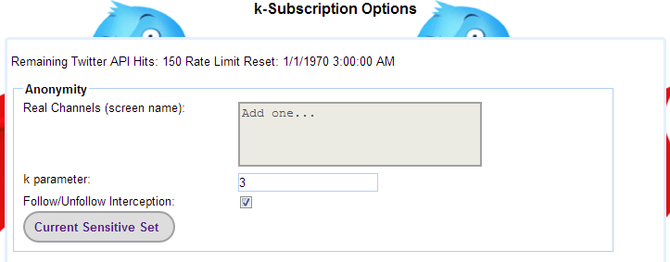
The k parameter
Fine-tune the k parameter to control the preferable privacy level and network overhead

Slide 19
What is the right k value?

Slide 20
Choosing a value for k
Analysis and simulation for disclosure probability as a function of k
Experimental evaluation for network overhead as a function of k

Slide 21
ANALYTICAL EVALUATION

Slide 22
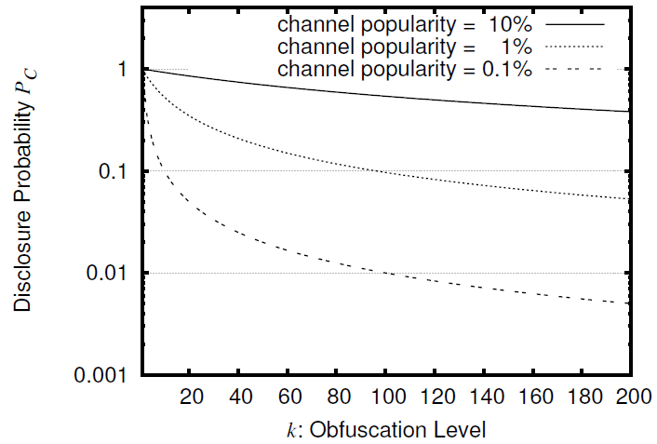
Uniform Sampling
|S|=1000 channels
When channel popularity is high (10%), it is difficult to obfuscate with uniform sampling
0.4
For channel popularity 1% and k=100, disclosure probability is 10%
For channel popularity 0.1% and k=100, disclosure probability is 1%

Slide 23
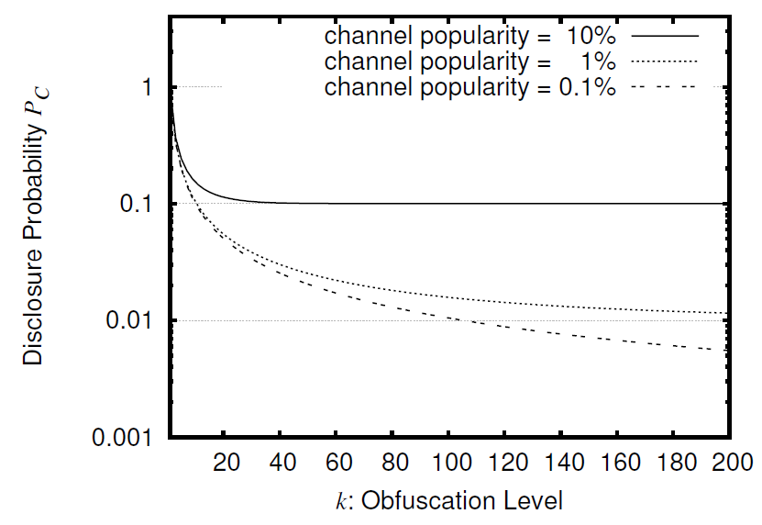
Proportional Sampling
|S|=1000 channels
For channel popularity 10% and k=40, disclosure probability is just 10%
For channel popularity 1% and k=50, disclosure probability is 2%

Slide 24
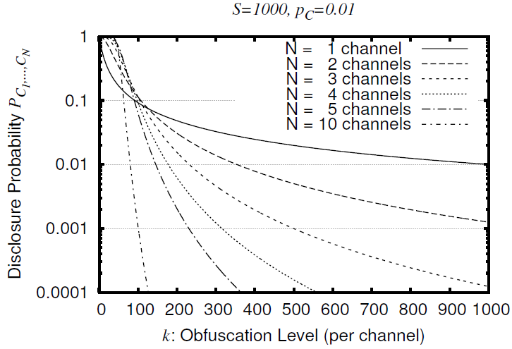
Following Multiple Channels
For high values of k, disclosure probability decreases significantly with number of channels
For low values of k, disclosure probability increases with the number of sensitive channels
Because users interested in these N channels are few
Because users interested in N sensitive channels follow k x N channels in total, which leads to more noise

Slide 25
Simulation-based Evaluation

Slide 26
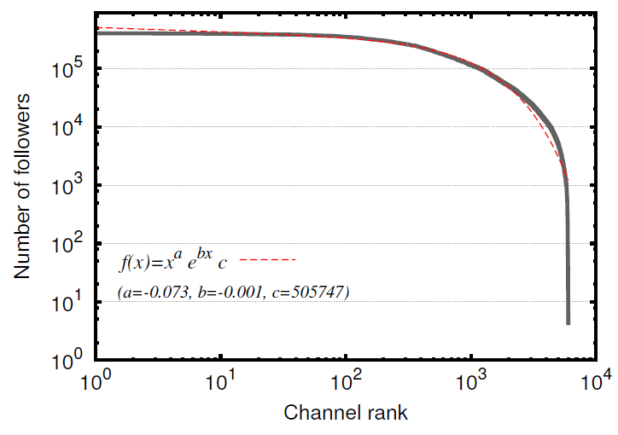
Sensitive Channels Popularity Distribution
Use of set S with 7, 000 sensitive channels using Twellow
distribution can be approximated very well using a power
law with exponential cutoff model

Slide 27
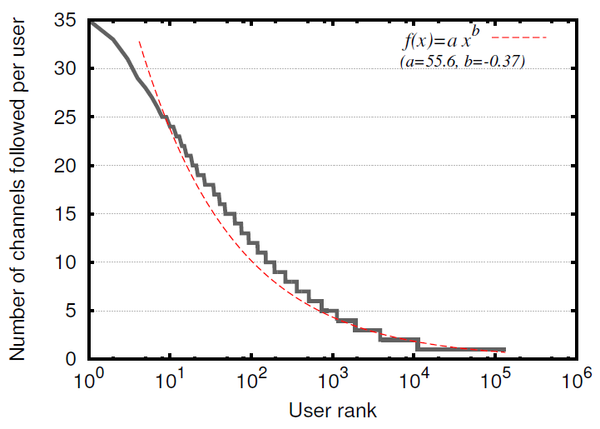
Number of sensitive channels users follow
0.85% follows 4 channels when 91.65% follows only 1 channel
can be approximated very well using a power law

Slide 28
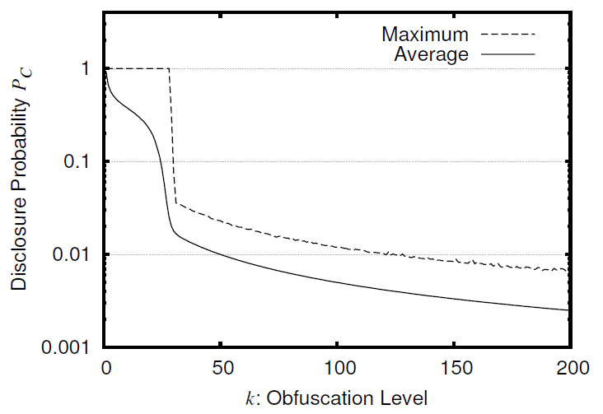
Simulation-Based Study
disclosure probability decreases rapidly with k for all channels and users
|S| = 1,000 channels U = 1,000,000 users

Slide 29
Experimental Evaluation

Slide 30
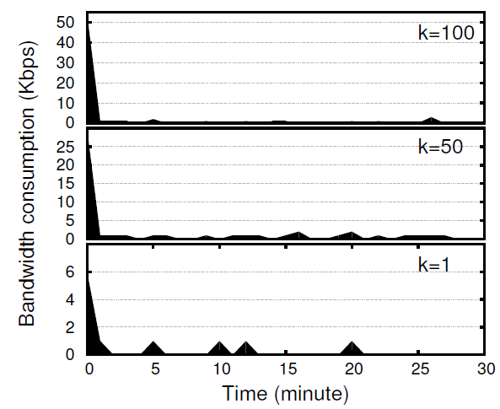
Bandwidth Consumption Over Time
Less than 1.5 Kbps to follow k=100 channels
Large spike when loading Twitter’s page
Between 0.5 – 1.0 Kbps Most of the bandwidth is used to download other information, which does not depend on k

Slide 31
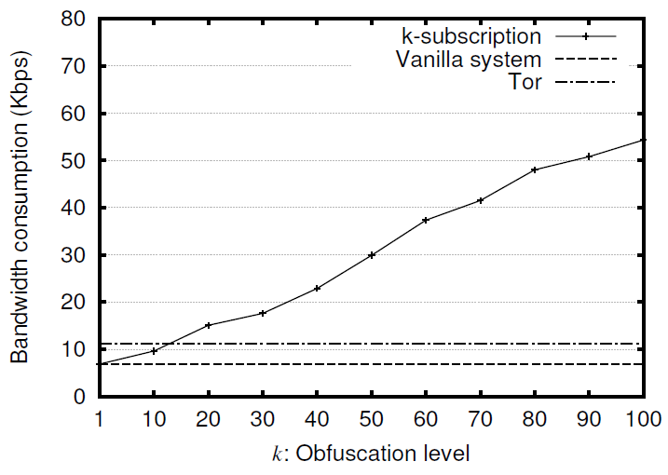
Bandwidth Consumption: Initialization Stage
Twitter downloads content (like widgets, scripts, CSS profile images, trends)
k-subscription downloads tweets from all k channels in order to create a full timeline

Slide 32
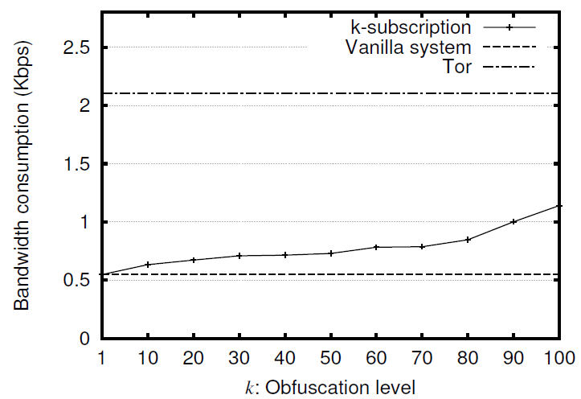
Bandwidth consumption: Idle stage

Slide 33
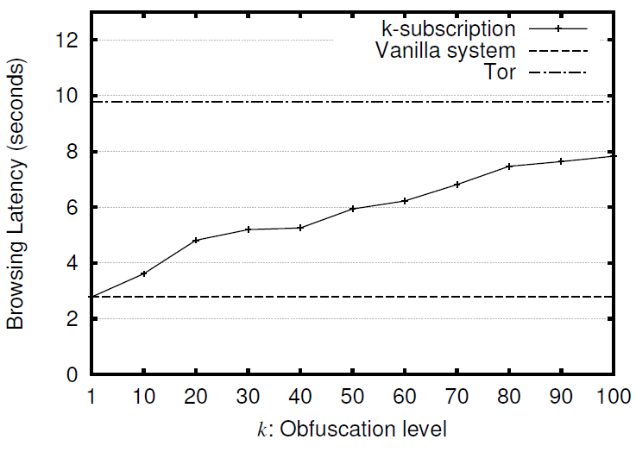
Browsing Latency
10 seconds to download and display Twitter page with Tor
7.7 seconds to download and display Twitter page when k=100
2.8 seconds to download and display Twitter page when k=1
When the browser remains open (idle case) we do not observe any delay

Slide 34
Our tool is available as a Google Chrome browser extension
This work has been published in the 29th Annual Computer Security Applications Conference (ACSAC ‘13) on Dec 2013 at New Orleans, USA

Slide 35
Conclusions
k-subscription: an obfuscation-based approach for privacy-preserving Twitter browsing
Hide user’s subscriptions within selected noise
Hide user’s subscriptions within noise of other users
Add noise from a common set with sensitive channels
Fine tuning the k parameter
Disclosure probability
Network overhead
In a future where user’s identity cannot be hidden privacy could be achieved by:
obfuscation and
mutual collaboration between users.

Slide 37
Backup Slides

Slide 38
Posting Messages
k-subscription protects microblogging browsing:
Does not aim to hide users’ interests when users want to post about a sensitive issue
Does not aim to hide users’ interests when users want to retweet a post of a sensitive channel
For protecting user posts there are alternative solutions:
Hummingbird, #h00t, etc. (using post encryption)

Slide 39
Short URLs
Short URL services usually cooperate with microblogging services. So these URL shortening services can be used to infer user’s interests based on user clicks on short URLs
k-subscription, when a user clicks on a short URL, resolves, transparently, on the background all short URLs in tweets from noise and real channels.

Slide 40
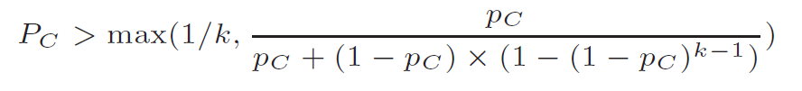



Formulas for Disclosure Probability P_{C}
Uniform Sampling:
Proportional Sampling:
Following multiple channels N:

Slide 41
Sensitive channels S
Maintained by a privacy-related organization
Users may request, through k-subscription, new sensitive channels to be added in this set
The set S must be shielded against malicious users that tries to insert a large number of fake channels in order to increase disclosure probability
CAPTCHAs to avoid computer bots that inserts batches of fake channels
Use of Yahoo Term Extraction API in order to evaluate the channel’s sensitivity
Channel’s activity and channel’s audience validation
Channel’s audience evaluation: amount of followers to the amount of following ratio, number posts coming from API, duplicate or spam posts, posts with unrelated links.

Slide 42
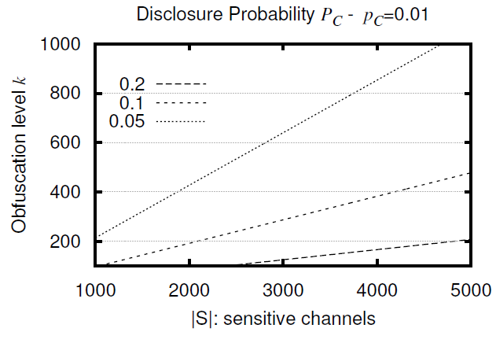
Size of Sensitive Channels Set (1/2)
Linear relationship between obfuscation level and size of sensitive channels set
If we double the size of sensitive channels, we need twice as high k for the same disclosure probability
Channel popularity: 1% Disclosure probabilities: 0.2, 0.1 and 0.05

Slide 43
Size of Sensitive Channels Set (2/2)
in order to keep the disclosure probability constant:
if we double |S| -> we must double k value
for a constant obfuscation level k:
larger |S| -> higher disclosure probability.
very small |S| would easily give away a user’s true interests+limit the users’ choice for channels
if S contains n members, the microblogging service will be able to conclude with probability at least 1/n that the user is interested in the channel she follows.
|S| must be enough so 1/|S| < UC/U

Slide 44
Why not N-tuples?
Whenever a user is interested in N related channels:
the (k − 1) × N noise channels that will follow
will be selected in N-tuple groups, so that each N-tuple consists of N related noise channels.
However: the microblogging service may use different similarity metrics to identify related channels.

Slide 45
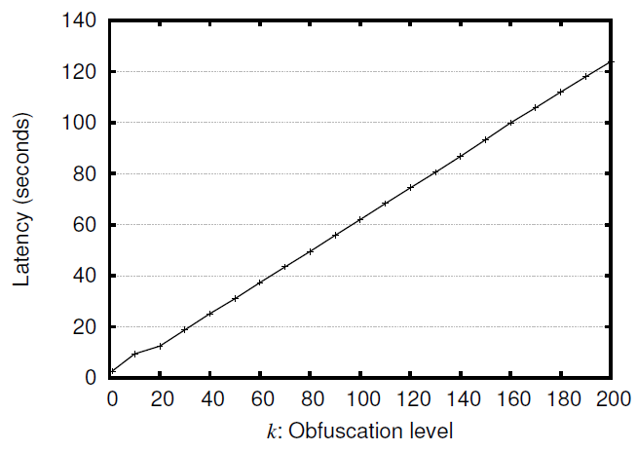
Time to follow a sensitive channel
It takes one minute to follow k=100 channels

Slide 46
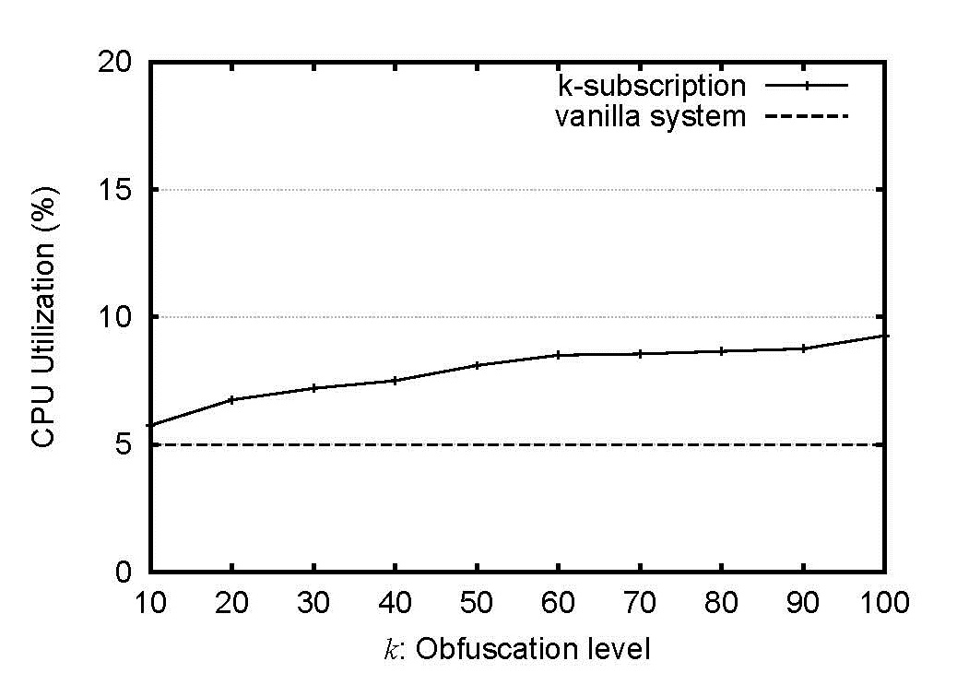
CPU load ~ Initialization stage
less than 3% during the Idle stage

Slide 47
What about giving the wrong impressions?
User following illness-related channels or bankruptcy-related channels => worrying friends + family
dummy account protects against worrying family
(but NOT against microblogging service, that can use IP tracking or cookies)
followings can be organized in separate private lists (Twitter provides this option).
That option also, does not offer protection against Twitter

Slide 48
What about disappearing channels?
People close or delete their accounts:
If users stop following channel D and it’s noise => correlate D’s disappearance with the users’ change of following patterns => users were interested in channel D.
If users noise channels start disappearing => service will be in a better position to find the exact channel they are really interested in.
add other noise? => NO, the service will figure out the noise channels
users interested in D + users who not interested in D but have included D as noise => should do nothing! => the service will not be able to differentiate which users are interested in D and which are not.

Slide 49
k-subscription-UNIF
when 10% of the users are interested in channel C:
it would take a significant percentage of the rest 90% to include channel C among their noise channels,
when popularity is around 1%:
then it is much easier to obfuscate it.
for k = 100 the disclosure probability is as low as 0.1

