Slide 1
Graph Algorithms for Central/Eastern US Highway Routing
Panagiotis Papadopoulos
Jeevana Shruti Kunuku
Ghaayathri Devi Kannan
Roshini Tamanamu
Pavan Praneeth Katakam
Veda Pranay
Medasani Surya Teja Kolli
TEAM 2
45-minute presentation plan: president intro, technical walkthrough, Python demo, results, discussion
PNW Spring 2026 CS 51510-002 Algorithms | Course Project

Slide 2
Presentation Roadmap and Timing
0-5 min: president introduction and project motivation
5-12 min: data, graph model, and business rules
12-27 min: BFS, DFS, Prim, Kruskal, Dijkstra, Bellman-Ford
27-35 min: comparison results and performance monitoring
35-42 min: Python demo
42-45 min: conclusion and questions
PNW Spring 2026 CS 51510-002 Algorithms | Course Project

Slide 3
Project Motivation
Learn graph algorithms through a travel-routing problem
Use Linux-style performance monitoring for CPU, memory, disk, and runtime
Combine algorithms with practical constraints: weather risk, elevation, fuel, and driving hours
Produce terminal output and visual map artifacts for each algorithm
PNW Spring 2026 CS 51510-002 Algorithms | Course Project

Slide 4
Dataset and Restrictions
38 graph nodes: one city for each Central/Eastern time-zone state/region plus Washington, DC
Weather window: January 1, 2026 through March 30, 2026
Weather risk: sun/cloud = 1, rain = 5, snow/ice = 10
Travel limit: 8 hours/day at 75 mph
Vehicle baseline: 45 miles per gallon
PNW Spring 2026 CS 51510-002 Algorithms | Course Project

Slide 5
Graph Construction Rule
Cities are graph nodes
Edges exist only between cities whose states share a border
Edge weight is estimated highway mileage from latitude/longitude
This rule explains connections such as Chicago, IL to Louisville, KY: Illinois and Kentucky border each other
PNW Spring 2026 CS 51510-002 Algorithms | Course Project

Slide 6
Full Graph: Neighboring-State Highway Network
The SVG uses real state outlines as the map layer
Blue/green dots are selected city nodes
Gray edges are allowed neighboring-state connections
Labels show city/state and estimated mileage
PNW Spring 2026 CS 51510-002 Algorithms | Course Project

Slide 7
Python Program Menu and Demo Flow
Menu can show cities, run individual algorithms, run all algorithms, or compare pairs
Dijkstra and Bellman-Ford ask for start and destination city
Each algorithm result saves a map SVG and prints the saved path
Terminal transcript is saved as output/terminal_output.txt
PNW Spring 2026 CS 51510-002 Algorithms | Course Project

Slide 8
Algorithm 1: BFS
Breadth-First Search explores level by level from the start city
Useful for reachability and broad expansion
Does not optimize weighted distance
Demo default: BFS starting from Chicago
PNW Spring 2026 CS 51510-002 Algorithms | Course Project

Slide 9
Algorithm 2: DFS
Depth-First Search follows a branch deeply before backtracking
Useful for structural exploration
Visit order differs from BFS even when both reach all nodes
Does not optimize weighted distance
PNW Spring 2026 CS 51510-002 Algorithms | Course Project

Slide 10
BFS vs DFS: Five-Case Comparison
Cases: Chicago, Dallas, Boston, Atlanta, Minneapolis
Both algorithms visit the same connected component
BFS gives level-order expansion; DFS gives deep branch exploration
Runtime is small for this dataset, but traversal behavior is visibly different
PNW Spring 2026 CS 51510-002 Algorithms | Course Project

Slide 11
Algorithm 3: Prim
Prim grows a minimum spanning tree outward from a selected start city
Best for connecting all cities with low total network mileage
Not a point-to-point travel route
Default example starts from Chicago
PNW Spring 2026 CS 51510-002 Algorithms | Course Project

Slide 12
Algorithm 4: Kruskal
Kruskal sorts all graph edges by weight
It adds the next cheapest edge that does not create a cycle
Produces the same MST total as Prim on the same graph
Useful as a validation partner for Prim
PNW Spring 2026 CS 51510-002 Algorithms | Course Project

Slide 13
Prim vs Kruskal: Five-Case Comparison
Prim was tested from five different starting cities
Kruskal was run on the same graph for each case
Both produced the same MST total distance
Different internal strategy, same optimization objective
PNW Spring 2026 CS 51510-002 Algorithms | Course Project

Slide 14
Algorithm 5: Dijkstra
Dijkstra finds the shortest weighted route between two selected cities
Works well here because all edge weights are positive
Example shown: shortest route from Chicago to Miami
Business result includes route, miles, travel risk, fuel, and best date
PNW Spring 2026 CS 51510-002 Algorithms | Course Project

Slide 15
Algorithm 6: Bellman-Ford
Bellman-Ford also finds shortest paths
It is slower on this positive-weight graph but useful for comparison
Supports negative edge weights in other graph problems
Example shown: same route pair as Dijkstra
PNW Spring 2026 CS 51510-002 Algorithms | Course Project

Slide 16
Dijkstra vs Bellman-Ford: Five-Case Comparison
Cases include Chicago-Miami, Dallas-Boston, Minneapolis-Atlanta, New Orleans-New York, Oklahoma City-Washington
Both algorithms returned the same shortest-path distances
Dijkstra was generally faster for this positive-weight graph
Bellman-Ford is algorithmically broader, but unnecessary for strictly positive mileage weights
PNW Spring 2026 CS 51510-002 Algorithms | Course Project

Slide 17
Travel Risk, Fuel, and Best Date
Risk per leg is the average of the two city risks
Elevation adjustment: real_distance = map_distance * (1 + tan(theta))
tan(theta) = elevation_difference_in_miles / map_distance
Gasoline consumption = real_distance / 45 mpg
Best date minimizes accumulated weather risk
PNW Spring 2026 CS 51510-002 Algorithms | Course Project

Slide 18
Linux Performance Monitoring
Every algorithm is wrapped in a performance monitor
Metrics: elapsed milliseconds, CPU percent, peak memory KB, disk read KB, disk write KB
psutil gives richer CPU/disk measurements when installed
tracemalloc captures peak memory without external packages
PNW Spring 2026 CS 51510-002 Algorithms | Course Project

Slide 19
Python Implementation Highlights
Standard-library graph implementation: adjacency list, heap queue, disjoint set, deterministic weather model
Menu-driven interface for repeatable class demonstration
SVG maps are generated automatically and opened as popups
Terminal output is saved for report screenshots and appendix material
PNW Spring 2026 CS 51510-002 Algorithms | Course Project

Slide 20
Python Demo Script
President: introduce motivation, team, and business problem
Demo 1: show cities and graph
Demo 2: run Dijkstra from Chicago to Miami and open SVG map
Demo 3: run Bellman-Ford for same cities
Demo 4: run comparison option and discuss results
PNW Spring 2026 CS 51510-002 Algorithms | Course Project

Slide 21
Conclusions and Contributions
BFS/DFS demonstrate traversal behavior
Prim/Kruskal validate minimum spanning tree construction
Dijkstra/Bellman-Ford validate shortest-path logic
Weather, elevation, and fuel formulas connect graph algorithms to travel planning
All team members contribute to report, demo, explanation, testing, and presentation
PNW Spring 2026 CS 51510-002 Algorithms | Course Project

Slide 22
Thank You
Questions?
Code, generated maps, terminal output, and report are included in the project folder.
PNW Spring 2026 CS 51510-002 Algorithms | Course Project

Slide 23
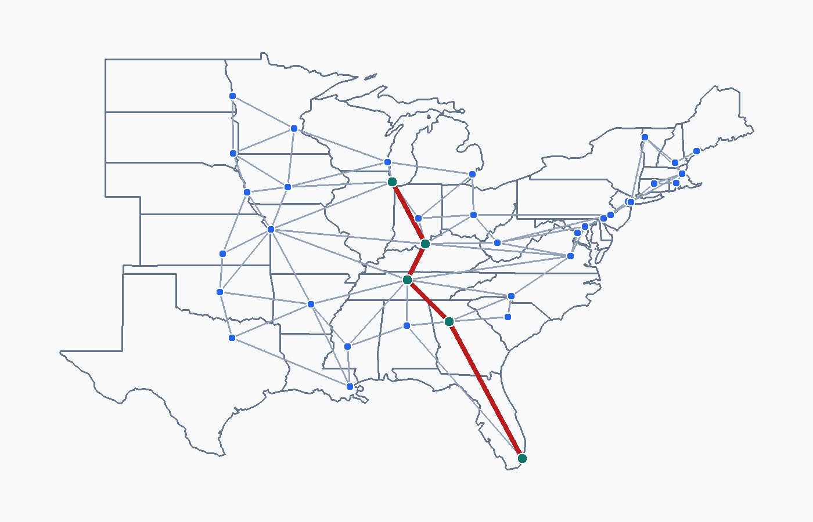
Route Comparison 1: Chicago → Miami
Travel Metrics
Route length: 5 cities
Path: Chicago → Louisville → Nashville → Atlanta → ...
Map distance: 1469.8 miles
Travel days: 3 (max 8 hrs/day)
Total hours on road: 19.6 hrs
Gasoline consumed: 32.66 gal (45 mpg)
Best start date: 2026-01-09
Weather risk: 4.0 (1.00/leg avg)
Dijkstra shortest route: Chicago to Miami
PNW Spring 2026 CS 51510-002 Algorithms | Course Project 3

Slide 24
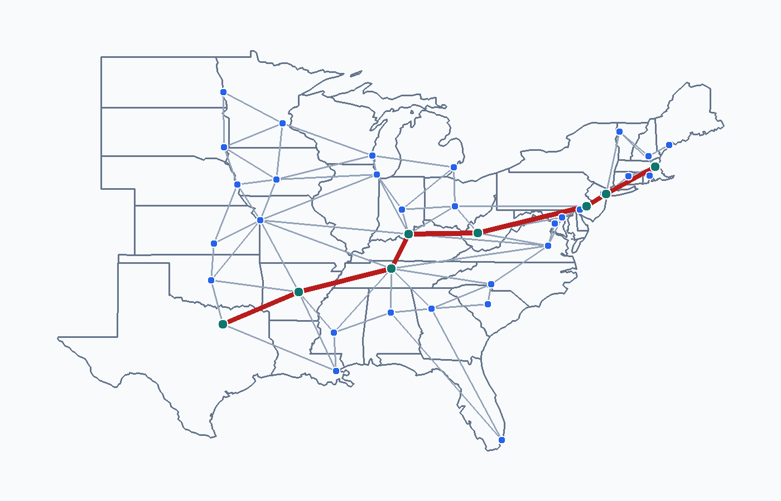
Route Comparison 2: Dallas → Boston
Travel Metrics
Route length: 8 cities
Path: Dallas → Little Rock → Nashville → Louisville → ...
Map distance: 1924.2 miles
Travel days: 4 (max 8 hrs/day)
Total hours on road: 25.7 hrs
Gasoline consumed: 42.76 gal (45 mpg)
Best start date: 2026-02-08
Weather risk: 11.0 (1.57/leg avg)
Dijkstra shortest route: Dallas to Boston
PNW Spring 2026 CS 51510-002 Algorithms | Course Project 3

Slide 25
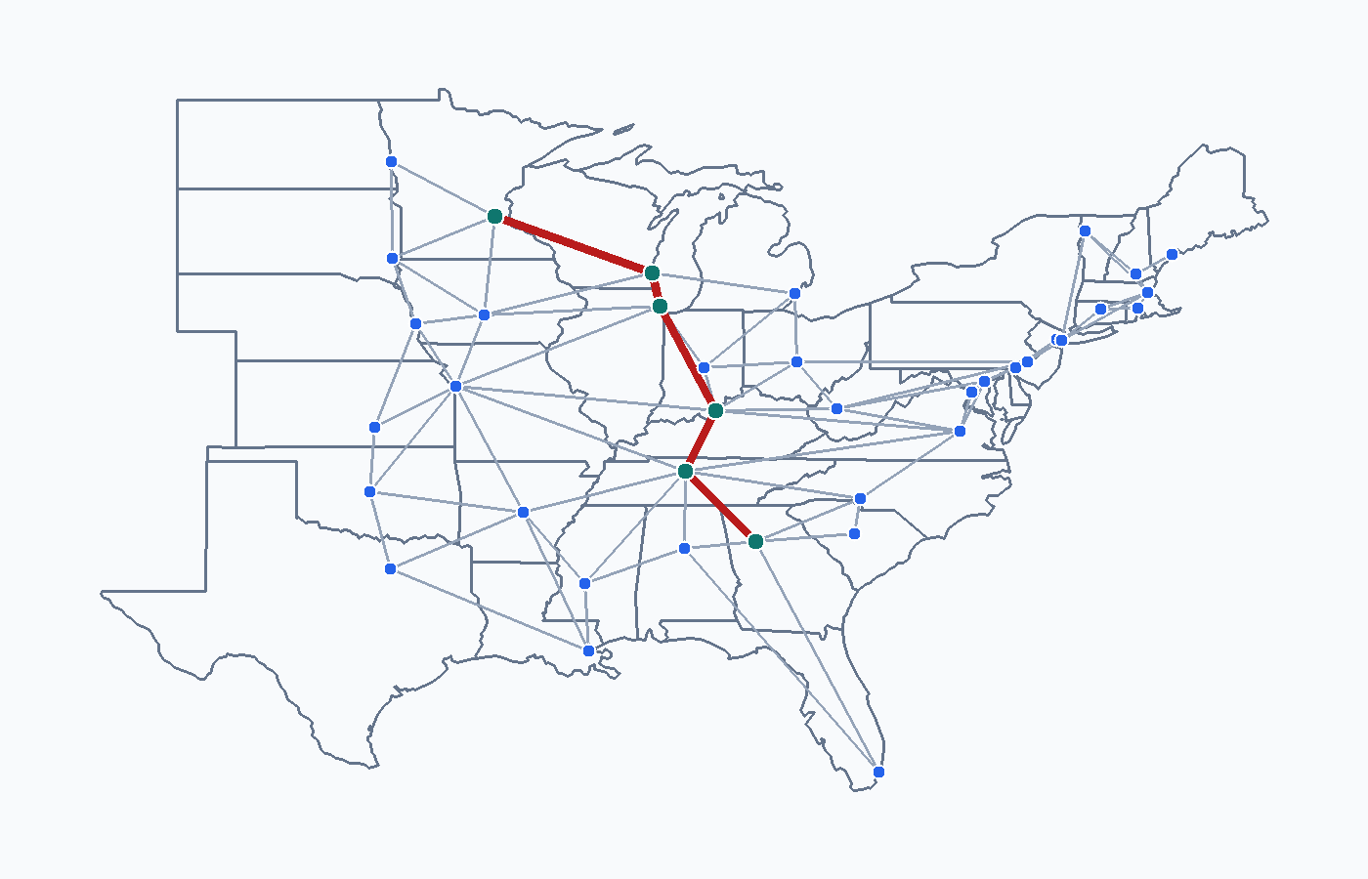
Route Comparison 3: Minneapolis → Atlanta
Travel Metrics
Route length: 6 cities
Path: Minneapolis → Milwaukee → Chicago → Louisville → ...
Map distance: 1202.0 miles
Travel days: 3 (max 8 hrs/day)
Total hours on road: 16.0 hrs
Gasoline consumed: 26.71 gal (45 mpg)
Best start date: 2026-01-09
Weather risk: 5.0 (1.00/leg avg)
Dijkstra shortest route: Minneapolis to Atlanta
PNW Spring 2026 CS 51510-002 Algorithms | Course Project 3

Slide 26
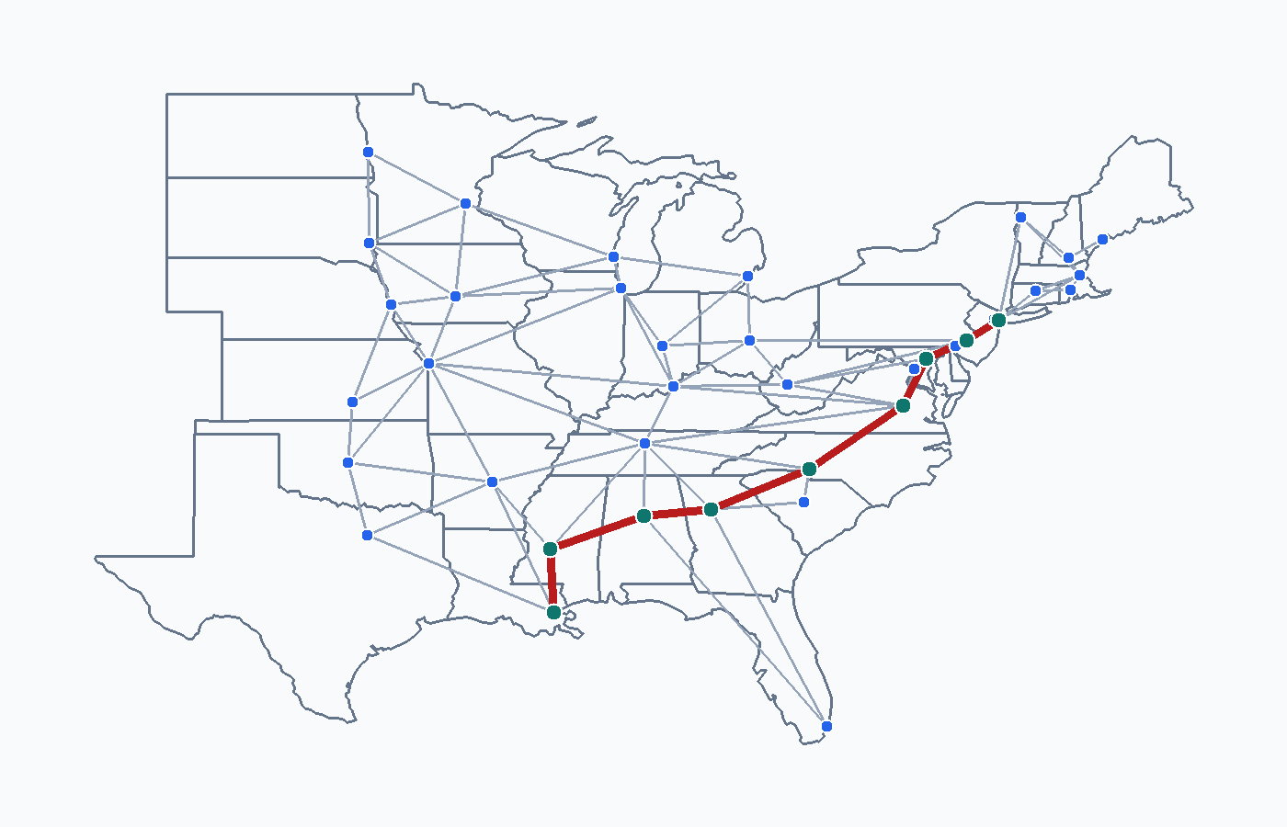
Route Comparison 4: New Orleans → New York
Travel Metrics
Route length: 9 cities
Path: New Orleans → Jackson → Birmingham → Atlanta → ...
Map distance: 1520.8 miles
Travel days: 3 (max 8 hrs/day)
Total hours on road: 20.3 hrs
Gasoline consumed: 33.8 gal (45 mpg)
Best start date: 2026-02-14
Weather risk: 12.0 (1.50/leg avg)
Dijkstra shortest route: New Orleans to New York
PNW Spring 2026 CS 51510-002 Algorithms | Course Project 3

Slide 27
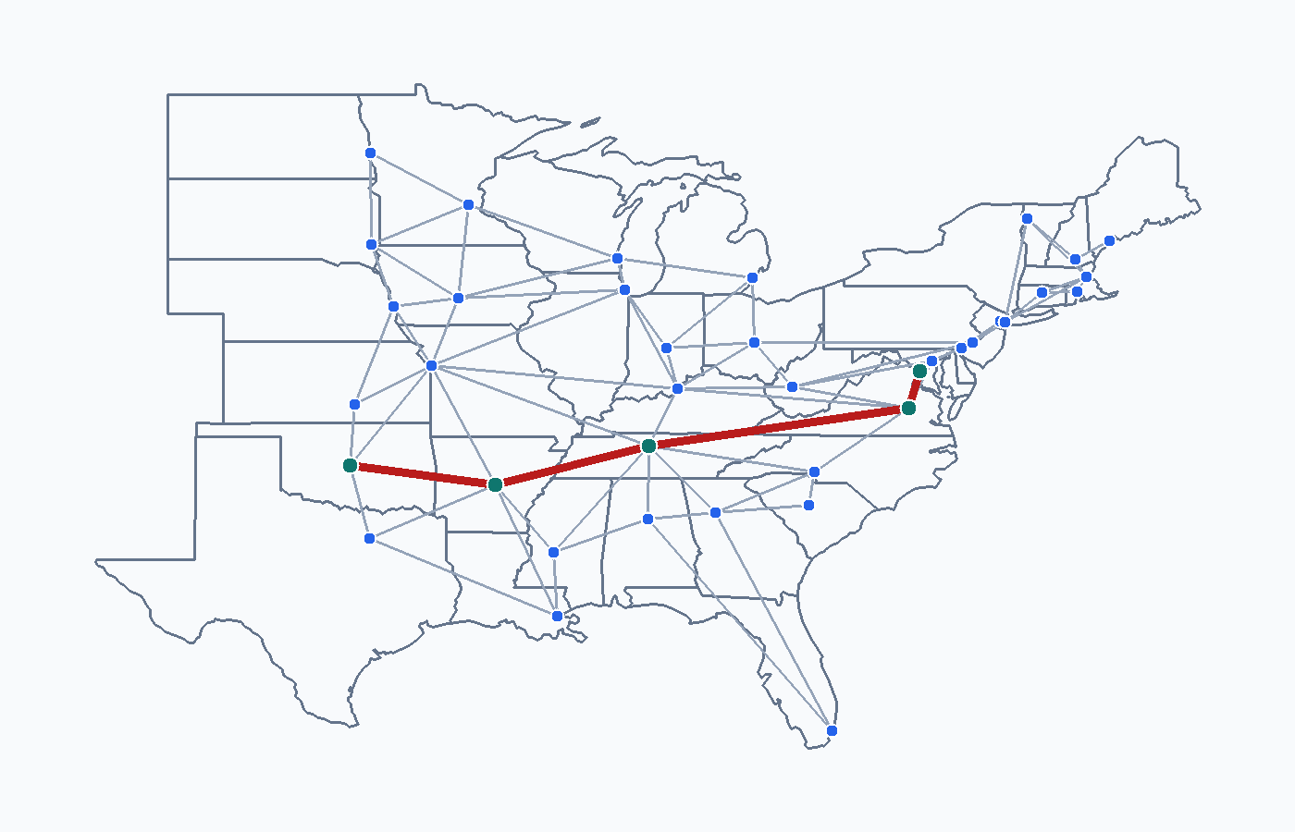
Route Comparison 5: Oklahoma City → Washington
Travel Metrics
Route length: 5 cities
Path: Oklahoma City → Little Rock → Nashville → Richmond → ...
Map distance: 1471.0 miles
Travel days: 3 (max 8 hrs/day)
Total hours on road: 19.6 hrs
Gasoline consumed: 32.68 gal (45 mpg)
Best start date: 2026-01-01
Weather risk: 4.0 (1.00/leg avg)
Dijkstra shortest route: Oklahoma City to Washington
PNW Spring 2026 CS 51510-002 Algorithms | Course Project 3

