Slide 1
Filtering malicious flows for IoT devices in Software-Defined Networks
7 May 2020
5930446421 Woraphop Limpisuk

Slide 2
Agenda
Introduction
Background / Motivation
System Design
Evaluation
Implications
Related works
Conclusions

Slide 3


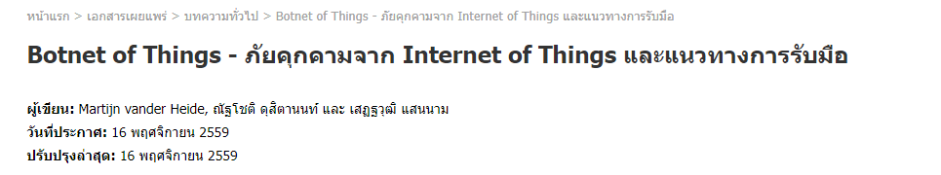
Introduction: IoT
Generally use on household, industrial, and commercial section
There are insecurities about IoT attack
Ex. Mirai
Notes:
Translate

Slide 4
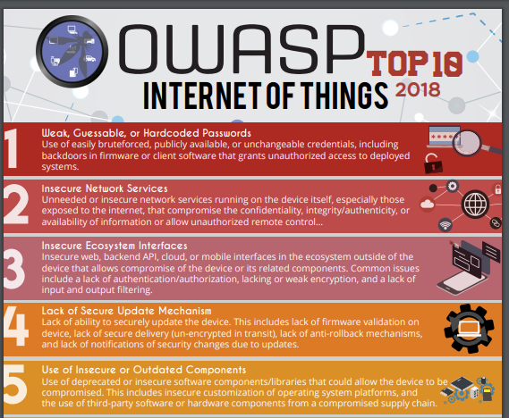
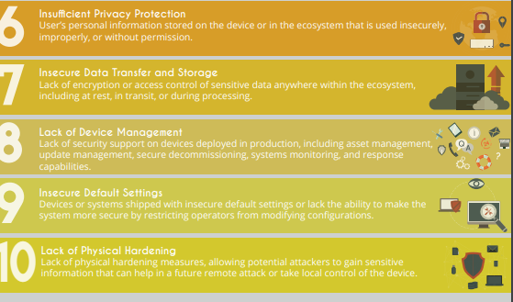
Introduction: Iot
According to OWASP Top 10
There are many aspect on insecuritiy.

Slide 5
Background / Motivation
Firewall = Rule-based ACL, inflexible
Commercial IDS/IPS = Expensive, No need to configuration, Higher Reliability
Open source IDS = Often use rules or signature base + High False alarm False alarms can be reduced with Artificial Intelligence Machine learning + IDS = Faster, Could detect novel attack,
Mishra, Preeti & Varadharajan, Vijay & Tupakula, Uday & Pilli, Emmanuel. (2018). A Detailed Investigation and Analysis of Using Machine Learning Techniques for Intrusion Detection. IEEE Communications Surveys & Tutorials. PP. 1-1. 10.1109/COMST.2018.2847722.
Notes:
Mishra, Preeti & Varadharajan, Vijay & Tupakula, Uday & Pilli, Emmanuel. (2018). A Detailed Investigation and Analysis of Using Machine Learning Techniques for Intrusion Detection. IEEE Communications Surveys & Tutorials. PP. 1-1. 10.1109/COMST.2018.2847722.

Slide 6
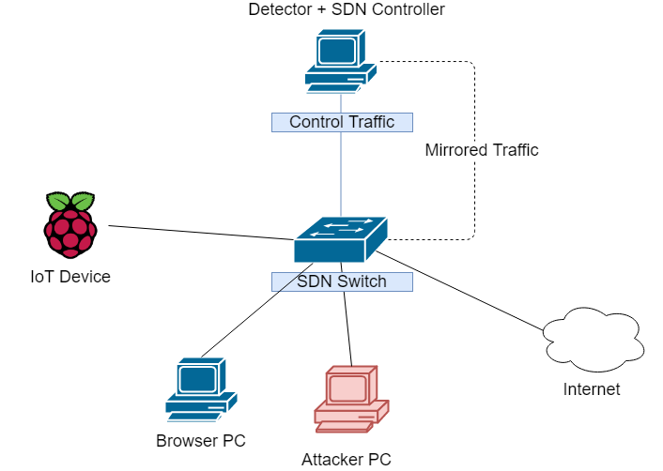
System Design – Network Architecture
The proposed system consists of SDN controller. SDN switch, and IoT devices, every equipment are inside private networks

Slide 7
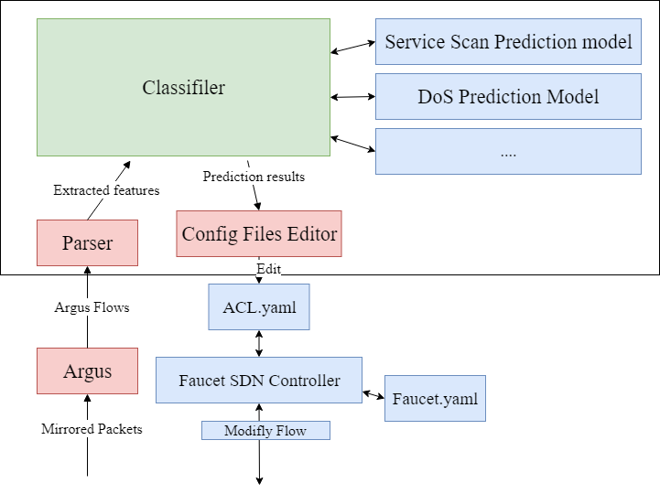
System Design – Detection and Blocking
The SDN switch is preconfigured to mirror every packets to SDN controller
The mirror packets is converted to flow data by Argus, then detection module will parse Argus flow into flow features, generate additional features and classify flow, when malicious flow is detected, the detection module will edit Access control list of SDN controller entries in order to block flow from source IP address.
Argus is layer 2+ Network auditing tools
Can prase live traffic, pcap, and more
SDN controller components
Notes:
Edit photo (As zoomed components) + Add argus

Slide 8
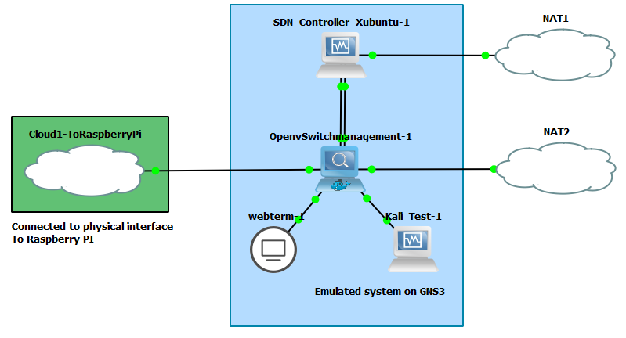
System Design – Testbed
Due to router problems
Testbed will be simulated on GNS3.
Most of system is emulated in GNS3 except Raspberry PI

Slide 9
System Design - Datasets
Feature Name | Meaning
state | Transaction state
seq | Argus sequence number
mean | Average duration of aggregated records
stddev | Standard deviation of aggregated records
min | Minimum duration of aggregated records
max | Maximum duration of aggregated records
srate | Source-to-destination packets per second
drate | Destination-to-source packets per second
N IN Conn P SrcIP | Number of inbound connections per source IP
N IN Conn P DstIP | Number of inbound connections per destination IP
BoT-IoT Dataset
We selected Service Scan and Dos Attack for this system
Model training will use features according to BoT-IoT 10 Best features.
Features was select by calculating Correlation coefficient and Joint entropy and select the best one.
 | Normal Traffic | Attack traffic
Service scanning data | 2733 | 1443364
TCP DoS data | 608 | 12315997
Notes:
Nickolaos Koroniotis, Nour Moustafa, Elena Sitnikova, Benjamin Turnbull, “Towards the Development of Realistic Botnet Dataset in the Internet of Things for Network Forensic Analytics: Bot-IoT Dataset”, https://arxiv.org/abs/1811.00701, 2018.

Slide 10
Evaluation – Model training
We use Neural Network for building prediction model.
We also use random forest, has similar accuracy, but predicting is slower (8 ms for random forest)
All of data is normalized with Min-Max transformation
Data is balanced with random oversampling
Epoch = 4, Batch size = 100 (DoS use Batch size 10000)
Activation function = ReLU , Sigmoid on output layer
Training with 75% of data, testing with 25% of data
Cross validation is not performed.
Notes:
Why neural? There also random forest but classification is slow

Slide 11
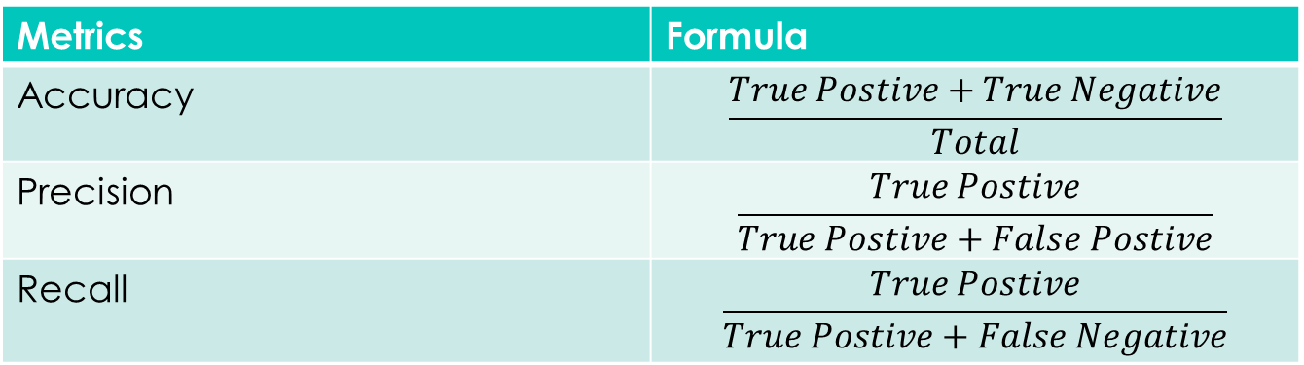
Evaluation – Model training
In order to calculate model performance, we will use these metrics.
Metrics | Formula
Accuracy | $$\frac{True Postive+True Negative}{Total}$$
Precision | $$\frac{True Postive}{True Postive+False Postive}$$
Recall | $$\frac{True Postive}{True Postive+False Negative}$$
Notes:
Why neural? There also random forest but classification is slow

Slide 12
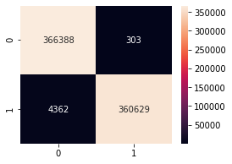
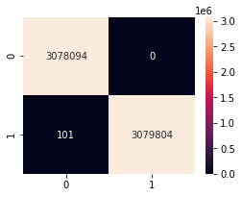
Evaluation – Model training
BoT-IoT TCP DoS Training result
n = 6,157,999
Accuracy = 1.0000
Precision = 1.0000
Recall = 1.0000
Confusion matrix:
BoT-IoT Service Scanning Training result
n = 731,682
Accuracy = 0.9936
Precision = 0.9991
Recall = 0.9880
Actual
Actual
Predicted
Predicted
Notes:
Train 75:25 flows entries
Add number of flows, and train testing

Slide 13
Evaluation – Testing on real traffic
Summation of 5 runs
Port Scanning : Nmap
Accuracy: 0.9541 Precision: 0.9643 Recall: 0.9677
Summation of 5 runs
TCP DoS: Hping3
Accuracy: 0.4759
Precision: 0.8721
Recall: 0.4312
Predicted
Predicted
 | 0 | 1
0 | 249 | 20
1 | 18 | 540
 | 0 | 1
0 | 221 | 98
1 | 881 | 668
Actual
Actual
Notes:
Do 5 times and average

Slide 14
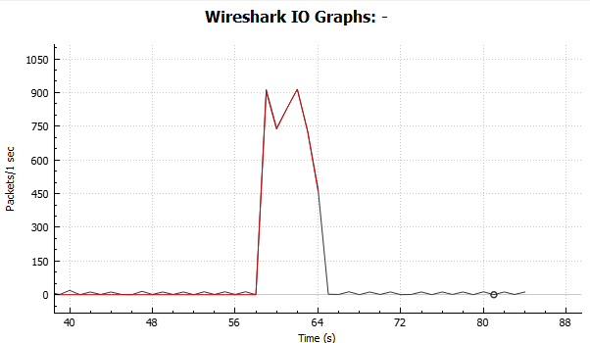
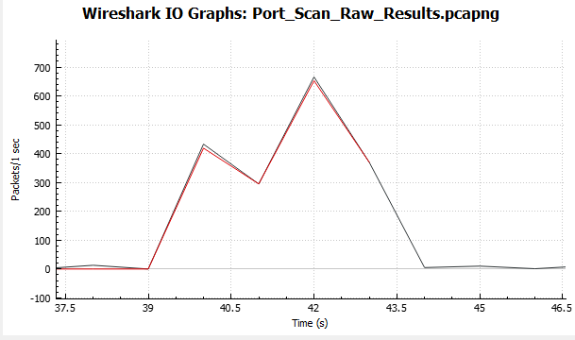
Evaluation – Recovery time
TCP DoS
Port Scanning
4.5 Seconds
6 Seconds
Notes:
Do 5 times and average

Slide 15
Conclusion
We created traffic flow classification for filter malicious flow for IoT networks
With SDN, we can scale system up (with multiple SDN switches)
With machine learning, the system could detect many kinds of attacking (although the model need to me improved due to false predictions)

Slide 16
Implication
Simulator can be use for simulate Ddos with diminished performance
The recovery time is slow, still not suitable for some attack, better approach is needed.
Faucet provided function is quite limited. (There’s no way to modify flow table directly without editing Faucet.yaml configuration file.)
There are false negative and false positive, the better data and machine learning techniques is needed.
Notes:
Bailey, Josh & Stuart, Stephen. (2016). Faucet: Deploying SDN in the enterprise. Communications of the ACM. 14. 10.1145/3009828.

Slide 17
Related Works
Detecting Volumetric Attacks on IoT Devices via SDN-Based Monitoring of MUD Activity
Notes:
How different- same of their works
What if hybrid
Compare maybe cut on

Slide 18
Q/A

Slide 19
Feedback
Tur
20 min
Video- speak + caption

