Slide 1
Distance-Vector Routing
CS 168 – Fall 2016 – Section 4

Slide 2
Agenda
Application
Transport
Network (L3)
Distance-Vector Routing
Network
Datalink
Physical

Slide 3
Distance-Vector Key Properties
Scalable
Unlike link-state, routers don’t need global network topology
Distributed
Routers communicate with neighbors to compute routes
Each router performs a small part of the algorithm
Avoids Loops
Minimizing metric is distance (or “cost,” so not necessarily physical distance)

Slide 4
Distance-Vector Routing
Each router…
Has a “vector” of distances to each dest
Computes its initial vector based on outgoing links
Also keeps track of next-hop router for each dest
Initial State
A | B | C
0, A | 2, B | 9, C
A | B | C | D
9, A | 1, B | 0, C | 16, D
9
A
C
2
1
16
B
D
7
A | B | C | D
2, A | 0, B | 1, C | 7,D
B | C | D
7, B | 16, C | 0, D

Slide 5
Two Components of Distance-Vector
Protocol
Each router floods its vector to neighbors when helpful
Algorithm
- Upon receiving a vector from a neighbor, each router uses Bellman-Ford to update its own vector

Slide 6
Protocol
Each router advertises (floods) its vector to its neighbors…
Whenever any distance to a dest changes in its vector
- Including when it builds its initial vector
2. Periodically
- Helps with consistency among neighbors

Slide 7
Protocol Example
Since each router just built its initial vector, each of them floods its vector
Only A is shown here, but B,C,D do the same
A | B | C | D
9, A | 1, B | 0, C | 16, D
A | B | C
0, A | 2, B | 9, C
9
A
C
2
1
16
B
D
7
B | C | D
7, B | 16, C | 0, D
A | B | C | D
2, A | 0, B | 1, C | 7,D

Slide 8
Algorithm
Upon receiving a vector from its neighbor, a router…
Learns about new destinations
Uses Bellman-Ford to update its vector
Flood vector if any entry changed!
(part of protocol, not algorithm)

Slide 9
Bellman-Ford
Bellman-Ford algorithm:
for d in destinations:
minCost, nextHop = ∞, None
for n in neighbors:
c = cost of link to n
a = advertised distance from n to d
if a + c < minCost:
minCost = a + c
nextHop = n
vector[d] = (minCost, nextHop)
This basically says:
Knowing the distances to each of my neighbors, and knowing each of my neighbors’ distances to other routers, I can find my shortest routes to these other routers.

Slide 10
Distance-Vector Walkthrough
Continuing the example from earlier
Let’s consider just router A for now
All routers initially flood their vectors
A | B | C
0, A | 2, B | 9, C
A | B | C | D
9, A | 1, B | 0, C | 16, D
9
A
C
2
1
16
B
D
7
B | C | D
7, B | 16, C | 0, D
A | B | C | D
2, A | 0, B | 1, C | 7,D

Slide 11
Walkthrough
9
A
C
2
1
16
B
D
Initially, A doesn’t know either of its neighbors’
vectors
7
A’s Perspective
B’s vector
?
C’s vector
?
A’s vector
A | B | C
0, A | 2, B | 9, C
A

Slide 12
Walkthrough
9
A
C
2
1
16
B
D
A receives B’s vector
- Learns about D
Using Bellman-Ford, updates its entries for dests C and D
- Floods new vector to neighbors
7
B’s vector
A | B | C | D
2, A | 0, B | 1, C | 7,D
B’s vector
A | B | C | D
2, A | 0, B | 1, C | 7,D
C’s vector
?
C’s vector
?
A | B | C
0, A | 2, B | 9, C
A | B | C | D
0, A | 2, B | 3, B | 9, B
A’s vector
A’s vector
A
A

Slide 13
Walkthrough
9
A
C
2
1
16
B
D
7
A receives C’s vector
Using Bellman-Ford, realizes it has no updated distances
- Does not flood vector to neighbors
B’s vector
A | B | C | D
2, A | 0, B | 1, C | 7,D
B’s vector
A | B | C | D
2, A | 0, B | 1, C | 7,D
C’s vector
A | B | C | D
9, A | 1, B | 0, C | 16, D
C’s vector
A | B | C | D
9, A | 1, B | 0, C | 16, D
A | B | C | D
0, A | 2, B | 3, B | 9, B
A | B | C | D
0, A | 2, B | 3, B | 9, B
A’s vector
A’s vector
A
A

Slide 14
Walkthrough
Eventually all vectors will converge
Routers still send periodic updates to deal with network changes
A | B | C | D
0, A | 2, B | 3, B | 9,B
A | B | C | D
3, B | 1, B | 0, C | 8, B
9
A
C
2
1
16
B
D
7
A | B | C | D
9, B | 7, B | 8, B | 0,D
A | B | C | D
2, A | 0, B | 1, C | 7,D

Slide 15
Count to Infinity
Bad things can happen…
 | A | B | C | D
A | 0, A | 2, B | 2, C | 4, C
C | 2 | 4 | 0 | 2
… | … | … | … | …
 | A | B | C | D
A | 0 | 2 | 2 | 4
C | 2, A | 4, A | 0, C | 2, D
… | … | … | … | …
2
A
C
2
2
B
D
D

Slide 16
Count to Infinity
C-D goes down. C must find new route!
 | A | B | C | D
A | 0, A | 2, B | 2, C | 4, C
C | 2 | 4 | 0 | 2
… | … | … | … | …
 | A | B | C | D
A | 0 | 2 | 2 | 4
C | 2, A | 4, A | 0, C | 2, D
… | … | … | … | …
2
A
C
2
B
D
D

Slide 17
Count to Infinity
It can go through A! (???)
 | A | B | C | D
A | 0, A | 2, B | 2, C | 4, C
C | 2 | 4 | 0 | 6
… | … | … | … | …
 | A | B | C | D
A | 0 | 2 | 2 | 4
C | 2, A | 4, A | 0, C | 6, A
… | … | … | … | …
2
A
C
2
B
D
D

Slide 18
Count to Infinity
Now A’s path to D changes as well…
 | A | B | C | D
A | 0, A | 2, B | 2, C | 8, C
C | 2 | 4 | 0 | 6
… | … | … | … | …
 | A | B | C | D
A | 0 | 2 | 2 | 4
C | 2, A | 4, A | 0, C | 6, A
… | … | … | … | …
2
A
C
2
B
D
D

Slide 19
Count to Infinity
Now C must update again…
 | A | B | C | D
A | 0, A | 2, B | 2, C | 8, C
C | 2 | 4 | 0 | 10
… | … | … | … | …
 | A | B | C | D
A | 0 | 2 | 2 | 8
C | 2, A | 4, A | 0, C | 10, A
… | … | … | … | …
2
A
C
2
B
D
D

Slide 20
And so on…

Slide 21
Count to Infinity
Now C must update again…
 | A | B | C | D
A | 0, A | 2, B | 2, C | 6000, C
C | 2 | 4 | 0 | 6002
… | … | … | … | …
 | A | B | C | D
A | 0 | 2 | 2 | 6000
C | 2, A | 4, A | 0, C | 6002, A
… | … | … | … | …
2
A
C
2
B
D
D

Slide 22
Special Case 1: Poison Reverse
If A updates its vector and needs to flood…
Since A uses neighbor C to get to D, A will…
Send its normal vector to all neighbors EXCEPT C
Send C a modified vector where the distance to D is infinity.
A | B | C | D
0, A | 2,B | 2,C | ∞
A | B | C | D
0, A | 2,B | 2,C | 4, C
2
A
C
2
2
B
D
D

Slide 23
Special Case 2: Split Horizon
Split horizon is the same as poison reverse, except…
In split horizon, A does not advertise its distance to D at all when sending its vector to C
Sometimes though, A would have to send a poison reverse message to C (if A previously told C about some other route to D)
A | B | C
0, A | 2,B | 2,C
A | B | C | D
0, A | 2,B | 2,C | 4, C
2
A
C
2
2
B
D

Slide 24
Special Case 3: Route Poisoning
When a link between A and C goes down and they can no longer reach each other…
A advertises infinity for dest C, and vice versa
A also advertises infinity to D because A uses C to get to D (same with C to B)
A | B | C | D
∞ | ∞ | 0, C | 2, D
A | B | C | D
0, A | 2,B | ∞ | ∞
A
C
2
2
B
D

Slide 25
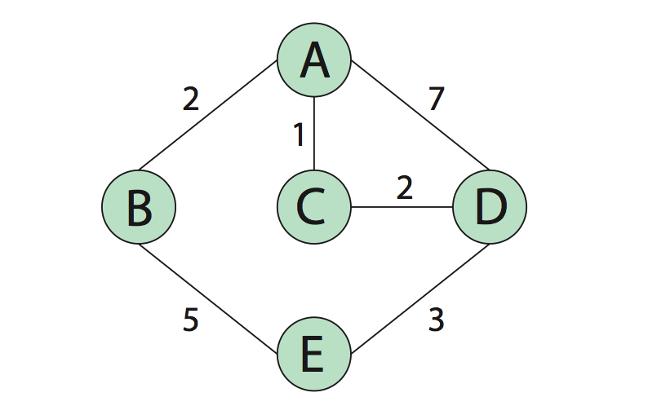
Diagram for Q1

Slide 26
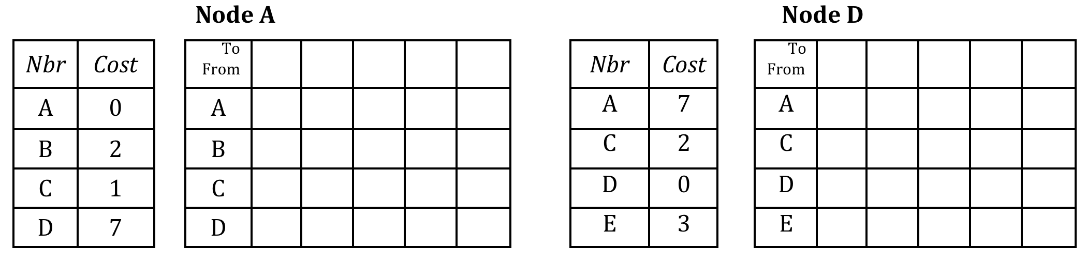
Problem 1 : A

Slide 27
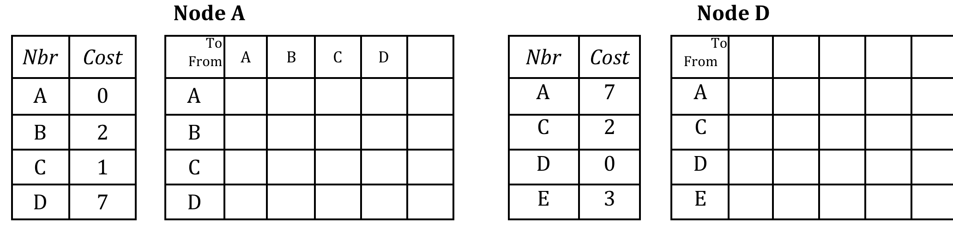
Problem 1 : A

Slide 28
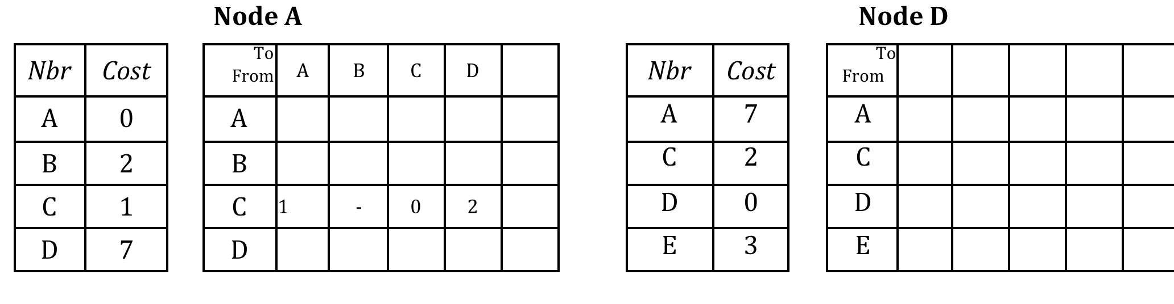
Problem 1 : A

Slide 29
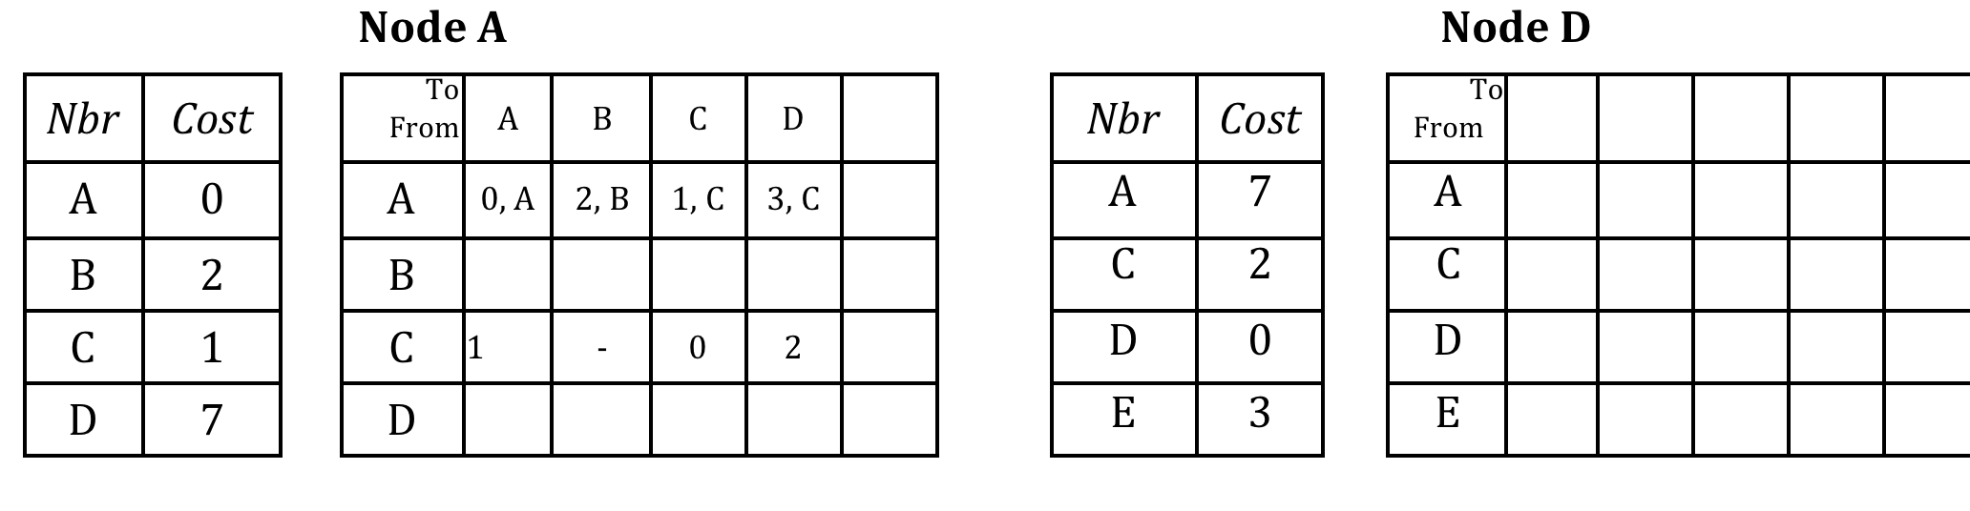
Problem 1 : A

Slide 30

Problem 1 : A

Slide 31
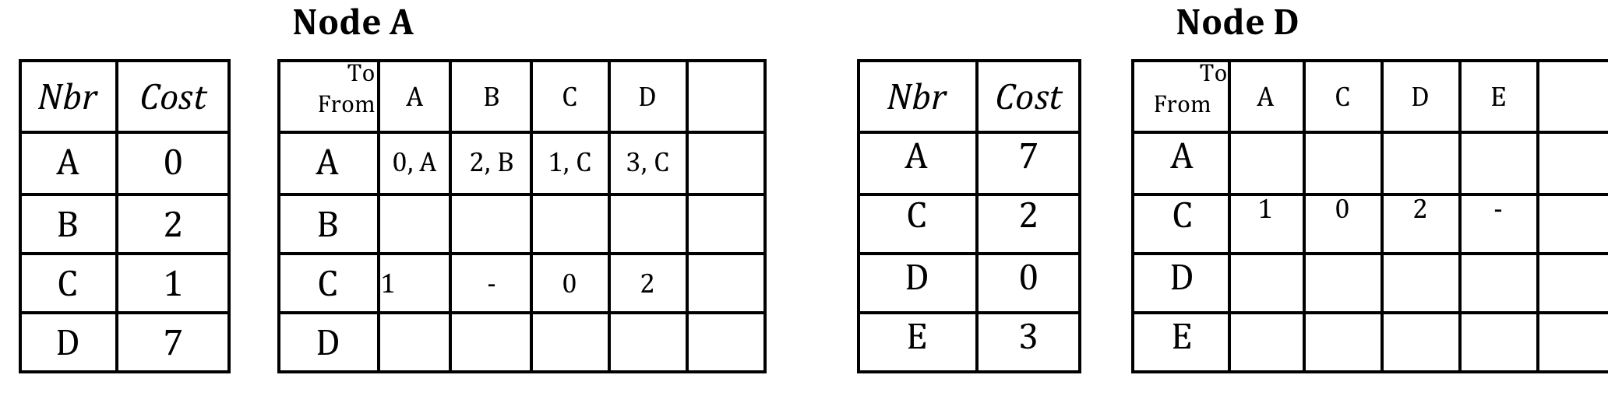
Problem 1 : A

Slide 32
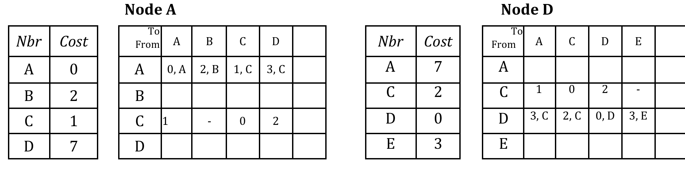
Problem 1 : A

