Slide 1
Secures and protects your application data

Slide 2

Learning Objectives
Always encrypted
Transparent data encryption
Vulnerability Assessment
Information Protection
Row-level security
Dynamic data masking
Threat detection
Auditing and compliance

Slide 3
Layers of protection
Azure Active Directory
Centrally manage and control identity and user access
Encryption
Encrypt a database, associated backups, and log files at rest—without changing your app
Data protection
Protect data at rest, in motion, or in use
Row-Level Security
Control which users can access specific row-level data
Auditing and threat detection
Get notified of potential threats with auditing tools and anomalous activity alerting
Regulatory compliance
Leverage ISO/IEC 27001/27002, Fed RAMP/FISMA, SOC, HIPPA, and PCI DSS compliance
Vulnerability Assessment and Data Discovery & Classification
Discover and classify sensitive data and discover and remediate insecure configurations.
Notes:
Objective: How Azure provides layers of protection
Talking Points:
Azure Active Directory is a comprehensive identity and access management cloud solution that provides a robust set of capabilities to manage users and groups.
Always Encrypted helps you protect sensitive data without having to relinquish the encryption keys to Azure SQL Database. Data remains encrypted at all times: in transit, in memory, on disk, and even during query processing.
Transparent Data Encryption helps you meet compliance requirements by encrypting your databases, associated backups, and transaction log files at rest without requiring changes to your applications.
Azure SQL Database supports Azure Active Directory (Azure AD) authentication provides an alternative to SQL authentication. It simplifies password management by allowing you to connect to a number of Azure services, including Azure SQL Database, using the same identity.
Row-Level security allows access to rows of data based on a user’s identity, role memberships, or query execution context.
Dynamic Data Masking lets you define masking patterns on database columns to limit the exposure of sensitive data.
Threat Detection complements Azure SQL Database Auditing and alerts on suspicious database activities at the database or logical server level.
Comprehensive, independently verified compliance. Azure is designed with a compliance strategy that helps customers address business objectives and industry standards and regulations. The security compliance framework includes test and audit phases, security analytics, risk management best practices, and security benchmark analysis to achieve certificates and attestations.
Certifications and attestations. Azure meets a broad set of international as well as regional and industry-specific compliance standards, such as ISO 27001, FedRAMP, SOC 1, and SOC 2. Azure’s adherence to the strict security controls contained in these standards is verified by rigorous third-party audits that demonstrate Azure services work with and meet world-class industry standards, certifications, attestations, and authorizations.
Data protection: Protect data at rest, in motion, or in use with encryption that uses the NIST Advanced Encryption Standard 256 cipher

Slide 4

Enterprise-grade security that is easy to use
PHYSICAL SECURITY
Trusted: most secure over last 7 years
NETWORK SECURITY
CLUSTER SECURITY
ACCESS MANAGEMENT
THREAT PROTECTION
INFORMATION PROTECTION
CUSTOMER DATA
Notes:
Key points
Defense-in-depth
Trusted: most secure over last 7 years

Slide 5
Azure Active Directory authentication
Overview
Manage user identities in one location
Enable access to Azure SQL Database and other Microsoft services with Azure Active Directory user identities and groups
Benefits
Alternative to SQL Server authentication
Limits proliferation of user identities across databases
Allows password rotation in a single place
Enables management of database permissions by using external Azure Active Directory groups
Eliminates the need to store passwords
Azure SQL Database
Customer 1
Customer 2
Customer 3
Notes:
Objective: Azure Active Directory authentication is a mechanism for connecting to Microsoft Azure SQL Database by using identities in Azure Active Directory.
Talking Points:
With Azure Active Directory authentication, you can centrally manage the identities of database users and other Microsoft services in a single location. Central identity management provides a single place to manage Azure SQL Database users and simplifies permission management. Benefits include:
An alternative to SQL Server authentication.
Help in stopping the proliferation of user identities across database servers.
The ability to perform password rotation in a single place.
Management of database permissions by using external Azure Active Directory groups.
Elimination of the need to store passwords: it enables integrated Windows authentication and other forms of authentication supported by Azure Active Directory.
Azure Active Directory authentication uses contained database users to authenticate identities at the database level.
Azure Active Directory members created in the managed domain or with a federated domain can be provisioned in Azure SQL Database.
Limitations:
Microsoft accounts (for example outlook.com, hotmail.com, live.com) or other guest accounts (for example gmail.com, yahoo.com) are not supported.
Only one Azure Active Directory administrator (a user or group) can be configured for an Azure SQL Database at any time.
Only an Azure Active Directory administrator can initially connect to the Azure SQL Database by using an Azure Active Directory account. The Azure Active Directory administrator can configure subsequent Azure Active Directory database users.
Some tools, like business intelligence (BI) and Microsoft Office Excel, are not supported.
Azure Active Directory authentication is supported by .NET Framework Data Provider for SQL Server (at least version in .NET Framework version 4.6).
Therefore SQL Server Management Studio (available with SQL Server 2016) and data-tier applications (DAC and .bacpac) can connect.
ODBC version 13.1 supports Azure Active Directory authentication
The sqlcmd.exe supports Azure Active Directory authentication beginning with version 13.1
PolyBase cannot authenticate by using Azure AD authentication.
Microsoft JDBC Driver 6.0 for SQL Server supports Azure AD authentication.
Two-factor authentication or other forms of interactive authentication are not supported.
https://docs.microsoft.com/en-us/azure/sql-database/sql-database-aad-authentication

Slide 6
Types of data encryption
Data encryption | Encryption technology | Customer value
In transit | Transport Layer Security (TLS) from the client to the server | Protects data between client and server against snooping and man-in-the-middle attacks *Azure SQL Database is phasing out Secure Sockets Layer (SSL) 3.0 and TLS 1.0 in favor of TLS 1.2
At rest | Transparent Data Encryption (TDE) for Azure SQL Database | Protects data on the disk Key management is done by Azure, which makes it easier to obtain compliance
In use (end-to-end) | Always Encrypted for client-side column encryption | Data is protected end-to-end, but the application is aware of encrypted columns This is used in the absence of data masking and TDE for compliance-related scenarios
In use
In transit
At rest
Column encryption
Customer data
Database files, backups, Tx log, TempDB
Notes:
Objective: Azure SQL includes a number of additional security measures for data. This slide provides an overview of SQL encryption in transit, at rest, and end-to-end.
Talking Points:
Key takeaway: Encrypted sensitive data and its corresponding keys are never seen in plain text in SQL Server
The customer will need to verify in the Azure Portal that the database is encrypted via PowerShell/T-SQL
Encryption-In-Transit technologies:
TLS from Client to Server
TLS = Transport Layer Security
Encryption at rest technologies:
TDE for SQL Database. On by default for newly deployed Azure SQL Databases. Note: TDE needs to be manually enabled for Azure SQL Managed Instance, older databases of Azure SQL Database, or Azure SQL Data Warehouse
TDE = Transparent Data Encryption
End-To-End encryption technologies:
Client-side column encryption for SQL Database (library available for download)

Slide 7
Transparent Data Encryption
All customer data encrypted at rest
Encryption keys managed by Azure
Application changes kept to a minimum
Transparent encryption/decryption of data in a TCE-enabled client driver
Support for equality operations (including joins) on encrypted data
Bring You Own Key (BYOK) supported
SQL Database
Notes:
Talking Points:
Fully managed by Azure
Support for user-managed TDE using Azure Key Vault planned (strict NDA)
Total Data Encryption with Always Encrypted for better performance
All cert/key management handled by Azure SQL
Simple Interface
Single SQL Statement/API call to enable/disable
Predictable Encryption Performance
Uses Azure SQL Database’s editions to ensure predictable performance
AES-NI Hardware Acceleration
Intel’s AES-NI support in TDE means better performance and better value
Reference: https://docs.microsoft.com/en-us/azure/sql-database/transparent-data-encryption-byok-azure-sql?view=sql-server-2017

Slide 8
Always Encrypted
Overview
Protect data at rest and in motion, on premises and in the cloud
Transparent client-side encryption, while SQL Server executes T-SQL queries on encrypted data
Benefits
Sensitive data remains encrypted and queryable at all times on-premises and in the cloud
Unauthorized users never have access to data or keys
No application changes
Client side
Server side
Encrypted query
TCE-enabled ADO .NET library
No app changes
SQL
Apps
Master key
Encrypted columnar key
Notes:
Objective: Always Encrypted is a feature designed to protect sensitive data, such as credit card numbers or national identification numbers (US Social Security numbers), stored in Azure SQL Database or SQL Server databases.
Talking Points:
Always Encrypted allows clients to encrypt sensitive data inside client applications and never reveal the encryption keys to the database engine (SQL Database or SQL Server). As a result, Always Encrypted provides a separation between those who own the data (and can view it) and those who manage the data (but should have no access). By ensuring on-premises database administrators, cloud database operators, or other high-privileged, but unauthorized users, cannot access the encrypted data, Always Encrypted enables customers to confidently store sensitive data outside of their direct control. This allows organizations to encrypt data at rest and in use for storage in Azure, to enable delegation of on-premises database administration to third parties, or to reduce security clearance requirements for their own DBA staff.
Always Encrypted makes encryption transparent to applications. An Always Encrypted-enabled driver installed on the client computer achieves this by automatically encrypting and decrypting sensitive data in the client application. The driver encrypts the data in sensitive columns before passing the data to the database engine, and automatically rewrites queries so that the semantics to the application are preserved. Similarly, the driver transparently decrypts data, stored in encrypted database columns, contained in query results.

Slide 9
How Always Encrypted works
Encrypted sensitive data and its corresponding keys are never seen in plaintext in SQL Server
Trusted – Client
Untrusted – SQL Server
ADO.NET
"SELECT Name FROM Customers WHERE SSN = @SSN",
"111-22-3333"
"SELECT Name FROM Customers WHERE SSN = @SSN",
0x7ff654ae6d
ciphertext
SQL
Result set
Result set
Name
Jim Gray
Name
0x19ca706fbd9a
dbo.Customers
Name | SSN | Country
0x19ca706fbd9a | 0x7ff654ae6d | USA
ciphertext
Notes:
Objective: Always Encrypted-enabled driver installed on the client computer achieves this by automatically encrypting and decrypting sensitive data in the SQL Server client application.
Talking Points:
The driver encrypts the data in sensitive columns before passing the data to SQL Server, and automatically rewrites queries so that the semantics to the application are preserved. Similarly, the driver transparently decrypts data, stored in encrypted database columns, contained in query results. Here are the details on how these feature works
Users specify individual columns of particular tables to be encrypted
Once encrypted, the data appears as an encrypted binary blob at all stages within the SQL Server database: on disk, in memory, during computations, and over the network
Users use a certificate store to save the encryption key.
Both encryption and decryption are done by the ADO.Net SqlClient driver for .Net 4.6. This driver will require access to the encryption key (via the certificate store, generally) and thereafter will communicate with the SQL Server directly to effect transparent encryption.
Specifically, when queries are parameterized, SqlClient will handshake with the SQL Server and identify which parameters are encrypted and will manage this process in both directions.
Example: the client code specifies a select statement with the parameter “where SSN = @SSN” and provides the parameter value “@SSN=’123-45-6789′” and the driver itself intercepts the parameter value and properly encrypts it

Slide 10
Protect data from high-privileged, unauthorized users
Client-side encryption
Sensitive data and related encryption keys are never revealed to the database engine
Encryption transparency
Client driver transparently encrypts query parameters and decrypts encrypted results
Queries on encrypted data
Support for equality comparison on columns encrypted using deterministic encryption
Enhanced client driver
SQL
plaintext
ciphertext
Notes:
Always Encrypted is our encryption of data in-use solution, which prevents SQL high-privileged users (such as DBAs, administrators of machines hosting SQL Server, or cloud admins) and malware from accessing your highly sensitive data in the database. Always Encrypted provides
Transparent client-side encryption , which removes the database from the attack surface, since the encrypted data and corresponding keys are NEVER seen in plaintext in SQL Server
Despite the fact the sensitive data is encrypted , you can still run queries using equality comparisons (e.g. JOIN, GROUP BY, and DISTINCT operators, and equality searches)
Minimal application changes required and the encryption & decryption is done within the client driver (ADO.NET, ODBC, JDBC).

Slide 11
Limitations of Always Encrypted
Reduced functionality of queries on encrypted columns
Encrypted columns only allow equality comparisons
Data needs to be moved out of the database for initial encryption and key rotation
This process can be time consuming and prone to network errors

Slide 12
Confidential computing
Overview
Confidential computing allows data to be protected inside a Trusted Execution Environment (TEE), also known as an enclave
An enclave is a protected region of memory that appears as a black box to the containing process and the OS
Microsoft supports SGX and VSM TEEs
Benefits
Only authorized code is permitted to run inside an enclave
Both the data and the code inside the enclave are inaccessible from the outside and protected from malicious insiders, hackers, and malware
Code
App
App
Data
Operating system
Enclave
Hypervisor
Hardware
Notes:
Customers can leverage enclave technologies in Azure in two ways:
By developing applications that directly use enclaves, e.g. perform computations on sensitive data inside the enclave
By using Azure services that leverage enclaves. One of those services is Azure SQL Database, which uses enclaves to enhance the functionality of the Always Encrypted feature.

Slide 13
Data protection inside a Trusted Execution Environment
Secure computations inside the enclave
When processing queries, the SQL Server database engine delegates rich computations and cryptographic operations on encrypted columns to the enclave, where the data is safely decrypted and processed
Enhanced client driver
SQL
plaintext
ciphertext
Enclave
plaintext
Notes:
The goal of Always Encrypted using enclaves is to keep the same level of security guarantees as the current GA version, while addressing its top limitations: limited functionality of SQL queries and operational challenges associated with moving data out of database for encryption/key rotation.
With Always Encrypted using enclaves, customers can protect their data in use without making painful compromises.

Slide 14
Benefits of Always Encrypted using enclaves
Protect your data in use from high-privilege but unauthorized users, including:
Malicious insiders, hackers and malware, and third-party access without consent
Avoid the pain of moving data
Execute rich computations in client apps without needing to move sensitive data to the client side
Perform initial encryption or key rotation without moving data with in-place encryption
CreditCardNo
XXXX-XXXX-XXXX-5796
XXXX-XXXX-XXXX-1978

Slide 15
Steps to employing Always Encrypted using enclaves
1
Configure an enclave-enabled column master key (CMK)
ENCLAVE_COMPUTATIONS property is specified in CMK metadata
The CMK is used to protect column encryption keys (CEK)
Configure a enclave-enabled column-encryption key (CEK)
A CEK that is encrypted with an enclave-enabled CMK
Only enclave-enabled CEKs are permitted to be shared with the enclave
Create enclave-enabled columns
Columns encrypted with enclave-enabled CEKs
Data stored in enclave-enabled columns can be processed inside the enclave
2
3
Notes:
The signature in the metadata of enclave-enabled CMKs helps ensure no one can tamper with the value of the ENCLAVE_COMPUTATIONS property. The client drivers checks the signature before assuming the CMK (and the CEKs, encrypted with the CMK) is enclave-enabled. In other words, if the CMK is not enclave-enabled, but the malicious admins tampers with the metadata to make the CMK enclave-enabled, the driver will detect that. Note that the signature is produced by signing the metadata property with the CMK during key provisioning.

Slide 16
Always Encrypted using enclaves
A new era in cybersecurity—confidential computing brings secure enclaves to Azure
Trusted execution environments protect data in use
First cloud to offer Intel Software Guard Extensions (SGX) enclaves
Sign up for an early access preview https://aka.ms/SQLEnclavesPreview
Notes:
Microsoft has just announced the confidential computing initiative that introduces secure enclaves (aka Trusted Execution Environments, or TEEs) to the Azure cloud.
Confidential computing makes it possible to protect sensitive data in use. It aims at providing assurance that customer’s sensitive data remains always under customer control. When data is “in the clear,” which is often required to analyze, interpret, or process the data, the data is protected inside a secure enclave. Inside the enclave, there is no way to view the data or the operations inside the enclave from the outside, even with a debugger. Enclaves even ensure that only authorized code is permitted to access data. If the code is altered or tampered, the operations are denied and the environment disabled. The enclave enforces these protections throughout the execution of code within it.
Initially, Azure will support two types of enclaves: Virtual Secure Mode and Intel Software Guard Extension (SGX). Virtual Secure Mode (VSM) is a software-based enclave that’s implemented by Hyper-V in Windows 10 and Windows Server 2016. Intel SGX is a hardware technology that is a preferred choice for customers who want their trust model to not include Azure or Microsoft at all. See Mark Russinovich’s blog post for more information about confidential computing: https://azure.microsoft.com/en-us/blog/introducing-azure-confidential-computing/.
With secure enclaves, we are now taking the Always Encrypted technology in Azure SQL Database to the next level.
Introduced in 2016, Always Encrypted was the first encryption in-use solution for databases. It ensured a SQL client driver could transparently encrypt and decrypt the data inside the client application. As a result, when the data entered the database system, it was already encrypted and it remained encrypted, even during query processing. Initially, Always Encrypted only allowed for equality comparison on encrypted data: e.g. simple point lookup queries. Other types of queries, e.g. queries involving pattern matching or sorting, were not supported.
By leveraging the confidential computing capabilities, Always Encrypted can support much richer queries by delegating computations on encrypted columns to an enclave, where the data can be safely decrypted and processed. E.g. LIKE predicates on encrypted columns or sorting data stored in encrypted columns is executed inside the enclave. This unlocks Azure SQL Database to new applications and customer scenarios, such as protection of a broad range of Personally Identifiable Information (PII) that often require pattern matching, sorting, and other rich computations to be performed inside the database system.
Enclaves also enabled in-place encryption. Until now, customers using Always Encrypted needed to use complex client-side tools to perform initial data encrypted or to rotate column encryption keys. Such tools needed to move the data out of the database for encryption or re-encryption. Now, such operations can be safely performed inside an enclave that is local to database, which eliminates the need to move the data outside of the database. This improves performance, reliability and security of encryption and key management operations.

Slide 17

Secure state best practices
Security updates
Keep up with recommended settings
Visibility
Track changes to identify vulnerabilities
Perform regulatory audits and internal or external reviews
Compliance
Notes:
We talk a lot with customers, and they don’t always know what a “secure state” looks like! What are the recommended best practices are from a security perspective? Documentation helps, but it only goes so far and isn’t always completely up to date. They would like to keep up, but don’t always know how.
Additionally – visibility about the current security status is key, understanding where the focus should be that poses the biggest threat to their database. And tracking this status over time needs to be simple, rather than having to re-run complex procedures every time to understand where the current vulnerabilities may be.
And we really hear a lot about customers need for addressing compliance demands – looking for tools that can simplify the work they do to meet these. With new data privacy regulations like the GDPR, these are becoming more critical all the time.

Slide 18
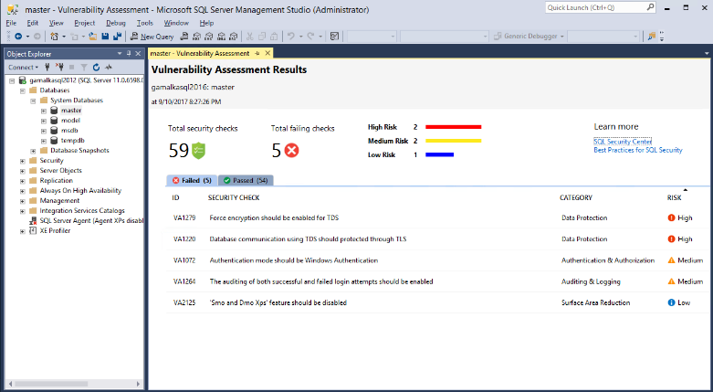
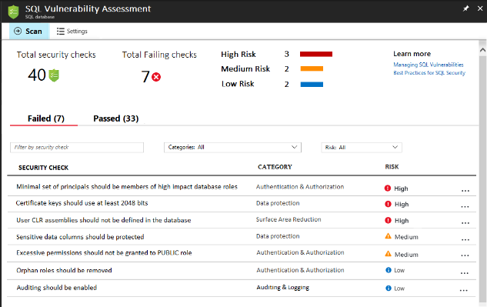
Vulnerability Assessment
Get visibility
Discover sensitive data and potential security holes
Remediate
Actionable remediation and security hardening steps
Customize
Baseline policy tuned to your environment, allowing you to focus on deviations
Report
Pass internal or external audits to facilitate compliance
SQL Server on-premises
Azure SQL Database
SQL
Identifies, tracks, and resolves SQL security vulnerabilities
Azure SQL Database
Vulnerability Assessment
Developer/DBA
Notes:
SQL Vulnerability Assessment is our newest security intelligence feature, recently released to Public Preview on Azure and via SSMS for SQL Server 2012 and up
It provides you visibility into the security state of your database system and allows you to continuously track and improve it over time
It is a built-in security feature in Azure SQL Database, and is also available using the latest SQL Server Management Studio (for SQL server on-premises or SQL on VM)
2) In short, SQL Vulnerability Assessment runs a set of security checks which
Discover sensitive data which is not protected
Identify security misconfigurations that could leave your database vulnerable to attack
Clear remediation steps for each issue found, including customized scripts to just click and run, and click-to-fix solutions.
Provides a clear, report that is customized to your environment, which is very helpful for security audits.
What is VA
a centralized dashboard for your SQL security needs.
runs a scan on your database, checking for a set of configurations and best practices, as well as exposed attack surface area that are important for the security of your database
Result = visibility into security state
View potential security issues, get an explanation for each and a remediation. Integral part of experience
Set up Baseline to customize results to match your environment. VA only shows REAL issues
Reports - documentation. Can be used for internal security audits or compliance like GDPR

Slide 19
Using Vulnerability Assessment
Run a scan
Built-in scanning service
1
Detect deviations
Subsequent scans will alert on deviations from your baseline
2
View a report
All-up assessment of security state
6
5
3
Drill-down to results
View detailed results and understand how they impact database security
Set a baseline
Customize scan requirements based on your environment
4
Remediate issues
Run scripts that resolve vulnerabilities directly within the report
Notes:
VA process
Demo coming, this runs thru the steps
Scan. Azure SQL service, on-prem - SSMS! Coming soon!!
View - DB security status
Drill down and understand.
Actionable remediation
‘acceptable’ issues or values that are accepted configuration -- ‘baseline’
Subsequent scans -- deviations -- focus on new and REAL issues.

Slide 20
Information Protection
Will be integrated into the Microsoft Information Protection framework
Protects data and moves across database boundaries in your organization
Automatic Data Discovery and recommendations to classify sensitive data
Each column associated with a sensitivity label and label type
Manual classification on data can also be added
Column label persisted as column metadata as new classification attributes in SQL Engine
Export classification information to Excel report for internal or external auditing purposes
Once a column is labeled it can be used for auditing and protection purposes
All labeled columns will be fully audited at run time for any queries that access them
Auditing will monitor which users access sensitive data and how much sensitive data they access
Discover
Classify
Label
Notes:
Talking Points:
A key goal for SQL Database V12 was to improve compatibility with Microsoft SQL Server 2014, and to maintain compatibility as new versions of SQL Server are released. Among other areas, V12 achieves parity with SQL Server in these important areas:Better database manageability
Table partitioning by rows with related enhancements to TRUNCATE TABLE
The availability of dynamic management views (DMVs) to help monitor and tune performance
Compression on page, and row wise
Large index rebuild and online index build/rebuild with LOB column
2 GB transaction size limit is removed
CHECKPOINT support
Extended Alter Database support
Non-admin DBCC commands (CHECKDB, for example)
Other programmability include:
Built-in JSON support
Window functions, with OVER
XML indexes and selective XML indexes
Change tracking
SELECT...INTO
Full-text search
ALTER DATABASE SCOPED CONFIGURATION (Transact-SQL)

Slide 21
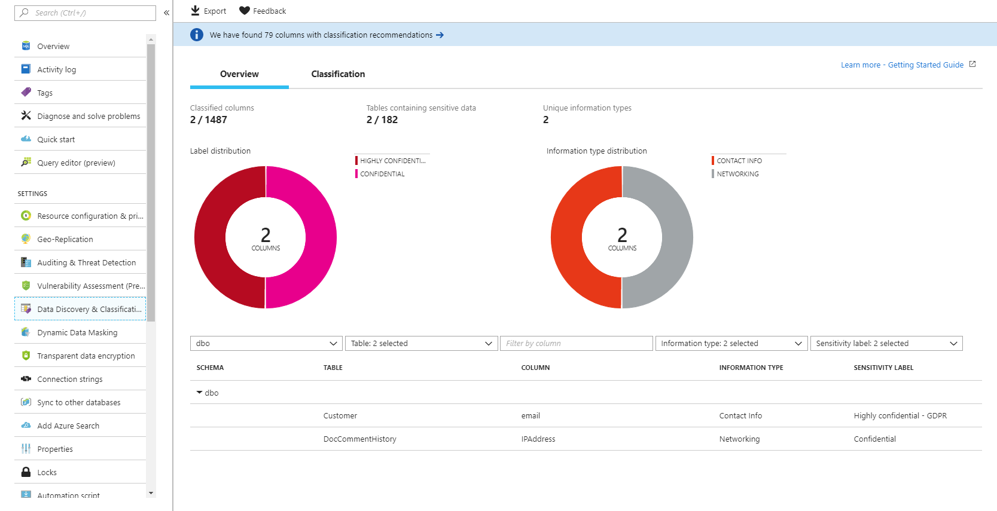
Data discovery & classification

Slide 22
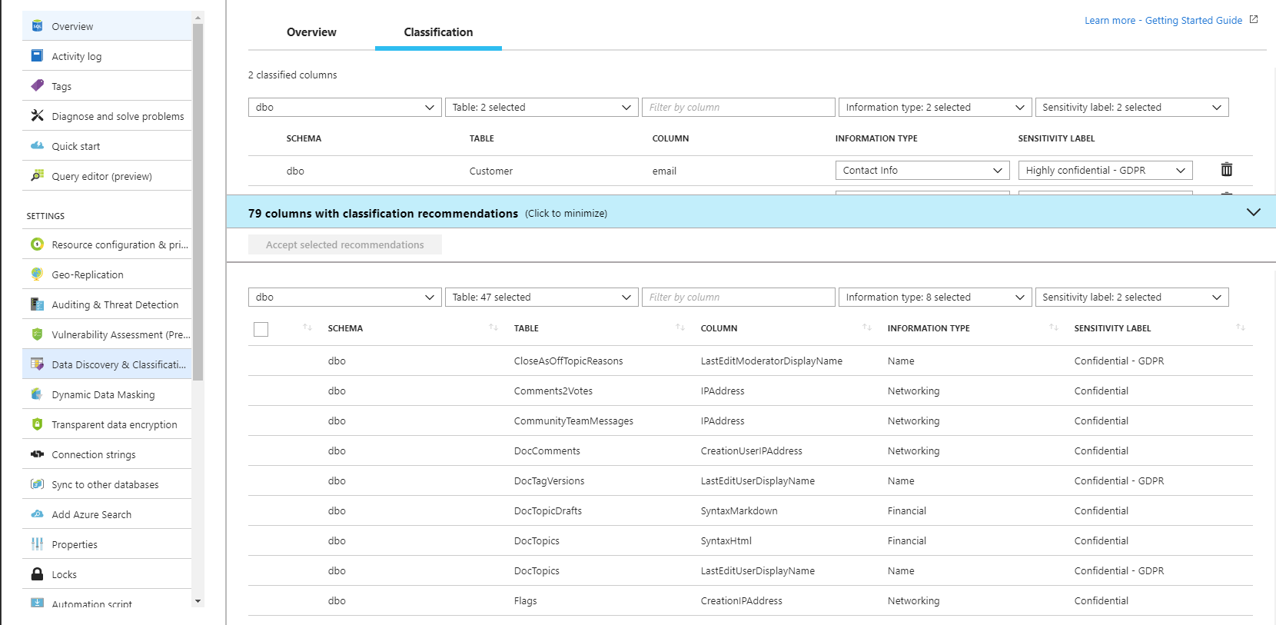
Data discovery & Classification

Slide 23
Row-level security
Control access of specific rows in a database table
Help prevent unauthorized access when multiple users share the same tables, or implement connection filtering in multitenant applications
Administer via SQL Server Management Studio or SQL Server Data Tools
Easily locate enforcement logic inside the database and schema bound to the table
Customer 1
Customer 2
Customer 3
SQL Database
Notes:
Objective: Row-Level Security (RLS) simplifies the design and coding of security in your application.
Talking Points:
RLS enables you to implement restrictions on data row access. For example, ensuring that workers can access only those data rows that are pertinent to their department, or restricting a customer's data access to only the data relevant to their company.
The access restriction logic is located in the database tier rather than away from the data in another application tier. The database system applies the access restrictions every time that data access is attempted from any tier. This makes your security system more reliable and robust by reducing the surface area of your security system.
Implement RLS by using the CREATE SECURITY POLICY Transact-SQL statement, and predicates created as inline table valued functions.

Slide 24
RLS in three steps
1. Policy manager creates filter predicate and security policy in T-SQL, binding the predicate to the Patients table
3. Security policy transparently rewrites query to apply filter predicate
2. App user (e.g., nurse) selects from Patients table
Database
Security policy
Filter Predicate:
INNER JOIN…
Nurse
Policy manager
Patients
CREATE FUNCTION dbo.fn_securitypredicate(@wing int)
RETURNS TABLE WITH SCHEMABINDING AS
return SELECT 1 as [fn_securitypredicate_result] FROM
StaffDuties d INNER JOIN Employees e
ON (d.EmpId = e.EmpId)
WHERE e.UserSID = SUSER_SID() AND @wing = d.Wing;
CREATE SECURITY POLICY dbo.SecPol
ADD FILTER PREDICATE dbo.fn_securitypredicate(Wing) ON Patients
WITH (STATE = ON)
Application
SELECT * FROM Patients
SEMIJOIN APPLY dbo.fn_securitypredicate(patients.Wing);
SELECT * FROM Patients
SELECT Patients.* FROM Patients,
StaffDuties d INNER JOIN Employees e ON (d.EmpId = e.EmpId)
WHERE e.UserSID = SUSER_SID() AND Patients.wing = d.Wing;
Notes:
Talking Points:
Policy manager creates a filter predicate and security policy
App user (e.g., a nurse) selects from the patient’s table
The query is transparently rewritten to apply the filter predicate
* Notice: No app changes!

Slide 25
Dynamic data masking
Limit the exposure of sensitive data by hiding it from users
Auto-discovery of potentially sensitive data to mask
Configurable masking policy from Azure Portal or via DDL in the Server
On-the-fly obfuscation of data in query results
Flexibility to define a set of privileged SQL users for un-masked data access
Table.CreditCardNo
4465-6571-7868-5796
4468-7746-3848-1978
4484-5434-6858-6550
SQL Database
Real-time data masking, partial masking
CreditCardNo
XXXX-XXXX-XXXX-5796
XXXX-XXXX-XXXX-1978
Notes:
Objective: Dynamic data masking limits sensitive data exposure by masking it to non-privileged users. Dynamic data masking helps prevent unauthorized access to sensitive data by enabling customers to designate how much of the sensitive data to reveal with minimal impact on the application layer. It’s a policy-based security feature that hides the sensitive data in the result set of a query over designated database fields, while the data in the database is not changed. Dynamic data masking is easy to use with existing applications, since masking rules are applied in the query results, and there is no need to modify existing queries.
Talking Points:
For example, a call center support person may identify callers by several digits of their social security number or credit card number, but those data items should not be fully exposed to the support person. A developer can define a masking rule to be applied to each query result that masks all but the last four digits of any social security number or credit card number in the result set. For another example, by using the appropriate data mask to protect personally identifiable information (PII) data, a developer can query production environments for troubleshooting purposes without violating compliance regulations.
Dynamic data masking limits the exposure of sensitive data and prevents accidental viewing by engineers that access directly databases for troubleshooting purposes or non-privileged application users. Dynamic data masking doesn’t aim to prevent privileged database users from connecting directly to the database and running exhaustive queries that expose pieces of the sensitive data. Dynamic data masking is complimentary to other SQL Server security features (auditing, encryption, row level security…) and it is highly recommended to enable them in addition in order to protect better the sensitive data in the database.
Since data is masked just before being returned to the user, changing the data type to an unmasked type will return unmasked data.
Dynamic data masking is available in SQL Server 2016 .However, to enable dynamic data masking, you must use trace flags 209 and 219. For SQL Database, see https://docs.microsoft.com/en-us/azure/sql-database/sql-database-dynamic-data-masking-get-started.
Source: https://msdn.microsoft.com/en-us/library/mt130841(v=sql.130).aspx

Slide 26
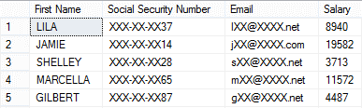
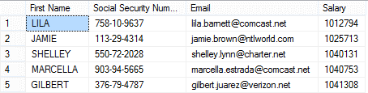
Dynamic data masking
Security officer defines dynamic data masking policy in T-SQL over sensitive data in the Employee table
2. The app user selects from the Employee table
3. The dynamic data masking policy obfuscates the sensitive data in the query results
ALTER TABLE [Employee] ALTER COLUMN [SocialSecurityNumber]
ADD MASKED WITH (FUNCTION = ‘SSN()’
ALTER TABLE [Employee] ALTER COLUMN [Email]
ADD MASKED WITH (FUNCTION = ‘EMAIL()’)
ALTER TABLE [Employee] ALTER COLUMN [Salary]
ADD MASKED WITH (FUNCTION = ‘RANDOM(1,20000)’)
GRANT UNMASK to admin1
Security officer
Business app
other logon
admin1 logon
SELECT [Name],
[SocialSecurityNumber],
[Email],
[Salary]
FROM [Employee]
Notes:
Objective: SQL Database dynamic data masking limits sensitive data exposure by masking it to non-privileged users. Dynamic data masking is supported for the V12 version of Azure SQL Database.
Talking Points:
Dynamic data masking helps prevent unauthorized access to sensitive data by enabling customers to designate how much of the sensitive data to reveal with minimal impact on the application layer. It’s a policy-based security feature that hides the sensitive data in the result set of a query over designated database fields, while the data in the database is not changed.
For example shown above, a security officer defines the masking policy in T_SQL over sensitive data at Employee table . Any app user, issue select query from the Employee table but those data items should not be fully exposed. A masking rule can be defined that masks all but the last four digits of any Social Security number or credit card number in the result set of any query. As another example, an appropriate data mask can be defined to protect personally identifiable information (PII) data, so that a developer can query production environments for troubleshooting purposes without violating compliance regulation.

Slide 27
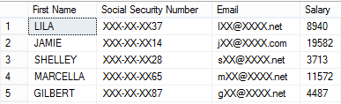
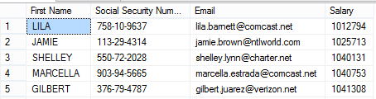
Dynamic data masking
Security officer defines dynamic data masking policy in T-SQL over sensitive data in the Employee table
3) The dynamic data masking policy obfuscates the sensitive data in the query results
2) The app user selects from the Employee table
SELECT Patients.* FROM Patients,
StaffDuties d INNER JOIN Employees e ON (d.EmpId = e.EmpId)
WHERE e.UserSID = SUSER_SID() AND Patients.wing = d.Wing;
ALTER TABLE [Employee] ALTER COLUMN [SocialSecurityNumber]
ADD MASKED WITH (FUNCTION = ‘SSN()’
ALTER TABLE [Employee] ALTER COLUMN [Email]
ADD MASKED WITH (FUNCTION = ‘EMAIL()’)
ALTER TABLE [Employee] ALTER COLUMN [Salary]
ADD MASKED WITH (FUNCTION = ‘RANDOM(1,20000)’)
GRANT UNMASK to admin1
Security
officer
other logon
admin1 logon
SELECT [Name],
[SocialSecurityNumber],
[Email],
[Salary]
FROM [Employee]
SELECT * FROM patients
SEMIJOIN APPLY dbo.fn_securitypredicate(patients.Wing);
Notes:
Objective: SQL Database dynamic data masking limits sensitive data exposure by masking it to non-privileged users. Dynamic data masking is supported for the V12 version of Azure SQL Database.
Talking Points:
Dynamic data masking helps prevent unauthorized access to sensitive data by enabling customers to designate how much of the sensitive data to reveal with minimal impact on the application layer. It’s a policy-based security feature that hides the sensitive data in the result set of a query over designated database fields, while the data in the database is not changed.
For example shown above, a security officer defines the masking policy in T_SQL over sensitive data at Employee table . Any app user, issue select query from the Employee table but those data items should not be fully exposed. A masking rule can be defined that masks all but the last four digits of any Social Security number or credit card number in the result set of any query. As another example, an appropriate data mask can be defined to protect personally identifiable information (PII) data, so that a developer can query production environments for troubleshooting purposes without violating compliance regulation.

Slide 28
Threat detection
Detect anomalous database activities that could indicate a potential threat
Configure threat detection policy in Azure Portal
Receive alerts from multiple database threat detectors that identify anomalous activities
Explore audit log around the time of an event
External attacker
SQL
Threat detection
Web app
Azure SQL Database
Malicious insider
Alert
Notes:
Objective: Azure SQL Database Threat Detection provides a new layer of security to your database by detecting anomalous database activities that can indicate a common threat, such as SQL injection attacks. Threat detection lets you detect and respond to potential threats as they occur. You can immediately explore the potential threat by using SQL database auditing to determine if the event is the result of an attempt to access, breach, or exploit data in the database. We know that often database threats leave tracks such as certain query patterns or abnormal database activities, and we make use of this knowledge to detect and notify when such suspicious events occur.
Talking Points:
The SQL Database Threat Detection offering includes:
Ability to configure threat detection from the Azure Portal
Ability to receive email alerts with proper information about the anomalous database activities occur
Ability to explore the audit log around the time of the event using Azure Portal or pre-configured excel template to determine of if the there was any vulnerability that was exploit to breach or exploit data in the database
Benefits include:
Simple configuration of SQL threat detection policy via Azure Portal.
Clear email alerts upon detection of suspicious databases queries indicating potential SQL injection events.
Ability to explore the audit log around the time of the event by using the Azure Portal or preconfigured Excel template.
No need to modify database procedures or application code.
Note: You can now receive proactive alerts on anomalous database activities that may indicate potential security threats by using the new Threat Detection feature
https://docs.microsoft.com/en-us/azure/sql-database/sql-database-threat-detection

Slide 29
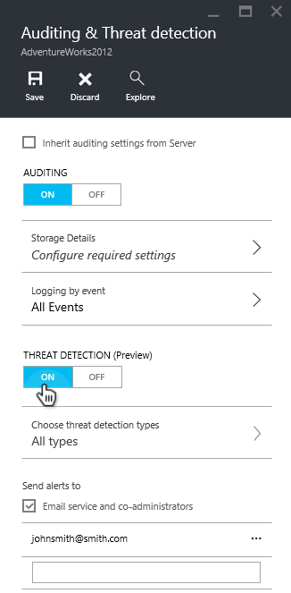
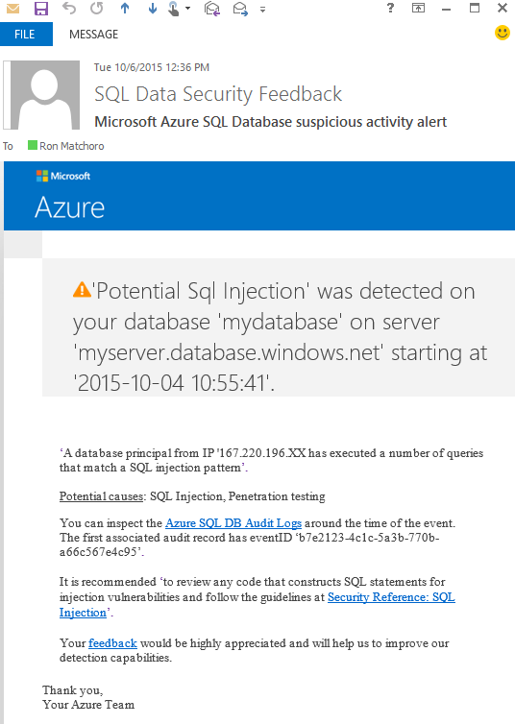
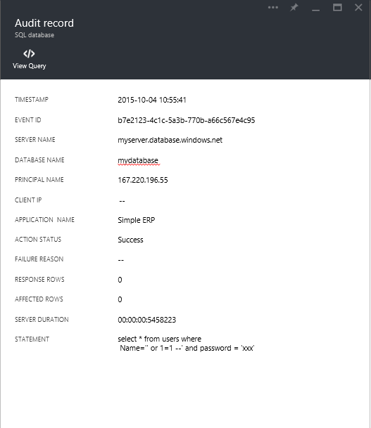
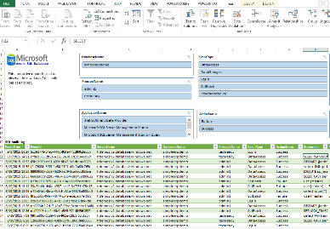

How threat detection works
Set up
Alert
Explore
Notes:
Objective: So how does SQL Database Threat Detection work?
Talking Points:
User navigates to the Azure Portal in order to configure auditing and threat detection. He can also enter a list of emails which will get the email notifications.
User receives a clear email notification upon detection of the anomalous activities in his database, including:
The anomalous database activity with proper context of the affected database and time
Recommended action to explore and mitigate the potential threats and User can investigate the SQL audit log around the time of the security alert using the Azure Portal and an Excel template

Slide 30
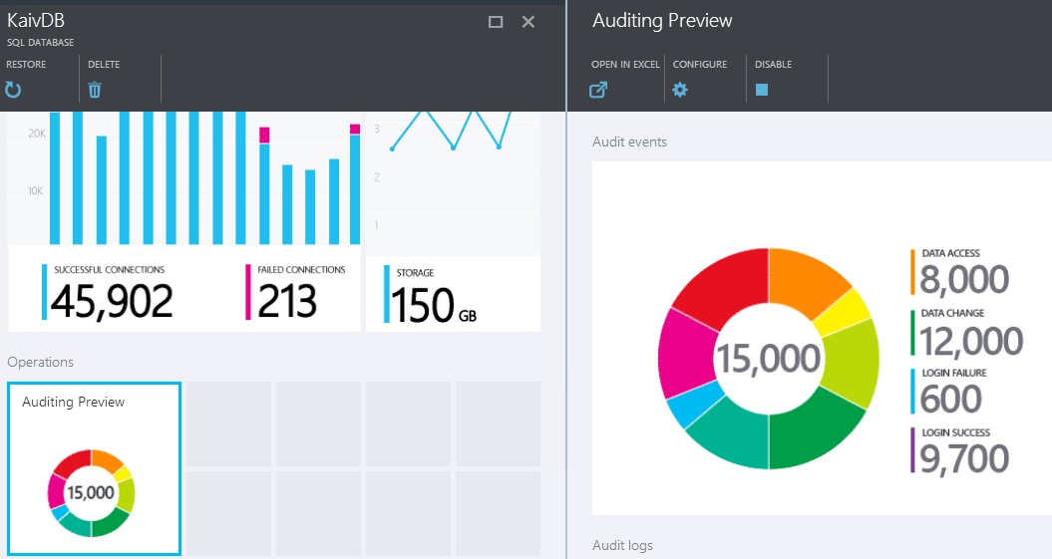
Azure SQL Database Auditing
Gain insight into database events and streamline compliance-related tasks
Configurable audit policy via the Azure portal and standard API
Audit logs reside in your Azure Storage account, or can be sent directly to Log Analytics or Event Hub
Azure portal viewer and SSMS for analysis of audit log
Compatible with SQL Server box auditing, including high granularity in defining audit policy
Audit log
SQL
Azure storage
SQL Database
Auditing
Application data
Notes:
Objective: Azure SQL Database Auditing tracks database events and writes audited events to an audit log in your Azure Storage account. Auditing is generally available for Basic, Standard, and Premium service tiers.
Talking Points:
Auditing can help you maintain regulatory compliance, understand database activity, and gain insight into discrepancies and anomalies that could indicate business concerns or suspected security violations.
Auditing tools enable and facilitate adherence to compliance standards but don't guarantee compliance.
SQL Database Auditing allows you to:
Retain an audit trail of selected events. You can define categories of database actions to be audited.
Report on database activity. You can use preconfigured reports and a dashboard to get started quickly with activity and event reporting.
Analyze reports. You can find suspicious events, unusual activity, and trends.

Slide 31
Layered approach to security
Securing your database
Firewall
Users & permissions
Connection string encryption
Securing your data
Encryption
Data masking
Row-level security
Securing changes to your data
Application and user activity auditing
SQL
App
Azure SQL Database
Notes:
Objective: In order to achieve the highest degree of protection and meet the regulatory compliances you need to secure your data in SQL Server on-premises or Azure SQL Database, we provide multiple layers of data protection.
Talking Points:
This includes encrypting data while at rest, in motion or in use, authenticating only authorized users against the database or application, and limiting user access to the appropriate subset of the data.
Additionally, we provide continuous monitoring and auditing of activities to help in the detection of potential threats and provide a record of critical events in case of a breach.
These rich security capabilities are each balanced by the ability to quickly implement features and mitigate security risk without compromising developer productivity or a customer’s experience.
These layers of protection are summarized across three areas: Protect Data, Control Access and Monitor Activity.

Slide 32
Securing your database with firewalls
Initially, all access to your Azure SQL Database server is blocked by the firewall
In order to begin using your Azure SQL Database server, you must go to the Management Portal
Internet
Microsoft Azure
SQL Database firewall
Server-level firewall rules
Client IP address in range?
No
Database-level firewall rule for database 4
Client IP address in range?
No
Connection fails
Yes
Yes
DB 1
DB 2
DB 3
DB 4
Database with a database-level firewall rule
SQL Database Server
Windows Azure Platform
Notes:
Talking Points:
Initially, all access to your Azure SQL Database server is blocked by the firewall. In order to begin using your Azure SQL Database server, you must go to the Management Portal and specify one or more server-level firewall rules that enable access to your Azure SQL Database server. Use the firewall rules to specify which IP address ranges from the Internet are allowed, and whether or not Azure applications can attempt to connect to your Azure SQL Database server.
However, if you want to selectively grant access to just one of the databases in your Azure SQL Database server, you must create a database-level rule for the required database with an IP address range that is beyond the IP address range specified in the server-level firewall rule, and ensure that the IP address of the client falls in the range specified in the database-level rule.
Connection attempts from the Internet and Azure must first pass through the firewall before they can reach your Azure SQL Database server or database, as shown in the following diagram.
Source: https://msdn.microsoft.com/en-us/subscriptions/downloads/ee621782

Slide 33
Trust architecture
Azure Active Directory and Azure SQL Database
On-premises active directory
ADFS
Azure Active Directory
Azure SQL Database
SQL Server Management Suite
ADALSQL
ADO .NET 4.6
SQL Server Data Tools
Azure Active Directory Authentication Library for SQL Server (ADALSQL)
App
Notes:
Objective: Trust architecture between Azure Active Directory and Azure SQL Database
Talking Points:
Azure Active Directory authentication is a mechanism of connecting to Microsoft Azure SQL Database by using identities in Azure Active Directory (Azure AD). With Azure Active Directory authentication you can centrally manage the identities of database users and other Microsoft services in one central location. Central ID management provides a single place to manage database users and simplifies permission management. Benefits include the following:
It provides an alternative to SQL Server authentication.
Helps stop the proliferation of user identities across database servers.
Allows password rotation in a single place
Customers can manage database permissions using external (AAD) groups.
It can eliminate storing passwords by enabling integrated Windows authentication and other forms of authentication supported by Azure Active Directory.
Azure Active Directory authentication uses contained database users to authenticate identities at the database level.
Azure Active Directory supports token-based authentication for applications token-based authentication for applications connecting to SQL Database.

Slide 34
Create a security policy
Create a security policy for row-level security
The following examples demonstrate the use of the CREATE SECURITY POLICY syntax
For an example of a complete security policy scenario, see Row-Level Security
-- The following syntax creates a security policy with a filter predicate for the Customer table
CREATE SECURITY POLICY [FederatedSecurityPolicy]
ADD FILTER PREDICATE [rls].[fn_securitypredicate]([CustomerId])
ON [dbo].[Customer];
-- Create a new schema and predicate function, which will use the application user ID stored in CONTEXT_INFO to filter rows.
CREATE FUNCTION rls.fn_securitypredicate (@AppUserId int)
RETURNS TABLE
WITH SCHEMABINDING
AS
RETURN (
SELECT 1 AS fn_securitypredicate_result
WHERE
DATABASE_PRINCIPAL_ID() = DATABASE_PRINCIPAL_ID('dbo') -- application context
AND CONTEXT_INFO() = CONVERT(VARBINARY(128), @AppUserId));
GO
Notes:
Objective: Row-level filtering of data selected from a table is enacted through a security predicate filter defined as an inline table valued function. The function is then invoked and enforced by a security policy. The policy can restrict the rows that may be viewed (a filter predicate), but does not restrict the rows that can be inserted or updated from a table (a blocking predicate). There is no indication to the application that rows have been filtered from the result set; if all rows are filtered, then a null set will be returned.
Talking Points:
Filter predicates are applied while reading data from the base table, and it affects all get operations: SELECT, DELETE (i.e. user cannot delete rows that are filtered), and UPDATE (i.e. user cannot update rows that are filtered, although it is possible to update rows in such way that they will be subsequently filtered). Blocking predicates are not available in this version of RLS, but equivalent functionality (i.e. user cannot INSERT or UPDATE rows such that they will subsequently be filtered) can be implemented using check constraints or triggers.
Filter predicates and security policies have the following behavior:
Define a security policy that filters the rows of a table. The application is unaware that any rows have been filtered for SELECT, UPDATE, and DELETE operations, including situations where all the rows have been filtered out. The application can INSERT any rows, regardless of whether or not they will be filtered during any other operation. Define a predicate function that joins with another table and/or invokes a function. The join/function is accessible from the query and works as expected without any additional permission checks.
Issue a query against a table that has a security predicate defined but disabled. Any rows that would have been filtered or restricted are not affected.
The dbo user, a member of the db_owner role, or the table owner queries against a table that has a security policy defined and enabled. Rows are filtered/restricted as defined by the security policy.
Attempts to alter the schema of a table bound by a security policy will result in an error. However, columns not referenced by the filter predicate can be altered.
Attempts to add a predicate on a table that already has one defined (regardless of whether it is enabled or disabled) results in an error.
Attempts to modify a function used as a predicate on a table within a security policy results in an error.
Defining multiple active security policies that contain non-overlapping predicates, succeeds.
Source: https://msdn.microsoft.com/en-us/library/azure/dn765131.aspx

Slide 35
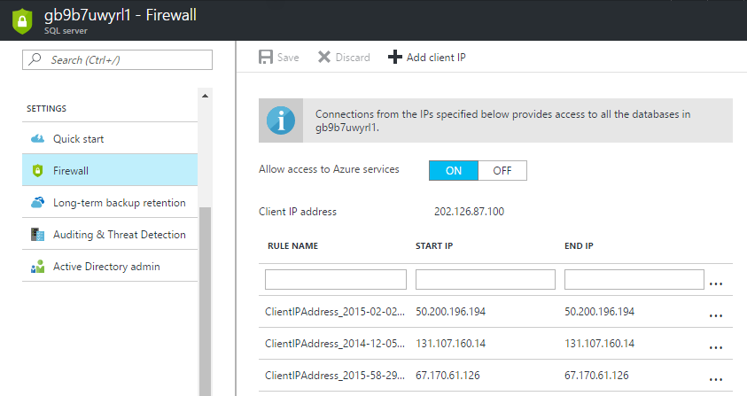
Firewall configuration using portals
By default, Azure blocks all external connections to port 1433
Enable in the following ways in Azure portal:
Classic portal: Server level – Configure page
New portal: Settings > Firewall > Firewall settings blade
Notes:
Objective: The first line of defense when controlling access to Microsoft Azure SQL Databases involves IP address and port filtering on the Azure SQL Server instance level, implemented as firewall rules defined in its master database.
Talking Points:
The firewall restricts incoming traffic to TCP port 1433 only. In addition, by default, all external (from the Azure point of view) connections are blocked, so you need to explicitly enable them by specifying the public IP address (or IP address range) assigned to your Internet entry point.
Azure Portal
Classic portal: Server level – configure page
New portal: settings – firewall – firewall settings blade

Slide 36
Firewall configuration using PowerShell/T-SQL
Manage SQL Database firewall rules using code
Windows PowerShell Azure cmdlets
New-AzureSqlDatabaseServerFirewallRule
Get-AzureSqlDatabaseServerFirewallRule
Set-AzureSqlDatabaseServerFirewallRule
Transact SQL
sp_set_firewall_rule
sp_set_database_firewall_rule
sp_delete_firewall_rule
sp_delete_database_firewall_rule
# PS Enable Azure connections
PS C:\> New-AzureSqlDatabaseServerFirewallRule `
-ServerName "Contoso" `
-AllowAllAzureServices `
-RuleName "myRule2"
-- PS Allow external IP access to SQL Database
PS C:\> New-AzureSqlDatabaseServerFirewallRule `
-ServerName "Contoso" `
-RuleName "myRule1" `
-StartIpAddress 12.1.1.1 `
-EndIpAddress 12.1.1.2
-- T-SQL Enable Azure connections
sp_set_firewall_rule N'Allow Windows Azure',
'0.0.0.0','0.0.0.0'
-- T-SQL Allow external IP access to SQL Database
sp_set_firewall_rule N'myRule1',
'12.1.1.1','12.1.1.2'
Notes:
Objective: The first line of defense when controlling access to Microsoft Azure SQL Databases involves IP address and port filtering on the Azure SQL Server instance level, implemented as firewall rules defined in its master database.
Talking Points:
In addition to the Azure Portal, firewall rules can be managed programmatically using Transact-SQL, REST API, and Azure PowerShell
Azure PowerShell
Get-AzureSqlDatabaseServerFirewallRule Returns the current server-level firewall rules
New-AzureSqlDatabaseServerFirewallRule Creates a new server-level firewall rule Set-AzureSqlDatabaseServerFirewallRule Updates the properties of an existing server-level firewall rule
Remove-AzureSqlDatabaseServerFirewallRule Removes server-level firewall rules
Transact-SQL
sp_set_firewall_rule -Creates or updates server-level firewall rules
sp_set_database_firewall_rule- Creates or updates the database-level firewall rules
sp_delete_firewall_rule- Deletes the firewall rule
sp_delete_database_firewall_rule- Delete the database firewall rule

Slide 37
Firewall configuration using REST API
Managing firewall rules through REST API must be authenticated
For information, see Authenticating Service Management Requests
Server-level rules can be created, updated, or deleted using REST API
To create or update a server-level firewall rule, execute the POST method
To remove an existing server-level firewall rule, execute the DELETE method
To list firewall rules, execute the GET
POST
https://management.core.windows.net:8443/{subscriptionId}/services/sqlservers/servers/Contoso/firewallrules
REQUEST BODY
<ServiceResource xmlns="http://schemas.microsoft.com/windowsazure">
<Name>myRule1</Name>
<StartIPAddress> 12.1.1.1 </StartIPAddress>
<EndIPAddress> 12.1.1.1 </EndIPAddress>
</ServiceResource>
DELETE
https://management.core.windows.net:8443/{subscriptionId}/services/sqlservers/servers/Contoso/firewallrules/myRule1
GET
https://management.core.windows.net:8443/{subscriptionId}/services/sqlservers/servers/Contoso/firewallrules
Notes:
Objective: Microsoft Azure SQL Database uses firewall rules to allow connections to your servers and databases. You can define server-level and database-level firewall settings for the master or a user database in your Azure SQL Database server to selectively allow access to the database.
Talking Points:
Microsoft Azure SQL Database uses firewall rules to allow connections to your servers and databases. You can define server-level and database-level firewall settings for the master or a user database in your Azure SQL Database server to selectively allow access to the database.
Manage server-level firewall rules through REST API
Managing firewall rules through REST API must be authenticated
Server-level rules can be created, updated, or deleted using REST API
To create or update a server-level firewall rule, execute the POST method
To remove an existing server-level firewall rule, execute the DELETE method
Source: https://msdn.microsoft.com/en-us/library/azure/dn505719.aspx

Slide 38
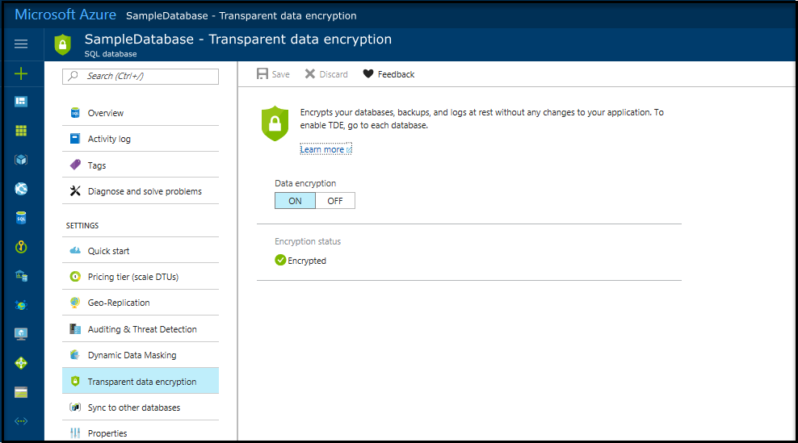
Customer experience
Customer can verify that the database is encrypted in portal or via PowerShell/T-SQL
Get-AzSqlDatabaseTransparentDataEncryption
[-ServerName] <String>
[-DatabaseName] <String>
[-ResourceGroupName] <String>
[-DefaultProfile <IAzureContextContainer>]
[-WhatIf]
[-Confirm] [<CommonParameters>]
Get-AzSqlDatabaseTransparentDataEncryption -ServerName "server01" -ResourceGroupName "resourcegroup01" -DatabaseName "database01"
ResourceGroupName ServerName DatabaseName State
----------------- ---------- ------------ -----
resourcegroup01 server01 database01 Disabled
Notes:
Reference:
https://docs.microsoft.com/en-us/azure/sql-database/transparent-data-encryption-azure-sql

Slide 39
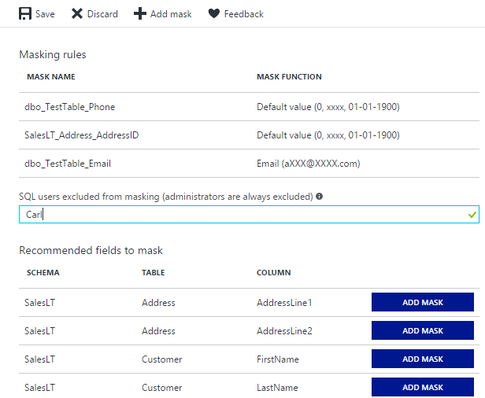
Minimal impact on applications
Existing application queries will not be affected
Sensitive data masked in the result set of a query
Option to restrict masking policy is available to exclude specific developers
Complementary to other security features that protect sensitive data
Limit access by setting firewall rules and user roles with minimal permissions
Encrypt sensitive data at rest
Use auditing for tracking discrepancies and anomalous activities
Notes:
Objective: The dynamic data masking has minimal impact on the application since the masking is done dynamically on the query results
Talking Points:
It is essential that customers should use additional security features to improve the protection of their sensitive data

Slide 40
Security administration overview
Point of difference | On-premises SQL Server | Microsoft Azure SQL Database
Where you manage server-level security | The Security folder in SQL Server Management Studio's Object Explorer | The master database
Server-level security role for creating logins | securityadmin fixed server role For more information, see Server-Level Roles | loginmanager database role in the master database
Commands for managing logins | CREATE LOGIN ALTER LOGIN DROP LOGIN | CREATE LOGIN ALTER LOGIN DROP LOGIN (There are some parameter limitations and you must be connected to the master database)
View that shows all logins | sys.syslogins (sys.sql_logins for SQL Server authentication logins) | sys.sql_logins (You must be connected to the master database)
Server-level role for creating databases | dbcreator fixed database role For more information, see Server-Level Roles | dbmanager database role in the master database
Command for creating a database | CREATE DATABASE | CREATE DATABASE (There are some parameter limitations and you must be connected to the master database)
Dropping databases | DROP DATABASE | DROP DATABASE If a user is in the dbmanager role, they have permission to DROP any database, regardless of which user originally created it.
View that lists all databases | sys.databases (view) | sys.databases (You must be connected to the master database)
Notes:
Objective: In Microsoft Azure SQL Database, when you sign up for the service, the provisioning process creates an Azure SQL Database server, a database named master, and a login that is the server-level principal of your Azure SQL Database server. That login is similar to the server-level principal, sa, for an instance of SQL Server on your premises.
Talking Points:
The Azure SQL Database server-level principal account always has permission to manage all server-level and database-level security. This topic describes how you can use the server-level principal and other accounts to manage logins and databases in Microsoft Azure SQL Database.
Security administration in Microsoft Azure SQL Database is similar to security administration for an on-premises instance of SQL Server. Managing security at the database-level is almost identical, with differences only in the parameters available. Because Azure SQL Databases can scale to one or more physical computers, Microsoft Azure SQL Database uses a different strategy for server-level administration. The following table summarizes how security administration for an on-premises SQL Server is different than in Microsoft Azure SQL Database.
The loginmanager Role
Like the securityadmin fixed server role for an on-premises instance of SQL Server, the loginmanager database role in Microsoft Azure SQL Database is has permission to create logins. Only the server-level principal login (created by the provisioning process) or members of the loginmanager database role can create new logins.
The dbmanager Role
The Microsoft Azure SQL Database dbmanager database role is similar to the dbcreator fixed server role for an on-premise instance of SQL Server. Only the server-level principal login (created by the provisioning process) or members of the dbmanager database role can create databases. Once a user is a member of the dbmanager database role, it can create a database with the Azure SQL Database CREATE DATABASE command, but that command must be executed in the master database. For more information, see CREATE DATABASE (Transact-SQL).
Source: https://msdn.microsoft.com/en-us/library/azure/ee336235.aspx

Slide 41




























The largest compliance portfolio in the industry
ISO 27001
SOC 1 Type 2
SOC 2 Type 2
PCI DSS Level 1
Cloud Controls Matrix
ISO 27018
Content Delivery and Security Association
Shared
Assessments
FedRAMP JAB P-ATO
HIPAA / HITECH
FIPS 140-2
21 CFR
Part 11
FERPA
DISA Level 2
CJIS
IRS 1075
ITAR-ready
Section 508 VPAT
European Union
Model Clauses
EU Safe Harbor
United Kingdom
G-Cloud
China Multi
Layer Protection Scheme
China
GB 18030
China
CCCPPF
Singapore
MTCS Level 3
Australian Signals
Directorate
New Zealand
GCIO
Japan
Financial Services
ENISA
IAF
Notes:
Reference: https://www.microsoft.com/en-us/trustcenter/compliance/complianceofferings

