Slide 1
What Choices Make A Killer Video Processor Architecture?
Jonah Probell
jonah@ultradatacorp.com
Ultra Data Corp
www.ultradatacorp.com

Slide 2
Outline
Overview of Ultra Data UD3000
Software programmability
Parallelism
  VLIW
  SIMD
  Multiprocessing
Appropriate use of on- and off-chip memory
  Optimal organization of data structures in DRAM
Deterministic performance
  5-port regfile
  2-port on-chip memory
  DMA controller instead of caches

Slide 3
Nobody’s Video Decoder Chip
SDRAM
SATA & I²C busses
Optics sled
Host / audio processor
SDRAM controller
I²C, SATA, timers
DVD optical interface
high-speed interconnect
Peripheral bus bridge
peripheral bus
Video Decode Processor
Video post-processing
Audio output
I²S / SPDIF / raw
Video output
S-video / raw 24-bit RGB or 8/16-bit YCrCb
Audio / Video DACs

Slide 4
The Ultra Data UD3000
2-port
DMEM
2-port
DMEM
FIFO
FIFO
Test
&
Set
…
…
System Bus Bridge
Crossbar Switch Fabric
Outer Loop Processor 0
Outer Loop Processor 1
Inner Loop Processor
0
Inner Loop Processor
1
Inner Loop Processor
2
Smart
2-D
DMA Controller
instruction extensions
instruction extensions

Slide 5
H.264 Main Profile Decode
OLP 0
CA
VLC
CABAC
DMA ctrl
load prediction source
store block
ILP 0
interpolation
ILP 1
inverse transform
apply
deltas
OLP 1
Deblocking
thresholds
Deblocking
Filter
ILP 2

Slide 6
The Inner Loop Processor
Switch Fabric
IMEM
Control Unit
32-bit RISC
Program Counter
Loads & Stores
Data Aligner
3-port
Regfile
32
32
Vector Unit
64-bit SIMD data
Multiply Acc
Data packing
5-port
Regfile
32
64

Slide 7
Video Codec Standards
ITU-T
standards
H.261
H.263
ITU-T / MPEG
joint standards
H.262 / MPEG-2
H.264 /
MPEG-4 Part 10 AVC
MPEG
standards
MPEG-1
MPEG-4
On2 Technologies
standards
VP3
VP4
VP5
VP6
DivX Networks standard
DivX
Microsoft standard
Windows Media Video
1984
1986
1988
1990
1992
1994
1996
1998
2000
2002
2004

Slide 8
VLIW Parallelism
load
multiply
load
multiply
load
multiply
shift
store
add
branch
data memory
load multiply
load multiply
load multiply
store shift
branch add
program sequencer
regfile
ALU
+ - x
& | !
>> <<
VLIW DSP program
sequential DSP program

Slide 9

SIMD Parallelism

Slide 10
Multiprocessor Parallelism
symmetric parallel multiprocessing
pipelined multiprocessing
video codec
system
video codec
system
motion estimation prediction
CPU 0
motion estimation prediction
CPU 0
transform & compression
CPU 1
transform & compression
CPU 1
deblocking
CPU 2
deblocking
CPU 2
software
hardware
software
hardware

Slide 11
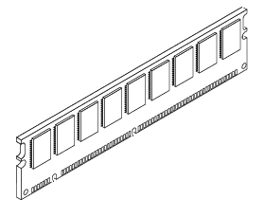
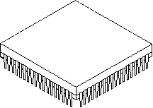
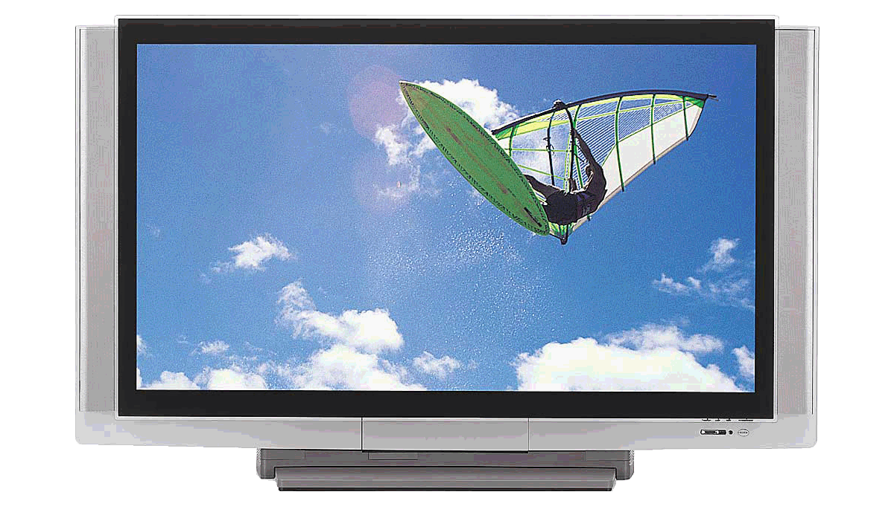
Data Bandwidths
SDRAM temporary data storage
bitstream source
video chip
display device

Slide 12
DRAM Optimal Data Ordering
DRAM
:
1k byte rows
Frame mapped to DRAM rows as a C-style two-dimentional array
Frame mapped to DRAM rows as square groups

Slide 13
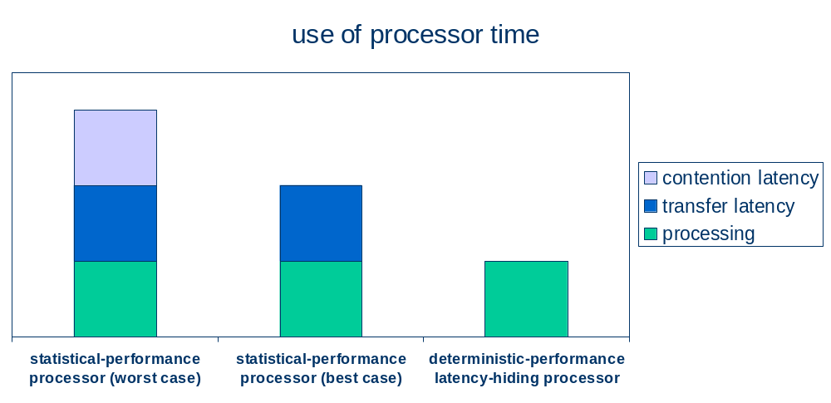
Deterministic Performance

Slide 14
The Inner Loop Processor
Switch Fabric
IMEM
Control Unit
32-bit RISC
Program Counter
Loads & Stores
Data Aligner
3-port
Regfile
32
32
Vector Unit
64-bit SIMD data
Multiply Acc
Data packing
5-port
Regfile
32
64

Slide 15
The Ultra Data UD3000
2-port
DMEM
2-port
DMEM
FIFO
FIFO
Test
&
Set
…
…
System Bus Bridge
Crossbar Switch Fabric
Outer Loop Processor 0
Outer Loop Processor 1
Inner Loop Processor
0
Inner Loop Processor
1
Inner Loop Processor
2
Smart
2-D
DMA Controller
instruction extensions
instruction extensions

Slide 16
A Killer Video Processor Architecture
Software programmability
Parallelism
  VLIW
  SIMD
  Multiprocessing
Appropriate use of on- and off-chip memory
  Optimal organization of data structures in DRAM
Deterministic performance
  5-port regfile
  2-port on-chip memory
  DMA controller instead of caches

Slide 17
Acknowledgements
This presentation is © Copyright 2004 Jonah Probell ALL RIGHTS RESERVED. Certain information for this document was derived from publicly available documents of Ultra Data Corp., UB Video Inc., On2 Technologies Inc., and Wikipedia. All trademarks mentioned in this document are property of their respective owners and are hereby acknowledged.
Jonah Probell
jonah@ultradatacorp.com
(781) 209-0886

