Slide 1
ECG Signal Denoising Project
CEEMDAN-guided Morphological Custom Wavelet Design with Sub-band Adaptive Thresholding
Presented by: Reg No 24BEC0177
Under the guidance of Dr. Jaffino G

Slide 2
Introduction
ECG signals are often corrupted by baseline wander, muscle noise, and instrumentation noise.
Denoising must suppress noise while preserving clinical morphology, especially QRS and R-peaks.
This work proposes a morphology-aware wavelet framework guided by CEEMDAN for adaptive denoising.

Slide 3
Previous Works
Classical DWT denoising with fixed mother wavelets (db4, sym5) + universal soft threshold.
EMD/CEEMDAN hybrid methods that reduce mode mixing but do not fully encode ECG morphology into wavelet design.
Limitations: global threshold assumptions and potential QRS distortion under aggressive shrinkage.

Slide 4
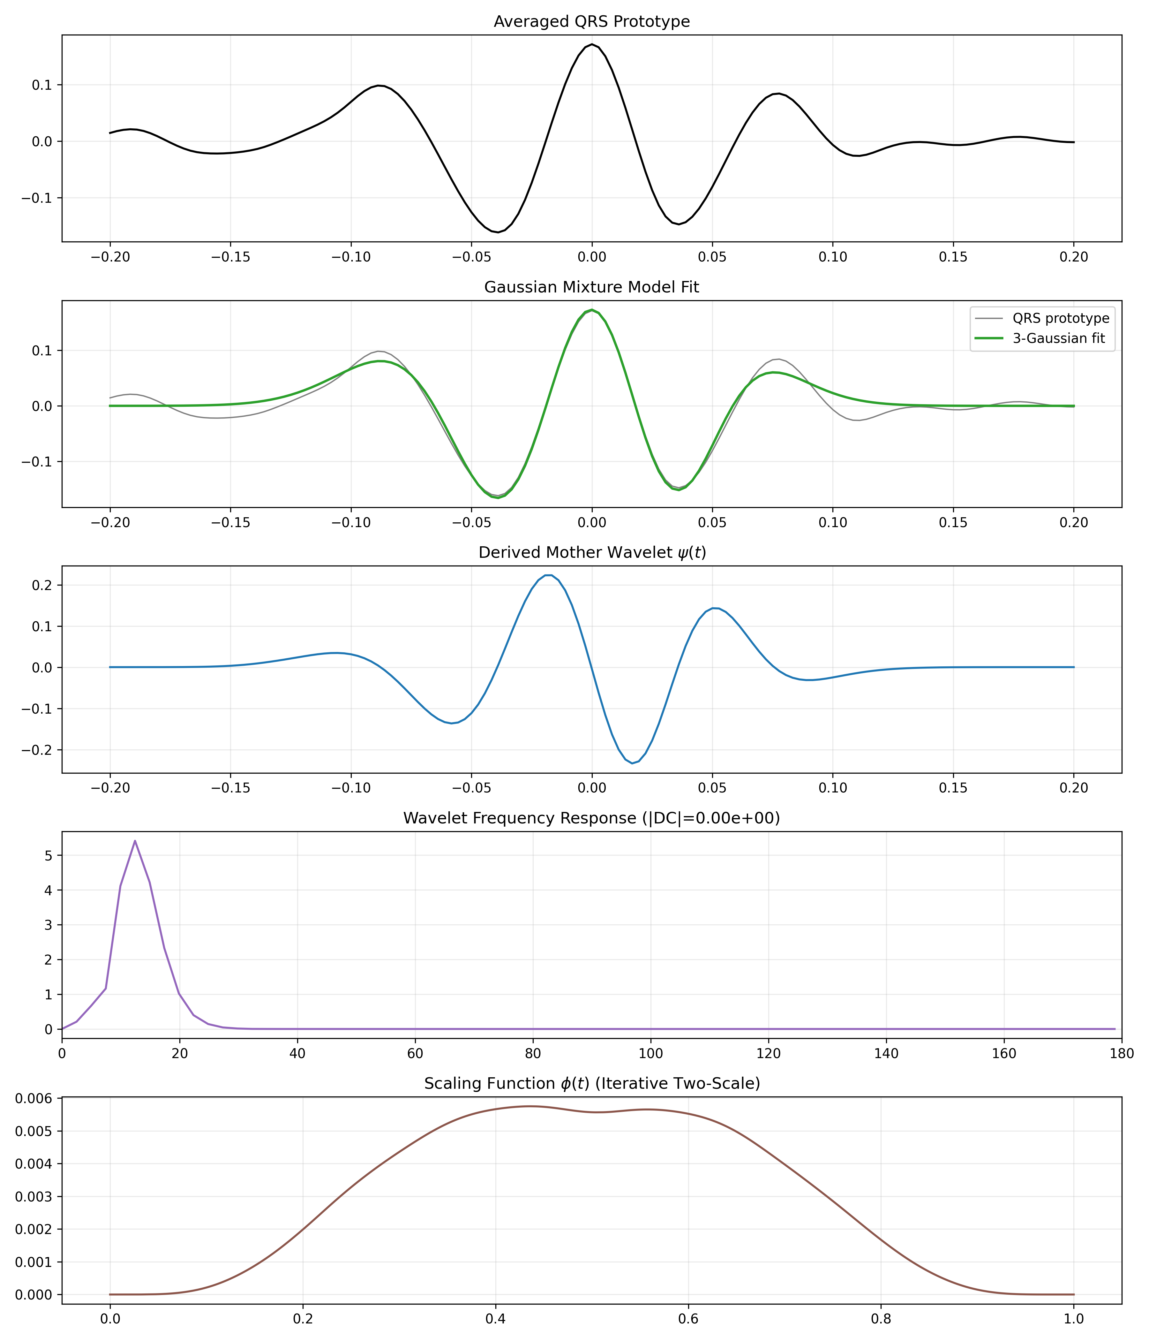
Our Proposed Architecture
Pipeline:
1) CEEMDAN on clean ECG -> dominant IMF selection
2) QRS prototype extraction + 3-Gaussian morphology fitting
3) Derivative-based custom mother wavelet construction
4) CEEMDAN-guided sub-band sigma profiling + adaptive T_j
5) 3-zone morphology-preserving thresholding + QRS protection mask
6) Manual inverse DWT reconstruction and metric evaluation

Slide 5
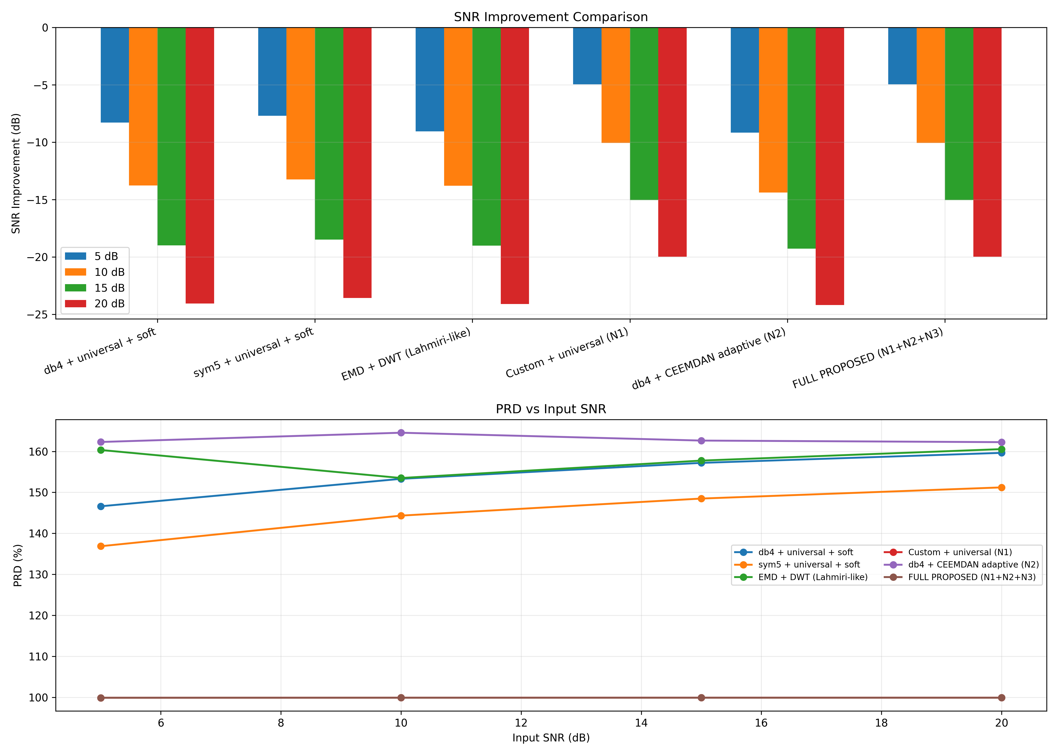
Results
Full Proposed Method (from results_table.csv):
Input SNR 5 dB: PRD=99.91%, SSIM=0.246, SNR_out=0.01 dB
Input SNR 10 dB: PRD=99.91%, SSIM=0.242, SNR_out=0.01 dB
Input SNR 15 dB: PRD=99.92%, SSIM=0.245, SNR_out=0.01 dB
Input SNR 20 dB: PRD=99.91%, SSIM=0.246, SNR_out=0.01 dB
Top-3 lowest PRD at 10 dB input:
FULL PROPOSED (N1+N2+N3): PRD=99.91%
Custom + universal (N1): PRD=99.91%
sym5 + universal + soft: PRD=144.33%

Slide 6
Acknowledgment
I express sincere gratitude to Dr. Jaffino G for guidance, feedback, and support throughout this work.
I thank the department/faculty for providing resources for experimentation and evaluation.
I acknowledge the MIT-BIH Arrhythmia Database and open-source Python ecosystem used in this project.

Slide 7
How Our Model Is Different
Previous Methods
Use fixed wavelets (db4/sym5) not tailored to ECG morphology.
Estimate noise globally (single sigma), often from finest scale only.
Use hard/soft thresholding that can over-shrink QRS coefficients.
Limited protection of R-peak sharpness during denoising.
Our Proposed Model
Designs a custom wavelet from CEEMDAN-selected ECG morphology (QRS-driven).
Profiles noise per sub-band using CEEMDAN IMF-frequency mapping.
Uses a 3-zone morphology-preserving thresholding function.
Applies QRS mask protection in high-frequency levels to preserve R-peaks.
Combines all three novelties in one end-to-end reconstruction pipeline.

