Slide 1
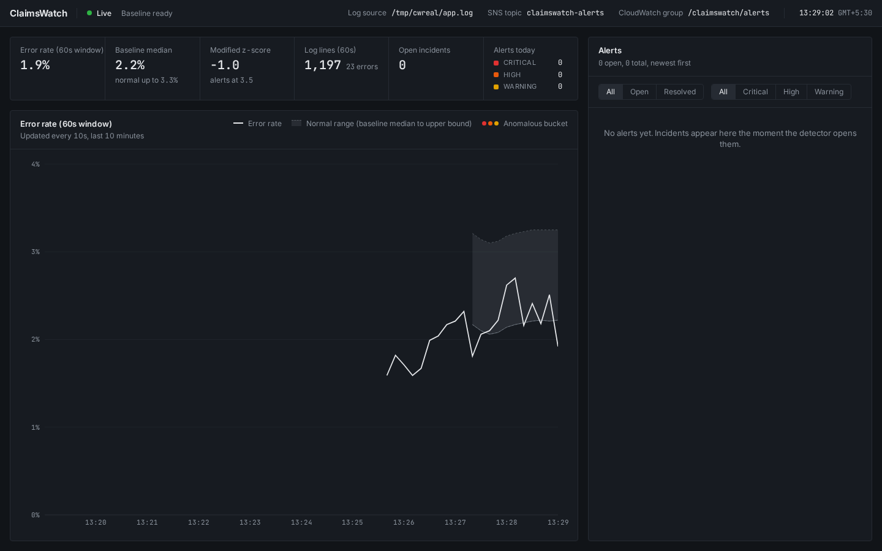
ClaimsWatch · Acentra Health “Build to Care” code-a-thon · 28 Sep 2026
When a Medicaid eligibility service fails, a patient can be turned away at the pharmacy.
Acentra Health formed in 2023 from the merger of CNSI and Kepro, with about 3,300 employees and an office in Chennai.
An AWS Advanced Partner, it runs evoBrix X, a cloud-based Medicaid claims platform.
ClaimsWatch watches claims-service logs and tells on-call what broke, and where, within seconds.
Team
Panshul Arora · Naman Rai · Aarati Deshmukh · Aaditey Nim
Sources: acentra.com/about-us · acentra.com/technologies/evobrix-x · aws.amazon.com/blogs/publicsector/acentra-health-processes-35m-medicare-documents-50-faster-with-idp-on-aws
github.com/panshularora/Acentra_HackForgeAI
1 / 8

Slide 2
Error-rate alerts tell the on-call engineer that something broke, but not what broke or where.
A typical error-rate alarm
The ClaimsWatch alert for the same incident
ALARM ErrorRate above threshold
CRITICAL
Error rate 7.1%, 3.2× normal
82% of errors come from claim‑adjudication: DB connection timeout
Which service? Which error? Which client?
The engineer starts digging through logs.
Peak z-score 16.4
Peak error rate 7.1% vs 2.2%
Both built from the same replayed database outage (make replay, seed 2026).
github.com/panshularora/Acentra_HackForgeAI
2 / 8

Slide 3
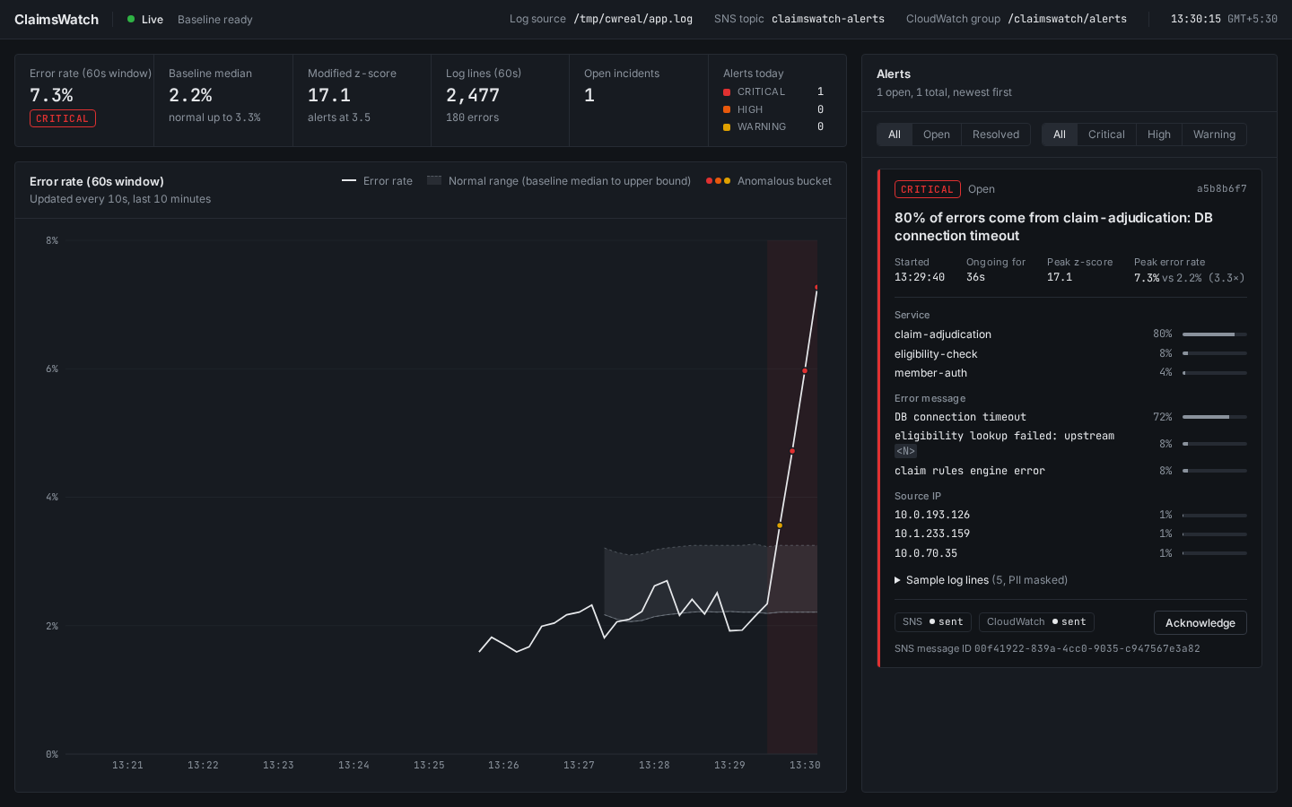
Our detector learns normal behaviour from the log itself and flags errors that rise well above it.
Modified z-score (Iglewicz & Hoaglin, 1993)
score = 0.6745 × (rate − median) / MAD
Severity thresholds
WARNING
score ≥ 3.5
HIGH
score ≥ 5
CRITICAL
score ≥ 8
Median and MAD of the last 30 window error rates, so one past spike barely moves them.
3.5 is the published outlier cut-off; 5 and 8 are our escalation steps.
github.com/panshularora/Acentra_HackForgeAI
3 / 8

Slide 4
From one log line to one alert, in six stages.
1
2
3
4
5
Tail
Parse + mask
Window
Baseline
Detect
ingest/tailer.py
ingest/parser.py
detection/window.py
detection/baseline.py
detection/detector.py
Polls app.log every 250 ms; survives truncation and rotation.
PHI is masked before any field is extracted.
10 s buckets roll into a 60 s error rate.
Median and MAD of the last 30 normal rates.
Score and severity; incident opens, updates, resolves.
6
Store and
fan out
WebSocket /ws
React dashboard
api/ws.py · api/routes.py
frontend/src/App.tsx
SQLite alert store
alerts/store.py
AWS publisher (background)
SNS + CloudWatch Logs
alerts/publisher.py
moto locally; real AWS as-is
github.com/panshularora/Acentra_HackForgeAI
4 / 8

Slide 5
The database outage was caught in 20 seconds, and the alert names the failing service.
20 seconds
detection latency, replay of a 45 s outage
(make replay, seed 2026)
Opened HIGH after 2 ten‑second buckets, peaked CRITICAL at z = 16.4.
“82% of errors come from claim‑adjudication: DB connection timeout”
Screenshot: the live stack during an injected outage (make incident-db).
github.com/panshularora/Acentra_HackForgeAI
5 / 8

Slide 6
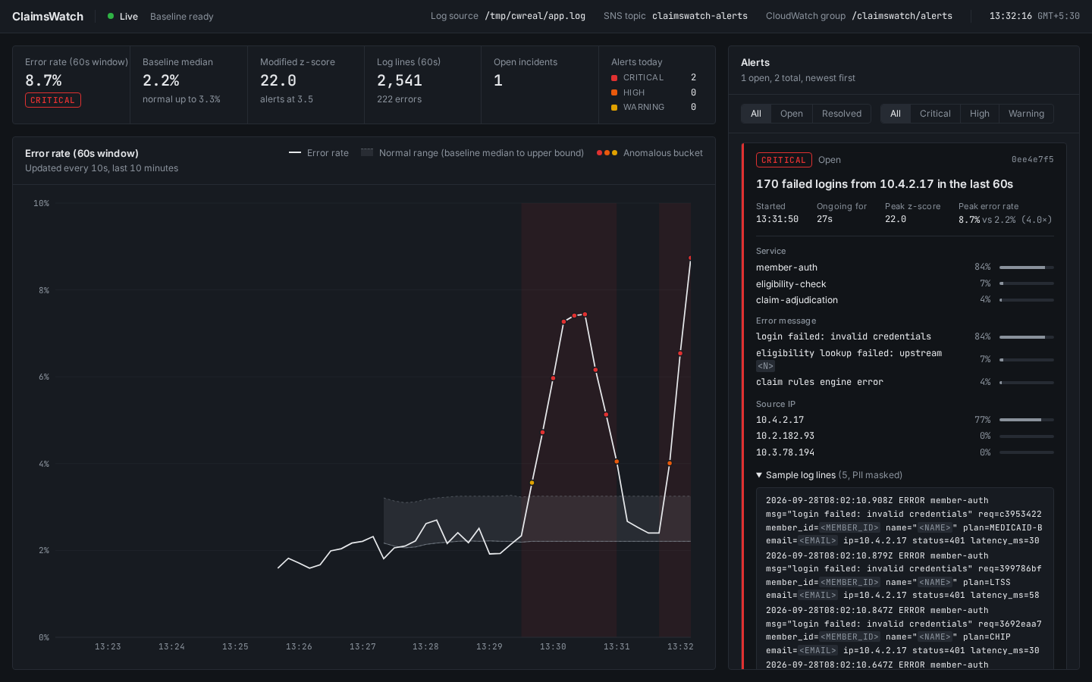
The same detector caught a credential-stuffing attack from 10.4.2.17.
10 seconds
detection latency, replay of a 30 s attack
(make replay, seed 2026)
Opened HIGH in the first bucket already naming the IP; peaked CRITICAL at z = 23.1.
“179 failed logins from 10.4.2.17 in the last 60s”
Screenshot: the live stack during an injected attack (make incident-auth).
github.com/panshularora/Acentra_HackForgeAI
6 / 8

Slide 7
Patient data is masked before any alert leaves the server.
One line from tools/loggen.py, before and after the parser
The alert read back from SNS by tools/sns_tail.py
RAW
SNS → SQS
2026-09-28T09:14:03.412Z ERROR member-auth msg="login failed: invalid credentials" req=a6a3a450 member_id=M1810111 name="Aisha Brown" plan=MEDICAID-A email=priya971@example.com ip=10.4.2.17 status=401 latency_ms=54
SNS MessageId 95cf7d28-420e-40d7-9b49-89e703c1bc78
Subject: [HIGH] ClaimsWatch: 71% of errors come from claim-adjudication: DB connection timeout
Publisher: sns sent, id 95cf7d28…; cloudwatch sent
MASKED (ingest/masking.py)
sample_lines[0]
2026-09-28T09:14:03.412Z ERROR member-auth msg="login failed: invalid credentials" req=a6a3a450 member_id=<MEMBER_ID> name="<NAME>" plan=MEDICAID-A email=<EMAIL> ip=10.4.2.17 status=401 latency_ms=54
2026-09-28T09:08:19.883Z ERROR claim-adjudication msg="DB connection timeout" req=b80aea2a member_id=<MEMBER_ID> name="<NAME>" plan=MEDICAID-B pool=claims-primary ip=10.1.78.45 status=503 latency_ms=5049
Member IDs, names, dates of birth, e-mails, SSNs and phone numbers are tagged in the parser; nothing downstream sees them.
Right: the production AlertPublisher sent the replayed outage alert to moto_server; tools/sns_tail.py read it back via SNS → SQS.
github.com/panshularora/Acentra_HackForgeAI
7 / 8

Slide 8
Across 18 replayed incidents: all detected in 10–20 seconds, with 0 false alarms.
Detection latency per replay seed (tools/replay.py --seed N, 20-minute scenario each)
Seed
2026
1
2
3
4
5
6
7
8
db-outage
20 s
20 s
20 s
10 s
10 s
20 s
20 s
20 s
20 s
cred-stuffing
10 s
10 s
10 s
10 s
10 s
10 s
10 s
10 s
10 s
False alarms
0
0
0
0
0
0
0
0
0
Every incident peaked CRITICAL; each run replays the production parser and detector on a simulated clock.
150 backend tests (pytest) and 87 frontend tests (Vitest) pass.
Code, tests and docs
github.com/panshularora/Acentra_HackForgeAI
github.com/panshularora/Acentra_HackForgeAI
8 / 8

