Slide 1

AURORA
Black-Start Microgrid — Autonomous Power Grid Restoration via Hybrid Renewable Energy
Team VoltForge · Problem Statement 3
Solar PV · 500 kWp
Wind · 300 kW
Geothermal · 200 kW
Hydrogen · 150 kW
Storage · 2 MWh

Slide 2

PROBLEM STATEMENT
Power Grid Failures & the Black-Start Challenge
Operating Condition 3: Power grid failure due to infrastructure damage
What Is a Black-Start?
1.2B
$280B
Restoring a power grid from a fully de-energized state with no external supply. Conventional methods need diesel gensets or hydro — geographically fixed, fuel-dependent, and incompatible with net-zero goals.
people without
reliable electricity
economic damage from
weather events, 2021
The Inverter Paradox
IEEE 1547-2018 forces solar/wind inverters to disconnect during abnormal voltage or frequency — exactly the state during a black-start. As grids add renewables, they get harder to restart: 60+ nations will exceed 50% renewable penetration by 2030 (IRENA).
50+
90
outage hours / year,
South Asia avg.
days to restore
Puerto Rico, 2017
Why Diesel Fails Today
$0.30–0.50/kWh LCOE · 8–15 min startup delay · 500–800 gCO₂/kWh · fuel-chain failure risk · incompatible with net-zero targets
Team VoltForge · AURORA · Hybrid Hack 2026
2 / 11

Slide 3
SOLUTION OVERVIEW
AURORA: System Design & Core Capabilities
A hybrid renewable microgrid that performs black-start with no external grid reference and no diesel
What AURORA Does
GENERATION
1.
Establishes a 400V / 50Hz bus from battery alone — no external reference
Multi-Source Hybrid
Solar + Wind + Geothermal + Hydrogen + Storage — complementary profiles eliminate dependence on any single source.
2.
Reaches stable operation in under 90 seconds from a dead grid
CONTROL
Grid-Forming Inverter + VSG
3.
Reconnects hospitals and critical loads within the first 30 seconds
Virtual Synchronous Generator emulation provides H=5–10s synthetic inertia, preventing frequency collapse in low-inertia islanded grids.
4.
Brings all five generation sources online in sequence
STORAGE
Dual-Chemistry Battery
5.
Transitions to fully optimized multi-source dispatch
Li-ion (1,200 kWh, <100ms response) + VRFB (800 kWh, 8h sustained). Cold-start from as low as 15% SoC.
INTELLIGENCE
3-Tier Hierarchical EMS
Primary droop control (<100ms), secondary frequency restoration (1–30s), tertiary MPC optimal dispatch (>30s).
Team VoltForge · AURORA · Hybrid Hack 2026
3 / 11

Slide 4
ENERGY SOURCES
Five Complementary Renewable Energy Sources
Each source covers a different operating condition — together they guarantee continuous generation
Solar PV
Wind Turbines
Geothermal
Hydrogen (PEM)
Hybrid Storage
500 kWp · 22.8% eff. · ~800 MWh/yr
3×100 kW DFIG · ~35% CF
200 kW binary · 90%+ CF
150 kW · seasonal storage
Li-ion 1.2MWh + VRFB 0.8MWh
Primary daytime generation; grid-forming inverter establishes initial bus voltage on startup.
Complements solar — peaks at night & winter, raising combined CF to ~55% vs 22% solar-only.
Constant baseload floor, weather-independent — critical for overnight & cloudy-period reliability.
Stores surplus renewable energy as green H₂, dispatches during multi-day low-wind/solar doldrums.
Black-start from 15% SoC. Li-ion for <100ms transients; VRFB for 8h sustained delivery.
Team VoltForge · AURORA · Hybrid Hack 2026
4 / 11

Slide 5
SYSTEM ARCHITECTURE
AURORA Architecture: Power & Control Flow
GENERATION
CONTROL
DISTRIBUTION
Solar PV · 500 kWp
DC BUS
AC BUS
Critical Loads
Hospitals · Emergency
Grid-Forming Inverter
(VSG Emulation)
Wind · 300 kW DFIG
400V / 50Hz / 1.2 MVA
H = 5–10s synthetic inertia
Community Loads
Residential · Commercial
Geothermal · 200 kW
Industrial Loads
& Grid Interconnect
H₂ Fuel Cell · 150 kW
EMS Controller
Primary: droop control <100ms
Secondary: freq. restore 1–30s
Tertiary: MPC dispatch >30s
Protection + SCADA
IEC 61850 / MODBUS
Hybrid Storage · 2 MWh
Bidirectional power flow · IEC 61850 GOOSE/MMS · DNP3/MODBUS SCADA · IEEE 1547.4 protection coordination
Team VoltForge · AURORA · Hybrid Hack 2026
5 / 11

Slide 6
BLACK-START PROTOCOL
90-Second Black-Start Sequence
From a completely dead grid to full multi-source operation — verified in MATLAB/Simulink + OPAL-RT HIL
01
02
03
04
0–5 s
5–30 s
30–60 s
60–90 s
Pre-Start Assessment
Voltage Establishment
Critical Load Energization
Full Restoration
EMS reads battery SoC (>15% required)
Inverter self-test & pre-charge
Protection relays set for island mode
GFI energizes 400V/50Hz on dead bus
VSG injects 5–10s virtual inertia
Frequency held within ±0.2 Hz
Hospitals, water, comms connected
Loads close in 5kW steps / 500ms
Geothermal & H₂ join in parallel
All five sources online
EMS switches to MPC dispatch
All loads energized, relays normal
Simulation validated: MATLAB/Simulink SimPowerSystems · HIL: OPAL-RT OP5700 · ITAE error: 0.042 rad vs 0.89 rad (PI-only control)
Team VoltForge · AURORA · Hybrid Hack 2026
6 / 11

Slide 7
DESIGN JUSTIFICATION
Why This Architecture: Comparative Analysis
AURORA vs. alternatives — assessed on LCOE, startup time, carbon, scalability & resilience
System
LCOE ($/kWh)
Black-Start
CO₂ (g/kWh)
Inertia
Scalable
Diesel Genset
0.30–0.50
8–15 min
500–800
✗ None
✗ Limited
Solar + Li-ion only
0.14–0.20
No (if dark)
~0
✗ None
✓ Moderate
Solar+Wind+Li-ion
0.12–0.18
Partial
~0
✗ None
✓ Good
Pumped Hydro
0.05–0.15
Yes
~0
✓ Natural
✗ Fixed geo.
AURORA (This Project)
0.09–0.14
< 90 s
Zero
✓ VSG
✓ 100kW–10MW
Key Design Decisions
VRFB over pure Li-ion for long-duration role: 20,000+ cycles, no capacity fade, fire-safe aqueous electrolyte.
Geothermal supplies 24/7 baseload (90%+ CF) — solves the “dark doldrums” that defeat pure solar/wind systems.
Hydrogen PEM bridges seasonal gaps, converting curtailed renewable energy into dispatchable fuel.
Team VoltForge · AURORA · Hybrid Hack 2026
7 / 11

Slide 8
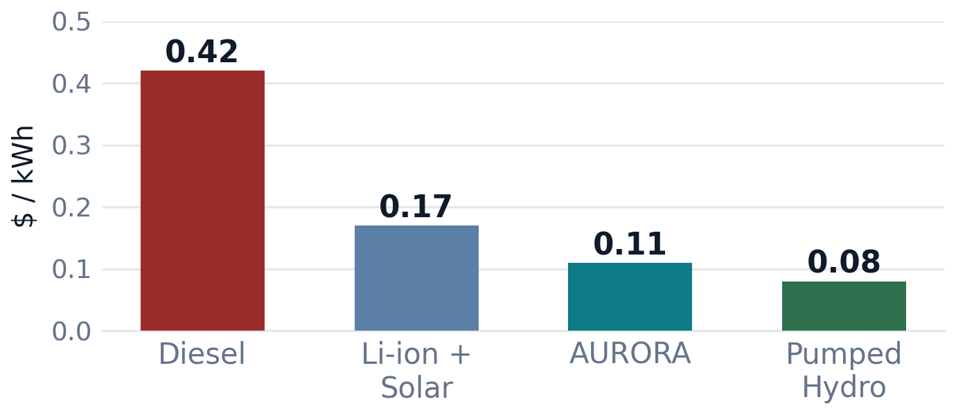
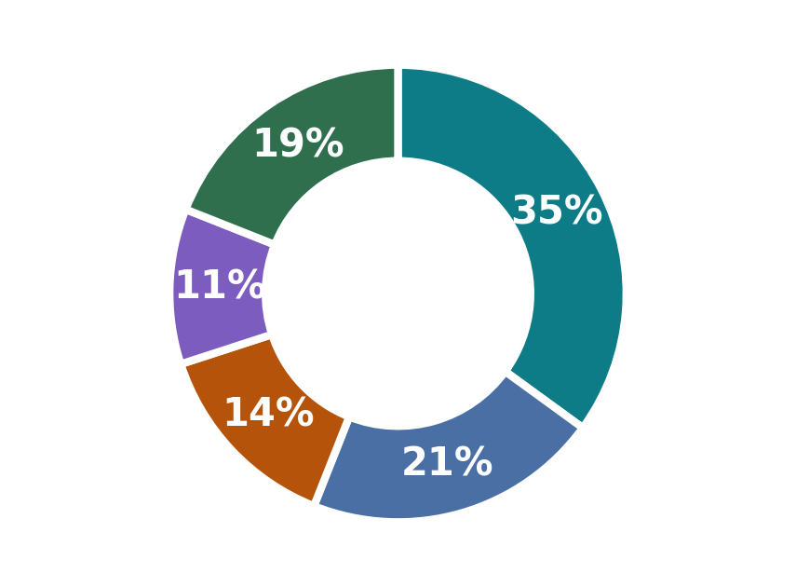
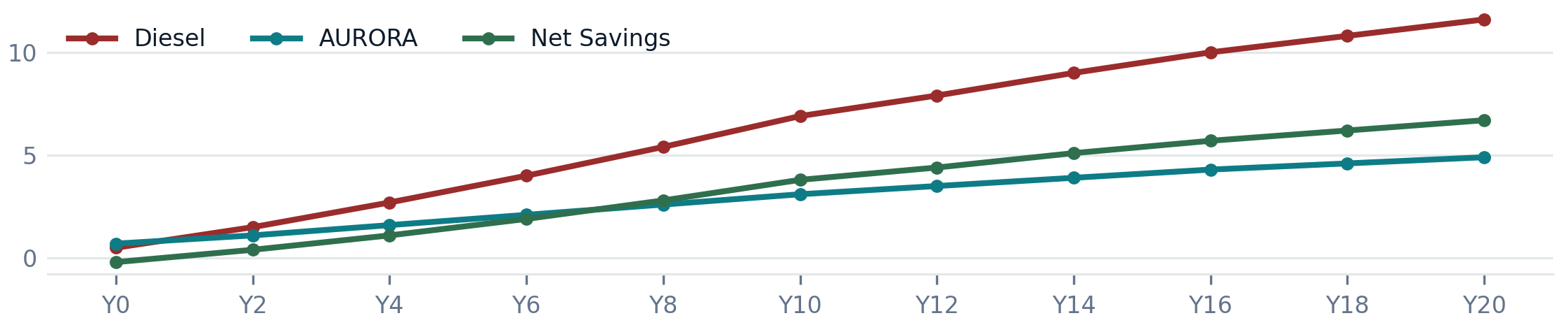
ECONOMIC & PERFORMANCE ANALYSIS
Quantitative Assessment: Cost, Performance & Impact
Levelized Cost of Energy ($/kWh)
Generation Capacity Mix
Solar PV 500kWp
Wind 300kW
Geothermal 200kW
H₂ Cell 150kW
Storage 250kW
20-Year Lifecycle Cost vs. Diesel ($M cumulative)
Team VoltForge · AURORA · Hybrid Hack 2026
8 / 11

Slide 9
EVALUATION
Advantages, Limitations & Mitigation Strategies
An honest engineering assessment — advantages significantly outweigh limitations at scale
Advantages
Limitations → Mitigations
< 90s black-start, no diesel, no external reference
Carbon-zero steady-state — IPCC 1.5°C pathway compliant
LCOE $0.09–0.14/kWh — 3–5× cheaper than diesel
VSG synthetic inertia prevents frequency collapse
Hospitals & emergency comms restored in first 30s
Modular: identical design from 100kW to 10MW
IEC 61850 compliant — integrates with existing SCADA
2,400 tCO₂ avoided per site per year vs. diesel
▸ VRFB CAPEX $300–500/kWh (vs $150–200 Li-ion)
→ Projected $150/kWh by 2030 (NREL); green financing available
▸ Dark doldrums — multi-day low solar + wind
→ Geothermal baseload + H₂ storage fully bridge the gap
▸ VSG tuning needs site-specific calibration
→ Pre-configured parameter sets for standard site types
▸ TRL 5–6 — not yet mass-deployed commercially
→ Full deployment readiness projected 2027–2028
Team VoltForge · AURORA · Hybrid Hack 2026
9 / 11

Slide 10
IMPLEMENTATION ROADMAP
From Simulation to Site: Tech Stack & Feasibility
How AURORA gets built — the simulation, control, and hardware stack behind every claim in this deck
Validated Simulation & Control Stack
Deployment Readiness
Power System Model
Now
TRL 5–6
MATLAB/Simulink SimPowerSystems — full 5-source generation, dual-chemistry storage, IEEE-1547 inverter model
Simulink + OPAL-RT HIL validated; component specs sourced from commercial datasheets
Real-Time HIL
2026–27
Pilot
OPAL-RT OP5700 hardware-in-loop — control logic tested against real-time grid physics, not just offline sim
100 kW containerized pilot at a single critical-load site (hospital / telecom tower)
Control Layer
2027–28
Scale
Grid-forming inverter + VSG emulation, 3-tier EMS (droop → secondary → MPC tertiary dispatch)
Modular replication 100kW–10MW — same control architecture, no redesign
Protection & SCADA
Why This Is Buildable, Not Theoretical
IEC 61850 GOOSE/MMS, DNP3/MODBUS, IEEE 1547.4 island-mode coordination — utility-standard, not custom
Every component (GFI, VRFB, PEM electrolyzer, DFIG turbines) is commercially available today — AURORA is a control + integration innovation, not unproven hardware.
Team VoltForge · AURORA · Hybrid Hack 2026
10 / 11

Slide 11
SUMMARY
AURORA: Carbon-Zero Black-Start in Under 90 Seconds
Autonomous Unified Renewable Orchestration for Resilient Activation
< 90 s
5 sources
$2.1M
2,400 t
TRL 5–6
grid restart — no diesel,
no external reference
Solar · Wind · Geothermal ·
Hydrogen · Storage
lifetime savings per site
vs. diesel over 20 yrs
CO₂ avoided per site
per year at full operation
commercial readiness
projected 2027–2028
Every component is commercially available today — AURORA is ready for a 100 kW pilot deployment.
Team VoltForge · Problem Statement 3: Black-Start Microgrid · Hybrid Hack 2026

