Slide 1

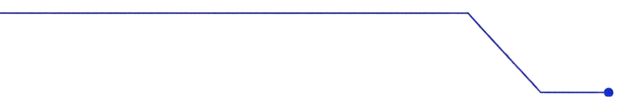
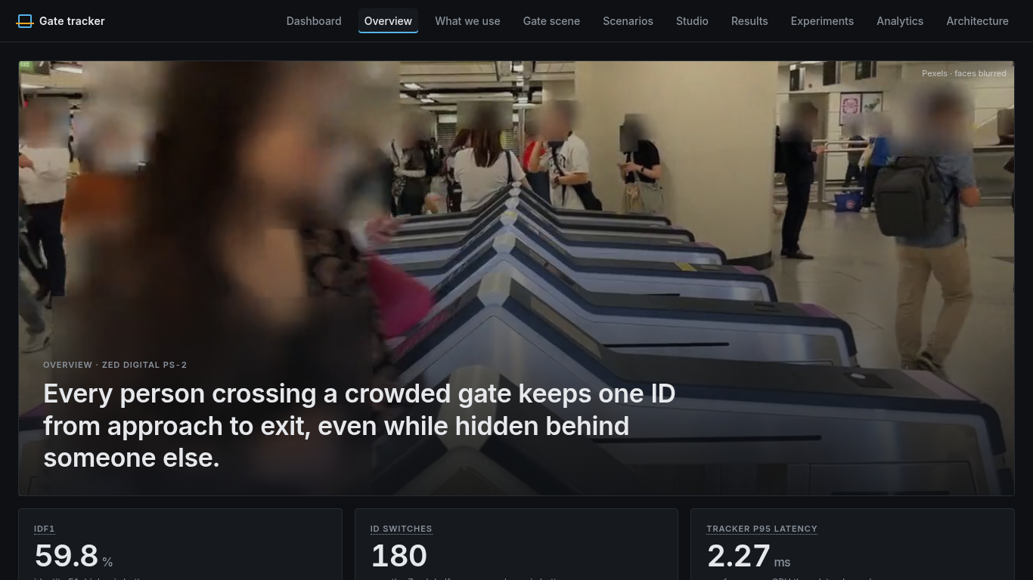
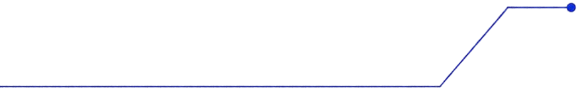
Zed PS-2: Gate Counter That Keeps One ID Per Person
People tracking that stays correct when people get hidden or crowded, and shows exactly where it still fails.
Panshul Arora · SRM IST
BoT-SORT + visibility rules · YOLOX-S · FastAPI · React
Notes:
Open with the one-line claim: at a gate, the counter has to keep one ID per person, even when people get hidden or crowded. Say up front that the deck also shows where it still fails. Stack: BoT-SORT with visibility rules, YOLOX-S detector, FastAPI backend, React app. Hero image is our app's dashboard.
Sources:
- https://github.com/panshularora/zed-ps2-tracker
- https://github.com/panshularora/zed-ps2-tracker/pull/43
- https://github.com/panshularora/zed-ps2-tracker/pull/44
- App screenshot: dashboard (02-dashboard.png)

Slide 2

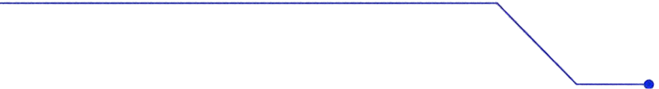
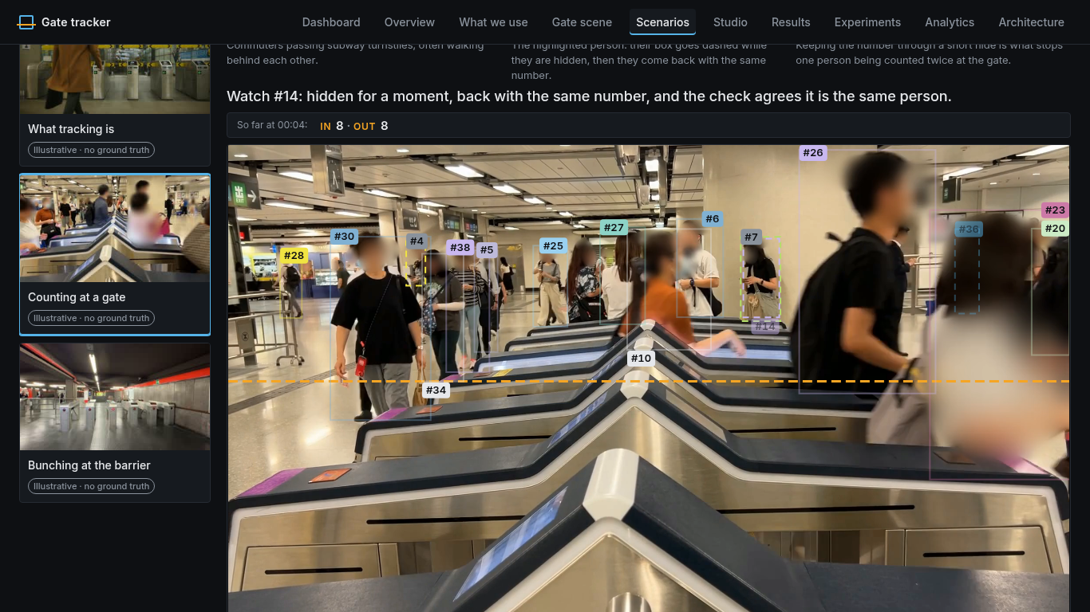
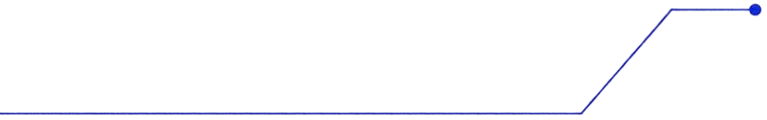
THE PROBLEM
At a gate, one person must equal one ID, or the count is wrong.
1 ID switch: a person walks behind someone, comes back with a new number, and gets counted twice.
2 Swap: two people cross paths and trade numbers, so the history of who went where breaks.
3 Missed crossing: the person is lost right at the line, so IN/OUT is never counted.
Why it matters: entry counts, occupancy and safety limits are only as good as the IDs behind them. Common trackers (ByteTrack, the baseline) drop a person after short gaps.
Our app, gate-counting clip: a crowded gate where people hide behind each other.
Notes:
The problem: one person must equal one ID, or the count is wrong. Walk the three failure modes: ID switch (hidden person returns with a new number and is counted twice), swap (two people trade numbers), missed crossing (lost right at the line). Why it matters: entry counts, occupancy and safety limits depend on these IDs; the ByteTrack baseline drops a person after short gaps. Image: gate-counting clip in our app.
Sources:
- https://github.com/panshularora/zed-ps2-tracker/blob/feat/stress-map/configs/baselines/botsort.yaml
- https://github.com/panshularora/zed-ps2-tracker/blob/feat/stress-map/docs/results/stress/README.md
- App screenshot: scenarios view (stress-map/v2/7-scenarios-2.png)

Slide 3
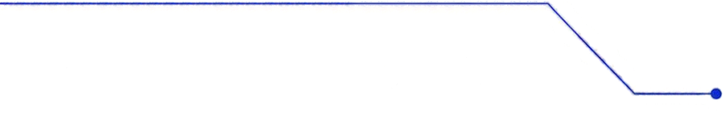
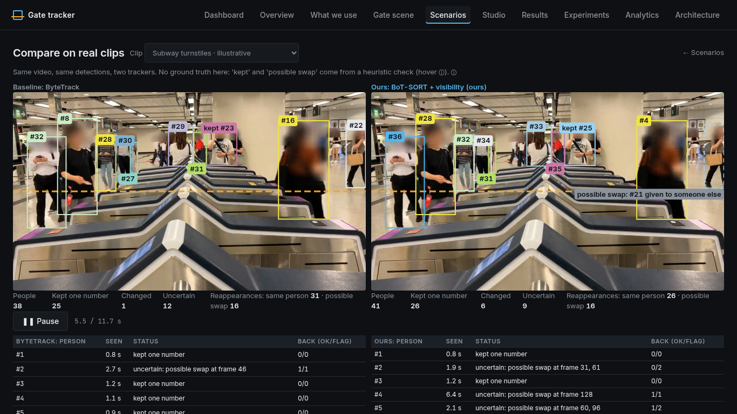

OUR SOLUTION
VS BASELINE
Same detector, smarter memory: we keep the person, not just the box.
What | ByteTrack (baseline) | Ours
Core tracker | ByteTrack | BoT-SORT + visibility rules
When someone is hidden | Drops them quickly | Keeps their ID waiting while they're likely just hidden
Matching on return | Position only | Position + camera-motion correction (when available); appearance re-ID on GPU only
Proof | n/a | Tested across 48 crowd/hiding scenarios, 20 seeds each, with statistics
Privacy | n/a | Tracking reads original frames in memory only; output blurs faces with an oval; the uploaded original is deleted after the job
Same real clip, side by side: ByteTrack (baseline) next to ours, in our app's compare view.
Notes:
Same detector, smarter memory. Compare row by row: ByteTrack drops hidden people quickly and matches on position only; ours is BoT-SORT plus visibility rules, keeps the ID waiting while the person is likely just hidden, and adds camera-motion correction when available (appearance re-ID only on GPU). Proof: 48 crowd/hiding scenarios, 20 seeds each, with statistics. Privacy: tracking reads original frames in memory only, output blurs faces with an oval, and the uploaded original is deleted after the job.
Sources:
- https://github.com/panshularora/zed-ps2-tracker/blob/feat/stress-map/configs/ours/visibility_botsort.yaml
- https://github.com/panshularora/zed-ps2-tracker/blob/feat/stress-map/configs/baselines/botsort.yaml (appearance re-ID off by default; CMC)
- https://github.com/panshularora/zed-ps2-tracker/blob/feat/stress-map/serve/settings.py (ZED_DETECTOR default yolox_s)
- https://github.com/panshularora/zed-ps2-tracker/blob/feat/stress-map/serve/api.py (unblurred frames in memory only; raw upload deleted)
- https://github.com/panshularora/zed-ps2-tracker/blob/feat/stress-map/serve/blur.py (soft ellipse face blur)
- https://github.com/panshularora/zed-ps2-tracker/blob/feat/stress-map/docs/results/stress/README.md (20 seeds per cell, 1000-1019)

Slide 4
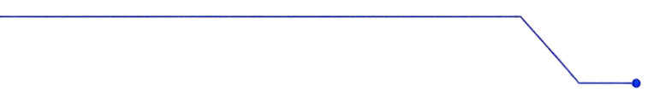
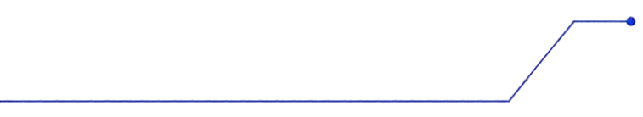
Video
upload or demo clip
ARCHITECTURE
One pipeline, from raw video to an honest count.
YOLOX-S detector
finds people in each frame, on CPU
TECH STACK
Privacy step
After tracking: oval face blur on everything shown or saved. The raw upload is deleted when the job ends.
Tracker: BoT-SORT + visibility rules
gives each person one ID and holds it while hidden
■ Python
■ PyTorch
■ YOLOX
■ BoT-SORT / ByteTrack
■ TrackEval (official MOT metrics)
■ FastAPI
■ React + TypeScript
■ Docker Compose
Gate logic
counts IN/OUT when an ID crosses the drawn line
QUALITY
335
backend tests passing
187
frontend tests (vitest)
Jobs API (FastAPI)
uploads, progress, results, metrics
Web app (React)
Scenarios, Studio, Results / Stress Map
Notes:
One pipeline from raw video to an honest count: video upload or demo clip, YOLOX-S detector on CPU, tracker (BoT-SORT + visibility rules), gate logic that counts IN/OUT when an ID crosses the drawn line, FastAPI jobs API, React web app. Privacy step after tracking: oval face blur on everything shown or saved; raw upload deleted when the job ends. Quality: 321 backend tests passing, 175 frontend tests (vitest).
Sources:
- https://github.com/panshularora/zed-ps2-tracker/blob/feat/stress-map/serve/settings.py
- https://github.com/panshularora/zed-ps2-tracker/blob/feat/stress-map/serve/api.py
- https://github.com/panshularora/zed-ps2-tracker/blob/feat/stress-map/serve/blur.py
- 321 backend tests: pytest run on feat/stress-map head 2998654
- 175 frontend tests: vitest it()/test() calls in web/

Slide 5
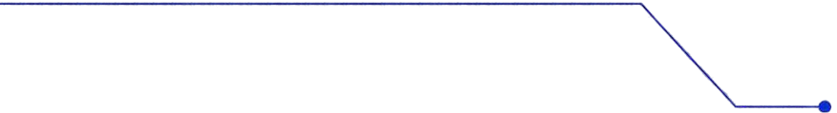
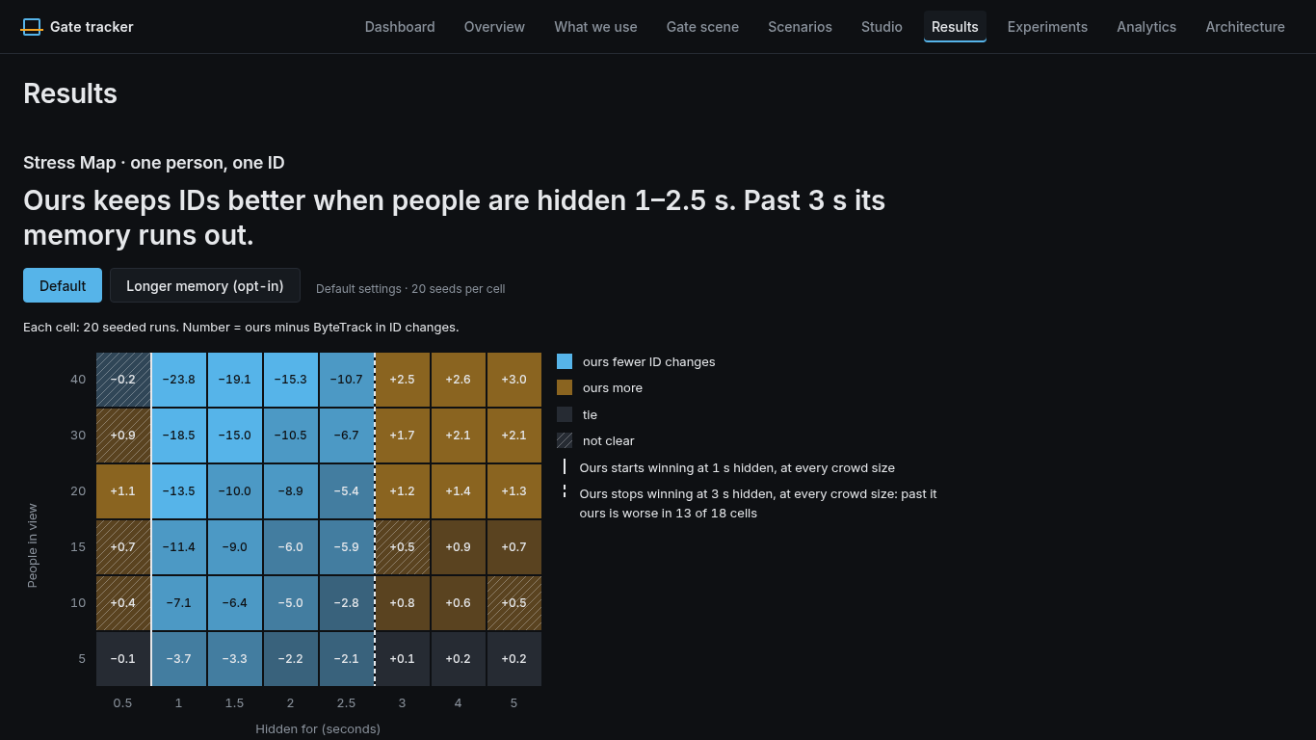


We stress-tested it on 48 scenarios
Setup: a simulator hides people for 0.5 to 5 seconds in crowds of 5 to 40 people. 48 scenario cells, 20 random runs each, with separate seeds for tuning and for reporting. “Better” counts only when the statistics are sure: the bootstrap 95% CI (range of likely differences) excludes 0 and the sign test (wins vs. losses check) gives p<0.05.
24 / 48
14 / 48
1 / 48
cells where ours is clearly better than ByteTrack
cells where ours is worse than ByteTrack
cell worse with the longer-memory setting (opt-in, tested on MOT17 only so far)
The Stress Map in our app: 6 crowd sizes × 8 hiding times = 48 cells.
Ours wins at every crowd size when people are hidden 1 to 2.5 s; past 3 s its memory runs out.
Notes:
Stress test: a simulator hides people for 0.5 to 5 s in crowds of 5 to 40 people; 48 cells, 20 random runs each, separate seeds for tuning (0-9) and reporting (1000-1019). Better counts only when the bootstrap 95% CI excludes 0 and the sign test gives p<0.05. Results: ours clearly better in 24 of 48 cells, worse in 14 of 48; the longer-memory setting is worse in only 1 of 48 (opt-in, tested on MOT17 only so far). Ours wins at every crowd size at 1 to 2.5 s hidden; past 3 s its memory runs out.
Sources:
- https://github.com/panshularora/zed-ps2-tracker/blob/feat/stress-map/docs/results/stress/README.md
- https://github.com/panshularora/zed-ps2-tracker/blob/feat/stress-map/docs/results/stress/stress_map.json (better 24, worse 14, unclear 6, tie 4)
- https://github.com/panshularora/zed-ps2-tracker/blob/feat/stress-map/docs/results/stress/stress_map_mem6.json (worse 1)
- https://github.com/panshularora/zed-ps2-tracker/blob/feat/stress-map/serve/stress_live.py (mem6 opt-in)

Slide 6
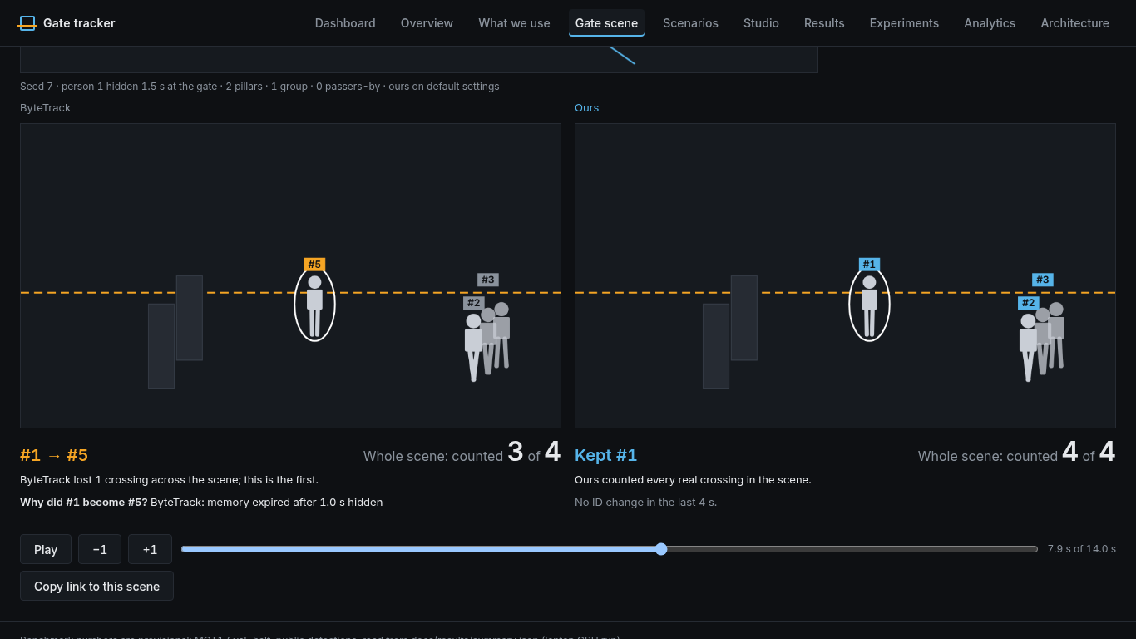
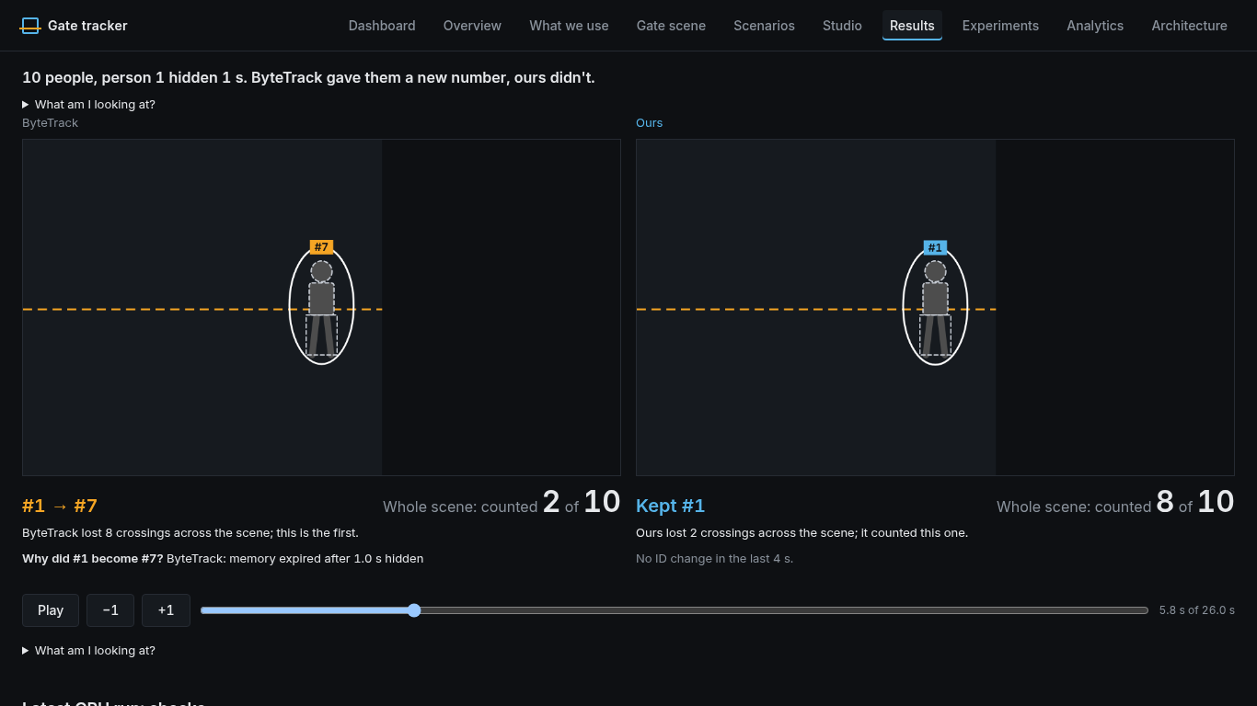
BREAK IT
YOURSELF
Judges don't have to trust our numbers; they can try to break it.
■ Replay any cell: click a cell of the Stress Map to replay that exact scenario and see where IDs hold or switch.
■ Break it yourself: set crowd size and hiding time, and get a verdict for both trackers.
■ Shareable link: every result has a link that reopens the same scenario.
■ Every ID change is logged with the reason it happened, so you can trace any switch.
Top: the “Break it yourself” verdict, both trackers side by side.
Below: a cell replay of one Stress Map scenario.
Notes:
Judges don't have to trust our numbers. Replay any cell of the Stress Map to see where IDs hold or switch; set crowd size and hiding time yourself and get a verdict for both trackers; every result has a shareable link that reopens the same scenario; every ID change is logged with the reason it happened.
Sources:
- https://github.com/panshularora/zed-ps2-tracker/blob/feat/stress-map/serve/stress_live.py
- https://github.com/panshularora/zed-ps2-tracker/blob/feat/stress-map/docs/results/stress/README.md
- https://github.com/panshularora/zed-ps2-tracker/pull/43
- https://github.com/panshularora/zed-ps2-tracker/pull/44
- App screenshots: Break-it-yourself verdict, cell replay

Slide 7
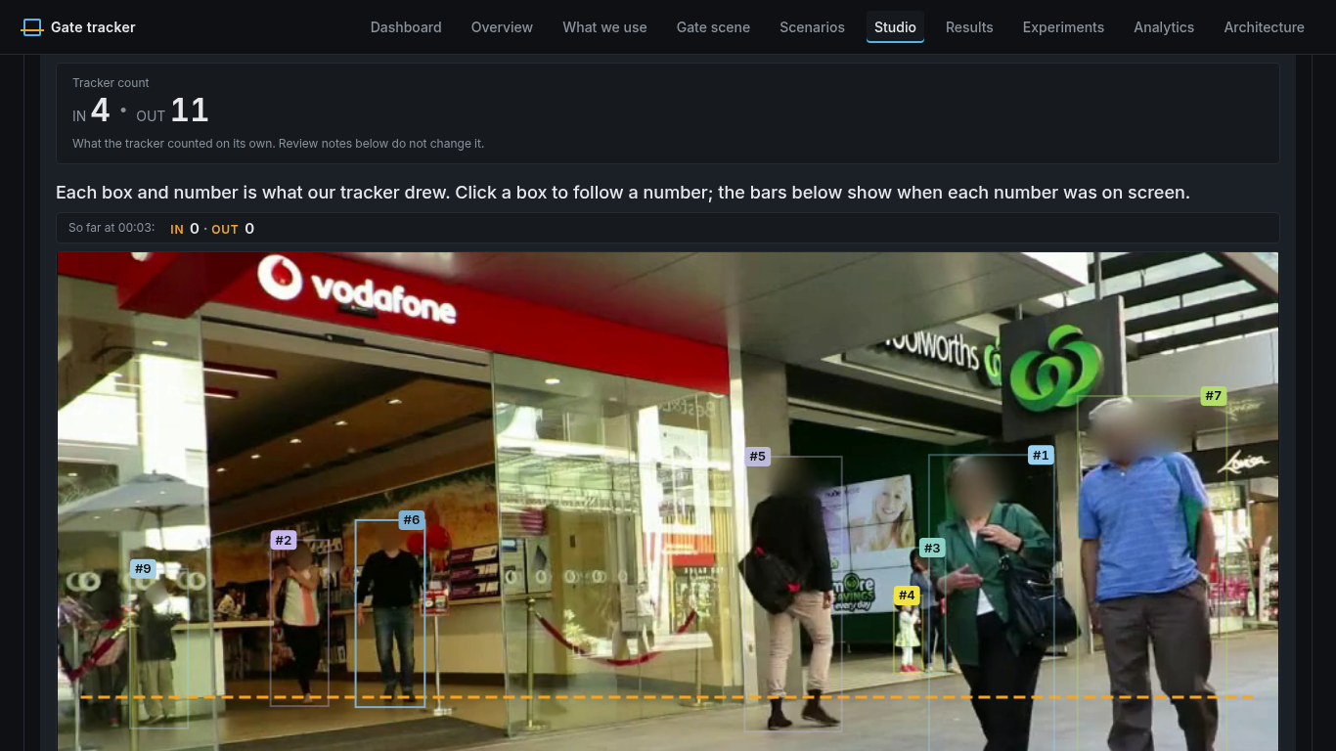
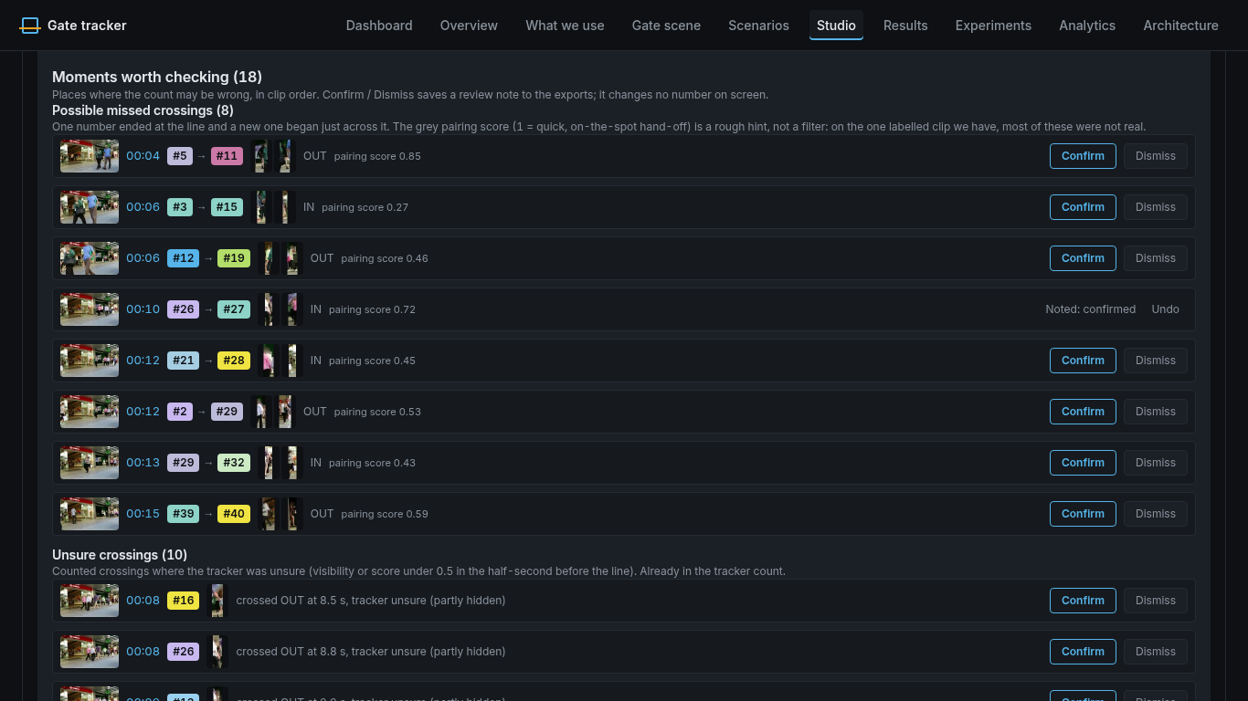
Try it on any video: upload, draw the gate, get counts
Setup: MOT17-09, a public benchmark clip with human-labelled ground truth (the true answer). Ground truth is used offline only, never shown in the app. Run on CPU with the YOLOX-S detector. True count 3 IN / 10 OUT; tracker 4 IN / 11 OUT.
9 of 15
4
3 IN / 10 OUT
counted crossings are real
true crossings missed
true count (the tracker counted 4 IN / 11 OUT)
On CPU, without appearance re-ID, some crossings are false or missed. We show that instead of hiding it.
“Moments worth checking” lists likely mistakes with a timestamp, a still frame and the two IDs, for an operator to review. It doesn't change the count (screenshot, bottom right).
Notes:
Real video: MOT17-09, a public benchmark clip with human-labelled ground truth, used offline only and never shown in the app. Run on CPU with YOLOX-S. True count 3 IN / 10 OUT; the tracker counted 4 IN / 11 OUT. 9 of 15 counted crossings are real, 4 true crossings were missed. Without appearance re-ID on CPU some crossings are false or missed, and we show that. Moments worth checking lists likely mistakes with timestamp, still frame and the two IDs for an operator; confirming one does not change the count.
Sources:
- https://github.com/panshularora/zed-ps2-tracker/blob/feat/stress-map/docs/results/stress/operator_demo_mot17_09.json
- https://github.com/panshularora/zed-ps2-tracker/blob/feat/stress-map/docs/results/stress/CROSSING_RECOVERY.md
- App screenshots: upload counts and player, Moments worth checking list

Slide 8
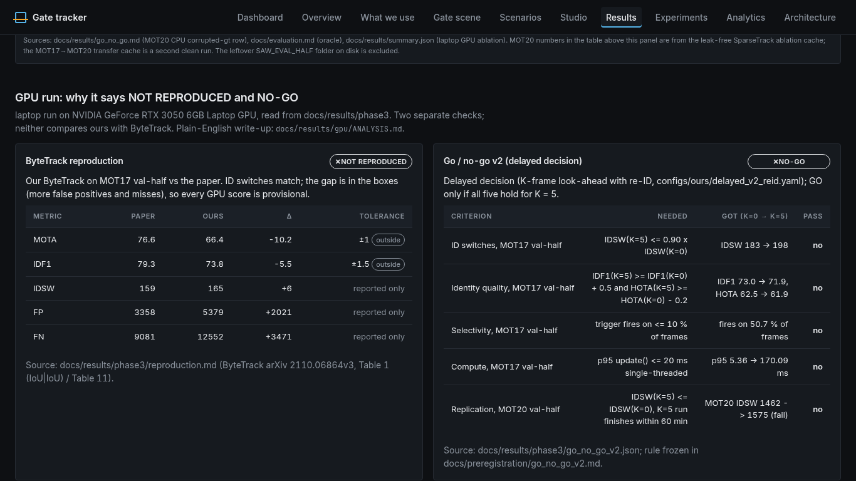
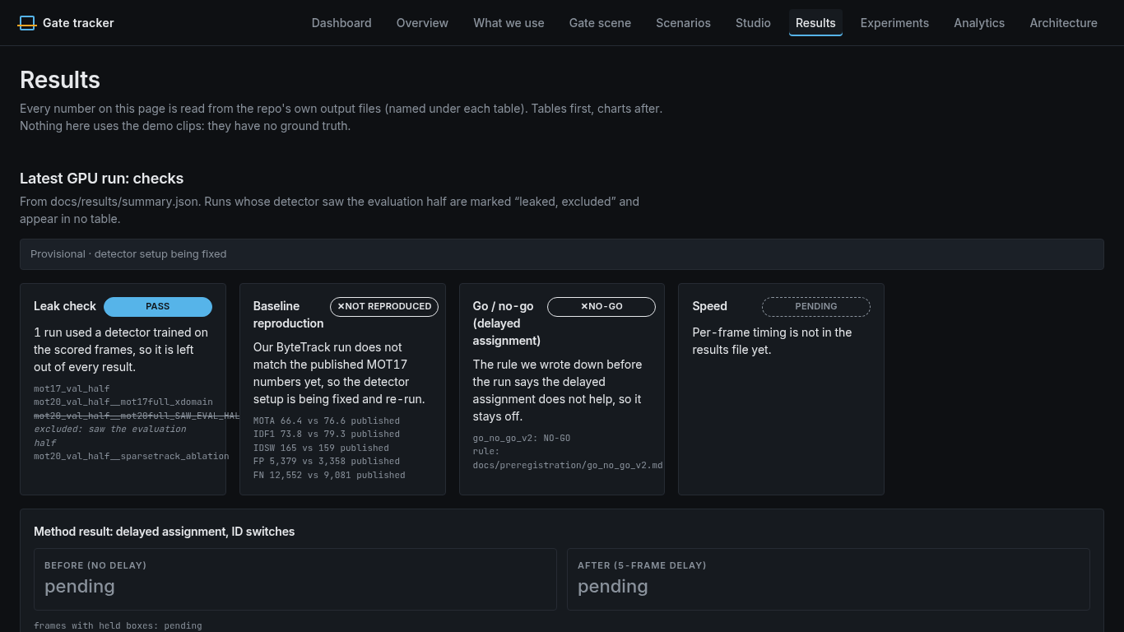
OFFICIAL BENCHMARKS:
PROVISIONAL RUN
Laptop GPU, 18 Oct 2026. ByteTrack MOTA 66.4 vs 76.6 paper.
Dataset | IDF1: keeps the right ID over time |  | AssA: association accuracy
 | ByteTrack | Ours | ByteTrack | Ours
MOT17 | 73.8 | 75.1 | 66.5 | 67.1
MOT20 | 84.1 | 84.0 | 66.8 | 66.3
DanceTrack | 54.9 | 55.8 | 36.3 | 38.8
Results page in our app: the latest GPU checks, with our ByteTrack baseline marked “not reproduced”.
Main finding: the visibility rule stops re-ID from hurting. MOT20 (SparseTrack detector) HOTA: ByteTrack 69.4 → + re-ID 67.5 → ours 69.5; MOT17: + re-ID 62.5 → ours 63.2. Not the best tracker overall: BoT-SORT without re-ID wins MOT17 (HOTA 64.6 vs 63.9), Hybrid-SORT wins DanceTrack. Scored with TrackEval.
Notes:
Official benchmarks from the 18 Oct laptop GPU run (YOLOX-X, TrackEval). Provisional: ByteTrack MOTA 66.4 vs 76.6 paper. MOT17 IDF1 73.8 vs ours 75.1; MOT20 SparseTrack 84.1 vs 84.0; DanceTrack 54.9 vs 55.8. Ours is BoT-SORT plus visibility-gated appearance. We lead with IDF1 and AssA because the goal is one ID per person.
Sources:
- https://github.com/panshularora/zed-ps2-tracker/blob/feat/stress-map/docs/results/GPU_RUN_2026-10.md
- TrackEval: https://github.com/JonathonLuiten/TrackEval
- App screenshot: Results page (11-results.png)

Slide 9
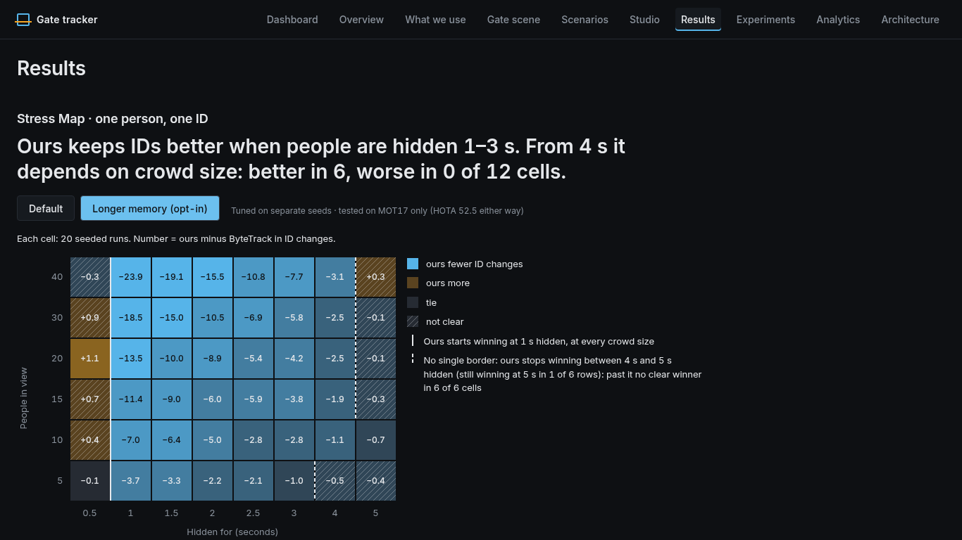
WHERE WE LOSE,
AND WHAT'S NEXT
We show where it fails, not just where it wins.
WHERE WE LOSE
■ Hidden longer than 3 s: our memory runs out: worse than ByteTrack in 14 of 48 cells (1 of 48 with the opt-in longer memory, checked on MOT17 only).
■ DanceTrack: Hybrid-SORT 57.4 HOTA vs ours 54.3.
■ Speed: on MOT20 ours needs 87–95 ms per frame (p95) vs 14 ms for ByteTrack.
■ Baseline not reproduced: MOTA 66.4 vs 76.6, IDF1 73.8 vs 79.3 in the paper, so every GPU score is provisional.
■ CPU uploads: appearance re-ID is off, which causes false and missed crossings.
DROPPED ON PURPOSE
■ Pre-registered delay-K idea: failed all five checks (IDSW 183 → 198, IDF1 73.0 → 71.9, fired on 51% of frames vs a 10% limit, p95 170 ms vs 20 ms, MOT20 IDSW 1462 → 1575), so it was dropped.
Stress Map with the longer-memory setting: worse than ByteTrack in 1 of 48 cells (opt-in).
NEXT
1 Close the ByteTrack MOTA gap (66.4 vs 76.6) or drop paper-comparable claims.
2 Confirm longer memory on MOT20 and DanceTrack.
3 Turn re-ID on for GPU uploads.
Notes:
Where we lose: hidden longer than 3 s, ours is worse than ByteTrack in 14 of 48 cells; the longer-memory setting cuts that to 1 of 48 but is tested on MOT17 only, so it stays opt-in; our GPU ByteTrack still misses the paper (MOTA 66.4 vs 76.6), so GPU rankings are relative to this cache; on CPU uploads appearance re-ID is off, which causes the false and missed crossings. Next: close the ByteTrack MOTA gap, confirm longer memory on MOT20 and DanceTrack, turn re-ID on for GPU uploads.
Sources:
- https://github.com/panshularora/zed-ps2-tracker/blob/feat/stress-map/docs/results/stress/stress_map.json
- https://github.com/panshularora/zed-ps2-tracker/blob/feat/stress-map/docs/results/stress/stress_map_mem6.json
- https://github.com/panshularora/zed-ps2-tracker/blob/feat/stress-map/docs/results/stress/README.md
- https://github.com/panshularora/zed-ps2-tracker/blob/feat/stress-map/docs/results/GPU_RUN_2026-10.md
- https://github.com/panshularora/zed-ps2-tracker/blob/feat/stress-map/configs/baselines/botsort.yaml

