Slide 1
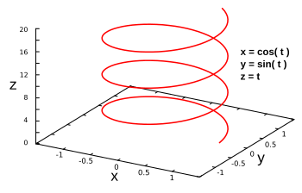
Idea sketch of coverage path planning for polyhedrons-shaped infrastructure
Feb 22 2019
Jungwon Kang
● Input/output of the proposed algorithm
▫ Input: given infrastructure model
▫ Ouput: via-points
● Steps in proposed algorithm
(1) Creating 3D configuration space from the given infrastructure model
(2) Creating helix to cover the 3D configuration space
(3) Projecting each helix points into the center of the 3D configuration space
(4) Set helix points (on the surface of 3D configuration space) as via-points
*Helix: https://en.wikipedia.org/wiki/Helix

