Slide 1
Meeting Materials for QDrone Project Regular Internal Meeting

Slide 2
Regular Internal Meeting for QDrone Project
Jan 7 2019
4PM at PSE 312
Participant: Jungwon Kang, Zahra Arjmandi, Kunwoo Park

Slide 3
Prerequisites for Pursuing Project
Software
Matlab
C++
Ubuntu
ROS
Theory (for backend: state estimation from sensor measurement)
EKF
MSCKF
Smoothing
Sensor
GPS
IMU
Camera
LiDAR

Slide 4
Tasks
Task 0: Building Systems
Task 1: Localization
Task 2: SLAM
Task 3: Navigation

Slide 5
Task 0: Building Systems
Building Complete Systems
Building Systems
Localization & Mapping
Navigation
Done!
DJI M100
(basic setup)
Localization
(range-based)
Navigation
(by just predefined via-point following)
Done!
DJI M100
(payload integration)
SLAM
Navigation
(by next-best-view point selection)
DJI M600 + Gimbal
(basic setup)
DJI M600 + Gimbal
(payload integration)
Simulator

Slide 6
Task 1: Localization
Following Predefined Via-Points
Building Systems
Localization & Mapping
Navigation
DJI M100
(basic setup)
Localization
(range-based)
Navigation
(by just predefined via-point following)
DJI M100
(payload integration)
In-progress
SLAM
Navigation
(by next-best-view point selection)
DJI M600 + Gimbal
(basic setup)
DJI M600 + Gimbal
(payload integration)
Simulator

Slide 7
Task 2: SLAM
Building a Map
Building Systems
Localization & Mapping
Navigation
DJI M100
(basic setup)
Localization
(range-based)
Navigation
(by just predefined via-point following)
DJI M100
(payload integration)
SLAM
Navigation
(by next-best-view point selection)
DJI M600 + Gimbal
(basic setup)
DJI M600 + Gimbal
(payload integration)
Simulator

Slide 8
Task 3: Navigation
Building a Map by Next-Best-View Point Selection
Building Systems
Localization & Mapping
Navigation
DJI M100
(basic setup)
Localization
(range-based)
Navigation
(by just predefined via-point following)
DJI M100
(payload integration)
SLAM
Navigation
(by next-best-view point selection)
DJI M600 + Gimbal
(basic setup)
DJI M600 + Gimbal
(payload integration)
Simulator

Slide 9
Meeting Results: What to do
Common
Basic setup for 'DJI M600 + Gimbal' (primarily by Zahra & Kunwoo)
Booking a PSE 4th floor room equipped with motion capture systems
Zahra
Understanding Kunwoo's EKF-based UWB localization code (including EKF)
Kunwoo
Sending thesis and experiment plan to prof. Sohn
Writing a paper for ISPRS Geospatial Week 2019
Jungwon
Writing a paper for IROS 2019

Slide 10
Future Plan
Jungwon's Rough Suggestion for Future Plan
Zahra (primarily semantic SLAM)
Conventional SLAM
▪ Using vision and/or LiDAR
▪ ORB2
Semantic SLAM
▪ Fusion with deep
Kunwoo (primarily UAV localization)
UWB-Inertial Odometry (UIO)
▪ EKF-based UIO and/or DOP
▪ MSCKF-based UIO and/or DOP
Localization with UIO + GPS switching
Jungwon: supports Kunwoo & Zahra mainly in technical issues.

Slide 11
IMU Calibration Problem
Jan 24 2019
Participant: Jungwon Kang, Zahra Arjmandi, Kunwoo Park, Yujia Zhang

Slide 12
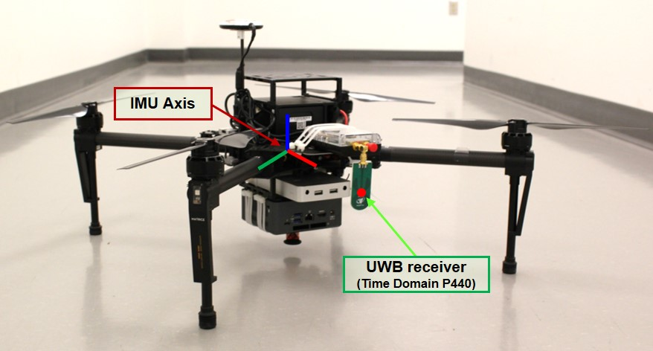
Problem 1
Where is the UWB receiver wrt IMU axis?

Slide 13
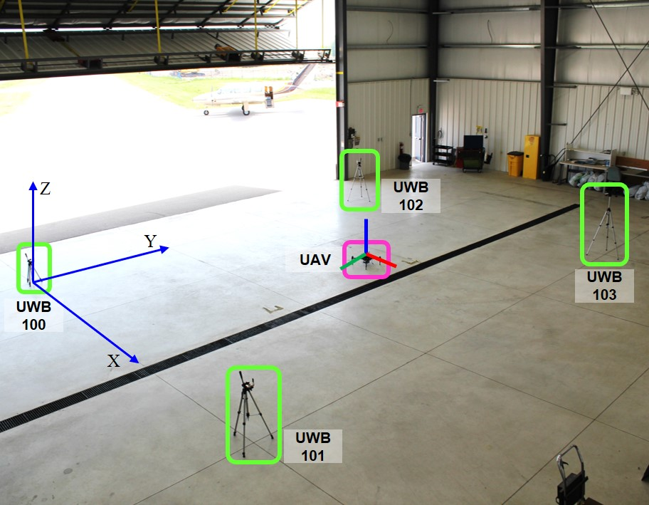
Problem 2
What is the initial R, T between UWB axis and IMU axis?

Slide 14
Plan for Year 2019
Feb 5 2019
Participant: Jungwon Kang, Zahra Arjmandi, Kunwoo Park

Slide 15
Plan for Year 2019
 |  | Month
 |  | 1 | 2 | 3 | 4 | 5 | 6 | 7 | 8 | 9 | 10 | 11 | 12
Building System | Payload purchase
 | Testing of M600 & Ronin-MX
 | Individual test of payload
 | Payload integration
UWB-aided localization | Kunwoo's Kalman filter
 | Jungwon's Smoothing
Demo | Path following
SLAM | Semantic SLAM
EKF / MSCKF / DOP
IROS
Payload
● Positioning sensor: Pozyx / Spatial / DJI-RTK
● Imaging sensor: ZED stereo / FLIR Duo R / Sony A7III
● Velodyne LiDARs: Puck LITE / Puck Hi-Res / HDL-32E

Slide 16
Current Progress & To do next
Mar 10 2019
Jungwon Kang

Slide 17
Current Progress & To Do Next
Subject | Detailed Task | Current Progress | To Do Next
System building | Payload purchase | ▪ Received Velodyne Puck Lite & Hi-Res | ▪ Receiving the rest of ordered items (All items are listed at the bottom of page.) ▪ Need to buy a cabinet with lockers ▪ Making a list of items
 | Testing M600 & Ronin-MX | ▪ Tested Ronin-MX ▪ Not tested M600 due to a broken battery ▪ The broken battery (TB48S) was delivered to the OmniView tech. | ▪ Need to order extra TB48S batteries. (Need $2000 for six TB48S)
 | Test of each payload | None
 | Payload integration | None
Dataset release | UWB-IMU dataset generation & release | None | ▪ Need to do experiments ▪ Need to release the dataset to the public ▪ Need to submit a paper about the dataset
Localization solution | UWB multilateration-based localization | ▪ Implemented an initial version of multilateration in C++ | ▪ Need to implement LM non-linear optimization in C++
 | UWB-EKF-based localization | ▪ Implemented in MATLAB (by Kunwoo) | ▪ Need to implement in C++ ▪ Need to write a thesis draft by Kunwoo
 | UWB-Smoothing-based localization | ▪ Implemented in MATLAB (by Jungwon) ▪ Submitted IROS paper | ▪ Need to implement in C++
Navigation solution | Coverage path planning | ▪ Implemented in MATLAB (by Zahra)
 | Implementing in real systems | None | ▪ Need to implement in M100 & M600
Payload
● Positioning sensor: Pozyx / Spatial / DJI-RTK
● Imaging sensor: ZED stereo / FLIR Duo R / Sony A7III
● Velodyne LiDARs: Puck LITE / Puck Hi-Res / HDL-32E

