Slide 1
Meeting Materials for QDrone Project Regular Internal Meeting

Slide 2
Regular Internal Meeting for QDrone Project
Jan 7 2019
4PM at PSE 312
Participant: Jungwon Kang, Zahra Arjmandi, Kunwoo Park

Slide 3
Prerequisites for Pursuing Project
Software
Matlab
C++
Ubuntu
ROS
Theory (for backend: state estimation from sensor measurement)
EKF
MSCKF
Smoothing
Sensor
GPS
IMU
Camera
LiDAR

Slide 4
Tasks
Task 0: Building Systems
Task 1: Localization
Task 2: SLAM
Task 3: Navigation

Slide 5
Task 0: Building Systems
Building Complete Systems
Building Systems
Localization & Mapping
Navigation
Done!
DJI M100
(basic setup)
Localization
(range-based)
Navigation
(by just predefined via-point following)
Done!
DJI M100
(payload integration)
SLAM
Navigation
(by next-best-view point selection)
DJI M600 + Gimbal
(basic setup)
DJI M600 + Gimbal
(payload integration)
Simulator

Slide 6
Task 1: Localization
Following Predefined Via-Points
Building Systems
Localization & Mapping
Navigation
DJI M100
(basic setup)
Localization
(range-based)
Navigation
(by just predefined via-point following)
DJI M100
(payload integration)
In-progress
SLAM
Navigation
(by next-best-view point selection)
DJI M600 + Gimbal
(basic setup)
DJI M600 + Gimbal
(payload integration)
Simulator

Slide 7
Task 2: SLAM
Building a Map
Building Systems
Localization & Mapping
Navigation
DJI M100
(basic setup)
Localization
(range-based)
Navigation
(by just predefined via-point following)
DJI M100
(payload integration)
SLAM
Navigation
(by next-best-view point selection)
DJI M600 + Gimbal
(basic setup)
DJI M600 + Gimbal
(payload integration)
Simulator

Slide 8
Task 3: Navigation
Building a Map by Next-Best-View Point Selection
Building Systems
Localization & Mapping
Navigation
DJI M100
(basic setup)
Localization
(range-based)
Navigation
(by just predefined via-point following)
DJI M100
(payload integration)
SLAM
Navigation
(by next-best-view point selection)
DJI M600 + Gimbal
(basic setup)
DJI M600 + Gimbal
(payload integration)
Simulator

Slide 9
Meeting Results: What to do
Common
Basic setup for 'DJI M600 + Gimbal' (primarily by Zahra & Kunwoo)
Booking a PSE 4th floor room equipped with motion capture systems
Zahra
Understanding Kunwoo's EKF-based UWB localization code (including EKF)
Kunwoo
Sending thesis and experiment plan to prof. Sohn
Writing a paper for ISPRS Geospatial Week 2019
Jungwon
Writing a paper for IROS 2019

Slide 10
Future Plan
Jungwon's Rough Suggestion for Future Plan
Zahra (primarily semantic SLAM)
Conventional SLAM
▪ Using vision and/or LiDAR
▪ ORB2
Semantic SLAM
▪ Fusion with deep
Kunwoo (primarily UAV localization)
UWB-Inertial Odometry (UIO)
▪ EKF-based UIO and/or DOP
▪ MSCKF-based UIO and/or DOP
Localization with UIO + GPS switching
Jungwon: supports Kunwoo & Zahra mainly in technical issues.

Slide 11
IMU Calibration Problem
Jan 24 2019
Participant: Jungwon Kang, Zahra Arjmandi, Kunwoo Park, Yujia Zhang

Slide 12
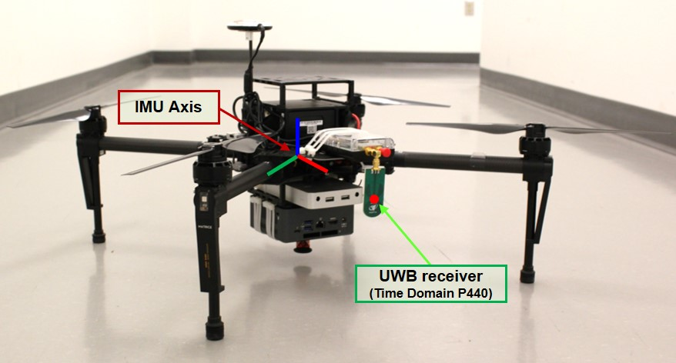
Problem 1
Where is the UWB receiver wrt IMU axis?

Slide 13
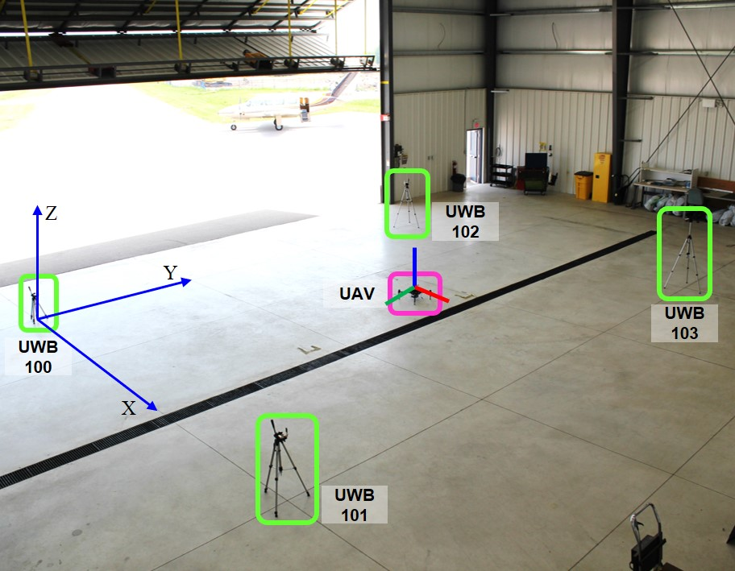
Problem 2
What is the initial R, T between UWB axis and IMU axis?

Slide 14
Plan for Year 2019
Feb 5 2019
Participant: Jungwon Kang, Zahra Arjmandi, Kunwoo Park

Slide 15
Plan for Year 2019
 |  | Month
 |  | 1 | 2 | 3 | 4 | 5 | 6 | 7 | 8 | 9 | 10 | 11 | 12
Building System | Payload purchase
 | Testing of M600 & Ronin-MX
 | Individual test of payload
 | Payload integration
UWB-aided localization | Kunwoo's Kalman filter
 | Jungwon's Smoothing
Demo | Path following
SLAM | Semantic SLAM
EKF / MSCKF / DOP
IROS
Payload
● Positioning sensor: Pozyx / Spatial / DJI-RTK
● Imaging sensor: ZED stereo / FLIR Duo R / Sony A7III
● Velodyne LiDARs: Puck LITE / Puck Hi-Res / HDL-32E

Slide 16
Current Progress & To do next
Mar 10 2019
Jungwon Kang

Slide 17
Current Progress & To Do Next
Subject | Detailed Task | Current Progress | To Do Next
System building | Payload purchase | ▪ Received Velodyne Puck Lite & Hi-Res | ▪ Receiving the rest of ordered items (All items are listed at the bottom of page.) ▪ Need to buy a cabinet with lockers ▪ Making a list of items
 | Testing M600 & Ronin-MX | ▪ Tested Ronin-MX ▪ Not tested M600 due to a broken battery ▪ The broken battery (TB48S) was delivered to the OmniView tech. | ▪ Need to order extra TB48S batteries. (Need $2000 for six TB48S)
 | Test of each payload | None
 | Payload integration | None
Dataset release | UWB-IMU dataset generation & release | None | ▪ Need to do experiments ▪ Need to release the dataset to the public ▪ Need to submit a paper about the dataset
Localization solution | UWB multilateration-based localization | ▪ Implemented an initial version of multilateration in C++ | ▪ Need to implement LM non-linear optimization in C++
 | UWB-EKF-based localization | ▪ Implemented in MATLAB (by Kunwoo) | ▪ Need to implement in C++ ▪ Need to write a thesis draft by Kunwoo
 | UWB-Smoothing-based localization | ▪ Implemented in MATLAB (by Jungwon) ▪ Submitted IROS paper | ▪ Need to implement in C++
Navigation solution | Coverage path planning | ▪ Implemented in MATLAB (by Zahra)
 | Implementing in real systems | None | ▪ Need to implement in M100 & M600
Payload
● Positioning sensor: Pozyx / Spatial / DJI-RTK
● Imaging sensor: ZED stereo / FLIR Duo R / Sony A7III
● Velodyne LiDARs: Puck LITE / Puck Hi-Res / HDL-32E

Slide 18
Current Tasks Task 1. Testing & Labeling of Items Task 2. Implementation of Waypoint Following
April 11 2019
Jungwon Kang

Slide 19
Task 1. Testing & Labeling of Items

Slide 20
Item List (Apr 11 2019)
Type | Item Name | Components | Delivery State | Testing State
Drone | DJI M600 Set | M600 body / Ronin-MX Gimbal / 2 RC / Batteries / RTK-GPS |  | Partially done
Drone | DJI M100 Set | M100 body / RC / Propellars / Batteries / A3 FC / Lightbridge |  | Partially done
Drone | DJI Mavic Air Set |  |  | Done
IMU | Spatial |  | Not delivered yet | Not done yet
UWB | TimeDomain | 5 UWB modules / 5 Batteries |  | Done
UWB | Pozyx |  | Not delivered yet | Not done yet
LiDAR | GeoSLAM | Scanner / Data logger / Dongle USB |  | Done
LiDAR | Velodyne Puck LITE |  |  | Not done yet
LiDAR | Velodyne Puck Hi-Res |  |  | Not done yet
LiDAR | Velodyne HDL-32E |  |  | Not done yet
Camera | Sony A7III |  | Not delivered yet | Not done yet
Camera | FLIR Duo R |  | Not delivered yet | Not done yet
Camera | ZED stereo |  | Not delivered yet | Not done yet
Camera | RealSense Depth |  |  | Not done yet
Computer | Intel NUC1 |  |  | Done
Computer | Intel NUC2 |  |  | Done
Computer | NVIDIA TX2 |  |  | Not done yet
Sub-device | Wifi router |  |  | Done
Sub-device | Laser distance |  |  | Done
Battery | Large1 |  |  | Done
Battery | Large2 |  |  | Done
Battery | Payload silver |  |  | Done
Solid | Tripod |  |  | Done
Solid | Chair |  |  | Done
Solid | Table |  |  | Done

Slide 21
Task 2. Implementation of
Waypoint Following

Slide 22

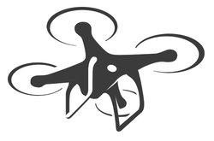
Implementation of Waypoint Following ^{(1/4)}
Objectives Implementation of waypoint following, where the waypoints are given by users in advance.
Waypoint
Notes:
그림출처: https://www.sttilophotography.com/office-and-apartment-block-textures-aoa-forums-3ad5333f19571a99.html

Slide 23
Implementation of Waypoint Following ^{(2/4)}
Procedure for Waypoint Following
*WP: Waypoint
Start
Set initial target WP
Localization
Module
Get UAV pose
No
Need
command?
Yes
Flight Controller
Send command
No
Reach
target WP?
Yes
Set next target WP
No
No more target WP?
Yes
End
Mission Runner
Flight Controller
Get UAV pose
Get UAV pose
Yes
No

Slide 24
Implementation of Waypoint Following ^{(3/4)}
Plan
Category | Task | Week 1 | Week 2 | Week 3 | Week 4
UWB | Implementing outlier removal in C++/ROS
UWB-aided Localization | Non-linear optimization in C++/ROS
 | Validation using Oshawa dataset
 | Validation by real experiment
Mission Runner | Implementing mission runner in C++/ROS
 | Validation by simulation
 | Validation by real experiment

Slide 25
Implementation of Waypoint Following ^{(4/4)}
References
■ DJI official1 - void Control::positionAndYawCtrl(float32_t x, float32_t y, float32_t z, float32_t yaw)
https://developer.dji.com/onboard-api-reference/index.html
https://developer.dji.com/onboard-api-reference/classDJI_1_1OSDK_1_1Control.html#a6ed4bc74691c3e4fb0d5b30bcb67d6f5
■ DJI official2
https://developer.dji.com/onboard-sdk/documentation/guides/component-guide-missions.html
https://developer.dji.com/onboard-sdk/documentation/sample-doc/missions.html#output
■ DJI Matrice100 control and waypoints following
https://youtu.be/kBwdWXCKFFI
■ Stand-alone waypoint navigator
https://github.com/ethz-asl/waypoint_navigator
■ Interface of DJI autopilot based on its OSDK (3.2)
https://github.com/ethz-asl/dji_onboard_sdk_ros/wiki/Waypoint-Following
■ Building your own DJI M100 drone
https://discourse.ros.org/t/building-your-own-dji-m100-drone/1272

Slide 26
Current Work Thread of QDrone Team
April 1 2019
Jungwon Kang

Slide 27
List of Work Thread
Building a mapping system
Building UWB-IMU dataset
Multilateration-based localization (by Zahra)
Graph-based UWB-IMU localization (by Jungwon)
EKF-based UWB-IMU localization (by Kunwoo)
Predefined path following using UWB-based localization
MTO project?

Slide 28
Meeting Minutes
Oct 8 2019
Jungwon, Zahra, Kunwoo, Prof. Gunho Sohn

Slide 29
Minutes 1
Paper Writing
Multilateration & EKF (led by Kunwoo)
Should finish by the end of Oct 2019
MDPI Journal of Drone
Q-Drone benchmark data (led by Zahra)
Should finish by the end of Nov 2019
Would release a first draft on Oct 17 (Thurs)
Pose graph for Q-Drone positioning (led by Jungwon)
Should finish by the end of Dec 2019

Slide 30
Minutes 2
Tasks
Building a payload system
By cooperating with Patrick
Having a meeting with Patrick on Oct 10 (Thurs)?
Demonstrating way-point following
Purchasing items
Batteries for M600 (from ADERSIM account)
Preparing Aug (Niagara / Oshawa) dataset
Writing MTO report

