Slide 1
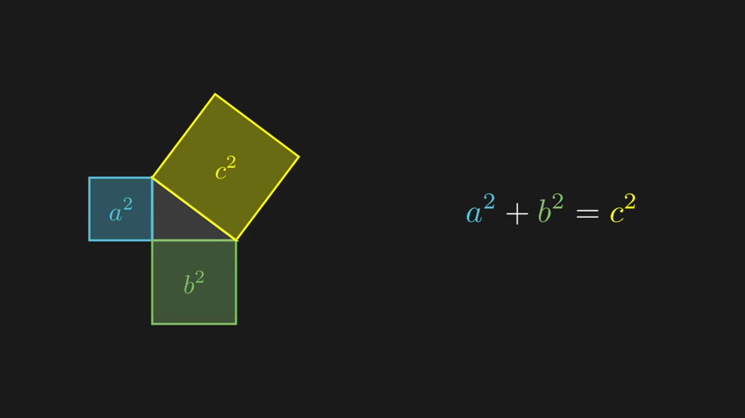
MANImation Studio
From one sentence to a narrated, 3Blue1Brown-style lesson video
Multi-agent AI system · Dhup Thumbadiya
A frame generated by the system: Pythagorean proof
Notes:
Introduce the project in one breath: you type one sentence describing a math, physics or computer-science idea, and the system produces a narrated animation in the style of the 3Blue1Brown YouTube channel, together with the code that draws it. The image on the right is an actual frame the system produced.

Slide 2
Two ways to make a 1-minute math animation today
Traditional animation software
Code libraries (e.g. Manim)
After Effects · Blender · Adobe Animate
Manim · Python · LaTeX: free and open source
$1,000 – 5,000
1 – 2 weeks
$200 – 1,000
1 – 3 days
estimated cost, 1-minute animation
time to produce it
estimated cost, 1-minute animation
time to produce it
Needs
a professional animator, plus paid software licences
Needs
subject knowledge and coding skill (Python, LaTeX)
How
every shape keyframed by hand; equations pasted in as images
How
animation written as code; the engine computes every position exactly
Weak spot
accuracy depends on the animator; changing one number means redoing the shot
Weak spot
most teachers can't program, and debugging takes most of the time
The gap: code libraries make exact animations cheap, but only for people who can program. MANImation Studio lets the AI write that code: our real run cost $0.073 for a 68-second narrated video.
Cost estimates: typical freelance rates for 2D explainer animation and for a Python developer's time.
Notes:
Compare the two ways people make math, CS and physics animations today. Traditional tools like After Effects or Blender need a professional animator, paid licences, and one to two weeks per minute; a 2D explainer minute typically costs one to five thousand dollars, and the animator still isn't checking the math. Code libraries like Manim, which 3Blue1Brown uses, are free and exact because the engine computes every position and LaTeX typesets the equations, but you need both subject knowledge and coding skill. Still a day or more per minute. That coding barrier is the gap we close: the AI writes the Manim code. Our real two-scene run cost 7 cents.

Slide 3
Why not just ask an AI video generator?
Video models like Sora or Veo learn what videos look like, not what the math means. They predict pixels, so:
✗
Equations come out garbled
✗
The math isn't exact
✗
You can't fix one detail
There is no LaTeX inside a video model. “x²” is just a shape it tries to draw, so symbols and labels get mangled.
A right angle drifts, a curve wobbles between frames. Nothing checks that what is drawn is actually true.
Change one number and the whole clip is regenerated, and it looks different. Clips are also short and not synced to narration.
AI video model
Prompt → guesses pixels, frame by frame → a video that only looks right
vs
MANImation Studio
Prompt → AI writes Manim code → the engine draws it with exact geometry and LaTeX
Our choice: the AI writes code, and a real math engine draws every frame: exact, checkable, editable.
Notes:
The obvious question: why not just use an AI video generator like Sora or Veo? Because they generate pixels. They have learned what videos look like, not what the math means. So equations come out garbled, since there's no LaTeX inside the model; geometry isn't exact, since nothing checks that a right angle stays a right angle; and you can't fix one detail without regenerating the whole clip, which then looks different. Our approach flips this: the AI writes code, and Manim with LaTeX draws every frame exactly. If something is wrong, we fix one line of code.

Slide 4
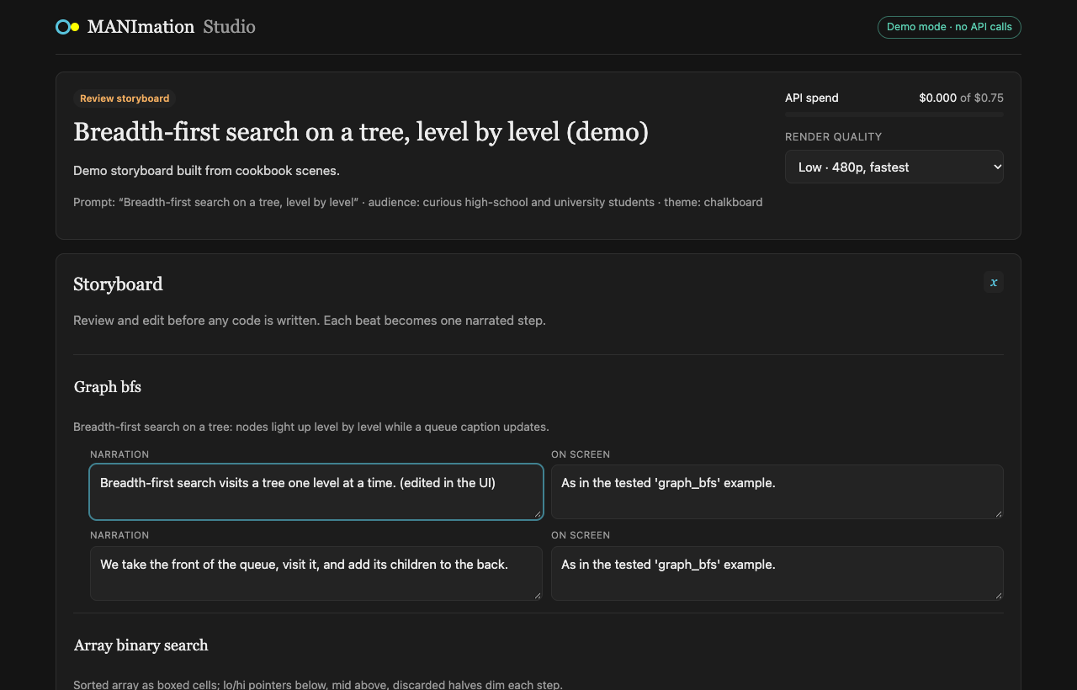
Our idea: describe it, review it, get the video
1
Describe
Type one sentence and choose a color theme, the audience and a budget.
2
Review
Read the storyboard the AI planned and edit any narration or visual before code is written.
3
Receive
Watch and download the narrated video, plus the Manim code for every scene.
The storyboard review screen of the web app
Notes:
This is the whole user experience in three steps. The important design choice is step two: the teacher stays in control. The AI proposes a storyboard, scene by scene and beat by beat, and the teacher can correct it before any code is written, which is also the cheapest moment to change your mind. The screenshot is the real review screen of our web app, built with React and FastAPI.

Slide 5
Architecture: how everything fits together
Web app React 19 · Vite · TypeScript
Create prompt → Review & edit storyboard → Live progress → Watch, download video + code
REST + WebSocket (live events)
Backend Python 3.12 · FastAPI · background worker · orchestrator (state machine)
Claude LLM
no AI, free
voice
1. Director
Claude Sonnet 5.5
plans scenes, narration → storyboard JSON
2. Coder
Claude Sonnet 5.5
writes one Manim file per scene
3. Validator
AST checks, API names, LaTeX pre-compile
4. Renderer
Manim CE + LaTeX preview + layout check
5. Narration
Deepgram Flux TTS, one voice session
6. Assembler
ffmpeg: final narrated MP4
↑ you approve the storyboard
re-check
error
error
Fixer Claude edits only the broken lines
LLM layer
Anthropic SDK · Sonnet 5.5 default, Opus 5.5 in quality mode · prompt caching · hard budget per video · cost log
Knowledge the AI codes against
manim_kit: themes, layout zones, helpers · 18 tested cookbook scenes · error → fix knowledge base
Storage & deploy
Every step checkpointed in a project folder (resume never pays twice) · one Docker image: Manim, LaTeX, ffmpeg
Notes:
Here's the whole system on one slide. On top, the React web app: you type a prompt, review and edit the storyboard, watch live progress over a WebSocket, and download the video and code. The FastAPI backend runs a plain Python state machine that calls specialised agents. The Director, Claude Sonnet 5.5, plans scenes and narration as structured JSON. After you approve, the Coder writes one Manim file per scene. The Validator and Renderer are deterministic and free: they check the code, render a preview with Manim and LaTeX, and check the layout. If anything fails, the Fixer, also Claude, edits only the broken lines with a text-editor tool and re-checks. Narration comes from Deepgram Flux TTS in one continuous voice session, and ffmpeg assembles the final MP4. Underneath: the LLM layer enforces a budget and caches prompts, the AI codes against our own tested toolkit and 18 cookbook scenes, and every step is checkpointed. All of it ships as one Docker image.

Slide 6
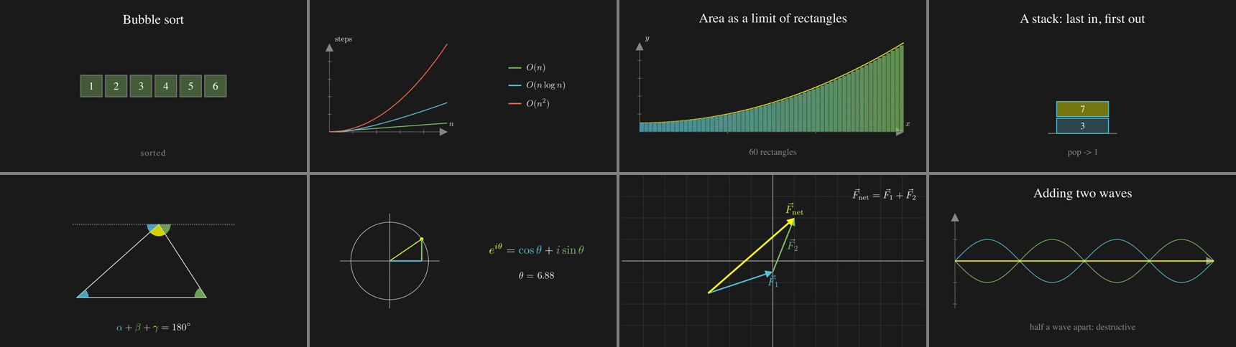
What it makes today, and what comes next
Frames from scenes the system renders: algorithms, calculus, physics, geometry, linear algebra
Working today
Next
Full web app: create, review, live progress, request changes
Narrated video in four themes, plus the source code
Runs offline in demo mode and in one Docker container
Visual critic: an AI that reviews rendered frames
Larger evaluation on 15 math, physics and CS topics
Slide-clip mode for lecture slides; more voices and languages
Notes:
Close by showing range: these frames are from scenes the system renders, covering algorithms, calculus, physics, geometry and linear algebra. Today the complete web application works end to end, produces narrated video in four colour themes, and runs offline in a demo mode or in a single Docker container. Next we want an AI critic that looks at rendered frames, a larger evaluation across fifteen topics, and a slide-clip mode so teachers can drop short animations straight into lectures. Then offer a live demo.

