Slide 1
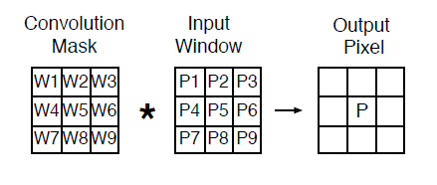
VLSI Project Convolution Accelerator in images
Anagnostou Pantazis
Karypidis Stathis

Slide 2
Contents
Version 1 (Without Pipeline)
Version 2 (With Pipeline)
Basic Modules:
Pixel Cache
Convolution
Control
Testing-Visualization
Results

Slide 3
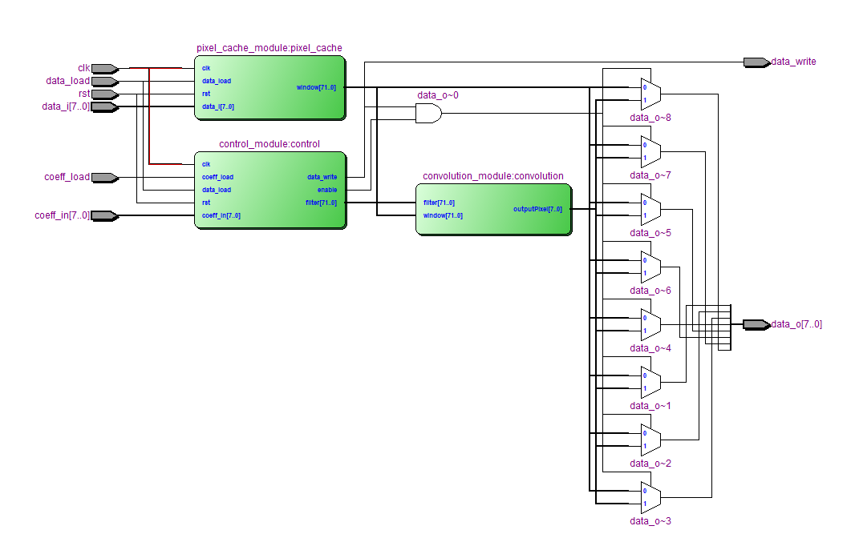
Version 1 (Without Pipeline)

Slide 4
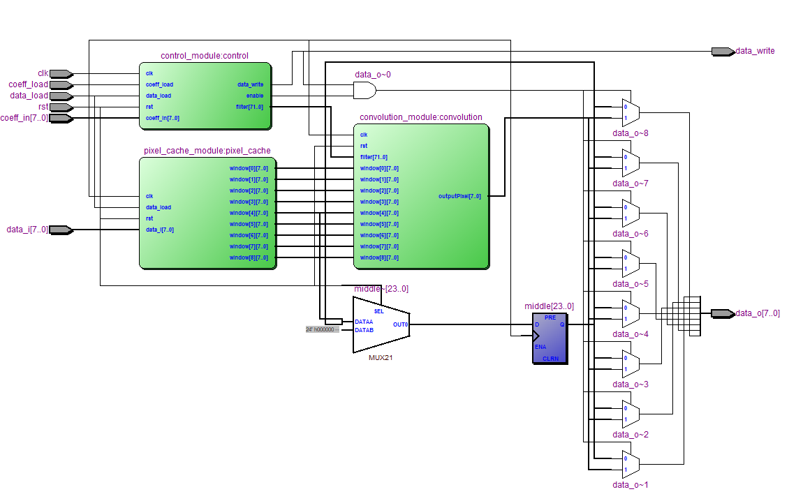
Version 2 (With Pipeline)

Slide 5
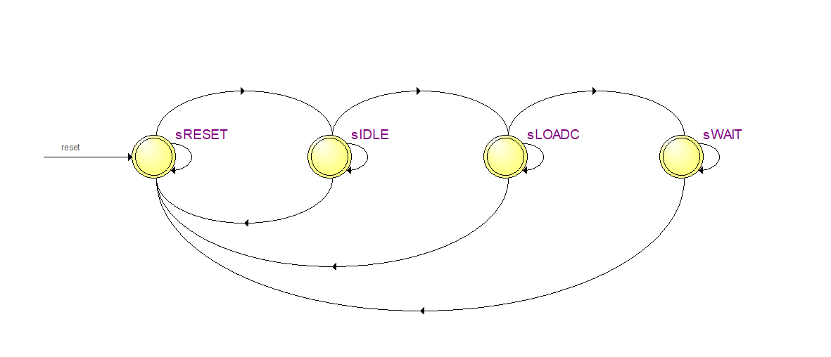
Basic Modules: Control (FSM)
counter=9
(coefficients loaded)
coeff_load

Slide 6
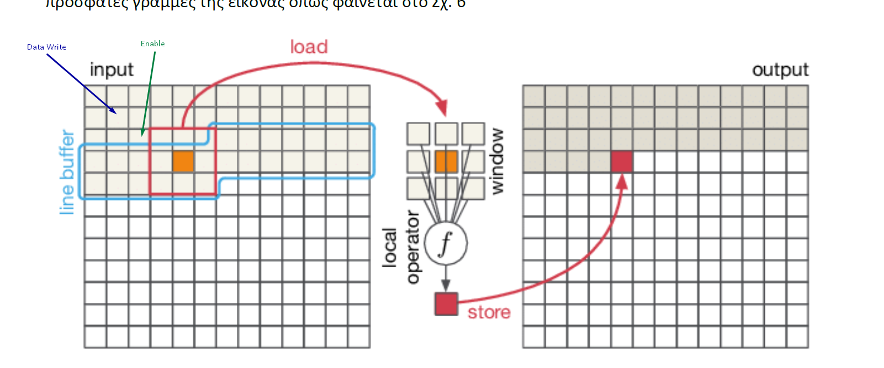
Control Signals (Enable & Data Write)

Slide 7
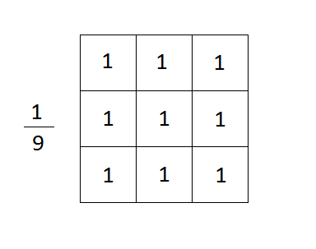
Testing-Visualization
Grayscale Images:
32x32
512x512
Used Box Blur Kernel

Slide 8


Results
Original
Blurred

Slide 9
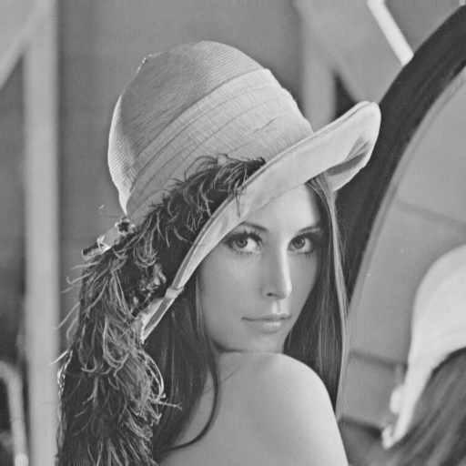

Results
Original
Blurred

