Slide 1
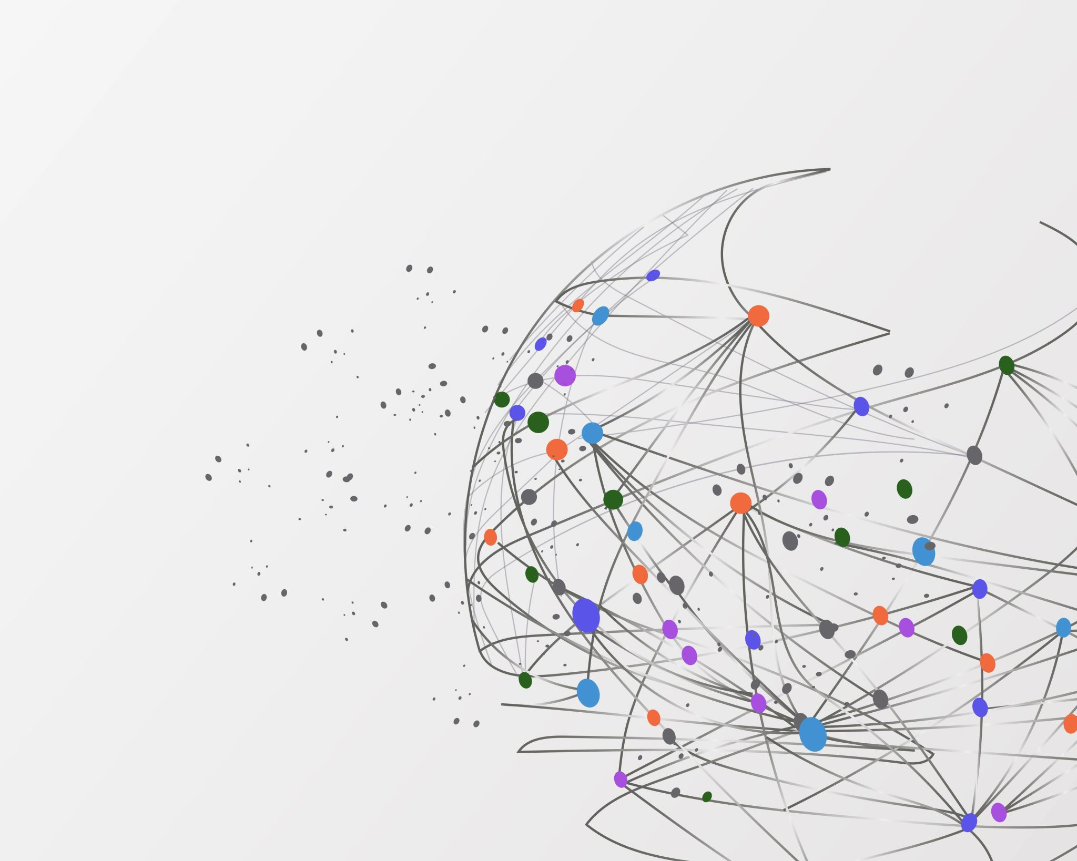
Sneasy Your Allergy Management Solution

Slide 2
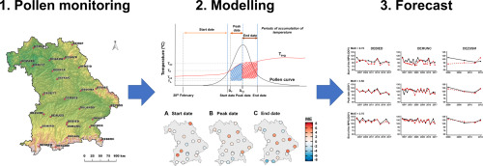
Problem and our solution (data)

Slide 3
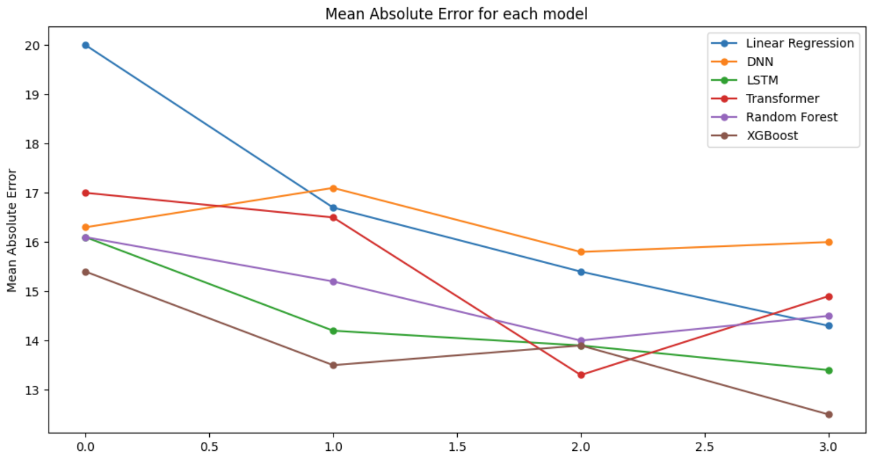
Problem and our solution (data)

Slide 4

Our solution
Sneasy

Slide 5
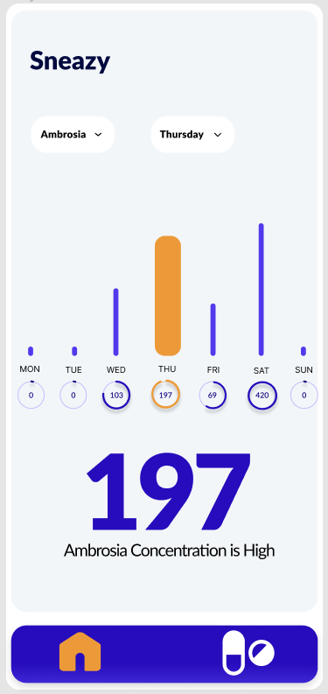
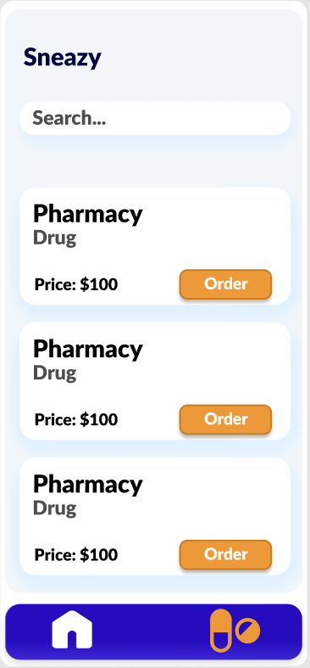
Mobile app

Slide 6

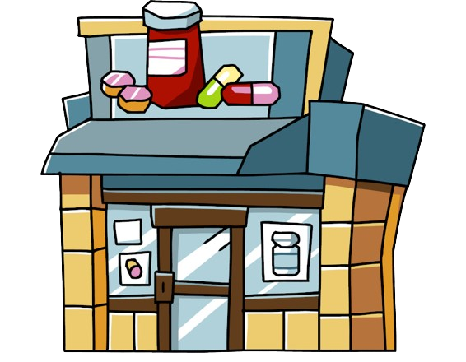

Business Model
User data
Medicine listing
App Services
Processed data

Slide 7

Business development
App and business development:
Early stage (gathering users and data)
Later stage (focusing on pharmacies)

Slide 8
Thanks for your attention

