Slide 1



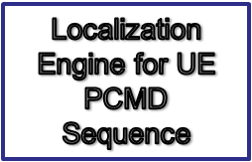



PCMD Localization Server/s
Periodic PCMD
Stream/Files
Applications

Slide 2
Expectation Maximization
For each UE, compute latitude, longitude of PCMD time-sequences using Algorithm-Localize
PCMD Time-Sequences of UEs
Existing Statistical Channel Model
Update channel model based on localized PCMD Sequences Using Algorithm CM-Update
Is localization termination criterion met?
NO
Localized PCMD Storage
YES

Slide 3
Batch EM
Particle Filter based localization for each UE PCMD series (Algorithm-1)
PCMD Time-Sequences of UEs
Random Forest Based Channel Model from Drive Test Data
Random-Forest Based Update of Channel Model
Is number of iterations more than a threshold?
NO
Localized PCMD Storage
YES

Slide 4






LUMD
cloud storage
LUMD Data Stream
MME
(Mobility Management Entity)
LUMD start/stop
LUMD start/stop
LUMD data
LUMD data
eNodeB
eNodeB
UE Measurements
UE Measurements

Slide 6
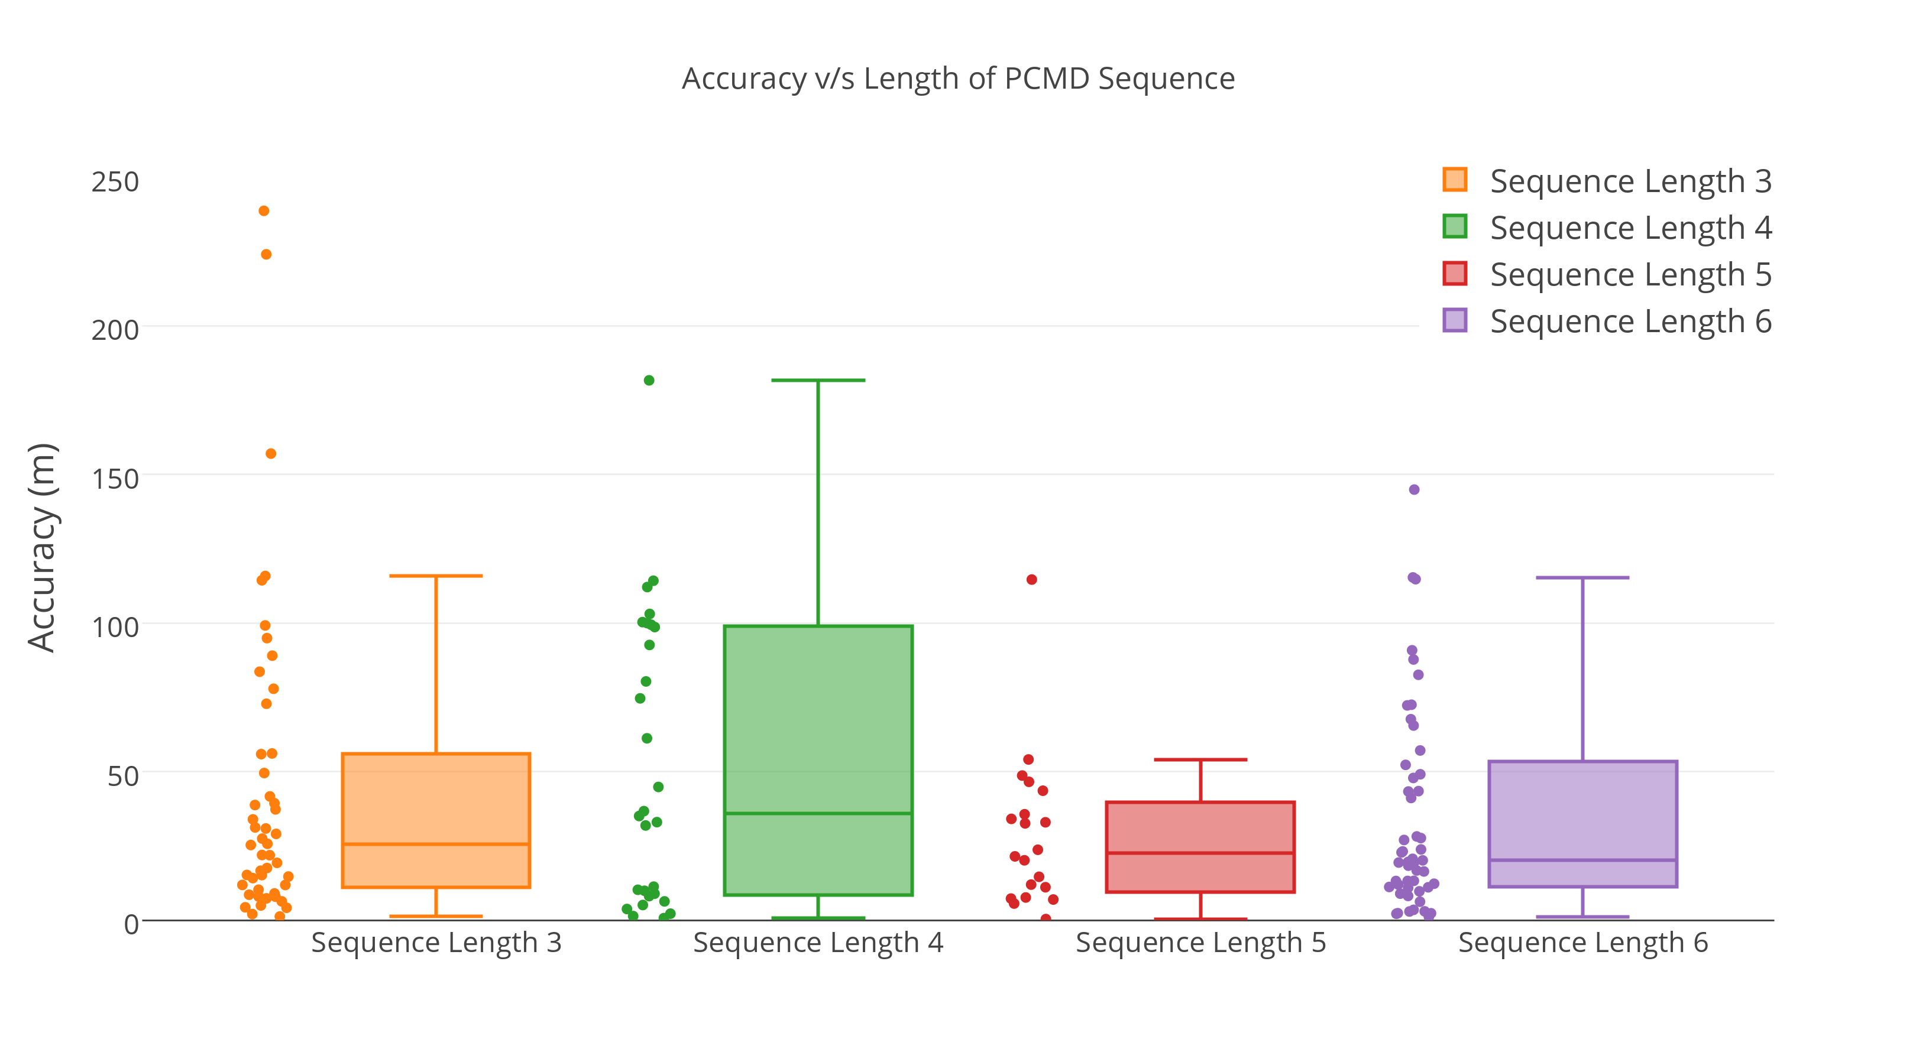
Accuracy vs Length of LUMD Sequence
Accuracy vs Length of LUMD Sequence

Slide 7
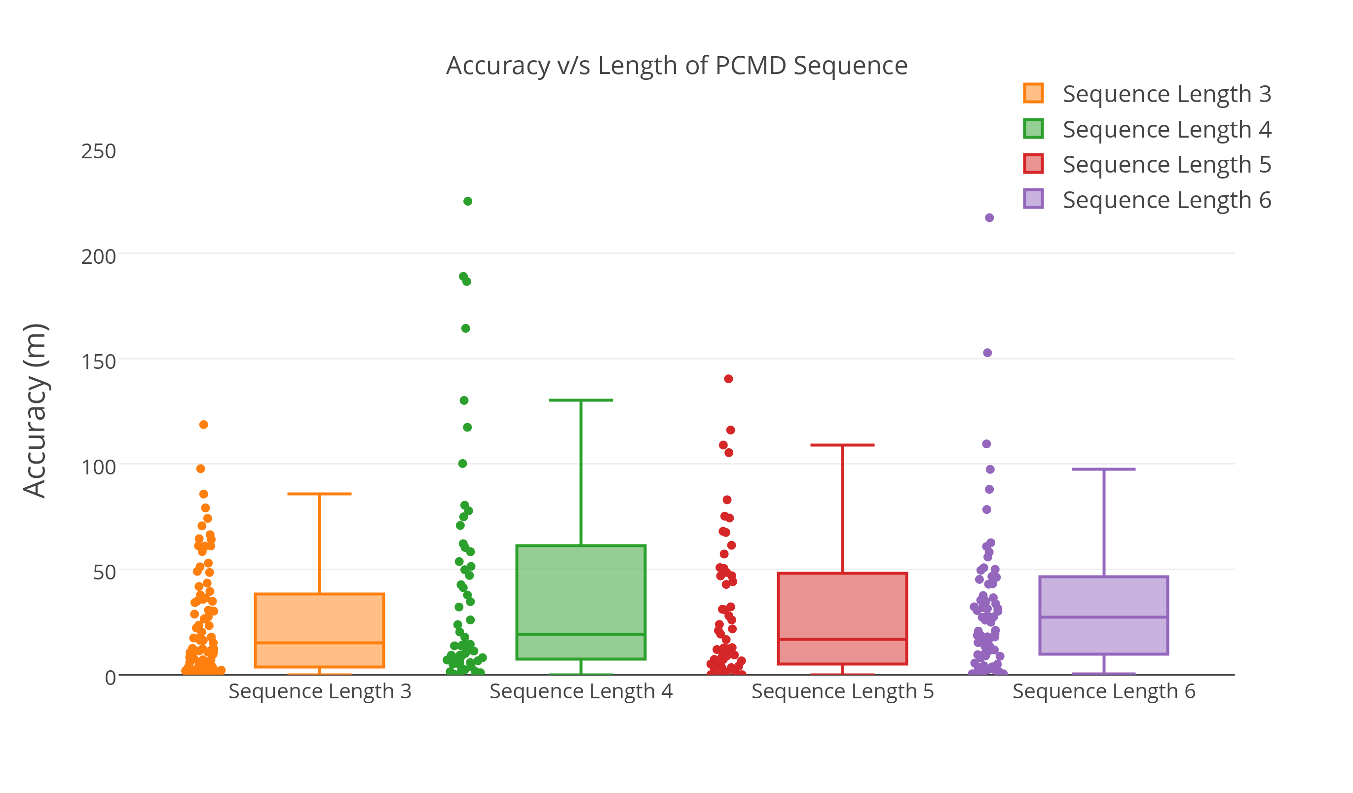
Accuracy vs Length of LUMD Sequence

