Slide 1
UNIVERSITY OF DODOMA | CT321 | 2025/2026
Analog Temperature
Monitoring System
Using ATmega32 ADC, LM35 Sensor
KiCad · SimulIDE · MPLAB for VS Code
PBL Project 2 – Group 2
Notes:
Welcome everyone. This is Group 1's presentation for CG 221 PBL Project 2. We built a complete Analog Temperature Monitoring System using the ATmega32 microcontroller.

Slide 2
Presentation Outline
01
Introduction & Problem Statement
05
KiCad Schematic & PCB
02
System Block Diagram
06
SimulIDE Simulation & Results
03
ATmega32 Pin Mapping
07
ADC Calculations
04
Firmware Design & Flowchart
08
GitHub Repository & Conclusion
Notes:
Here is a quick overview of what we will cover today.

Slide 3
Introduction
Background
Real-world signals (temperature, pressure, sound) are analog. The ATmega32 is a purely digital device — it cannot process these signals directly.
An ADC is required to bridge the gap, converting a continuously varying analog voltage into discrete digital values the microcontroller can act upon.
& Problem Statement
ADC
Analog-to-Digital
Converter
Problem Statement
Industries — agriculture, healthcare, data centers, manufacturing — need continuous temperature monitoring. This project implements a standalone MCU-based system that:
• Reads temperature from an analog sensor
• Classifies readings into Low / Normal / High
• Provides visual LED and audio buzzer alerts
• Optionally logs data via USART serial output
LM35
Precision Temp
Sensor
AVR
ATmega32
8-bit MCU
Since physical hardware is unavailable, demonstration is done via SimulIDE simulation.
Notes:
The ATmega32 is an 8-bit AVR microcontroller. It can only process digital signals, so we use its built-in 10-bit ADC to read the analog voltage from the LM35 sensor.

Slide 4
Project Objectives
1
Configure ATmega32 ADC
5
LED & Buzzer Outputs
Set up 10-bit ADC on channel ADC0 (PA0) using ADMUX & ADCSRA registers
Drive Green, Yellow, Red LEDs and buzzer based on temperature zone
2
Interface LM35 Sensor
6
USART Data Logging
Connect precision analog temp sensor outputting 10 mV per °C
Transmit formatted temperature strings to PC terminal at 9600 bps
3
ADC → Temperature
7
KiCad Design
Convert digital ADC counts to °C using integer arithmetic formula
Design full schematic and PCB layout with ERC/DRC passing
4
3-State Classification
8
SimulIDE Simulation
Classify into Low (<25°C), Normal (25–35°C), and High (>35°C)
Build and validate all conditions without physical hardware
Notes:
We had 8 clear objectives for this project covering hardware, firmware, simulation, and documentation.

Slide 5
System Block Diagram
Green LED (PB0)
Low Temp <25°C
Analog Voltage (10 mV/°C)
Digital (0–1023)
LM35
Sensor
ATmega32
ADC (PA0)
ATmega32
CPU
Yellow LED (PB1)
Analog Input
10-bit Digitizer
Firmware Logic
Normal 25–35°C
Red LED (PB3)
High Temp >35°C
Buzzer PB6
Notes:
The LM35 outputs 10 millivolts per degree Celsius. This analog voltage goes into the ATmega32 ADC on pin PA0. The firmware processes it and drives the output peripherals.

Slide 6
ATmega32 Pin Mapping
PA0 / ADC0
PB3
Input (Analog) · ADC Channel 0
Output · Buzzer Drive
LM35 Output
Buzzer (2N2222)
PB0
Output · LED – Low Temp
Green/Blue LED
PB1
AVCC / AREF
Output · LED – Normal
Power/Ref · ADC Supply + Ref
Yellow LED
100 nF caps
PB2
XTAL1/2
Output · LED – High
Clock · 16 MHz Crystal
Red LED
Y1 + 22 pF caps
Notes:
PA0 is used as the analog input. Port B pins 0-3 drive the LEDs and buzzer. PD1 handles USART transmit. AVCC and AREF need proper decoupling capacitors for clean ADC readings.

Slide 7
Firmware Design & Flowchart
START
Firmware Highlights
Initialize I/O, ADC, USART
Language:
C (ANSI C99) – XC8 / avr-gcc
Start ADC Conversion (ADSC=1)
ADC Setup:
ADMUX = 0x40 (AVCC ref, CH0)
ADCSRA = 0x87 (EN + prescaler /128)
Wait for ADSC to clear
Read ADC Result (10-bit)
Temp Formula:
T°C = (ADC × 500) / 1023
Integer math — no float!
Convert: Temp = ADC×500/1023
loop
Classify: Low / Normal / High
Error Check:
ADC < 5 or > 900 → blink all LEDs
+ send error via USART
Drive LED + Buzzer outputs
Loop Delay:
500 ms between samples
(_delay_ms from <util/delay.h>)
LOOP
Notes:
The firmware uses only integer arithmetic to avoid floating-point overhead on the 8-bit AVR. The formula T = ADC×500/1023 is accurate to within half a degree Celsius.

Slide 8
KiCad Schematic & PCB Design
Schematic Design
PCB Layout
· ATmega32-16PU as main MCU
Board Size:
~80 × 60 mm compact layout
· LM35DZ sensor → PA0 via 100 nF filter
LM35 Placement:
Board edge — away from heat sources
· 3× LEDs with 330 Ω current-limiting resistors
ADC Trace:
Short, direct to PA0 — away from digital traces
· Buzzer driven by 2N2222 NPN transistor
Decoupling Caps:
C3 & C4 within 2 mm of MCU pins
· 1N4148 flyback diode across buzzer
Ground Plane:
Solid GND pour on back copper layer
· 10 kΩ pull-up reset button circuit
Power Traces:
VCC/GND ≥ 0.5 mm wide
· 16 MHz crystal + 22 pF load capacitors
Silkscreen:
All refs labeled: U1, U2, D1–D4, R1–R5…
· 100 nF decoupling caps on VCC, AVCC, AREF
DRC:
0 Errors, 0 Warnings ✓
· USART 6-pin header connector
Gerber Files Generated: F_Cu · B_Cu · F_SilkS · F_Mask · B_Mask · Edge_Cuts · .drl
· ERC: 0 Errors, 0 Warnings ✓
Notes:
The schematic was drawn in KiCad 7. The PCB was carefully laid out with the LM35 at the board edge for good airflow, and decoupling capacitors placed as close as possible to the MCU pins.

Slide 9
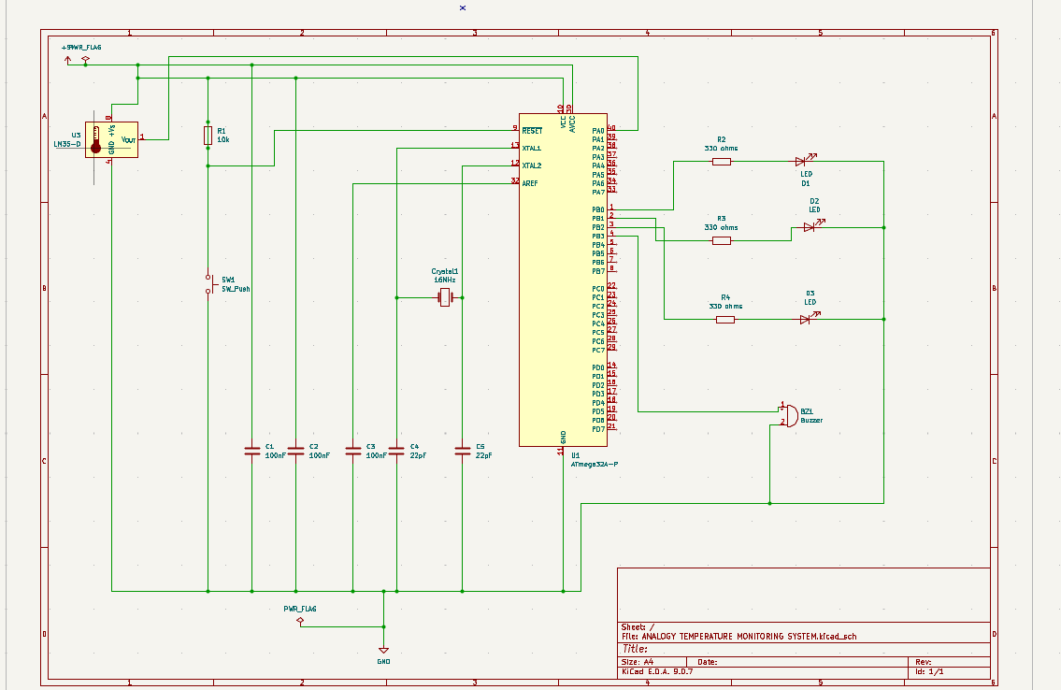

Slide 10
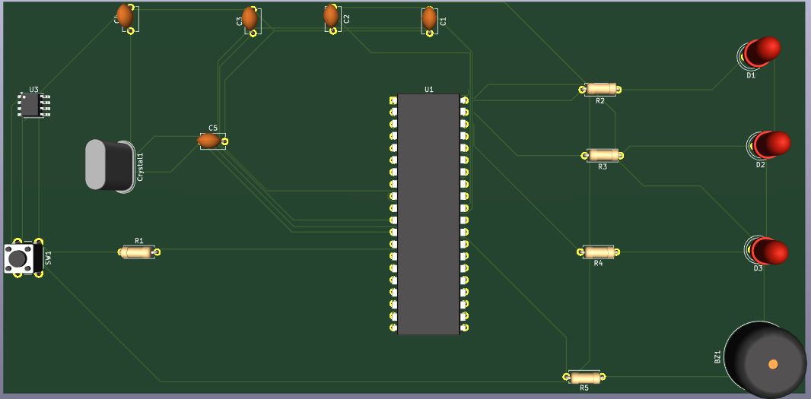

Slide 11
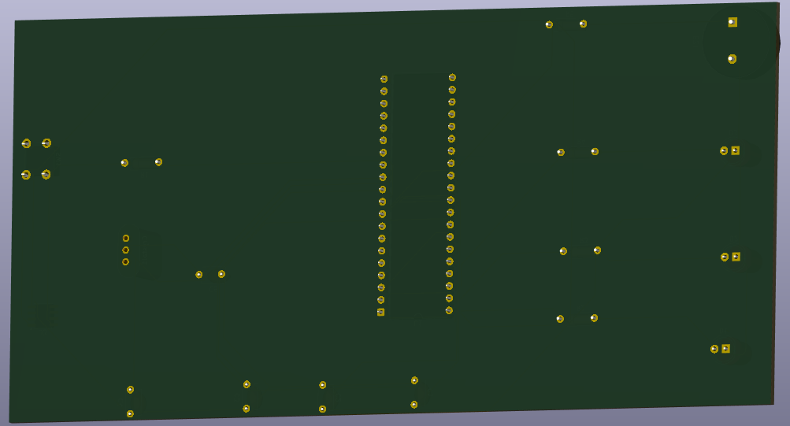

Slide 12
SimulIDE Simulation Results
LM35 model not available in SimulIDE — potentiometer used to simulate equivalent sensor voltage
TC-01
TC-02
TC-03
TC-04
Low Temperature
Normal Temperature
High Temperature
Sensor Error
Input:
~0.20 V
Input:
~0.30 V
Input:
~0.40 V
Input:
~0 V
ADC Count:
~41
ADC Count:
~61
ADC Count:
~82
ADC Count:
<5
Temp:
~20°C
Temp:
~30°C
Temp:
~40°C
Temp:
N/A
LED:
Green/Blue LED ON
LED:
Yellow LED ON
LED:
Red LED ON
LED:
All LEDs blink
Buzzer:
Buzzer OFF
Buzzer:
Buzzer OFF
Buzzer:
Buzzer ON
Buzzer:
Error via USART
✓ PASS
✓ PASS
✓ PASS
✓ PASS
All 8 test cases passed — including boundary tests at 25°C and 35°C, dynamic transitions, and USART serial output
Notes:
We tested four main conditions plus boundary tests. The ADC reads correctly and the firmware correctly switches between LED states. USART output was confirmed in SimulIDE's serial monitor.

Slide 13
ADC Calculations
Key Formulas
Conversion Table
ADC Resolution:
5.0 V ÷ 1023 ≈ 4.887 mV / LSB
Temp (°C)
LM35 (mV)
ADC Count
Firmware °C
ADC from Voltage:
ADC = (Vin × 1023) / 5.0
0°C
0 mV
0
0°C
Voltage from ADC:
Vin = (ADC × 5.0) / 1023
20°C
200 mV
41
20°C
Temp from Voltage:
T°C = Vin / 0.010 (LM35: 10 mV/°C)
25°C
250 mV
51
25°C
Combined Formula:
T°C = (ADC × 500) / 1023
30°C
300 mV
61
30°C
Worked Example – 30°C
35°C
350 mV
72
35°C
Step 1: V_in = 30°C × 10 mV/°C = 300 mV = 0.300 V
Step 2: ADC = (0.300 × 1023) / 5.0 ≈ 61 counts
Step 3: T = (61 × 500) / 1023 = 30500 / 1023 ≈ 29.8°C ✓
40°C
400 mV
82
40°C
50°C
500 mV
102
50°C
100°C
1000 mV
205
100°C
Notes:
The integer formula T = ADC×500/1023 is accurate to within half a degree Celsius, which matches the LM35 sensor's own typical accuracy of plus or minus half a degree.

Slide 14
Complete Test Results
All 8 Test Cases
TC-01
Low Temp
✓
TC-02
Normal Temp
✓
TC-03
High Temp
✓
TC-04
Sensor Error
✓
TC-05
Boundary 25°C
✓
TC-06
Boundary 35°C
✓
TC-07
Dynamic Low→High
✓
TC-08
USART Output
✓
8/8
Test Cases
Passed
100%
Pass
Rate
±0.5°C
Calculation
Accuracy
Notes:
All eight test cases passed in SimulIDE. The firmware correctly handles all temperature zones, boundary conditions, sensor errors, and USART data logging.

Slide 15
GitHub Repository
ATmega32_ADC_Temperature_Monitor
Commit History
Visibility:
Public · MIT License
#1 – Initial repo + README
Commits:
11 structured commits
#2 – Firmware: main.c + config.h
URL:
https://github.com/panthermodes/ANALOGY-TEMPERATURE-MONITORING-SYSTEM-GROUP2.git
#3 – KiCad schematic
#4 – PCB layout + 3D screenshots
Repository Structure
#5 – Gerber manufacturing files
#6 – Compiled HEX file
📁 firmware / src / main.c · hex / *.hex
#7 – SimulIDE circuit + test screenshots
📁 kicad / schematic / · pcb / · gerber /
#8 – ADC calculation documentation
#9 – Pin mapping + test results
📁 simulide / circuit / · screenshots /
#10 – Block diagram + flowchart
📁 documentation / block_diagram · flowchart
#11 – Demonstration video link
📄 README.md (project overview + setup)
📁 media / demonstration_video_link.txt
Notes:
The repository has 11 commits following good version control practices — each commit covers one logical milestone of the project.

Slide 16
Conclusion
10/10
8/8
11
7
Tasks Completed
Test Cases Passed
Git Commits
Gerber Layers
Key Learning Outcomes
✓ ATmega32 ADC configuration using ADMUX & ADCSRA registers
✓ USART initialization and character transmission for serial data logging
✓ Analog sensor interfacing — LM35 precision temperature sensor
✓ KiCad schematic & PCB design including analog signal routing best practices
✓ Integer-based ADC-to-temperature conversion (no floating point overhead)
✓ SimulIDE circuit simulation for firmware validation without physical hardware
✓ GPIO output control for LEDs and buzzer via DDRB & PORTB registers
✓ Professional documentation and GitHub version control practices
University of Dodoma (CIVE) · CG 221 · Group 2 · 2025/2026
Notes:
In conclusion, we successfully built a complete temperature monitoring system from schematic design to simulation. The project gave us hands-on experience with AVR microcontroller programming, analog sensor interfacing, PCB design, and proper documentation practices. Thank you.

