Slide 1

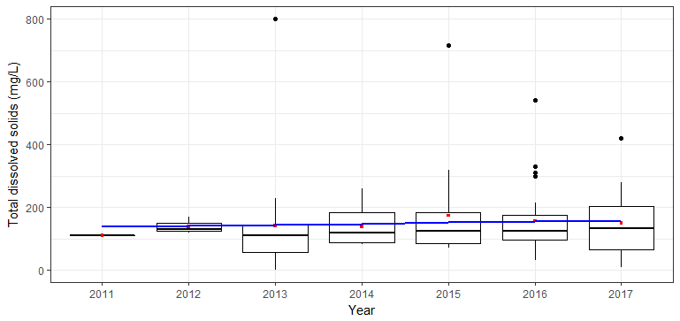
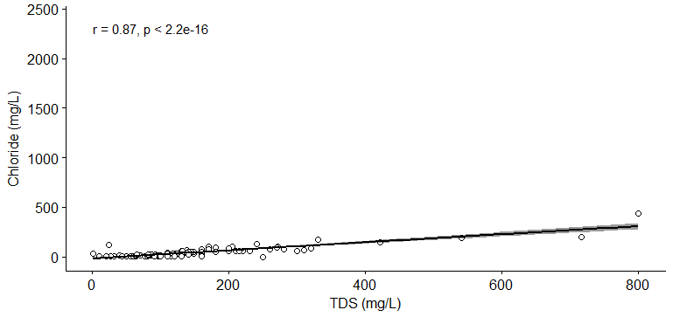
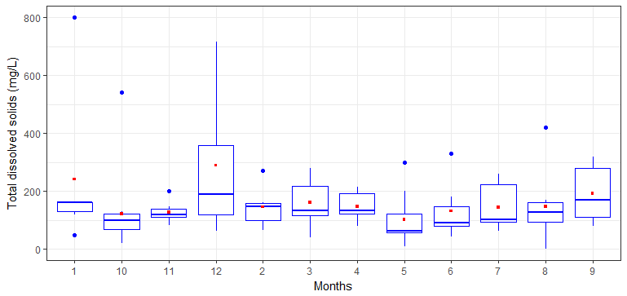
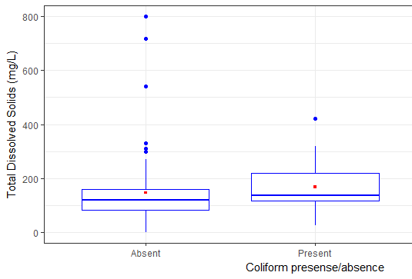
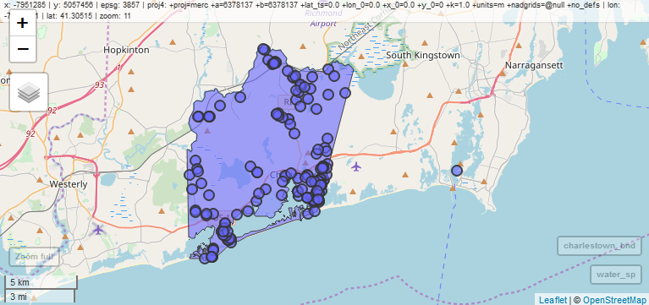
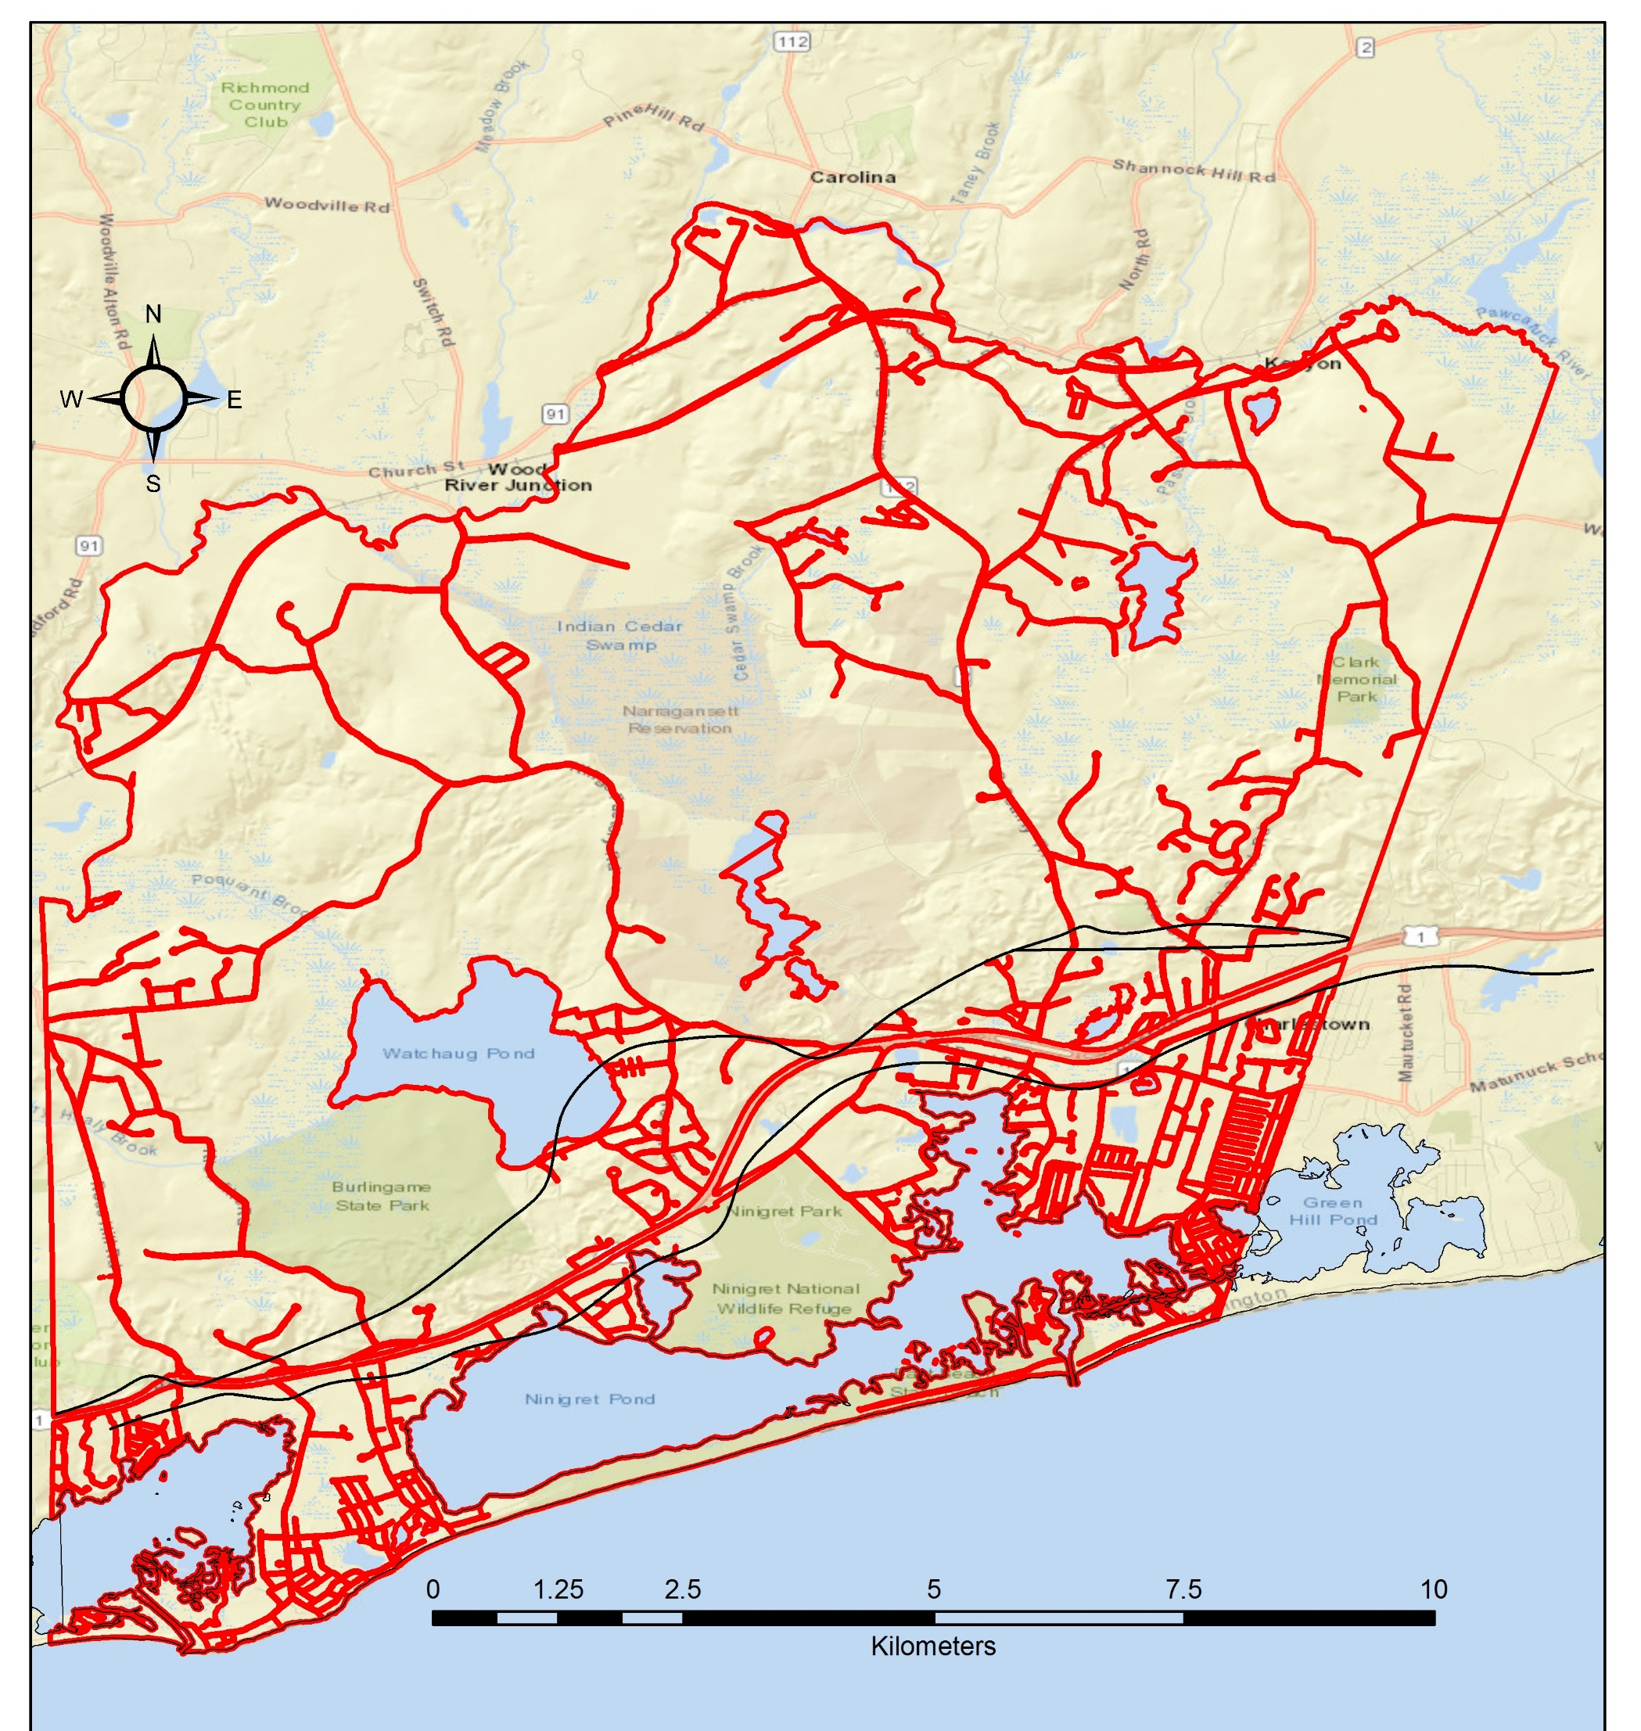
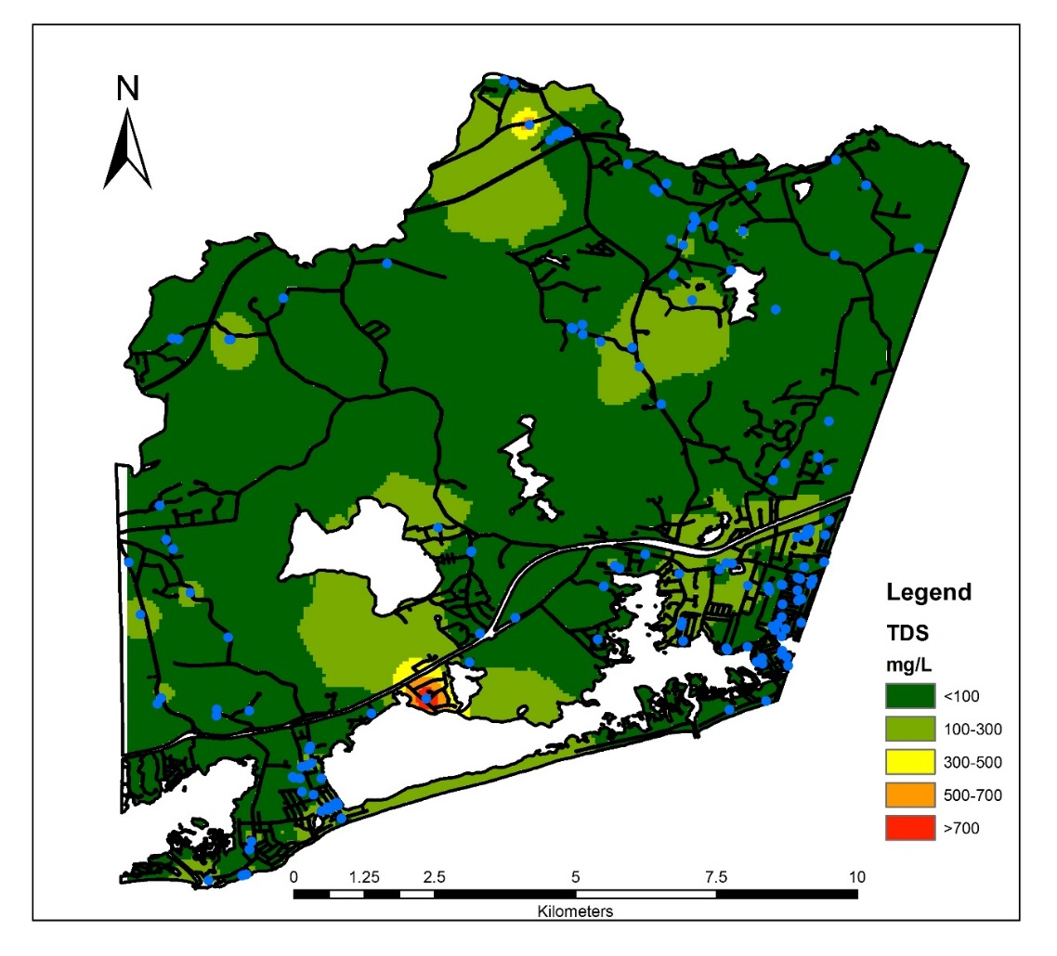
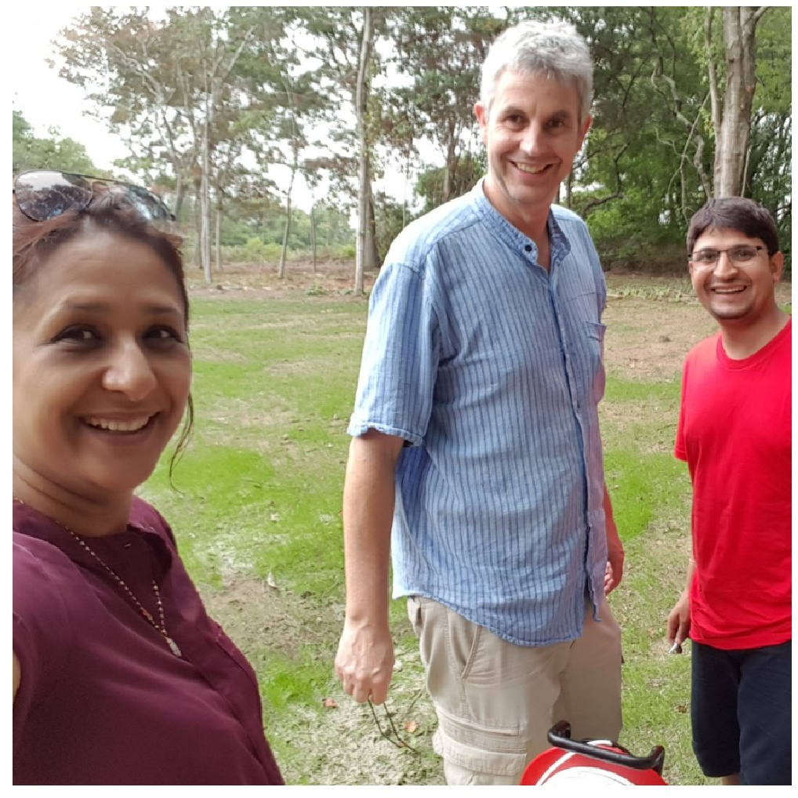
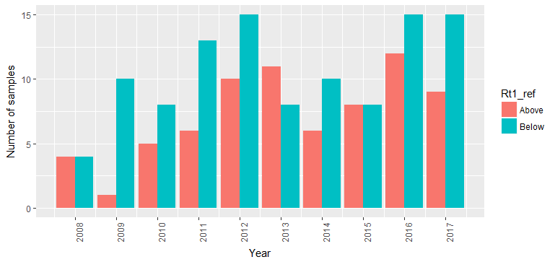
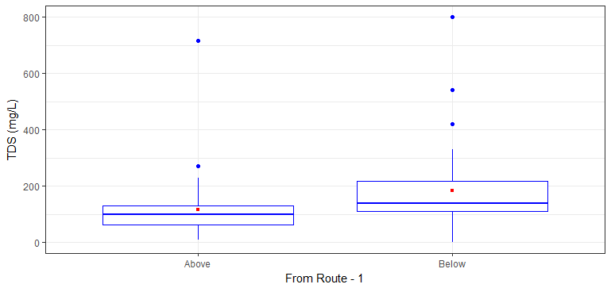
Salinization of Drinking Water Wells – A Case from Charlestown in Southern Rhode Island
Jeeban Panthi*, Soni M. Pradhanang, Thomas Boving
University of Rhode Island, Department of Geosciences
*Corresponding Author: jeeban_panthi@uri.edu
1. Introduction
Freshwater aquifers in coastal aquifers are susceptible to degradation due to its proximity to seawater and the intensive water demands in to feed the increasing population in coastal zones. The wells in coastal areas are becoming saline due to the saltwater intrusion into freshwater aquifer. Tsunamis, hurricanes, droughts, and climate variability are acute driver of saltwater intrusion (Moujabber et al. 2006; FitzGerald et al. 2008). In Rhode Island, more than 40% of the public water supply comes from the groundwater and the rate is higher in Southern cities.
2. Objectives
Analysis of the well water quality indicator focusing to salinization using free and open source software R
3. Study area
Figure 1: Map showing the Charlestown in Rhode Island. Blue circles are sampling sites
Charlestown is a small town in Southern part of Rhode Island and it is bordered by the Atlantic ocean in the south. There are more than 4000 wells in the town and the well water is the only source of drinking water.
4. Data
Figure 2: Number of well water samples taken in different years
Electrical conductivity, chloride, total dissolved solids, coliform detection were obtained from 175 wells since 2008 till 2017. The data were collected by the town of Charlestown and the data are not in a fixed time interval. The number of samples available are shown in figure 2.
5. Results
5.1 Temporal variation of salinity in well water
Figure 3: Yearly variation of total dissolved solids. The blue line indicates the trend and red dots are average (mean) values.
The TDS does not show any linear trend in yearly time scale. However the inter-annual variation is high.
Figure 4: Monthly variation of total dissolved solids. Red dot indicate the average value for the month.
In monthly scale, the salinity level varies with highest in December to the lowest in May and October months. The high level in winter could be the application of de-icing salt on roads which ultimately enters to the groundwater aquifer.
5.2 Spatial variation of salinity in well water
Fig 5: The interpolation of the TDS
It shows that the areas connected with the salt ponds have been recorded with the higher concentration
Fig 5: Average TDS below and above Route 1 highway
The salinity level is higher in the areas below Route 1 highway than above areas. It signals that there could be a potential problem of saltwater intrusion.
5.3 TDS relationship with water quality indicators
Figure 7: Correlation between TDS and chloride concentration
The strong correlation between TDS and chloride with significant level indicates that one indicator compliments other. In future, researcher can just measure one to predict the other if there is research scarcity to monitor both the water quality parameters.
Figure 8: TDS relationship with the presence of coliform
The TDS vale is higher in the well waters where coliform is detected/present. With this we can postulate that the areas with organic pollutions have higher TDS so the coliform.
6. Conclusion
The salinity level is higher in winter season indicates that the groundwater is contaminated with road de-icing salt.
Higher salinity level in the water samples close to the sea and salt ponds could be due to the salt water intrusion into groundwater aquifer.
Correlation and total dissolved solids are highly correlated and the correlation coefficient is significant at 5% level.
Acknowledgement
Charlestown Town Office for well water quality data, RIGIS for spatial layers and Coastal Resource Management Center (CRMC) for financial support are acknowledged. Dr. Rachel Schwartz, professor at URI, trained the first author to deal with big data by free and open access software.
RCP 4.5 (2070-2099)
RCP 8.5 (2040-2069)
RCP 8.5 (2070-2099)
Photo: Well-water monitoring in Charlestown

