Slide 1

Tile-based GIS
Felix Delattre

Slide 2
What is tile-based GIS?
Grid based data GIS.

Slide 3
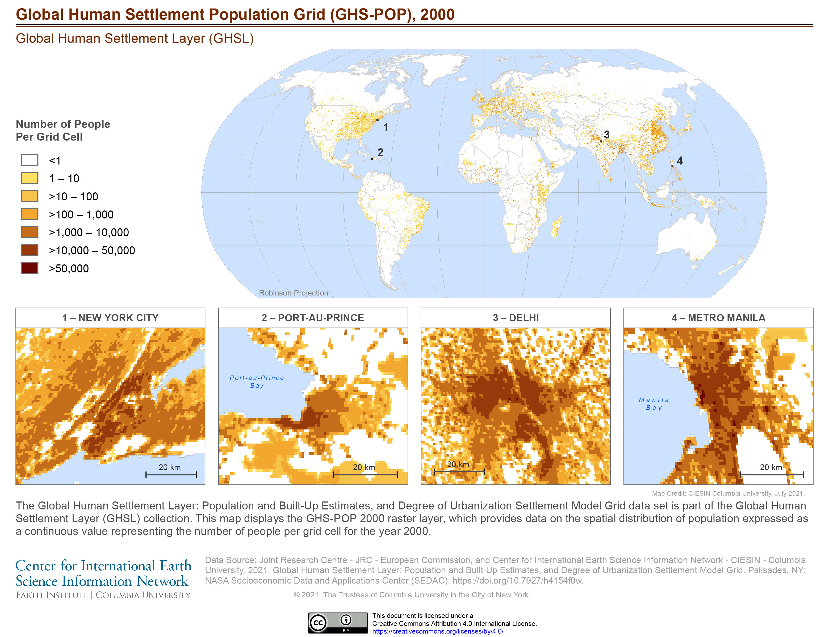

Slide 4
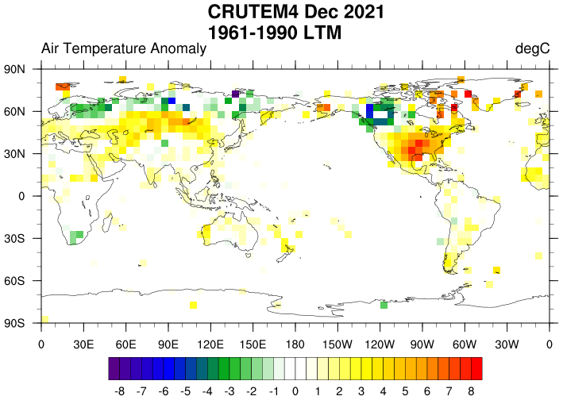

Slide 5
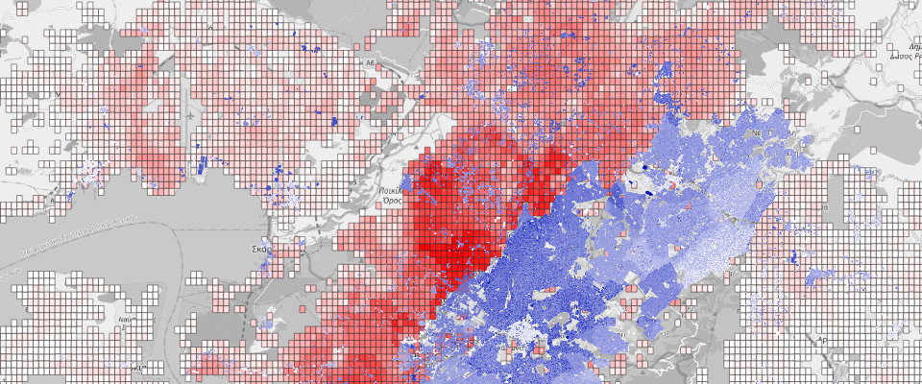


Slide 6
What is tile-based GIS?
Grid based data GIS.
But stored and represented as tiles.
No storing of geospatial geometries are necessary.

Slide 7
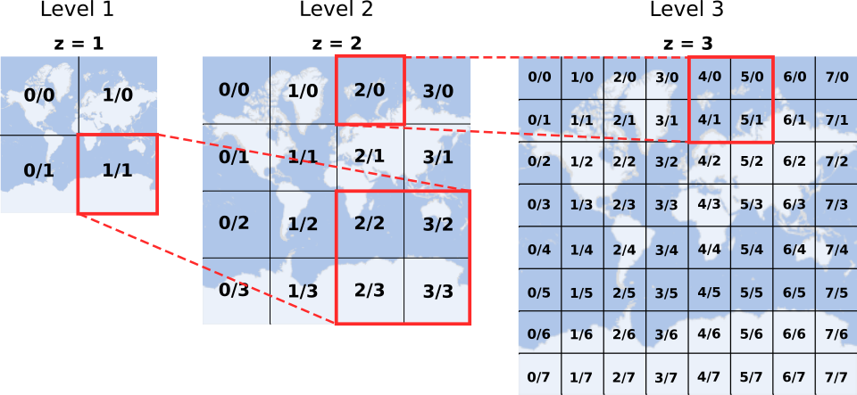

Slide 8
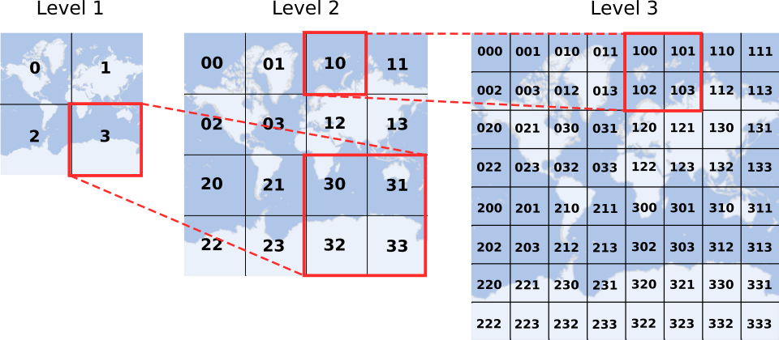

Slide 9
What is tile-based GIS?
Advantage: fast computing
Constraint: Grid cell sizes differs over latitudes

Slide 10
CREATE TABLE tiles (
quadkey VARCHAR(255) PRIMARY KEY,
value FLOAT NOT NULL
);

Slide 11
Visualization
Vector tiles from PostgreSQL PostGIS with ST_AsMVT
+ magic sauce with custom functions

Slide 12
Functions
convert_xyz_to_quadkey(x INTEGER, y INTEGER, z INTEGER)
convert_quadkey_to_xyz(quadkey TEXT)

Slide 13
Functions
convert_xyz_to_quadkey(x INTEGER, y INTEGER, z INTEGER)
convert_quadkey_to_xyz(quadkey TEXT)
generate_tiles_of_tiles_with_values(
z INTEGER, x INTEGER, y INTEGER, target_zoom_level INTEGER
)

Slide 14
It’s showtime

Slide 15
Thanks!
Code: https://github.com/pantierra/tilegis
Play with it: https://tilegis.centroi.de (during FOSS4G Europe)
Talk to me!

